Slide 1
WANTED (Alive):
Collaborators for a new Time Tracking Solution
#MeteorUnconf, Berlin 15.07.2016
Michael Wolff
Thorsten Gebhardt

Slide 2


Some Background Information
Who we are, what we do and what we need…
cognovo = agile software development inspired by scrum and managed with GitHub
5
Timekeeping/ Consolidation
Production
Source Control
Ticket System
PM/Scrum-Tool
@
Billing
Customers
€

Slide 3
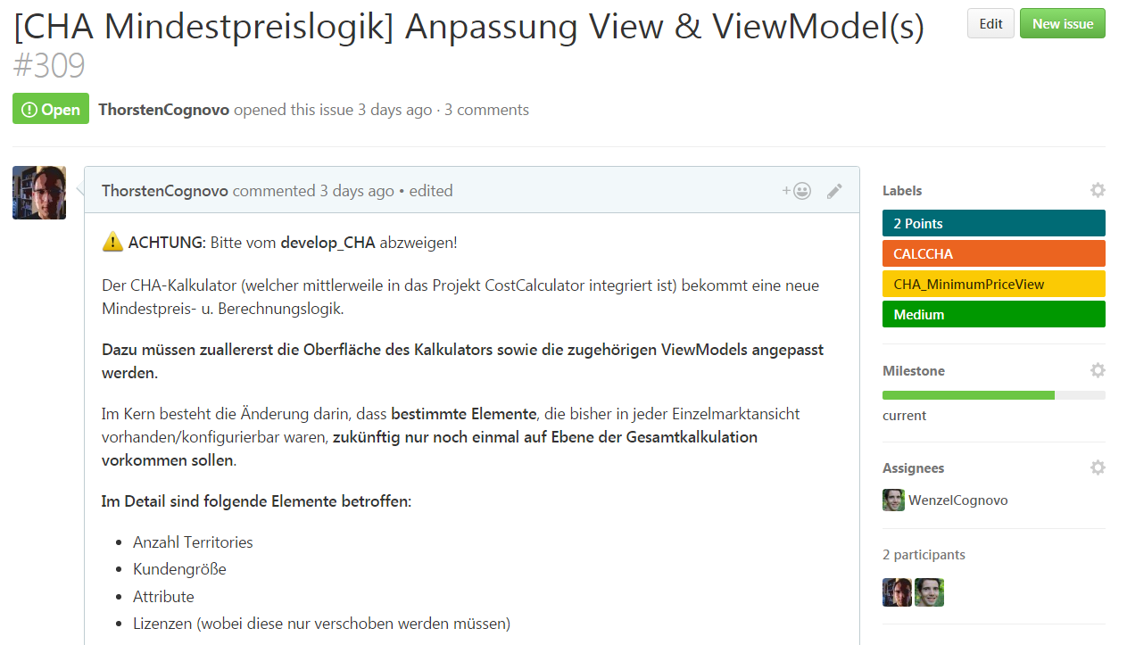
Production with GitHub
How does it look like?

Slide 4
Timekeeping/Consolidation
How does it (still) look like?
5
1
# | CostCenter | h | Task
309 | CALCCHA | 7 | moved controls
309 | CALCCHA | 3 | defined properties
309 | CALCCHA | 5 | …
PO12345 | 12 | Minimum Price CHA

Slide 5
The new Solution
A rough concept
Developer
Bookkeeper
tikki

Pure time tracking
Does not control budgets
Reporting
Projectmanager
Consolidation
Controls budgets (not developers)

Slide 6
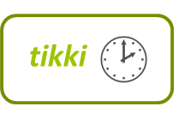
The new Solution
GitHub Integration
Order
→ ProjectManager controls budget
#Issue
#Issue
#Issue
→ Developer focuses on his work

Slide 7

The new Solution
What we want & What we don‘t want
A smart Tool which makes time tracking fun and easy for everybody
An „all-in-one, Big Brother is watching you“- Tool
GitHub integration
x
Billing
Order based Budget Control
x
Developer Contolling
Role based Dashboards
x
Stop Watches
Reminder System
x
Productivity Enhancement Tool

Slide 8
The new Solution
How about you?
Similar Needs?
Keen on discussing some details?
Already found a nice tool?
Bored?
Wanna join?
…

Slide 9

thx.
Michael Wolff
Dipl.-Ing.
Inhaber
mwolff@cognovo.de
t: +49 721 - 5979389
m: +49 170 - 3445286
www.cognovo.de
@michaelwolff100
Thorsten Gebhardt
M.Sc. Wirtsch.-Ing.
Projektentwicklung
tgebhardt@cognovo.de
t: +49 30 - 53660662
m: +49 176 - 81093209

