Slide 1

How to use Azimuth to do cell type annotation
Xiaochen Zhang
MIG

Slide 2
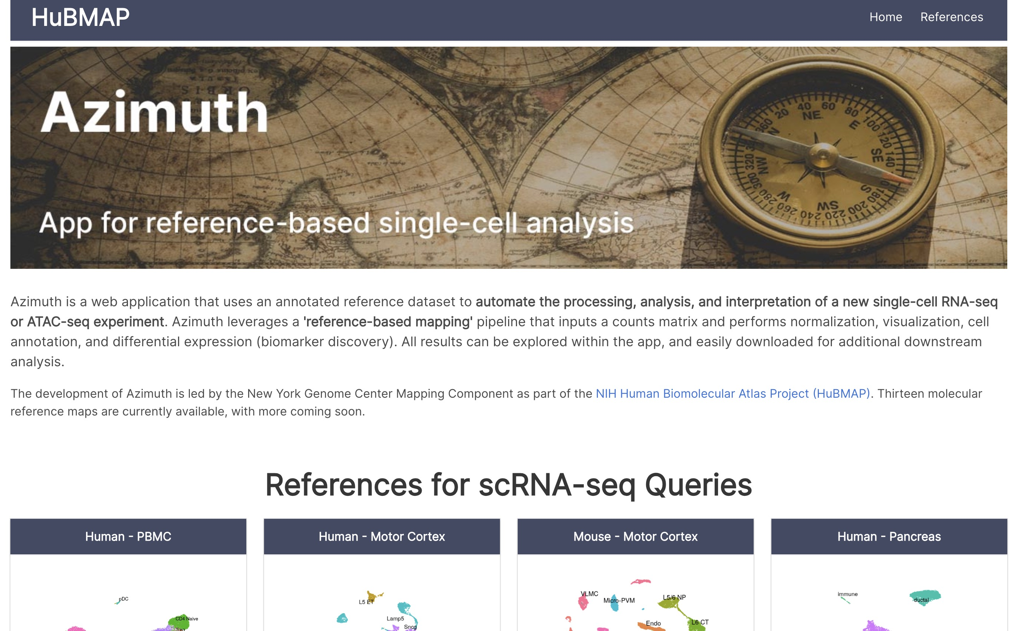
0
Open Azimuth‘s official website:
https://azimuth.hubmapconsortium.org/

Slide 3
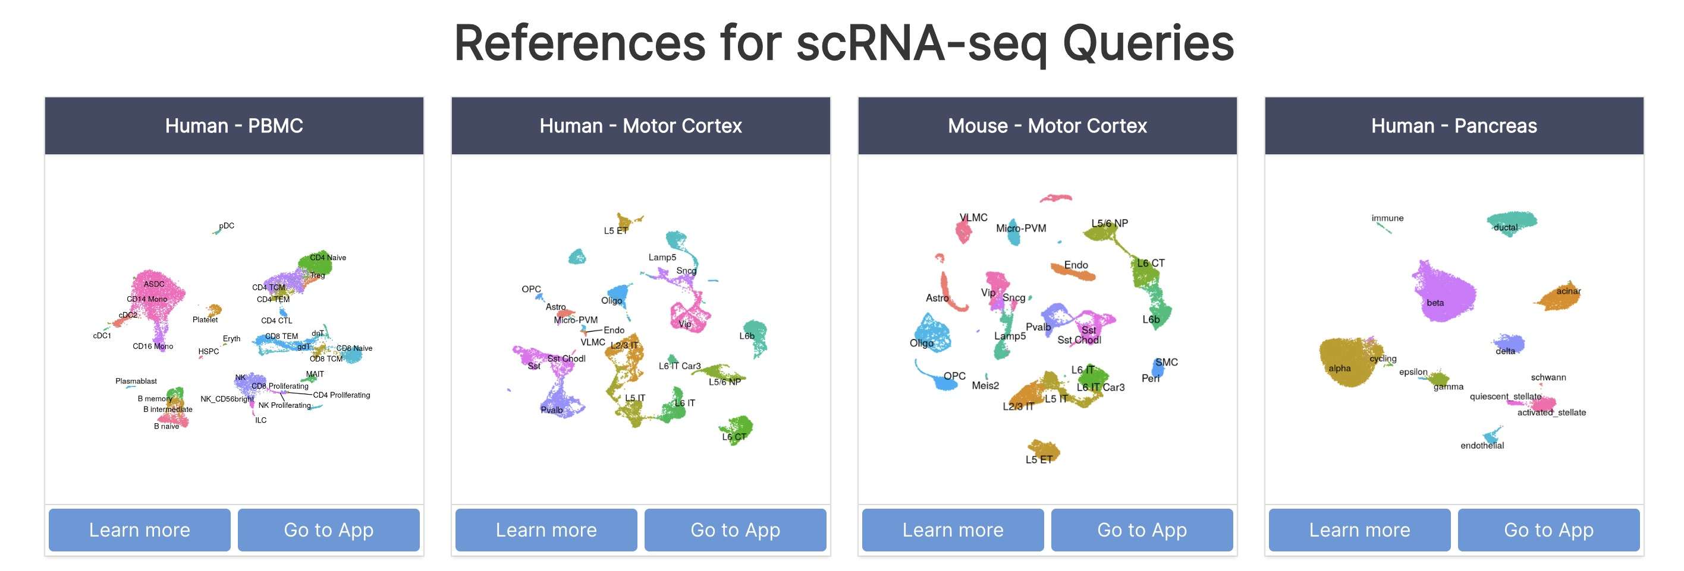
1
Find ‘References for scRNA-seq Queries’
-> Then find ‘Human - PBMC’
-> click ‘Go to App’

Slide 4
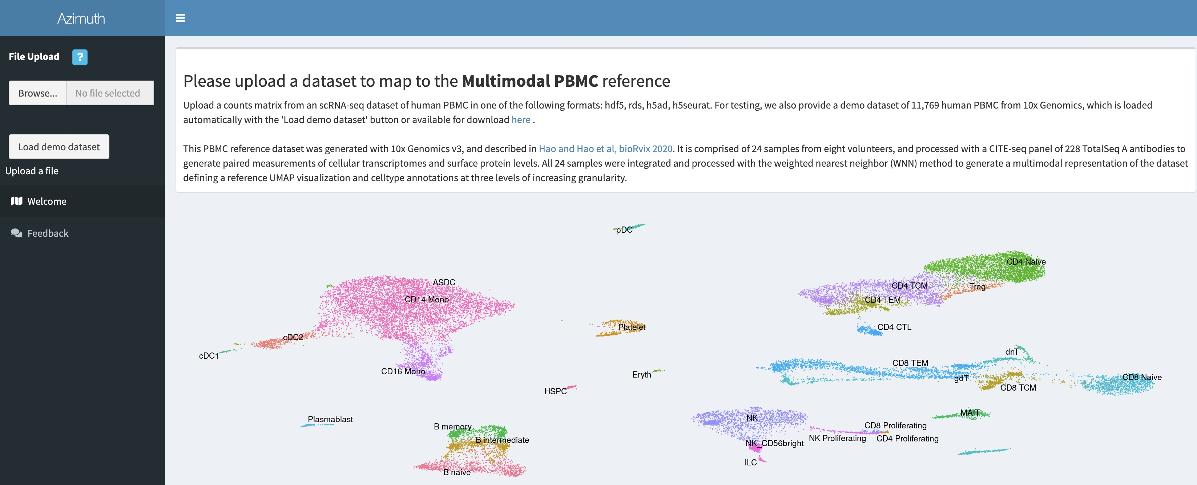
2
Click ‘Browse’
-> find ‘pbmc_10x_v2.Rds’ at your working directory
–> Click ‘Open’

Slide 5
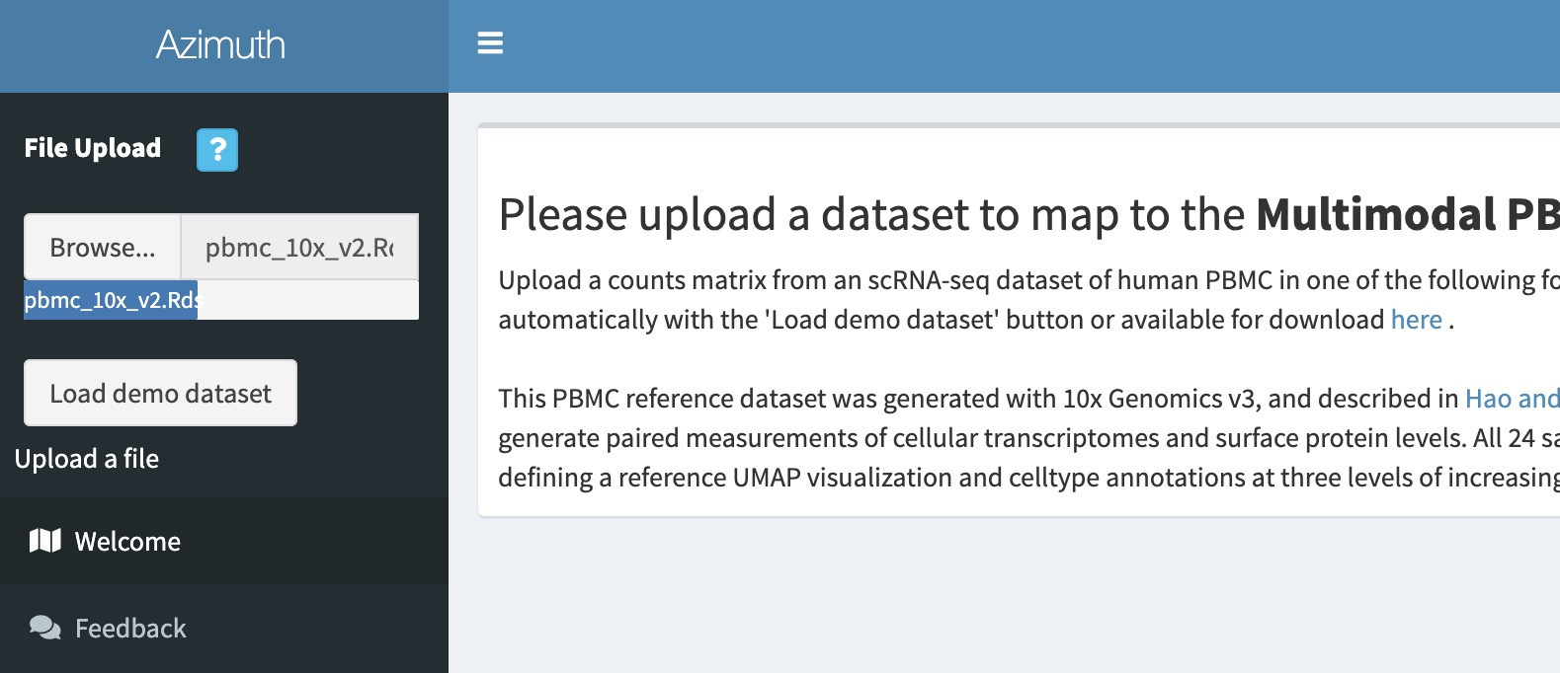
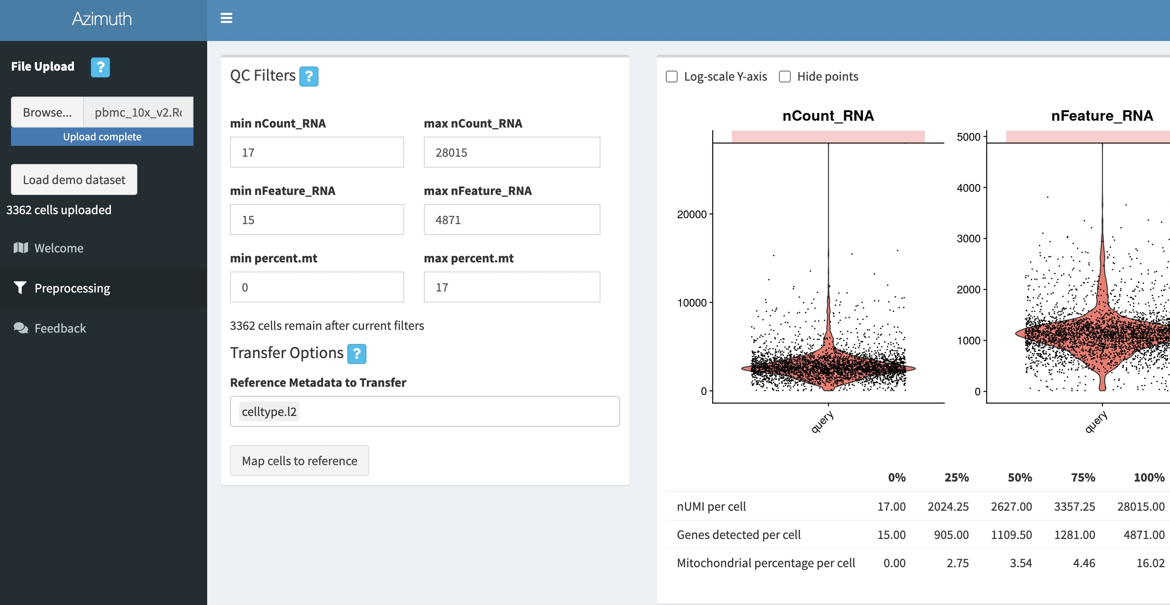
3
Waiting for the Rds file upload to the website
Sometimes errors occur due to bad network:
Try again or Use the tsv results we provide

Slide 6
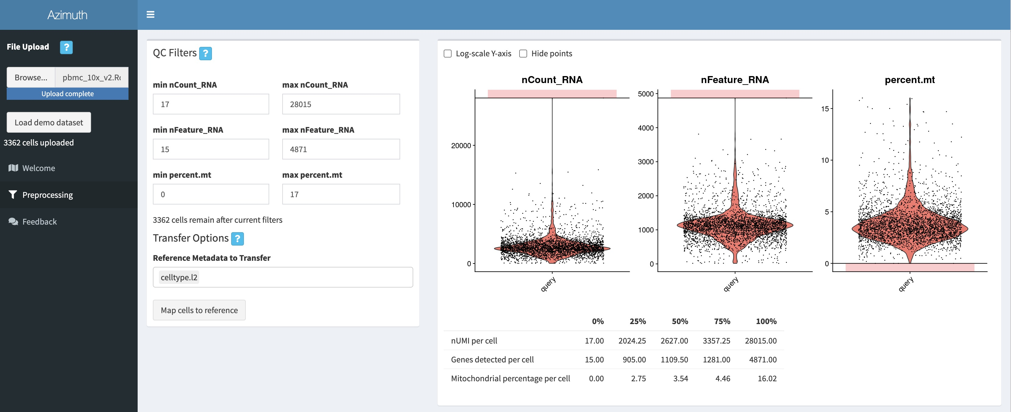
4
Click ‘Map cells to reference’

Slide 7
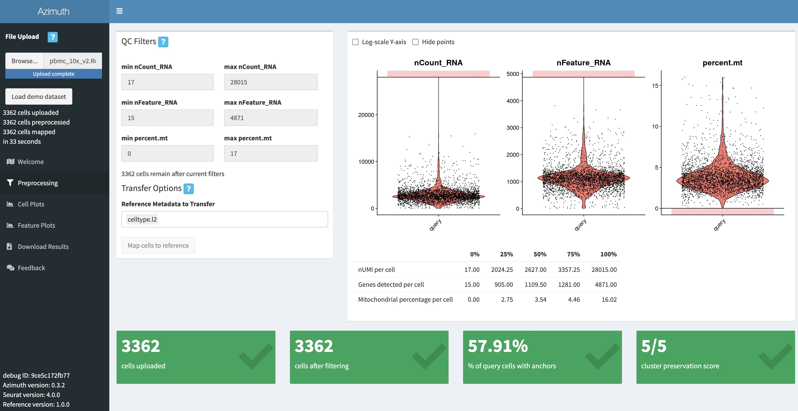
5
Click ‘Download Results’

Slide 8
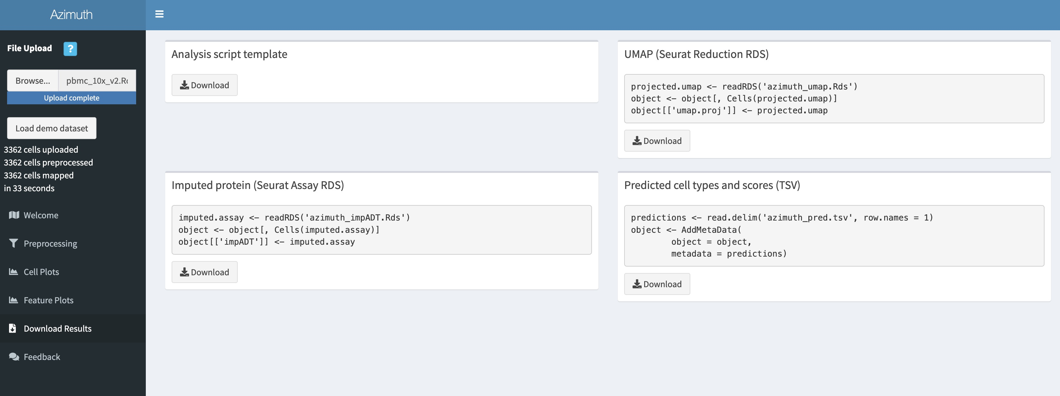
6
Find 'Predicted cell types and scores (TSV)'

Slide 9
7
Click ‘Download’

Slide 10
8
Copy the tsv file (azimuth_pred.tsv) to your R working directory

