Slide 1
Faster than u
Prove that you are the best in running, cycling or skating.

Slide 2
Don’t want to be a
LONELY RUNNER?
Want to know how much
Calories you will burn?

Slide 3
What we can do
Run together even if you are in different cities
Compare your running status with your competitor in real-time
Compare your running status with recorded running track
Predict how much calories you will burn

Slide 4
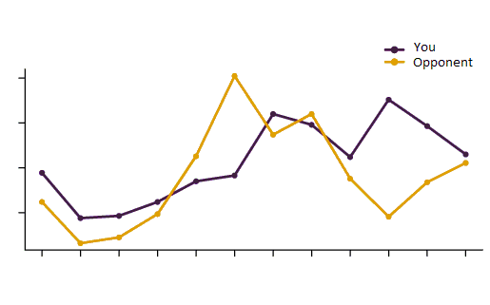
What we can do
Run together even if you are in different cities
Compare your running status with your competitor in real-time
Compare your running status with recorded running track
Predict how much calories you will burn

Slide 5
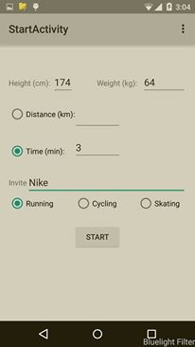
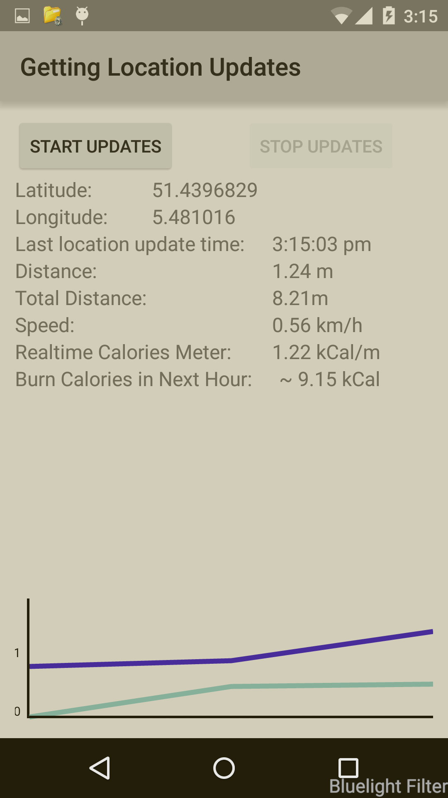

AND…
Voice Notifications

Slide 6
Thank you!

