Slide 1
Tweet Sentiment Extraction
https://www.kaggle.com/c/tweet-sentiment-extraction/overview

Slide 2
Dataset
Data columns
textID = A unique identifier
text = Tweet
selected_text
Sentiment = Target Class
Train consist of 27481 tweets
Test consist of 3534 tweets

Slide 3
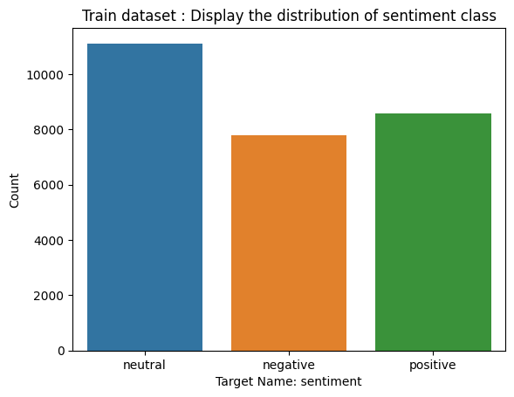
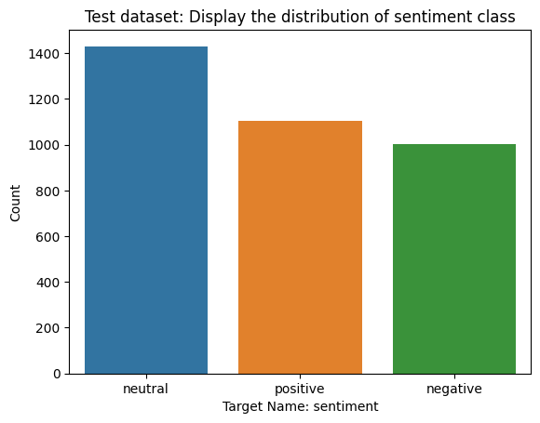
Target Distribution
Train distribution
Negative: 7781
Neutral: 11118
Positive: 8582
Test distribution
Negative: 1001
Neutral: 1430
Positive: 1103

Slide 4
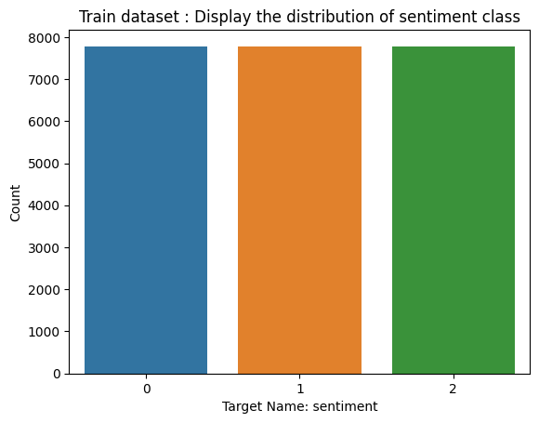
Undersampling
Train distribution
Negative: 7781
Neutral: 7781
Positive: 7781

Slide 5
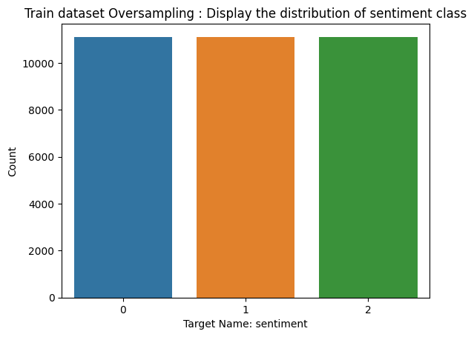
Oversampling
Train distribution
Negative: 11118
Neutral: 11118
Positive: 11118

Slide 6
Text pre-processing Steps
1. Convert Text to lower case
2. Expand contractions
3. Replace Slang Words
4. Remove emoji
5. Convert accented characters to ASCII characters
6. Remove punctuations and special characters
7. Remove Consequently Char
8. Remove Numbers
10. Trim text and Remove extra double whitespaces
11. Auto Spelling
12. Lemmatization
5. Remove HTML tags

Slide 7
Remove Stop Words
As it can be seen from the output, removal of stop words can remove words that required in order to perform accurate sentiment analysis
Input | Output
Restaurant had a really good service!! | Restaurant good service!!
I did not like the food!! | I like food!!
This product is not good!! | This product good!!

Slide 8
Remove Proper Nouns
Common Nouns | Proper Nouns
Man | Hugo, George
Country | Australia, Greece
Town | Paris, Barcelona
Proper Nouns

Slide 9
Text Normalization
Word | Lemma | Stem
studies | study | studi
cries | cry | cri
Stemming VS
Lemmatization

Slide 10
Text Cleaning Examples
Initial Text | Cleaned Text
I`d have responded, if I were going | i ` d have responded if i were going
Sooo SAD I will miss you here in San Diego!!! | soon sad i will miss you here in san diego
my boss is bullying me... | my boss is bullying me
what interview! leave me alone | what interview leave me alone
Sons of ****, why couldn`t they put them on the releases we already bought | sons of why couldn ` t they put them on the releases we already bought
http://www.dothebouncy.com/smf - some shameless plugging for the best Rangers forum on earth | some shameless plugging for the best rangers forum on earth
2am feedings for the baby are fun when he is all smiles and coos | am feelings for the baby are fun when he is all smiles and cool
Soooo high | soon high
Both of you | both of you
Journey!? Wow... u just became cooler. hehe... (is that possible!?) | journey wow u just became cooler here is that possible
as much as i love to be hopeful, i reckon the chances are minimal =P i`m never gonna get my cake and stuff | as much as i love to be hopeful i reckon the chances are minimal =p i ` m never gon na get my cake and stuff
I really really like the song Love Story by Taylor Swift | i really really like the song love story by taylor swift
My Sharpie is running DANGERously low on ink | my share is running dangerously low on ink
i want to go to music tonight but i lost my voice. | i want to go to music tonight but i lost my voice
test test from the LG enV2 | test test from the lg env
Uh oh, I am sunburned | uh oh i am sunburned
S`ok, trying to plot alternatives as we speak *sigh* | s ` ok trying to plot alternatives as we speak sigh

Slide 11



Application Stack

Slide 12
Dictionary
Initial Size: 14.523
Remove 1
8470

Slide 13
Word Embeddings
Bag of words
Word2vec
TfidfVectorizer
Skip-Thought Vectors

Slide 14
Naive Bayes Algorithms
Bernoulli Naive Bayes : It assumes that all our features are binary such that they take only two values. Means 0s can represent “word does not occur in the document” and 1s as "word occurs in the document" .
Multinomial Naive Bayes : Its is used when we have discrete data (e.g. movie ratings ranging 1 and 5 as each rating will have certain frequency to represent). In text learning we have the count of each word to predict the class or label.
Gaussian Naive Bayes : Because of the assumption of the normal distribution, Gaussian Naive Bayes is used in cases when all our features are continuous. For example, in Iris dataset features are sepal width, petal width, sepal length, petal length. So, its features can have different values in data set as width and length can vary. We can’t represent features in terms of their occurrences. This means data is continuous. Hence, we use Gaussian Naive Bayes here.

Slide 15

Over Sampling VS Under Sampling
Model | Over Sampling Macro Precision, recall, f1-score | Under Sampling Macro Precision, recall, f1-score
Logistic Regression | 0.7421328479168467, 0.74215765541426, 0.7421178220000996 | 0.7421328479168467, 0.74215765541426, 0.7421178220000996
Support Vector Machine | 0.745209249164927, 0.7446096884430804, 0.7446813338410809
Naive Bayes | 0.5085220651004936, 0.5085243856333719, 0.4556614874507921
MLP

