Slide 2
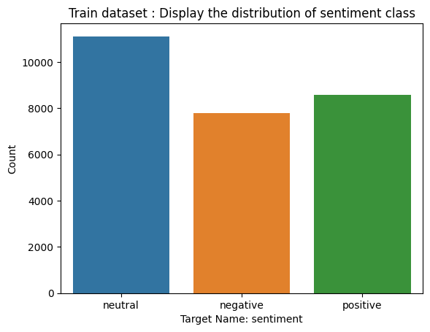
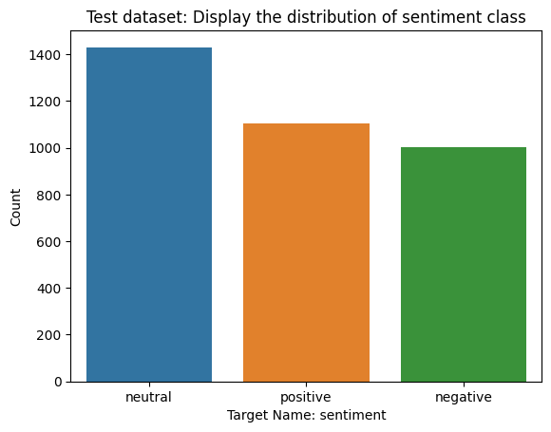
Unbalanced Dataset
Train distribution
negative 7781
neutral 11118
positive 8582
Test distribution
negative 1001
neutral 1430
positive 1103

Slide 3
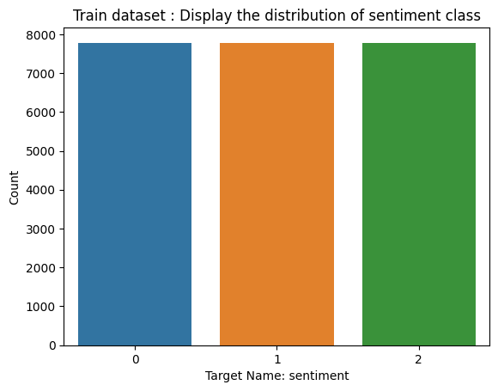
Balanced Dataset
Train distribution
Negative: 7781
Neutral: 7781
Positive: 7781

Slide 4
Text pre-processing Steps
1. Remove punctuations / Remove special characters
2. Remove URLs
3. Remove HTML tags
4. Remove emoji
5. Convert accented characters to ASCII characters
6. Expand contractions
7. Remove numbers (or converted on string)
8. Trim text and Remove extra whitespaces
9. Expand contractions
10. Case Normalization: Lowercase all texts
11. Remove stop words, no need for this operations since in sentiment analysis we will lose information
12. Stemming vs Lemmatization (which one to choose?)
13. Tokenization (per sentence or all the corpus?)

