Slide 1
Birthday-Planner iOS application for managing and coordinating birthday events and reminders
iOS application development (CSE 4083)
Manoj M Mallya (200905130) and Chirag Rao (200905154)
E Section, CS&E, M.I.T., Manipal
Mentors: Dr. Manjunath K N and Dr. Prakash K Aithal

Slide 2
Introduction
Software requirement specification
Design
Implementation
Future scope
Results and Testing
Background
Motivation
Existing work
Problem statement
User stories
Design principles
GUI Design
Software classes
Navigation method
Coding standards
iOS framework
Dependencies
System requirements
Results
GUI testing
Feature testing
First presentation
Final presentation
Deliverable

Slide 3

Introduction
The impact of hectic lifestyles on remembering and celebrating birthdays thoughtfully is challenging.
The aim of the project is to create an intuitive and user-friendly Birthday-Planner iOS application that simplifies the process of planning and coordinating birthday events, encouraging meaningful and well-organized celebrations
The proposed methodology encompasses employing the Model-View-Controller pattern, adhering to software engineering principles, with rigorous testing to efficiently manage and celebrate birthdays.
The value proposition is that our app provides a seamless and user-friendly solution to effortlessly manage birthdays, ensuring timely reminders and personalized planning.
Expected outcome is a user-friendly Birthday-Planner iOS application, adept at addressing the challenges of efficient birthday organization, thus enhancing personal connections.
The work is aligned to enhancing the joy of birthday celebrations.

Slide 4
Software requirements specification
Problem statement
Busy lifestyles
Inadequate planning
Forgetting special occasions
Impact on relationships
Creating memorable moments
User stories
Persona: Everyday Celebrator
Need: Effortless Birthday Engagement
Purpose: As an everyday celebrator, I want a simple tool that allows me to easily add and save upcoming birthdays, ensuring I never miss wishing my relatives and friends on their special days. Timely reminders are essential to prompt me, as I often get caught up in daily routines. Viewing a calendar with highlighted birthdays allows me to plan my schedule effectively, ensuring I can spread joy and well wishes to my loved ones consistently.

Slide 5
Design
Design principles
User Centric design
Simplicity
Observer Design Pattern(Notifications)
GUI Design
Native iOS app theme.
DatePicker, TextFields Widgets.
Software classes
UINotifications class
AppDelegate class for managing persistent context.
User class
Birthday class
Navigation method
Navigation Controller

Slide 6
Implementation strategy
Coding standards
Conforms to Swift Style guide.
Camel casing.
No semicolons.
Max line width is 100 characters.
Dependencies.
Fully Native application, no external dependencies, apart from Xcode 14 and having an Apple device.
Software engineering principles followed
SDLC flowchart followed.
Feasibility Study → Design → Code → Testing → Deployment
Abstraction, Encapsulation.
DRY – Don’t Repeat Yourself principle.
System requirements
Apple MacBook or desktop computer with 8 GB RAM and 200GB hard disk with a high-resolution display for app development and either the iPad or mobile device for app deployment.

Slide 7
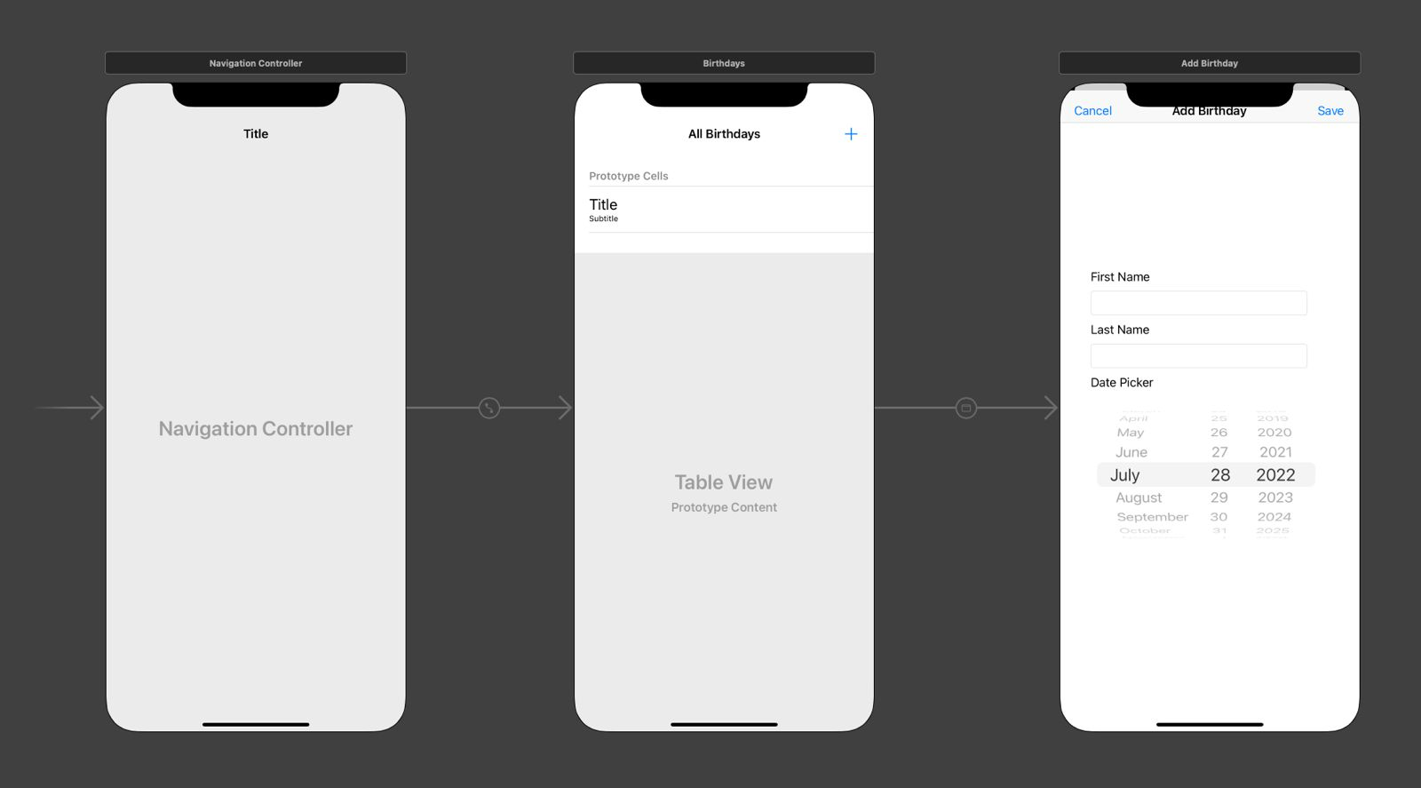
Results

Slide 8
Testing
GUI testing
Checking constraints:
Whether works on all screen sizes.
Whether works on different orientations.
Making sure there’s no skew or glitches.
Whether proper CTA (Call to Action) buttons have been enforced.
Features testing:
Whether logic works as intended.
Edge cases and boundary values taken into consideration
No First Name
No last name
Whether data is persistent across multiple sessions.
Whether notifications are triggered correctly and at the right time, in the correct timezone.

Slide 9
Dissemination
To the scientific community: To facilitate remembering the birthdays of close ones, not just applicable to the scientific community but to everyone across the globe, the scope is massive.
Publicizing: By using the MAHE innovation center and the Ministry of Education’s help, we can make this project widespread, by adding many other features in the long run.
Target community audience: Everyone in the world can use our app, there is no restriction whatsoever, just an iPhone is needed.
IP (Intellectual Property): Our project has been implemented from scratch and using native iOS libraries. We have not applied for any license however we do plan on making part of our app open-source.
Commercialization: We can use a freemium model, where only some features are available for free, for accessing all features, the user must pay a small fee.
TRL(Technology Readiness Level) achieved: Level 4: We have almost built a prototype, which hasn’t been tested in a relevant environment.

Slide 10
Conclusion and future scope
Not just birthdays, this can be extended to all kinds of events like marriages or dinners.
Scheduling meets during these events, an end-to-end system for managing all aspects of events, for example, number of people attending, available caterers, number of people sharing the same birthday, etc.
Connecting to Firebase for push notifications.
Migrating to a database instead of using persistent context. A No-SQL database works best.
Adding proper versioning to the app.
Streamlining development workflow, using CI/CD techniques.
Improving the UI.
From simple wishes to celebrations grand,
spread happiness across the land.

Slide 11
References
Develop in Swift Fundamentals Xcode 13: https://books.apple.com/us/book/develop-in-swift-fundamentals/id1581182804
YouTube channel - SwiftKoding4Everyone: https://www.youtube.com/@SwiftKoding4Everyone
Coursera course - Swift 5 iOS App Developer Specialization: https://www.coursera.org/programs/manipal-education-tguaf/specializations/swift-5-ios-app-developer
Swift documentation: https://developer.apple.com/documentation/swift

