Slide 1
From Robustness to Efficiency
Yin Tat Lee
University of Washington

Slide 2
Theme

Slide 3
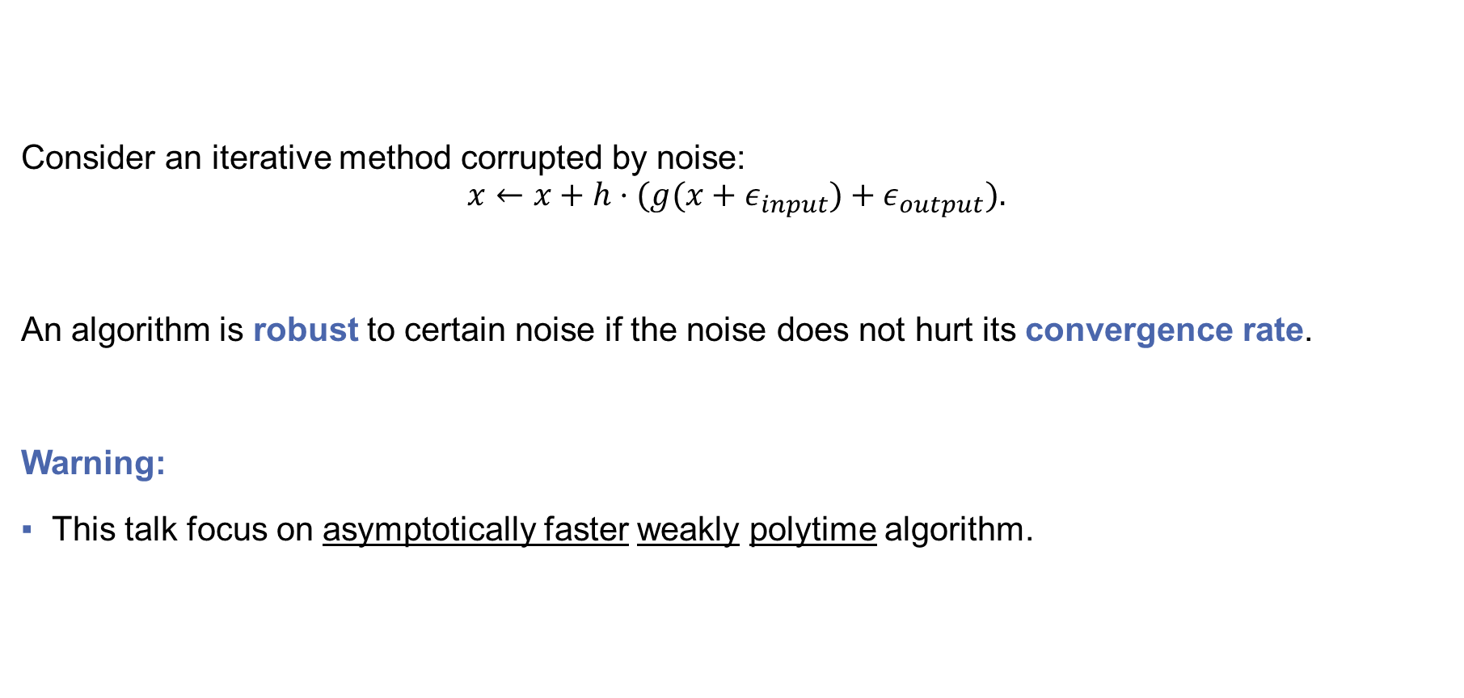
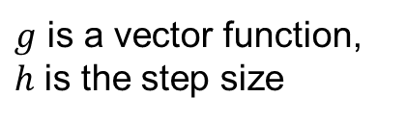
Theme
Consider an iterative method corrupted by noise:
$$x←x+h⋅(g(x+ε_{input})+ε_{output}).$$
An algorithm is robust to certain noise if the noise does not hurt its convergence rate.
Warning:
This talk focus on asymptotically faster weakly polytime algorithm.
How designing robust algorithms lead to fast algorithms?
$g$ is a vector function,
$h$ is the step size

Slide 4
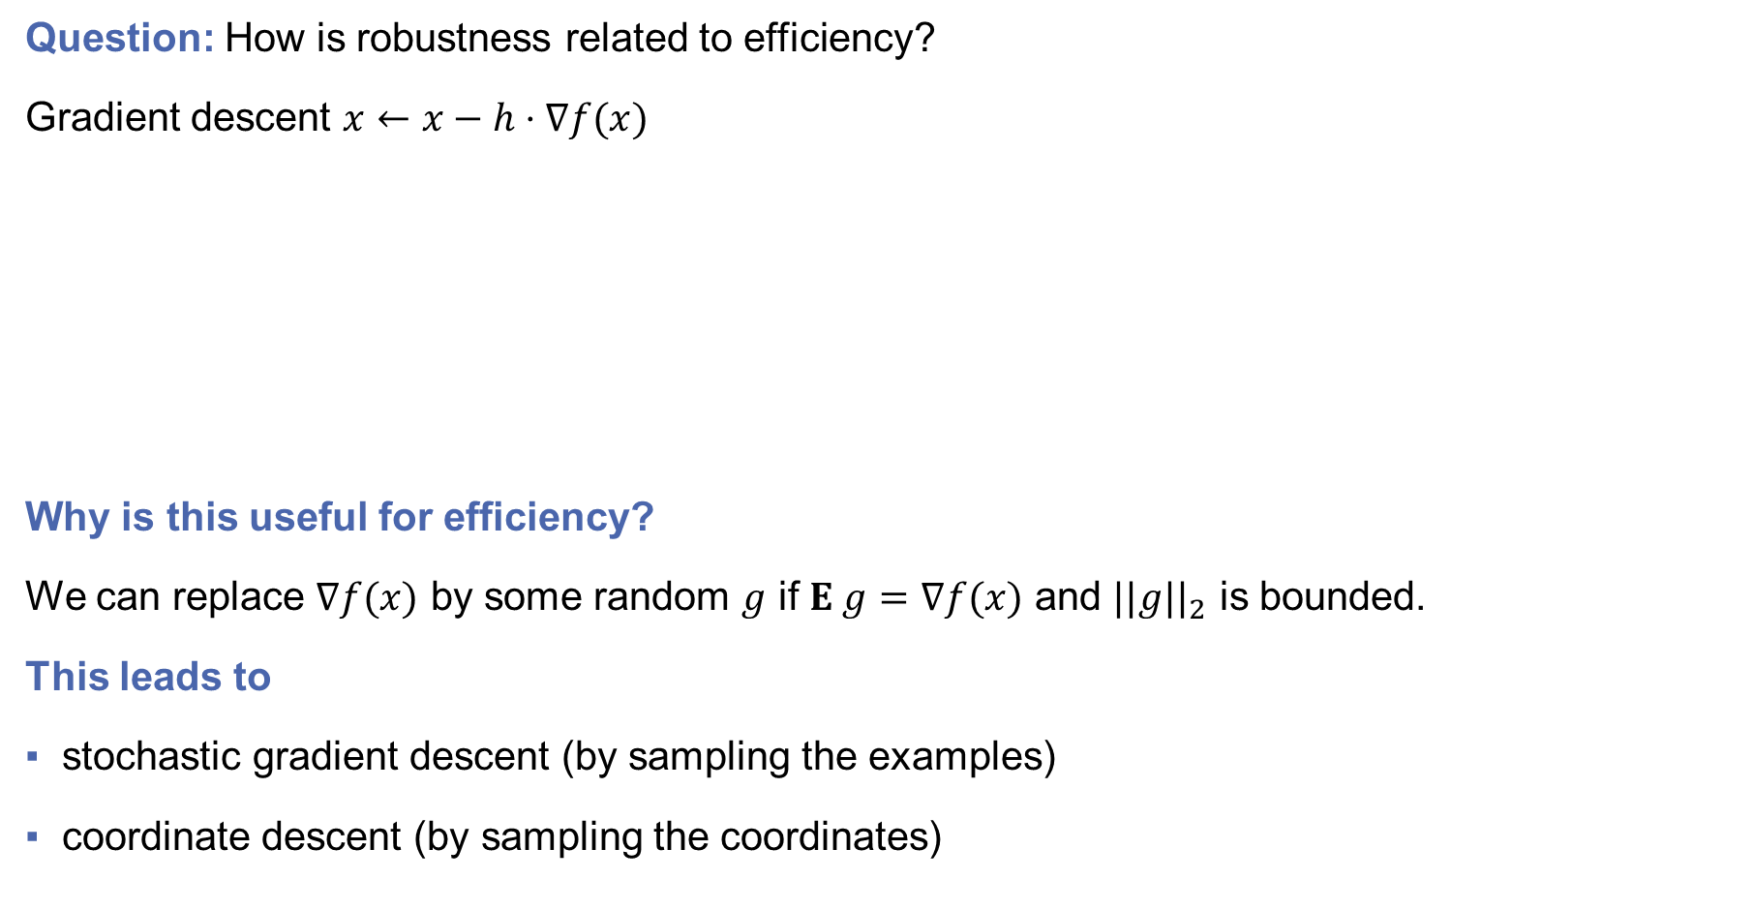


Example 1: Gradient Descent
Problem:
$$\min_{x}{f(x)}$$
Question: How is robustness related to efficiency?
Gradient descent $x←x−h⋅∇f(x)$
Why is this useful for efficiency?
We can replace $∇f(x)$ by some random $g$ if $E g=∇f(x)$ and $||g||_{2}$ is bounded.
This leads to
stochastic gradient descent (by sampling the examples)
coordinate descent (by sampling the coordinates)
Fact*: Gradient descent is robust under unbiased output $ℓ_{2}$noise.
Namely, the algorithm
$$x←x−h⋅(∇f(x)+ε)$$
gives a similar result as gradient descent if $E ε=0$ and $||ε||_{2}$ is bounded.
* Not a precise result because the convergence depends on the function class.

Slide 5

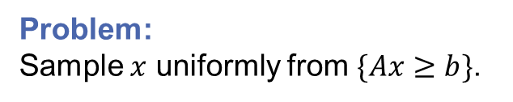
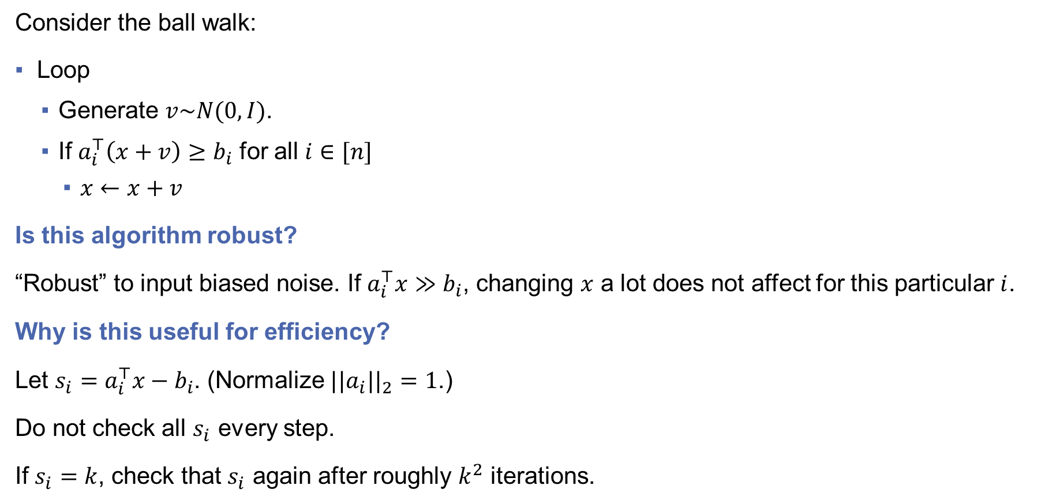


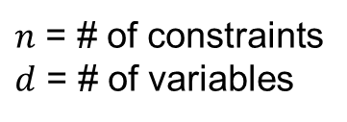
Example 2: Ball Walk
Problem:
Sample $x$ uniformly from $\{Ax≥b\}$.
$n$ = # of constraints
$d$ = # of variables
Consider the ball walk:
Loop
Generate $v\sim N(0,I)$.
If $a_{i}^{⊤}\left(x+v\right)≥b_{i}$ for all $i∈[n]$
$x←x+v$
Is this algorithm robust?
“Robust” to input biased noise. If $a_{i}^{⊤}x≫b_{i}$, changing $x$ a lot does not affect for this particular $i$.
Why is this useful for efficiency?
Let $s_{i}=a_{i}^{⊤}x−b_{i}$. (Normalize $||a_{i}||_{2}=1$.)
Do not check all $s_{i}$ every step.
If $s_{i}=k$, check that $s_{i}$ again after roughly $k^{2}$ iterations.
(Lovász 90)
$$x$$
Each step takes $O(nd)$ time.
It leads to $O(d)$ amortized time.
Lazy Update
When the algorithm is robust, we can delay some calculations.
(Mangoubi-Vishnoi 19)

Slide 6
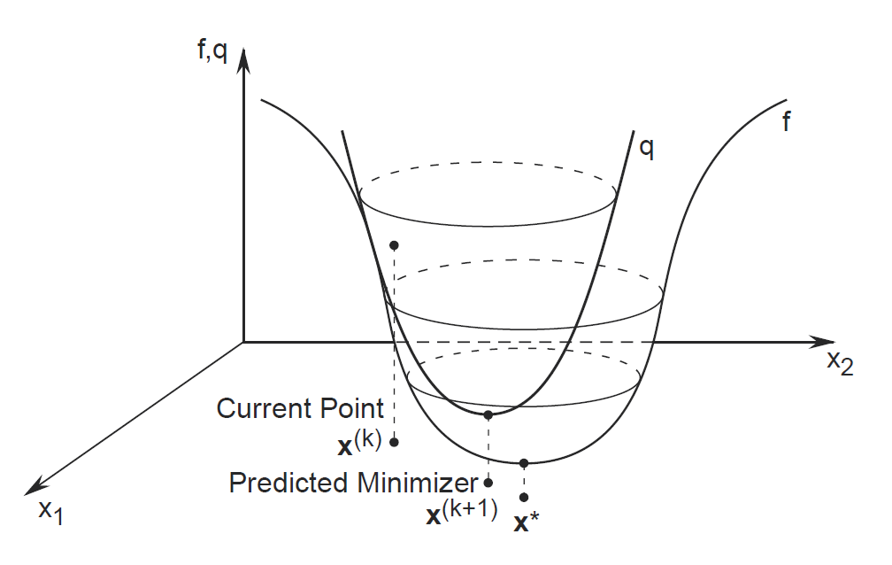
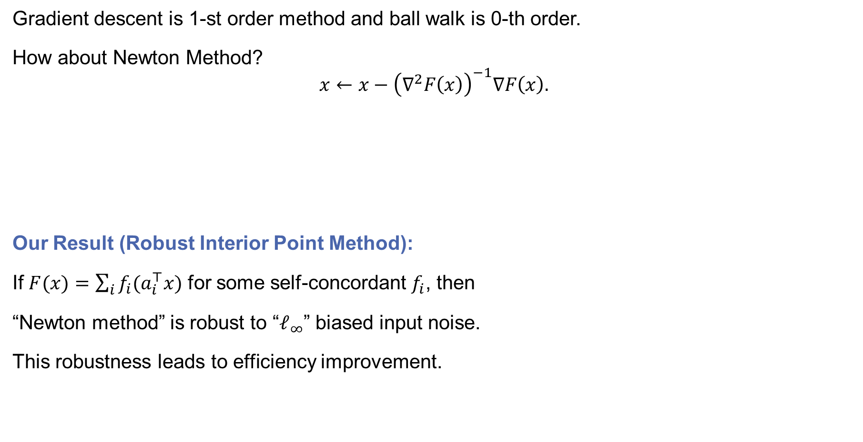

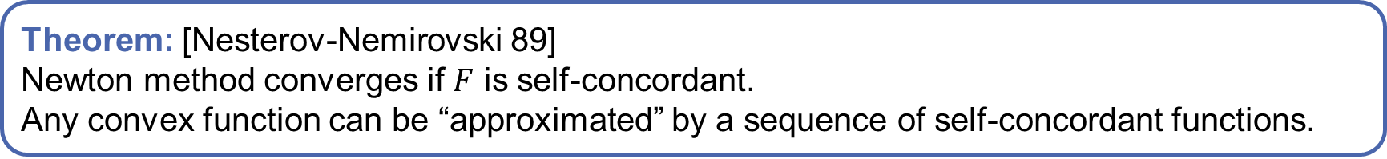
“Newton method”
Gradient descent is 1-st order method and ball walk is 0-th order.
How about Newton Method?
$$x←x−{\left(∇^{2}F\left(x\right)\right)}^{−1}∇F\left(x\right).$$
Our Result (Robust Interior Point Method):
If $F(x)=\sum_{i}{f_{i}(a_{i}^{⊤}x)}$ for some self-concordant $f_{i}$, then
“Newton method” is robust to “$ℓ_{∞}$” biased input noise.
This robustness leads to efficiency improvement.
Theorem: [Nesterov-Nemirovski 89]
Newton method converges if $F$ is self-concordant.
Any convex function can be “approximated” by a sequence of self-concordant functions.
$$F^{′′′}≤2{\left(F^{′′}\right)}^{3/2}$$

Slide 7
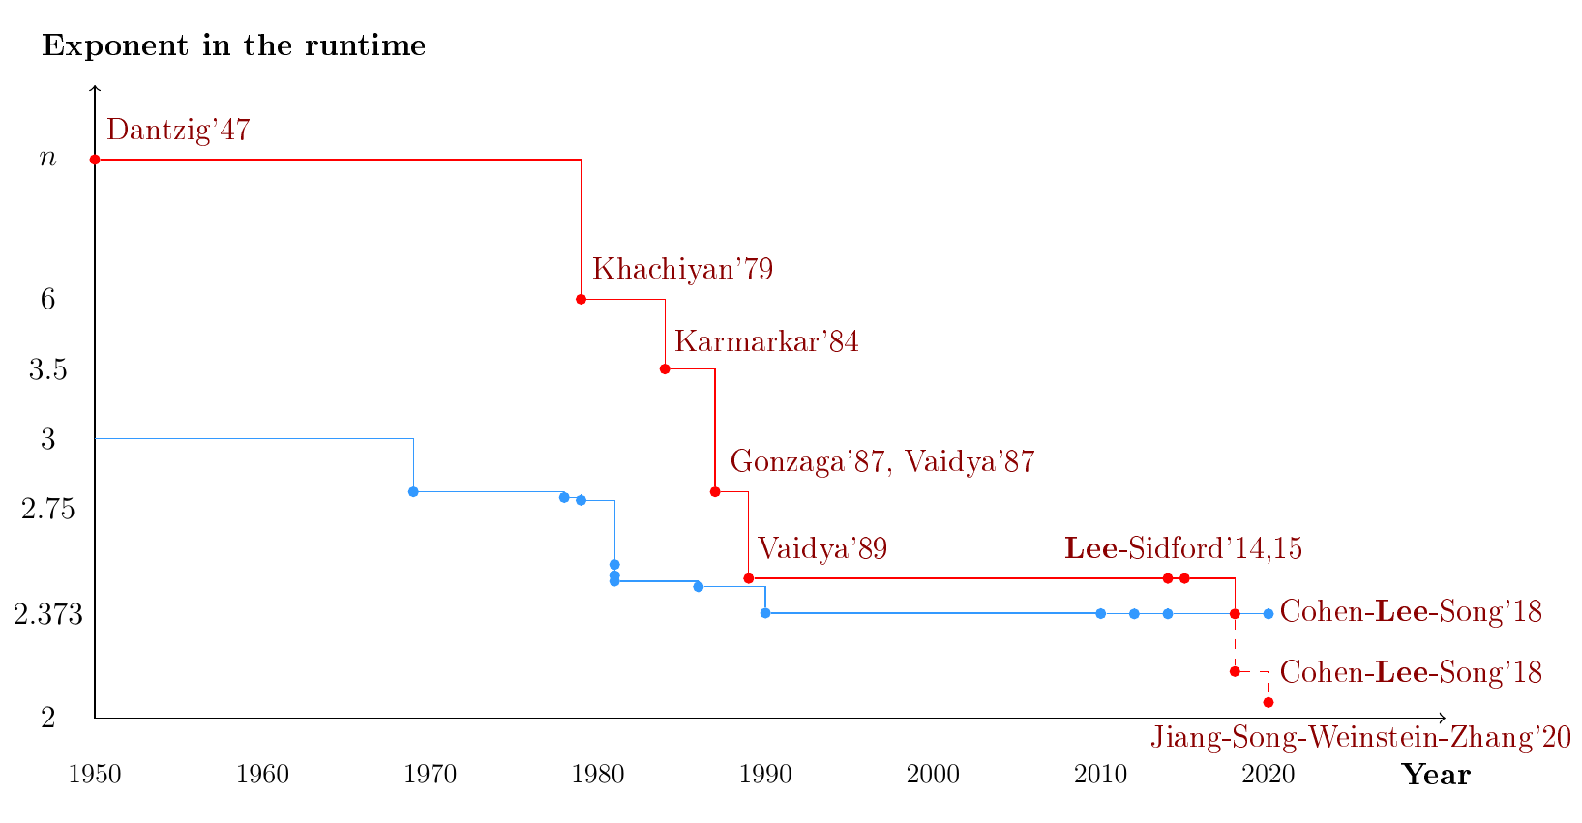
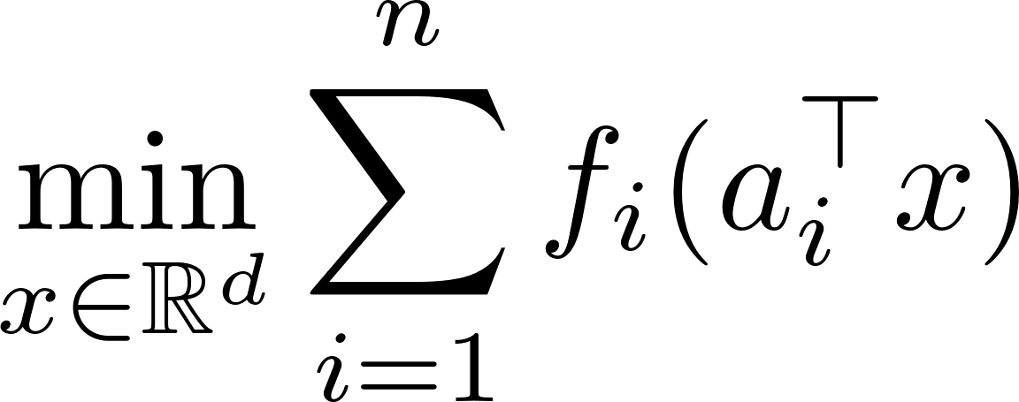
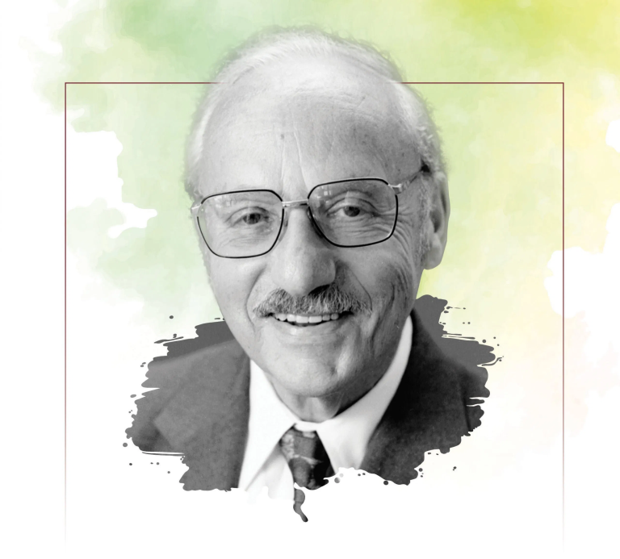
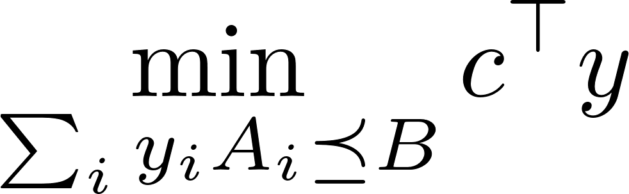



Consequence of Robust Interior Point Method
Extended to
Generalized linear models
Semidefinite programs
…
Linear Programs
$$\min_{Ax=b,x≥0}{c^{⊤}x}$$
Dantzig
Linear Systems
$$Ax=b$$
If we can solve $Ax=b$ in $n^{2}$

Slide 8
Robust Interior Point Method
Newton method can made to be robust to input.
Cohen-Lee-Song 19
v.d.Brand 20

Slide 9
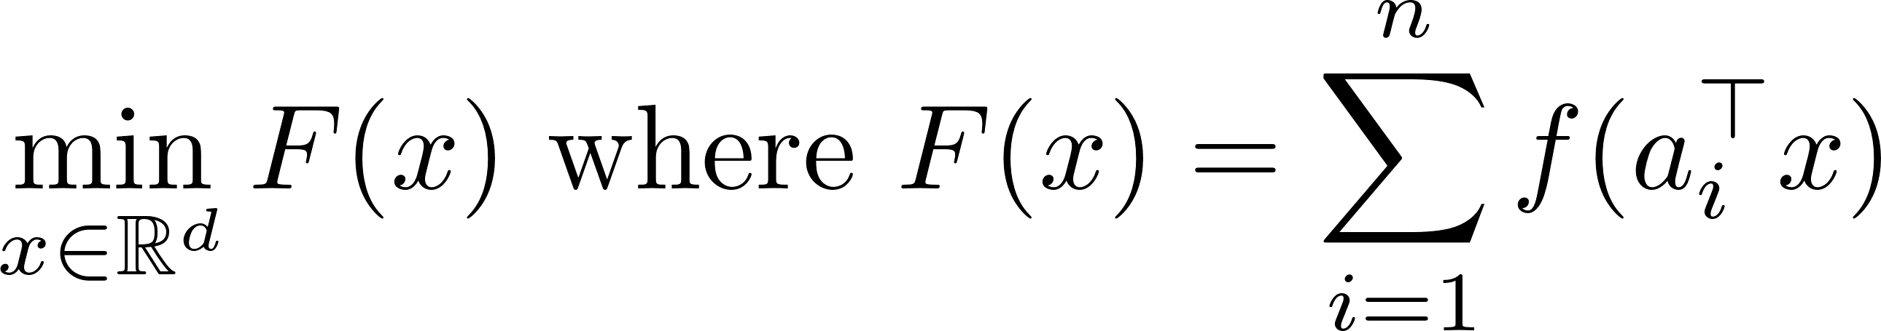
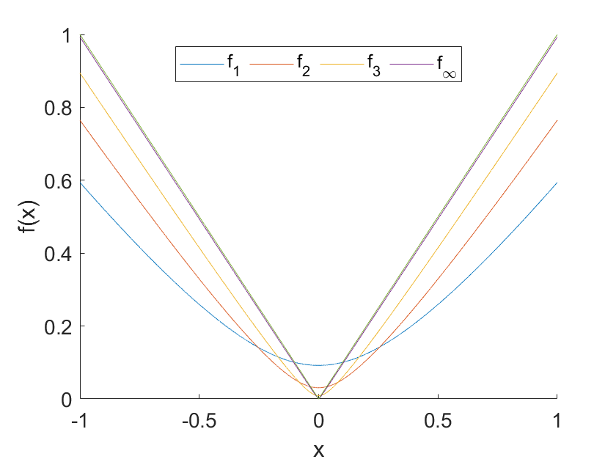
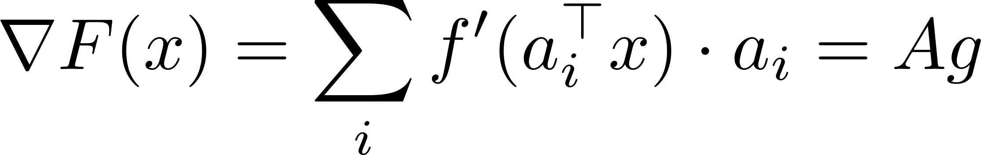
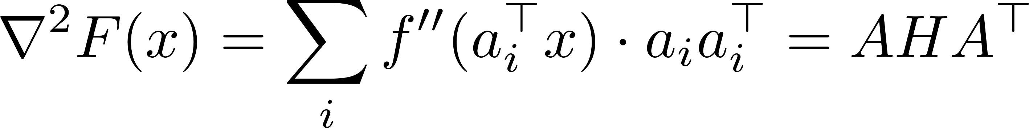
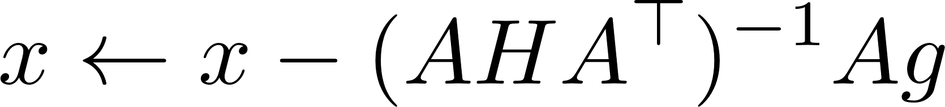
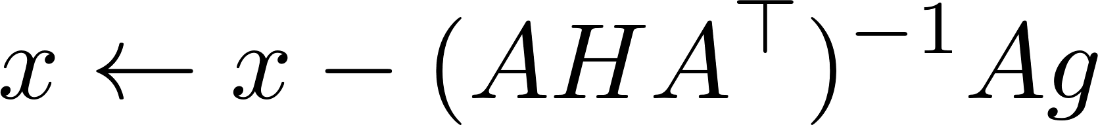



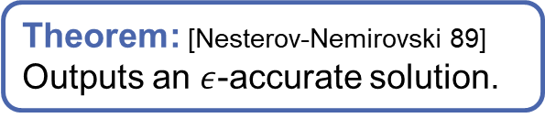

Formula for Newton Method
$a_{i}$ = $i$-th col of $A$
$g_{i}=f′(a_{i}^{⊤}x)$
$H$ is diagonal:
$H_{ii}=f′′(a_{i}^{⊤}x)$
Consider the problem
We compute the gradient and Hessian of $F$:
Newton Method:
Interior Point Method:
For $t=1,2,⋯,O(\sqrt{n} log⁡(1/ε))$
where $g_{i}=f_{t}^{′}(a_{i}^{⊤}x)$, $H_{ii}=f_{t}′′(a_{i}^{⊤}x)$.
Output $x$
$A$ is data matrix
Self-concordant function
Theorem: [Nesterov-Nemirovski 89]
Outputs an $ε$-accurate solution.
For simplicity, you can think $f_{t}=f$.

Slide 10
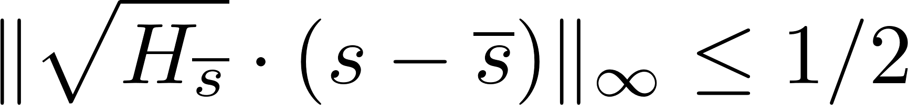
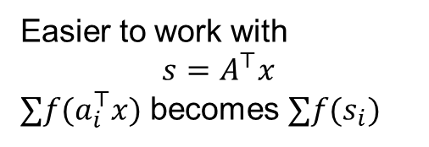

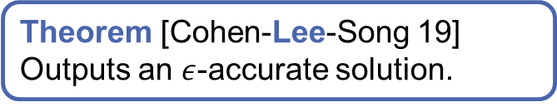


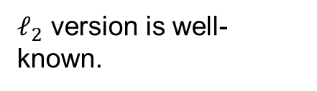



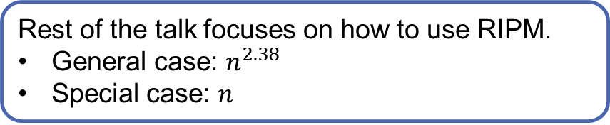

Robust Interior Point Method
Easier to work with
$$s=A^{⊤}x$$
$∑f(a_{i}^{⊤}x)$ becomes $∑f(s_{i})$
$ℓ_{2}$ version is well-known.
Loop $O(\sqrt{n} log⁡(1/ε))$ iterations
Update $\overline{s}$ such that
Implicitly perform
Output $x$ (using $s=A^{⊤}x$)
Advantage:
Update to $\overline{s}$ can be sparse.
Don’t need to compute $s$ exactly.
We only need a data structure for s that:
Output $s$ at the end.
Tell which $s_{i}$ changed a lot.
Theorem [Cohen-Lee-Song 19]
Outputs an $ε$-accurate solution.
$$s$$
If we require $ℓ_{2}$ close, update will be dense.
$$\overline{s}$$
$$\overline{s}$$
$$s$$
$$s,\overline{s}$$
Rest of the talk focuses on how to use RIPM.
General case: $n^{2.38}$
Special case: $n$
Total Time

Slide 11

Example: “$n^{2.38}$ Time”
Update when necessary and batch update when possible
Cohen-Lee-Song 19
v.d.Brand 20

Slide 12
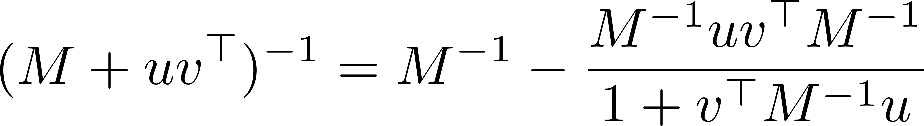

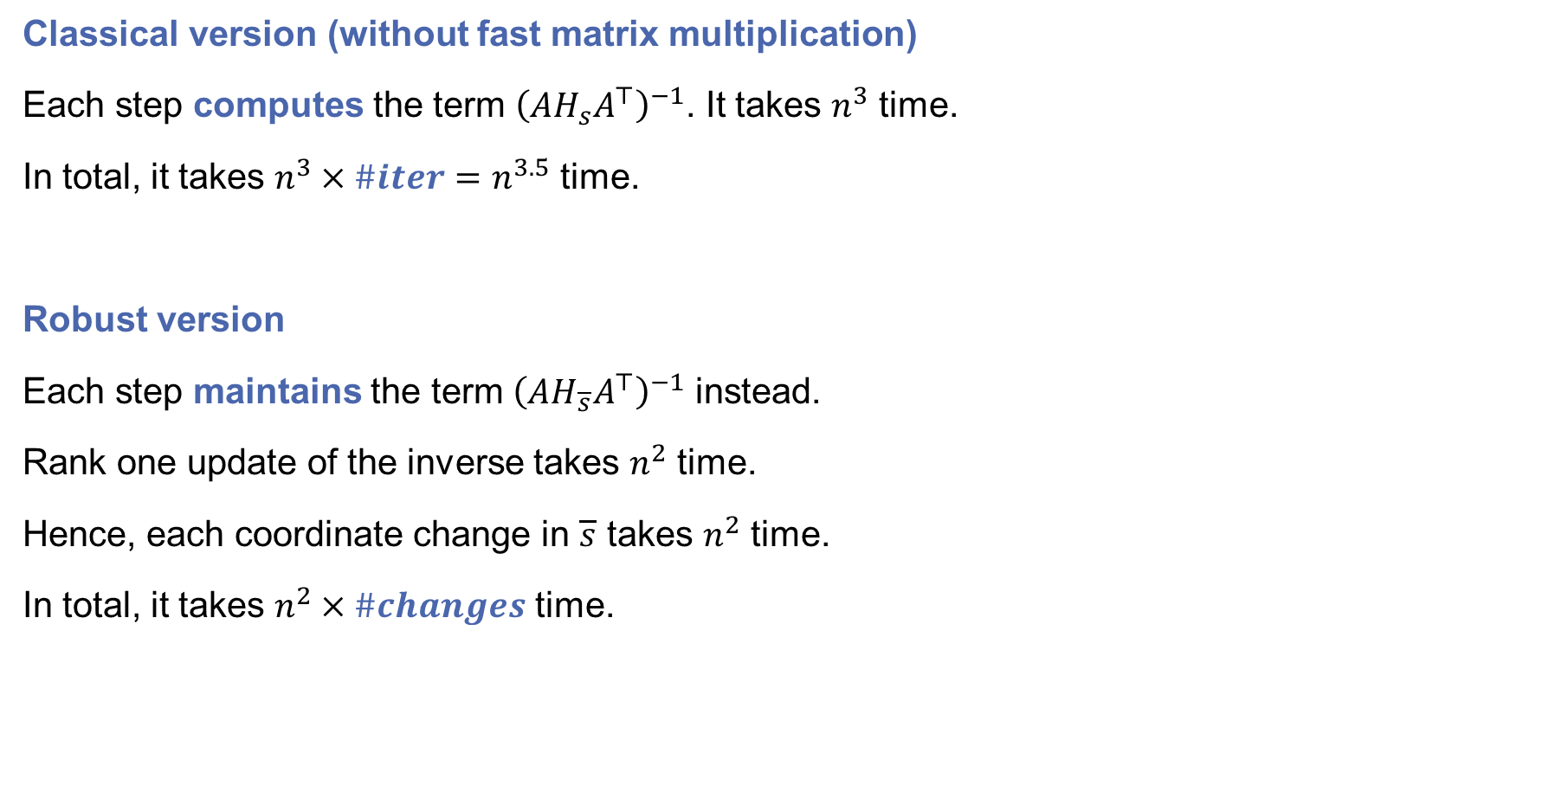
Why $\overline{s}$ is useful?
Setting:
assume $n≈d$
Classical version (without fast matrix multiplication)
Each step computes the term ${\left(AH_{s}A^{⊤}\right)}^{−1}$. It takes $n^{3}$ time.
In total, it takes $n^{3}×\#iter=n^{3.5}$ time.
Robust version
Each step maintains the term ${\left(AH_{\overline{s}}A^{⊤}\right)}^{−1}$ instead.
Rank one update of the inverse takes $n^{2}$ time.
Hence, each coordinate change in $\overline{s}$ takes $n^{2}$ time.
In total, it takes $n^{2}×\#changes$ time.
Sherman–Morrison formula:

Slide 13



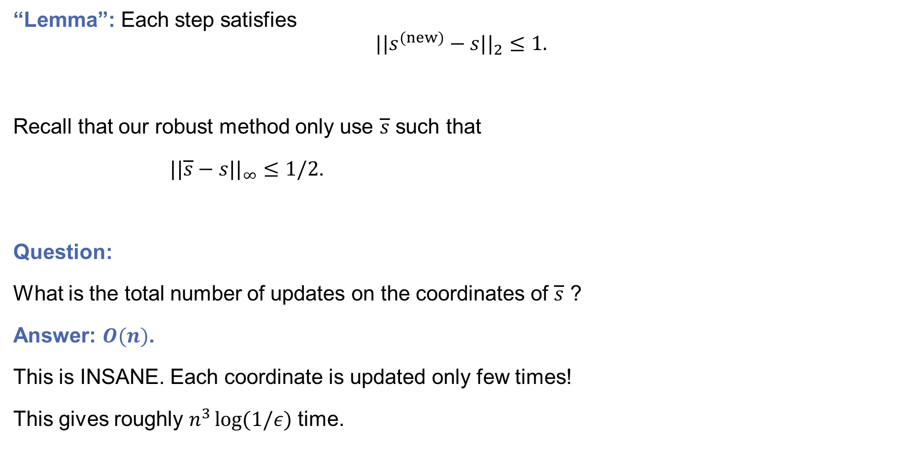
# of coordinate changes
Question:
Does runtime depend on # steps?
What if we use small step $h$
$$x←x−h{\left(∇^{2}F\right)}^{−1}\left(∇F\right)?$$
Answer:
Runtime depends on # $\overline{s}$ changes.
It depends on $ℓ_{2}$ movement.
And it is independent of $h$.
“Lemma”: Each step satisfies
$$||s^{(new)}−s||_{2}≤1.$$
Recall that our robust method only use $\overline{s}$ such that
$||\overline{s}−s||_{∞}≤1/2$.
Question:
What is the total number of updates on the coordinates of $\overline{s}$ ?
Answer: $O(n)$.
This is INSANE. Each coordinate is updated only few times!
This gives roughly $n^{3}\log{(1/ε)}$ time.
Greedy schedule for $\overline{s}$
For every step,
If $\left|s_{i}−{\overline{s}}_{i}\right|≥1/2$, set ${\overline{s}}_{i}=s_{i}$
Ignored normalization in norms and many log terms

Slide 14

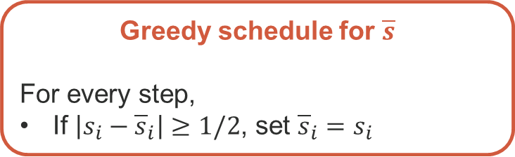

Batch Update
Consider two cases:
$\sqrt{n}$ steps, each step updates the inverse by $\sqrt{n}$ rank
$1$ step, each step updates the inverse by $n$ rank
Which is faster?
Batched is better due to (fast matrix multiplication) or GPU or communication or …
Idea: Update preemptively to batch the updates.
Preemptive schedule for $\overline{s}$
For the $k$-th step (with $k$ is a multiple of $2^{l}$),
If $\left|s_{i}^{(k)}−s_{i}^{(k−2^{l})}\right|≥1/\log{n}$, set ${\overline{s}}_{i}=s_{i}^{(k)}$
Namely, if $s_{i}$ moved a lot in $2^{l}$ steps, update ${\overline{s}}_{i}$.
This gives $n^{2.38}$ time for generalized linear model.
Greedy schedule for $\overline{s}$
For every step,
If $\left|s_{i}−{\overline{s}}_{i}\right|≥1/2$, set ${\overline{s}}_{i}=s_{i}$

Slide 15
Other Results

Slide 16
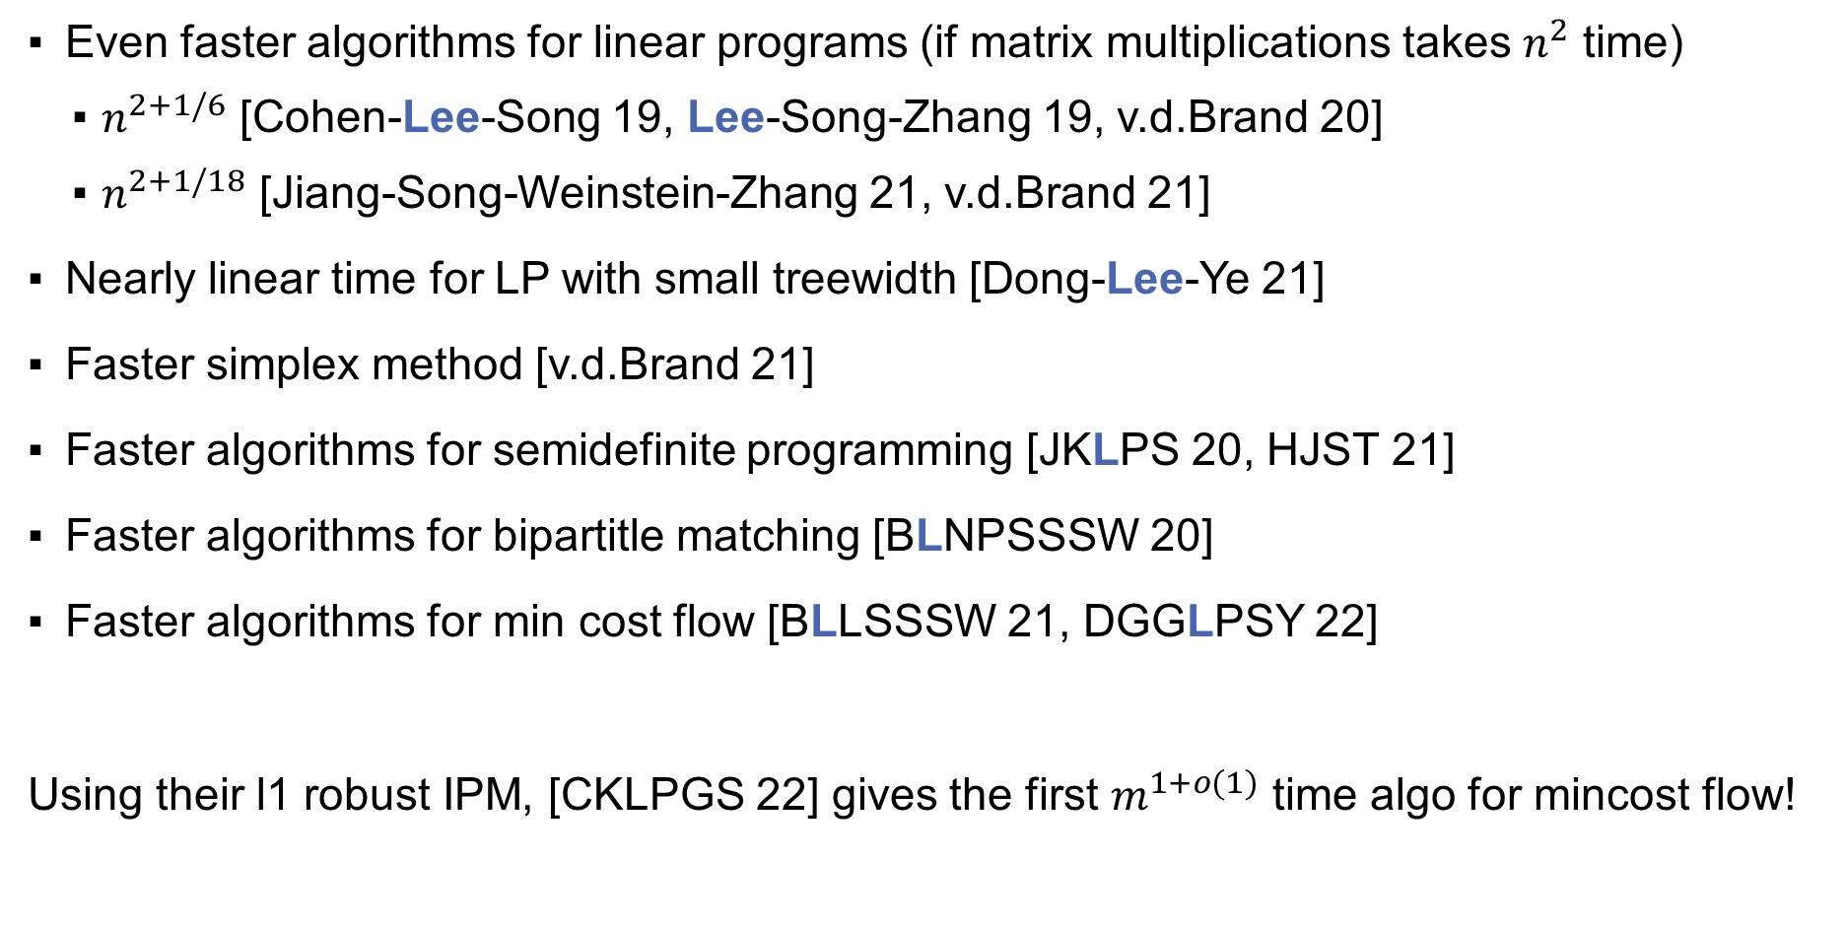
Other Applications / Related Work
Even faster algorithms for linear programs (if matrix multiplications takes $n^{2}$ time)
$n^{2+1/6}$ [Cohen-Lee-Song 19, Lee-Song-Zhang 19, v.d.Brand 20]
$n^{2+1/18}$ [Jiang-Song-Weinstein-Zhang 21, v.d.Brand 21]
Nearly linear time for LP with small treewidth [Dong-Lee-Ye 21]
Faster simplex method [v.d.Brand 21]
Faster algorithms for semidefinite programming [JKLPS 20, HJST 21]
Faster algorithms for bipartitle matching [BLNPSSSW 20]
Faster algorithms for min cost flow [BLLSSSW 21, DGGLPSY 22]
Using their l1 robust IPM, [CKLPGS 22] gives the first $m^{1+o(1)}$ time algo for mincost flow!

Slide 17
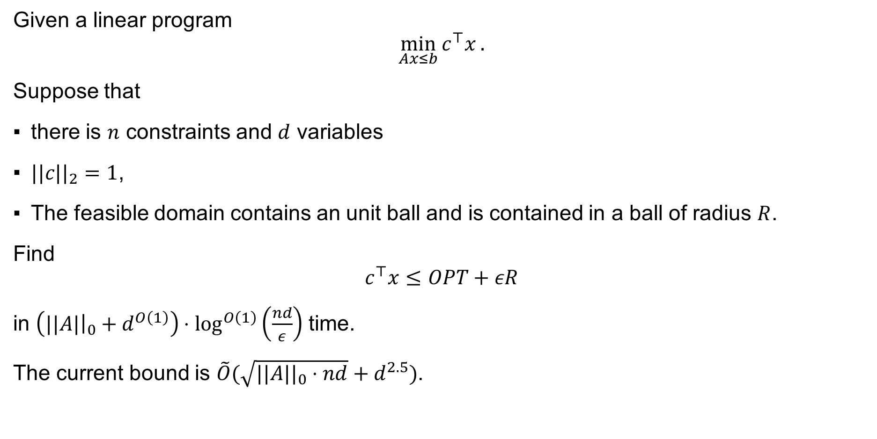
Open Problem: LP in input sparsity time
Given a linear program
$$\min_{Ax≤b}{c^{⊤}x}.$$
Suppose that
there is $n$ constraints and $d$ variables
$||c||_{2}=1$,
The feasible domain contains an unit ball and is contained in a ball of radius $R$.
Find
$$c^{⊤}x≤OPT+εR$$
in $\left(||A|{\left.​\right|}_{0}+d^{O\left(1\right)}\right)⋅\log^{O\left(1\right)}\left(\frac{nd}{ε}\right)$ time.
The current bound is $\tilde{O}(\sqrt{||A||_{0}⋅nd}+d^{2.5})$.

