Slide 2
Semi Devices

Slide 3
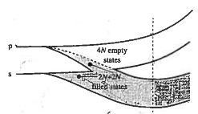






N Isolated Si atoms
CrystallineSi N-atoms
E
n=3
E
4N allowed states
(conduction band)
p
s
Electron energy
6N p-states total
Electron energy
Forbidden states
2N s-states total
4N allowed states
(valence band)
(4N electrons total)
E
Mostly
empty
$$E_{top}$$
$$E_{c}$$
Electron energy
$$E_{G}$$
Electron energy
$$E_{v}$$
Mostly
filled
$$E_{bot}$$
decreasing
atom spacing
$$x$$
Fig-semi-dev-band.png
R0 02/19/25
Isolated Si atoms
Si lattice spacing

Slide 4
Passives

Slide 5






$$V_{R}$$
$$L$$
$$W$$
$$Δx$$
$$h$$
$$Δv$$
Fig-passives-res.png R0 01/08/25

Slide 6






$$+Q$$
$$V_{1}$$
$$A$$
$$\vec{E}$$
$$−Q$$
$$V_{2}$$
Fig-passives-cap.png R0 01/09/25

Slide 7









$$Gaussian Surface$$
$$+Q$$
+
+
+
+
+
+
+
+
+
+
$$V_{1}$$
$${\vec{E}}_{fringe}$$
$$\vec{E}$$
$$d$$
$$−Q$$
_
_
_
_
_
_
_
_
_
_
$$V_{2}$$
$$Area=A$$
Fig-passives-cap.png R1 01/10/25

Slide 8






$$Gaussian Surface$$
$$+Q$$
+
+
+
+
+
+
+
+
+
+
_
_
_
_
_
$$Dielectric$$
+
+
$$\vec{E}$$
+
+
+
$$d$$
$$−Q$$
_
_
_
_
_
_
_
_
_
_
Fig-passives-cap2.png R0 01/10/25

Slide 9














$$\vec{B}$$
-
$$I$$
$$I$$
-
+
$$V=\frac{dψ}{dt}$$
$$s$$
$$V=\frac{dψ}{dt}$$
+
$$I$$
$$I$$
-
-
$$I$$
$$L$$
$$V=L\frac{dI}{dt}$$
$$V=L\frac{dI}{dt}$$
$$s$$
+
+
$$I$$
Fig-passives-ind.png R0 01/09/25

Slide 10







$$V=\frac{dψ_{2}}{dt}$$
$$s_{2}$$
$$=M_{12}\frac{dI_{1}}{dt}$$
$$\vec{B_{12}}$$
$$I_{1}$$
$$s_{1}$$
$$I_{1}$$
Fig-passives-ind2.png R0 01/09/25

Slide 11
Linear Ckts

Slide 12
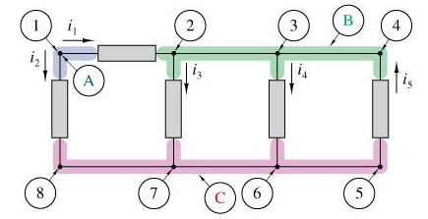
Fig-circuits-KCL.png R0 01/12/25

Slide 13
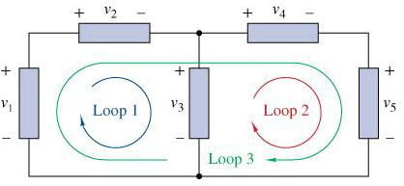
Fig-circuits-KVL.png R0 01/12/25

Slide 14
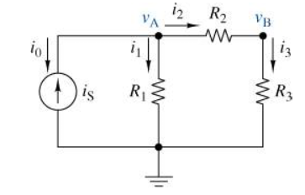
Fig-circuits-nodev.png R0 01/12/25

Slide 15
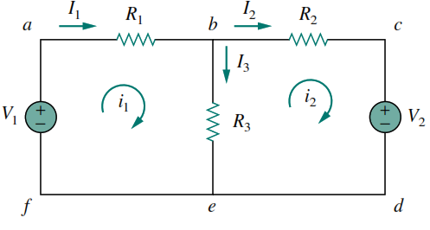
Fig-circuits-meshi.png R0 01/14/25

Slide 16
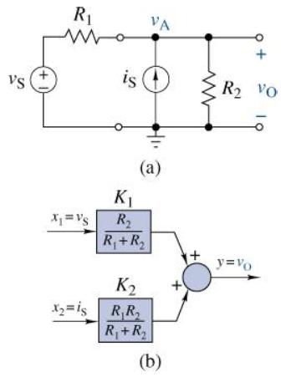
Fig-circuits-sposition.png R0 01/18/25

Slide 17
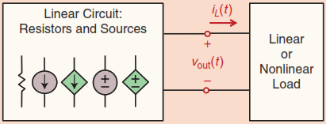
Fig-circuits-linckt.png R0 01/19/25
A linear circuit with resistors and both dependent and independent sources is connected to a linear or non-linear load

Slide 18
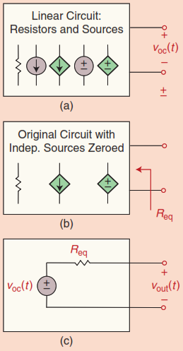
Fig-circuits-thevenin.png R0 01/19/25
Thevenin Equivalent: (a) Disconnect the load and measure the open-circuit voltage. (b) Zero all independent sources to find the equivalent resistance. (c) The Thévenin circuit combines the open-circuit voltage in series with the equivalent resistance.

Slide 19
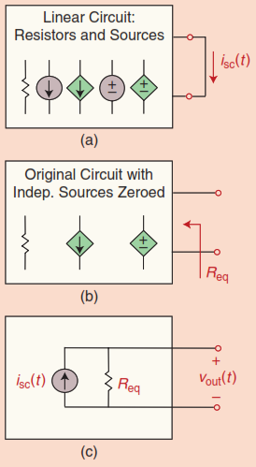
Fig-circuits-norton.png R0 01/19/25
(a) To determine the short circuit current at the output, we short the load and measure its current. (b) To determine the equivalent resistance, we zero all the independent sources inside the block. (c) The Norton equivalent circuit is formed by putting the short circuit current in parallel with the equivalent resistance, as determined in (a) and (b).

Slide 20
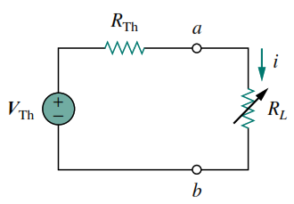
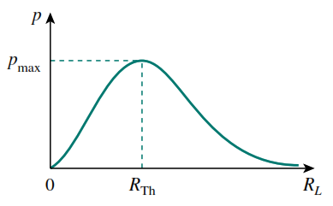
(b)
(a)
Fig-circuits-maxpower.png R0 01/21/25
(a) Circuit used for max power transfer analysis. (b) Sketch of power delivered to the load as a function of $R_L$

Slide 21
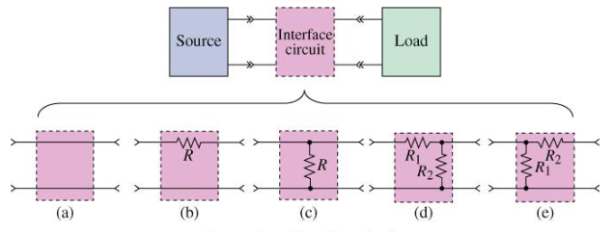
Fig-circuits-interface.png R0 01/22/25
A general interface circuit and a few examples: (a) Simple pass-through (often omitted), (b) series resistor, (c) parallel resistor, (d) L-pad left, (e) L-pad right

