Slide 1
IC Engineering 1
Figures

Slide 2
Semi Devices

Slide 3
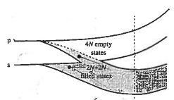






Caption: Conceptual development of the energy band model starting with N isolated Si atoms on the top left, then showing the split bands for Crystalline SI N-atoms and concluding, at bottom right, with the popular version of the energy band model.
N Isolated Si atoms
CrystallineSi N-atoms
E
n=3
E
4N allowed states
(conduction band)
p
s
Electron energy
6N p-states total
Electron energy
Forbidden states
2N s-states total
4N allowed states
(valence band)
(4N electrons total)
E
Mostly
empty
$$E_{top}$$
$$E_{c}$$
Electron energy
$$E_{G}$$
Electron energy
$$E_{v}$$
Mostly
filled
$$E_{bot}$$
Fig-semi-dev-band.png
R0 02/19/25
decreasing
atom spacing
$$x$$
Isolated Si atoms
Si lattice spacing
Ref: Fig 2.5 p-28 Pierret

Slide 4











Few electrons
$$E_{C}$$
Wide
$$E_{G}\sim 8 eV (S_{i}O_{2})$$
$$E_{G}\sim 5 eV (Diamond)$$
$$E_{V}$$
(a) Insulator
Thermal excitation moderately easy
$$E_{C}$$
$$E_{G}≈1.42 eV (GaAs)$$
Caption: Illustration of the distinction between (a) insulator, (b) semiconductor, and (c ) metal.
$$E_{G}≈1.12 eV (Si)$$
$$E_{V}$$
$$E_{G}≈0.66 eV (Ge)$$
(Room temperature)
(b) Semiconductor
Very
narrow
$$E_{C}$$
$$E_{V}$$
or
Fig-semi-dev-class.png
R0 02/19/25
(c) Metal
Ref: Fig 2.8 p-31 Pierret

Slide 5
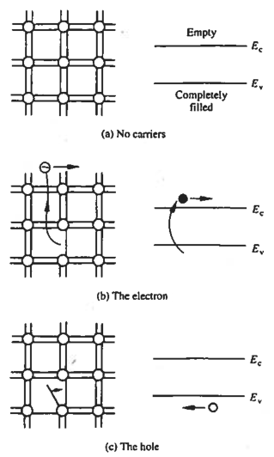
Caption: Visualization of carriers using the bonding model (left) and the energy band model (right) (a) No-carrier situation; (b) visualization of an electron; (c ) visualization of a hole.
Fig-semi-dev-carrierviz.png
R0 02/19/25
Ref: Fig 2.7 p-30 Pierret

Slide 6
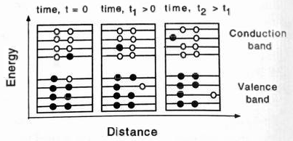
![Electrons move in an electric field. The band diagrams are like figure @fig-semi-dev-class, but with an expanded energy scale showing closely packed levels, each accommodating two electrons. Solid circles show electrons in a level; open circles indicate available levels.](figures/fig-semi-dev-carrier-efield){#fig-semi-dev-carrier-efield}
R0 02/20/25
Ref: Fig 1.2 p-6 Shur

Slide 7
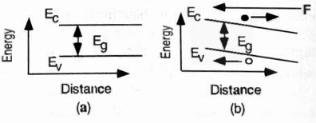
![Energy band diagrams for a uniform semiconductor sample in (a) zero and (b) non-zero electric field.](figures/fig-semi-dev-band-efield){#fig-semi-dev-band-efield}
R0 02/20/25
Ref: Fig 1.3 p-7 Shur

Slide 8
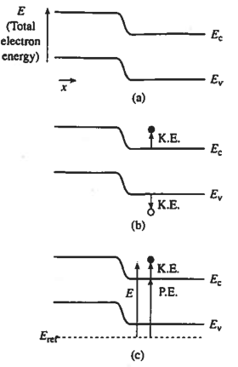
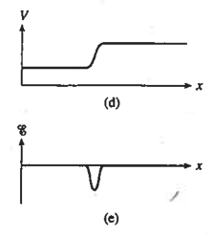
![Relationship between band bending and electrostatic variables in a semiconductor: (a) energy band diagram showing band bending; (b) identification of carrier kinetic energies; (c) electron potential energy; (d) electrostatic potential; (e) electric field vs. position from part (a).](figures/fig-semi-dev-band-electrostatic.png){#fig-semi-dev-band-electrostatic}
R0 02/20/25
Ref: Fig 3.10 p-90 Pierret

Slide 9
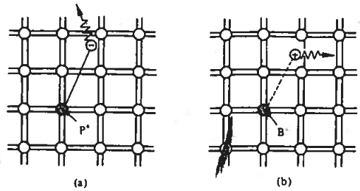
![Visualization of (a) donor and (b) acceptor actions via the bonding model. In (a), _Column V_ element P replaces a Si atom; in (b), Column III element B replaces a Si atom.](figures/fig-semi-dev-viz-doping){#fig-semi-dev-viz-doping}
R0 02/22/25
Ref: Fig 2.10 p-36 Pierret

Slide 10
Passives

Slide 11






$$V_{R}$$
$$L$$
$$W$$
$$Δx$$
$$h$$
$$Δv$$
Fig-passives-res.png R0 01/08/25

Slide 12






$$+Q$$
$$V_{1}$$
$$A$$
$$\vec{E}$$
$$−Q$$
$$V_{2}$$
Fig-passives-cap.png R0 01/09/25

Slide 13









$$Gaussian Surface$$
$$+Q$$
+
+
+
+
+
+
+
+
+
+
$$V_{1}$$
$${\vec{E}}_{fringe}$$
$$\vec{E}$$
$$d$$
$$−Q$$
_
_
_
_
_
_
_
_
_
_
$$V_{2}$$
$$Area=A$$
Fig-passives-cap.png R1 01/10/25

Slide 14






$$Gaussian Surface$$
$$+Q$$
+
+
+
+
+
+
+
+
+
+
_
_
_
_
_
$$Dielectric$$
+
+
$$\vec{E}$$
+
+
+
$$d$$
$$−Q$$
_
_
_
_
_
_
_
_
_
_
Fig-passives-cap2.png R0 01/10/25

Slide 15














$$\vec{B}$$
-
$$I$$
$$I$$
-
+
$$V=\frac{dψ}{dt}$$
$$s$$
$$V=\frac{dψ}{dt}$$
+
$$I$$
$$I$$
-
-
$$I$$
$$L$$
$$V=L\frac{dI}{dt}$$
$$V=L\frac{dI}{dt}$$
$$s$$
+
+
$$I$$
Fig-passives-ind.png R0 01/09/25

Slide 16







$$V=\frac{dψ_{2}}{dt}$$
$$s_{2}$$
$$=M_{12}\frac{dI_{1}}{dt}$$
$$\vec{B_{12}}$$
$$I_{1}$$
$$s_{1}$$
$$I_{1}$$
Fig-passives-ind2.png R0 01/09/25

Slide 17
Linear Ckts

Slide 18
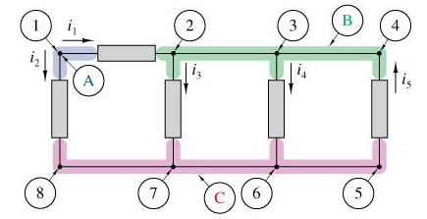
Fig-circuits-KCL.png R0 01/12/25

Slide 19
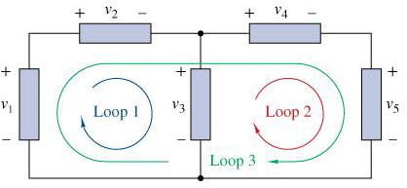
Fig-circuits-KVL.png R0 01/12/25

Slide 20
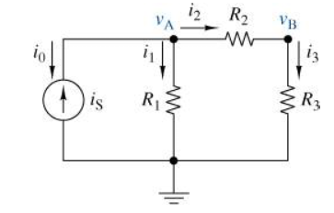
Fig-circuits-nodev.png R0 01/12/25

Slide 21
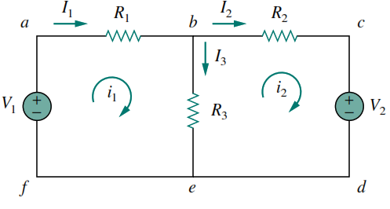
Fig-circuits-meshi.png R0 01/14/25

Slide 22
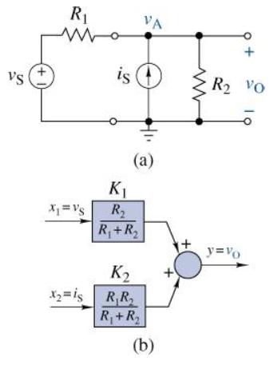
Fig-circuits-sposition.png R0 01/18/25

Slide 23
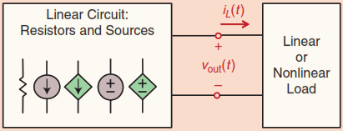
Fig-circuits-linckt.png R0 01/19/25
A linear circuit with resistors and both dependent and independent sources is connected to a linear or non-linear load

Slide 24
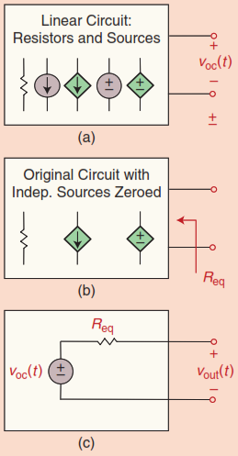
Fig-circuits-thevenin.png R0 01/19/25
Thevenin Equivalent: (a) Disconnect the load and measure the open-circuit voltage. (b) Zero all independent sources to find the equivalent resistance. (c) The Thévenin circuit combines the open-circuit voltage in series with the equivalent resistance.

Slide 25
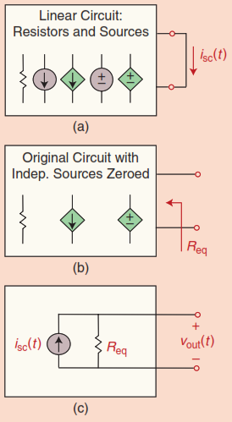
Fig-circuits-norton.png R0 01/19/25
(a) To determine the short circuit current at the output, we short the load and measure its current. (b) To determine the equivalent resistance, we zero all the independent sources inside the block. (c) The Norton equivalent circuit is formed by putting the short circuit current in parallel with the equivalent resistance, as determined in (a) and (b).

Slide 26
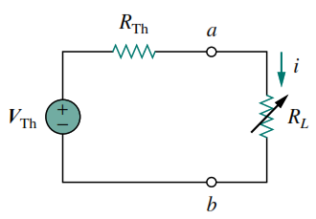
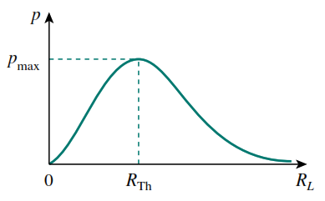
(b)
(a)
Fig-circuits-maxpower.png R0 01/21/25
(a) Circuit used for max power transfer analysis. (b) Sketch of power delivered to the load as a function of $R_L$

Slide 27
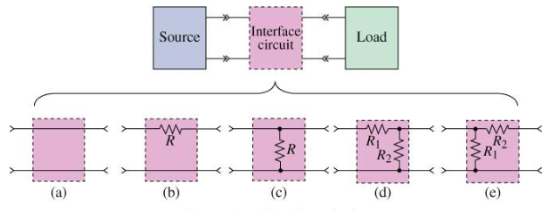
Fig-circuits-interface.png R0 01/22/25
A general interface circuit and a few examples: (a) Simple pass-through (often omitted), (b) series resistor, (c) parallel resistor, (d) L-pad left, (e) L-pad right

