Slide 1
IC Engineering 1
Figures

Slide 2
Semi Devices
Pn-junction

Slide 3
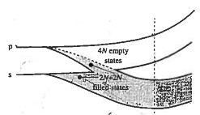






Caption: Conceptual development of the energy band model starting with N isolated Si atoms on the top left, then showing the split bands for Crystalline SI N-atoms and concluding, at bottom right, with the popular version of the energy band model.
N Isolated Si atoms
CrystallineSi N-atoms
E
n=3
E
4N allowed states
(conduction band)
p
s
Electron energy
6N p-states total
Electron energy
Forbidden states
2N s-states total
4N allowed states
(valence band)
(4N electrons total)
E
Mostly
empty
$$E_{top}$$
$$E_{c}$$
Electron energy
$$E_{G}$$
Electron energy
$$E_{v}$$
Mostly
filled
$$E_{bot}$$
Fig-semi-dev-band.png
R0 02/19/25
decreasing
atom spacing
$$x$$
Isolated Si atoms
Si lattice spacing
Ref: Fig 2.5 p-28 Pierret

Slide 4






Caption: Conceptual development of the energy band model starting with N isolated Si atoms on the top left, then showing the split bands for Crystalline SI N-atoms and concluding, at bottom right, with the popular version of the energy band model.
N Isolated Si atoms
CrystallineSi N-atoms
E
n=3
E
4N allowed states
(conduction band)
p
s
Electron energy
6N p-states total
Electron energy
Forbidden states
2N s-states total
4N allowed states
(valence band)
(4N electrons total)
E
Mostly
empty
$$E_{top}$$
4N empty states
$$E_{c}$$
Electron energy
$$E_{G}$$
Electron energy
2N + 2N
filled states
$$E_{v}$$
Mostly
filled
$$E_{bot}$$
Fig-semi-dev-band.png
R1 03/12/25
decreasing
atom spacing
$$x$$
Isolated Si atoms
Si lattice spacing
Ref: Fig 2.5 p-28 Pierret

Slide 5











Few electrons
$$E_{C}$$
Wide
$$E_{G}\sim 8 eV (S_{i}O_{2})$$
$$E_{G}\sim 5 eV (Diamond)$$
$$E_{V}$$
(a) Insulator
Thermal excitation moderately easy
$$E_{C}$$
$$E_{G}≈1.42 eV (GaAs)$$
Caption: Illustration of the distinction between (a) insulator, (b) semiconductor, and (c ) metal.
$$E_{G}≈1.12 eV (Si)$$
$$E_{V}$$
$$E_{G}≈0.66 eV (Ge)$$
(Room temperature)
(b) Semiconductor
Very
narrow
$$E_{C}$$
$$E_{V}$$
or
Fig-semi-dev-class.png
R0 02/19/25
(c) Metal
Ref: Fig 2.8 p-31 Pierret

Slide 6
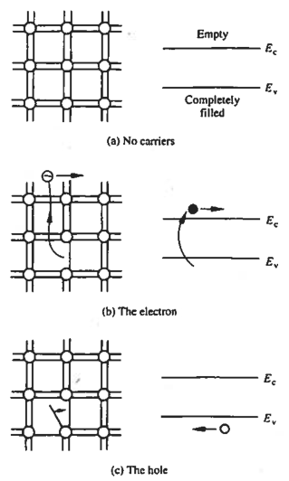
Caption: Visualization of carriers using the bonding model (left) and the energy band model (right) (a) No-carrier situation; (b) visualization of an electron; (c ) visualization of a hole.
Fig-semi-dev-carrierviz.png
R0 02/19/25
Ref: Fig 2.7 p-30 Pierret

Slide 7
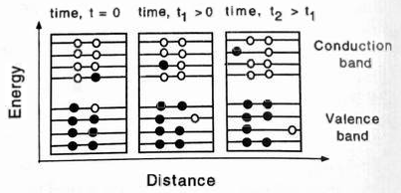
![Electrons move in an electric field. The band diagrams are like figure @fig-semi-dev-class, but with an expanded energy scale showing closely packed levels, each accommodating two electrons. Solid circles show electrons in a level; open circles indicate available levels.](figures/fig-semi-dev-carrier-efield){#fig-semi-dev-carrier-efield}
R0 02/20/25
Ref: Fig 1.2 p-6 Shur

Slide 8
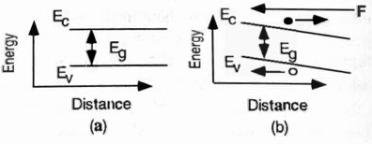
![Energy band diagrams for a uniform semiconductor sample in (a) zero and (b) non-zero electric field.](figures/fig-semi-dev-band-efield){#fig-semi-dev-band-efield}
R0 02/20/25
Ref: Fig 1.3 p-7 Shur

Slide 9
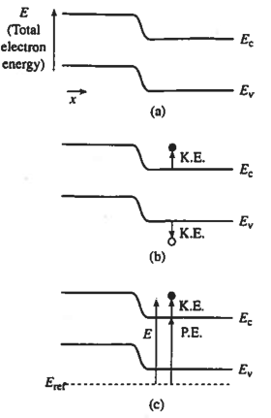
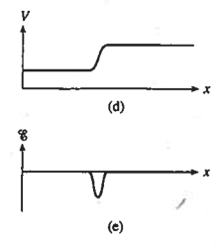
![Relationship between band bending and electrostatic variables in a semiconductor: (a) energy band diagram showing band bending; (b) identification of carrier kinetic energies; (c) electron potential energy; (d) electrostatic potential; (e) electric field vs. position from part (a).](figures/fig-semi-dev-band-electrostatic.png){#fig-semi-dev-band-electrostatic}
R0 02/20/25
Ref: Fig 3.10 p-90 Pierret

Slide 10
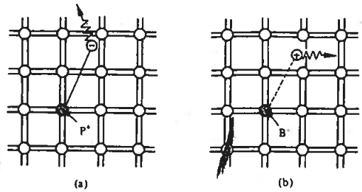
![Visualization of (a) donor and (b) acceptor actions via the bonding model. In (a), _Column V_ element P replaces a Si atom; in (b), Column III element B replaces a Si atom.](figures/fig-semi-dev-viz-doping){#fig-semi-dev-viz-doping}
R0 02/22/25
Ref: Fig 2.10 p-36 Pierret

Slide 11
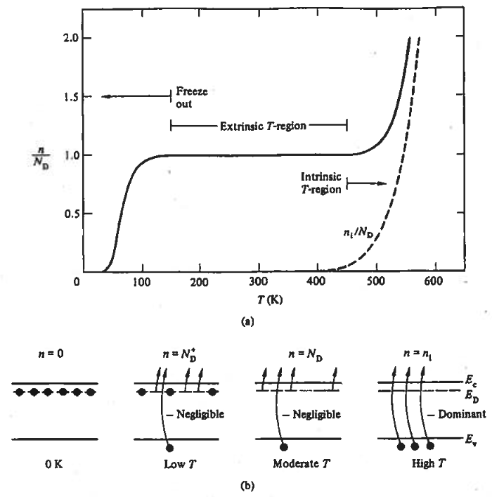
![(a) Typical temperature dependence of majority-carrier concentration in a phosphorus-doped semiconductor. The plot includes $n_i/N_D$ vs. T (dashed line) for comparison. (b) Qualitative explanation of the concentration-temperature relationship shown in (a).](figures/fig-semi-dev-carrier-vs-t.png){#fig-semi-dev-carrier-vs-t}
R0 02/23/25
Ref: Fig 2.22 p-66 Pierret

Slide 12
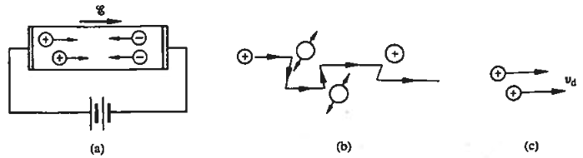
![Visualization of carrier drift: (a) motion of carriers within a biased semiconductor bar; (b) _drifting_ hole on a microscopic or atomic scale; (c) carrier drift on a macroscopic scale.](figures/fig-sem-dev-carrier-drift.png){#fig-sem-dev-carrier-drift}
R0 02/23/25
Ref: Fig 3.1 p-76 Pierret

Slide 13
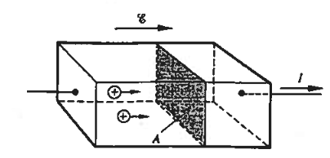
![Expanded view of a biased $p$-type semiconductor bar of cross-sectional area $A$.](figures/fig-semi-dev-current-drift.png){#fig-semi-dev-current-drift}
R0 02/23/25
Ref: Fig 3.3 p-77 Pierret

Slide 14
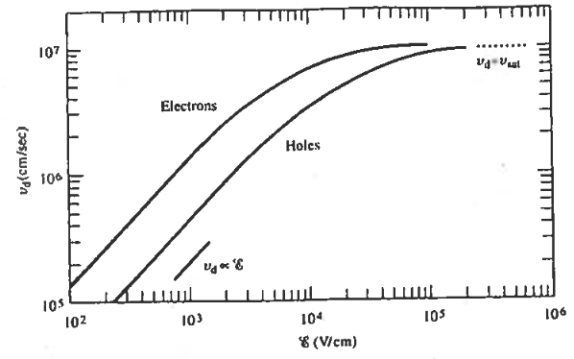
![Measured carrier drift velocity within ultrapure silicon kept at ambient temperature, analyzing its relationship with the imposed electric field.](figures/fig-semi-dev-drift-vs-efield.png){#fig-semi-dev-drift-vs-efield}
R0 02/23/25
Ref: Fig 3.4p-78 Pierret

Slide 15
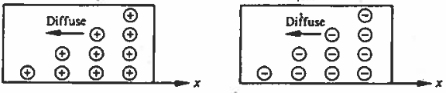


![Visualization of electron and hole diffusion in a macroscopic scale](figures/fig-semi-dev-diffusion.png){#fig-semi-dev-diffusion}
$$J_{P |diff}$$
$$J_{N |diff}$$
R0 03/12/25
Ref: Fig 3.12 p-95 Pierret

Slide 16
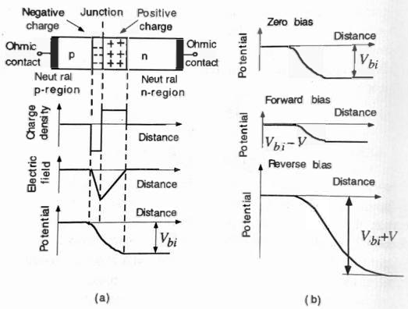
![Distribution of charge, electric field, and potential for a $p-n$ junction diode (a) when unbiased, and (b) contrast of potential distributions under zero, forward, and reverse bias conditions.](figures/fig-semi-dev-pnjunc.png){#fig-semi-dev-pnjunc}
R0 03/17/25
Ref: Fig 1.4 p-10 Shur

Slide 17
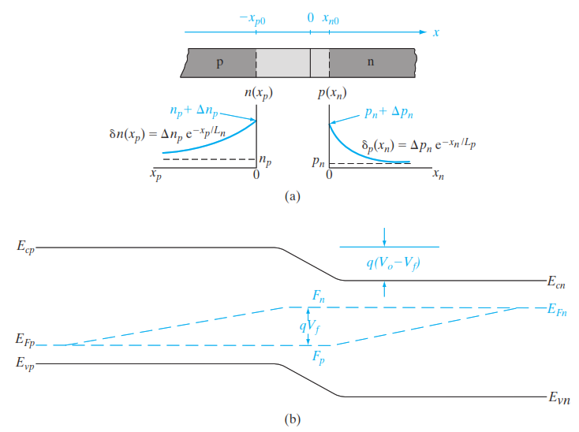
![Forward-biased junction: (a) distribution of minority carriers on both sides of the transition region, alongside the definitions for distances $x_n$ and $x_p$ measured from the edges of the transition zone; (b) positional variation of the quasi-Fermi levels](figures/fig-semi-dev-pn-current.png){#fig-semi-dev-pn-cuurent}
R0 03/18/25
Ref: Fig 5.15 p-191 Streetman

Slide 18
Semi Devices
BJT

Slide 19
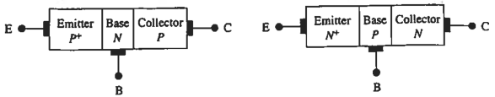
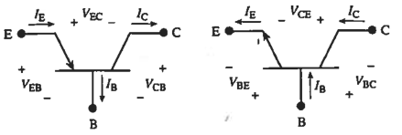
![Schematic depiction and circuit symbols for (a) _npn_ and (b) _pnp_ BJTs illustrating on the top the device areas, terminal labels, and on the bottom the d.c. terminal currents, voltages, and reference polarities.](figures/fig-semi-dev-bjt-sch){#fig-semi-dev-bjt-sch}
(a) pnp
(a) npn
R0 04/16/25
Ref: Fig 10.2 p-372 Pierret

Slide 20
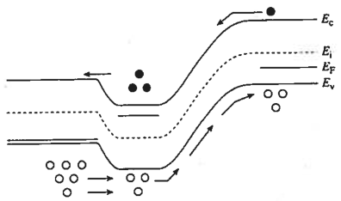
![Bandgap visualization of carrier activity in a pnp BJT in active mode. ](figures/fig-semi-dev-bjt-iband){#fig-semi-dev-bjt-iband}
R0 04/17/25
Ref: Fig 10.8 p-380 Pierret

Slide 21
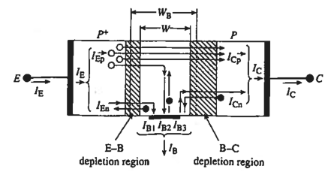
![Spatial visualization of the diffusion currents flowing I](figures/fig-semi-dev-bjt-curr){#fig-semi-dev-bjt-curr}
R0 04/16/25
Ref: Fig 10.9 p-381 Pierret

Slide 22
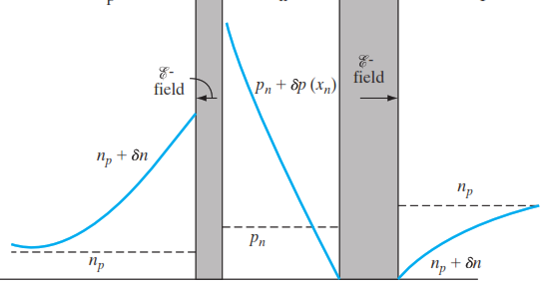






![Excess carrier distribution in the base for active-region operation.](figures/fig-semi-dev-bjt-base){#fig-semi-dev-bjt-base}
E-B space charge region
B-C space charge region
Emitter (p)
Base (n)
Collector (p)
$p_{n}(x)$
$$p_{n0}$$
$$x$$
R0 04/17/25
$$0$$
$$W_{B}$$
Ref: Fig 7-7 p-362 Streetman
Ref: Fig 7.7 p-253 Gray-Searles

Slide 23
Semi Devices
MOS

Slide 24
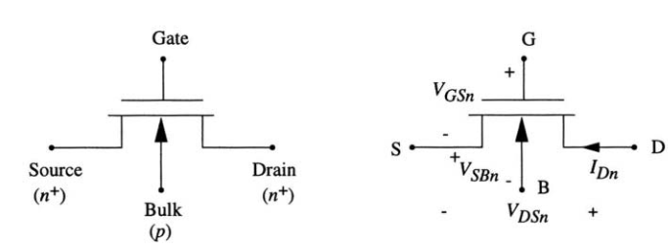
![nMOSFET (nMOS) circuit symbol.](figures/fig-semi-dev-mos-sch){#fig-semi-dev-mos-sch}
(a) nMOS symbol
(b) Current voltage conventions
R0 04/20/25
Ref: Fig 1-1 p-1 Uyemera

Slide 25
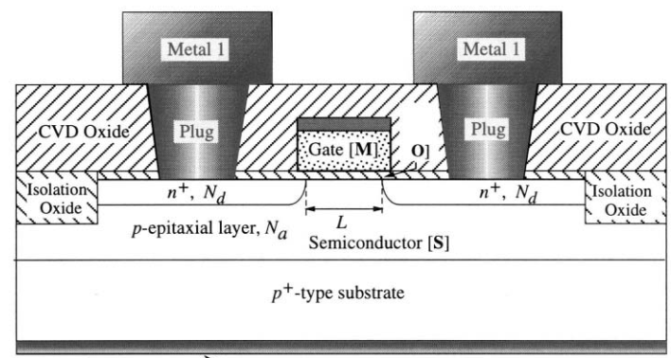
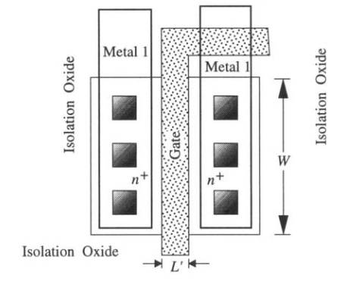
![(a) nMOSFET (nMOS) cross-section view. (b) Top View] (figures/fig-semi-dev-mos-csec){#fig-semi-dev-mos-csec}
Metal-1
Metal-1
Contact
Contact
Bulk/substrate connection
(a) nMOS cross-section
(b) nMOS top-view
R0 04/20/25
Ref: Fig 1-2 p-2 Uyemera

Slide 26
Passives

Slide 27






$$V_{R}$$
$$L$$
$$W$$
$$Δx$$
$$h$$
$$Δv$$
Fig-passives-res.png R0 01/08/25

Slide 28






$$+Q$$
$$V_{1}$$
$$A$$
$$\vec{E}$$
$$−Q$$
$$V_{2}$$
Fig-passives-cap.png R0 01/09/25

Slide 29









$$Gaussian Surface$$
$$+Q$$
+
+
+
+
+
+
+
+
+
+
$$V_{1}$$
$${\vec{E}}_{fringe}$$
$$\vec{E}$$
$$d$$
$$−Q$$
_
_
_
_
_
_
_
_
_
_
$$V_{2}$$
$$Area=A$$
Fig-passives-cap.png R1 01/10/25

Slide 30






$$Gaussian Surface$$
$$+Q$$
+
+
+
+
+
+
+
+
+
+
_
_
_
_
_
$$Dielectric$$
+
+
$$\vec{E}$$
+
+
+
$$d$$
$$−Q$$
_
_
_
_
_
_
_
_
_
_
Fig-passives-cap2.png R0 01/10/25

Slide 31














$$\vec{B}$$
-
$$I$$
$$I$$
-
+
$$V=\frac{dψ}{dt}$$
$$s$$
$$V=\frac{dψ}{dt}$$
+
$$I$$
$$I$$
-
-
$$I$$
$$L$$
$$V=L\frac{dI}{dt}$$
$$V=L\frac{dI}{dt}$$
$$s$$
+
+
$$I$$
Fig-passives-ind.png R0 01/09/25

Slide 32







$$V=\frac{dψ_{2}}{dt}$$
$$s_{2}$$
$$=M_{12}\frac{dI_{1}}{dt}$$
$$\vec{B_{12}}$$
$$I_{1}$$
$$s_{1}$$
$$I_{1}$$
Fig-passives-ind2.png R0 01/09/25

Slide 33
Linear Ckts

Slide 34
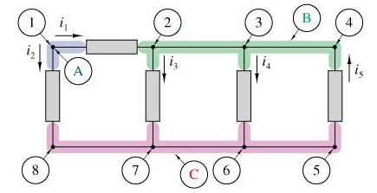
Fig-circuits-KCL.png R0 01/12/25

Slide 35
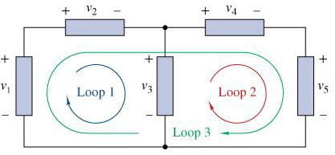
Fig-circuits-KVL.png R0 01/12/25

Slide 36
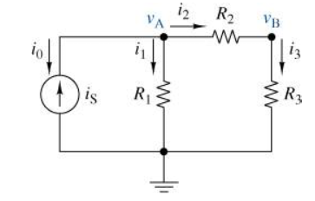
Fig-circuits-nodev.png R0 01/12/25

Slide 37
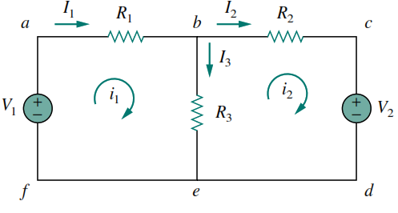
Fig-circuits-meshi.png R0 01/14/25

Slide 38
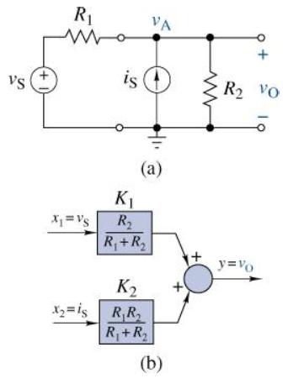
Fig-circuits-sposition.png R0 01/18/25

Slide 39
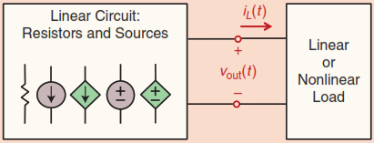
Fig-circuits-linckt.png R0 01/19/25
A linear circuit with resistors and both dependent and independent sources is connected to a linear or non-linear load

Slide 40
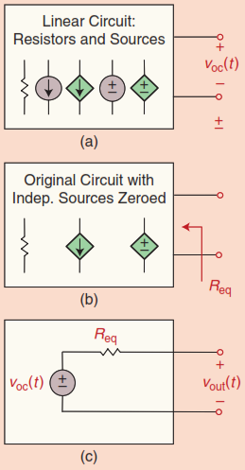
Fig-circuits-thevenin.png R0 01/19/25
Thevenin Equivalent: (a) Disconnect the load and measure the open-circuit voltage. (b) Zero all independent sources to find the equivalent resistance. (c) The Thévenin circuit combines the open-circuit voltage in series with the equivalent resistance.

Slide 41
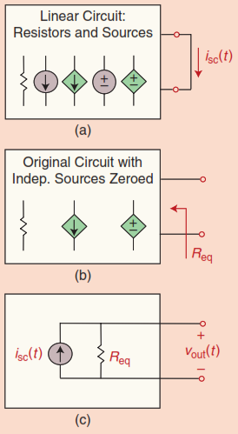
Fig-circuits-norton.png R0 01/19/25
(a) To determine the short circuit current at the output, we short the load and measure its current. (b) To determine the equivalent resistance, we zero all the independent sources inside the block. (c) The Norton equivalent circuit is formed by putting the short circuit current in parallel with the equivalent resistance, as determined in (a) and (b).

Slide 42
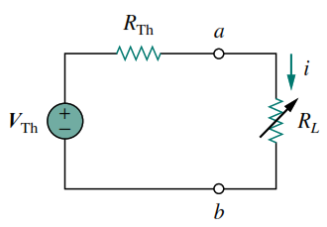
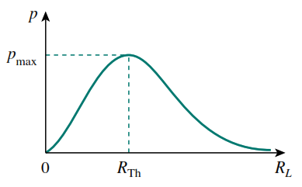
(b)
(a)
Fig-circuits-maxpower.png R0 01/21/25
(a) Circuit used for max power transfer analysis. (b) Sketch of power delivered to the load as a function of $R_L$

Slide 43
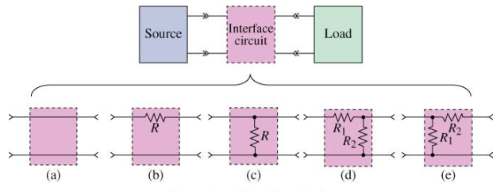
Fig-circuits-interface.png R0 01/22/25
A general interface circuit and a few examples: (a) Simple pass-through (often omitted), (b) series resistor, (c) parallel resistor, (d) L-pad left, (e) L-pad right

Slide 44
RC Ckts

Slide 45
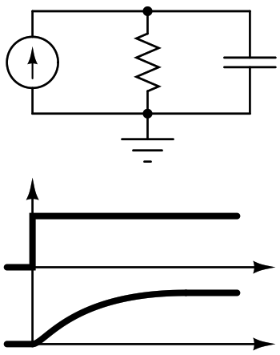









+
$$i(t)$$
$$v_{C}(t)$$
$$R$$
$$C$$
-
$$i(t)$$
$$I_{0}$$
$$t$$
$$I_{0}R$$
$$v_{C}(t)$$
Fig-rc-step.png R0 06/17/25

