Slide 1
Radio (BLE/WiFi/LoRa)
Digital Peripherals
ANT
SPI
DIO1
UART
I2C
DIO2
RST
RMU/POR
Core & Memory
Port Mapper
Processor
(RISC-V)
Timer
DIO3
Power Management
<24V
Switching Converter
PWM
DIO4
VBAT
AHB
APB
3.3V
3.3V
Bridge
VREG1
SRAM
1k 32b
Linear Regulators
Analog Peripherals
AIO1
1.8V
1.8V
VREG2
Bandgap
AIO2
Temp Sensor
Clock Management
AIO3
XTL1
ADC
XTAL OSC
RING OSC
PLL
XTL2
MUX
AIO4
ANALOG
DIGITAL
MIXED

Slide 2
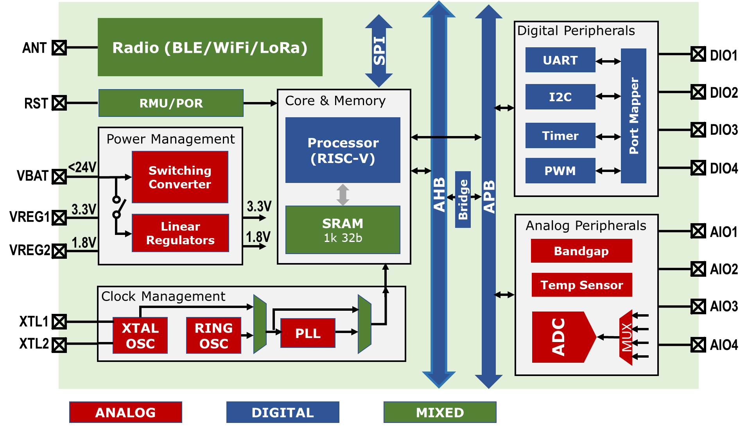

Slide 3
Old Stuff

Slide 4
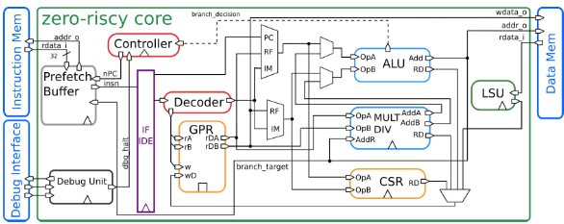
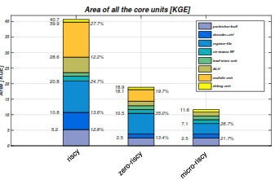
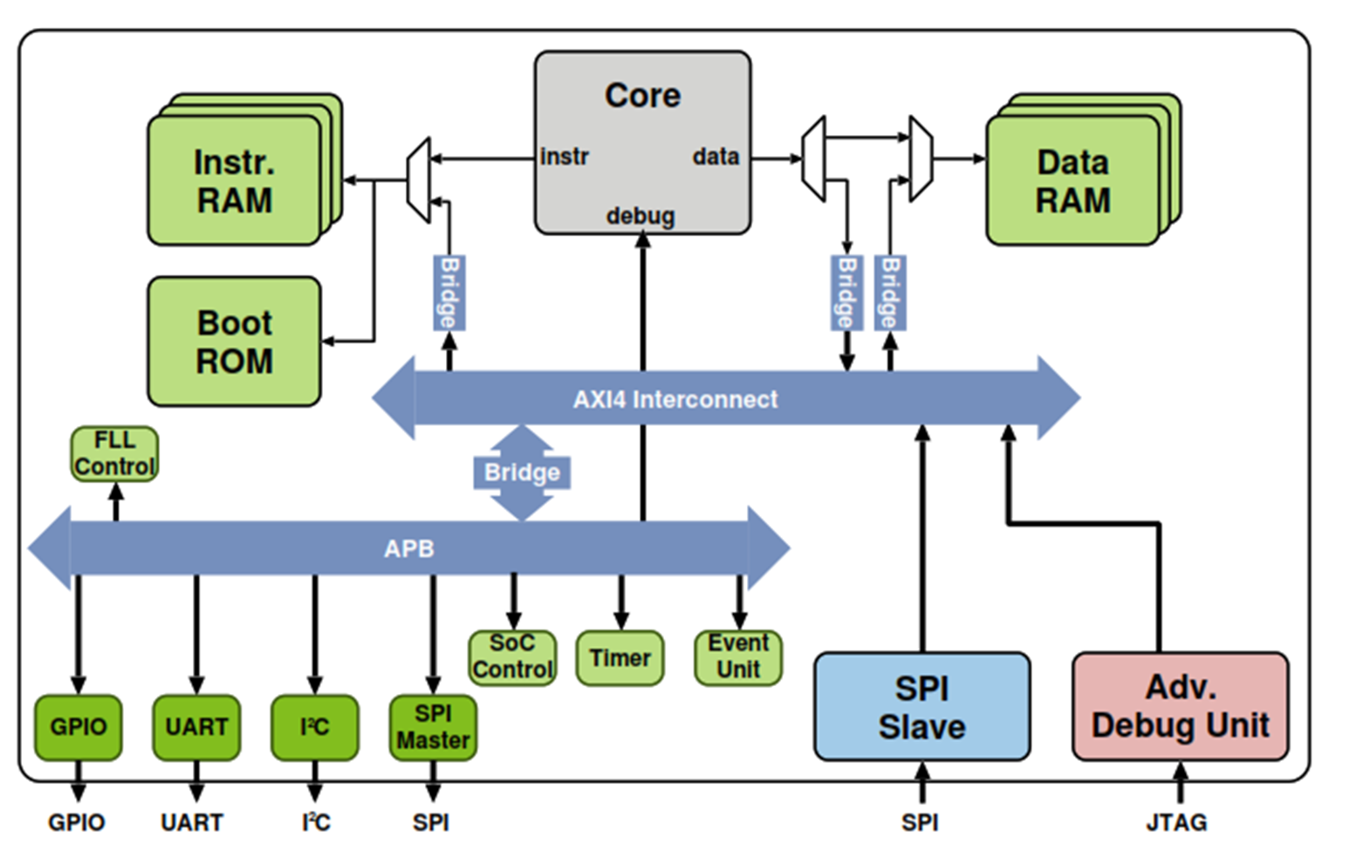
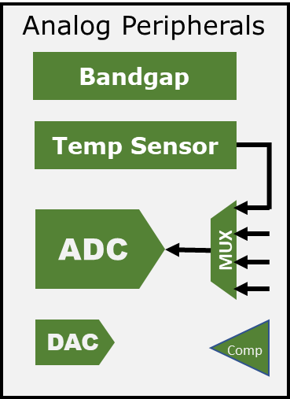
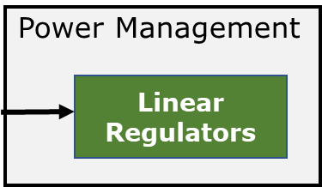
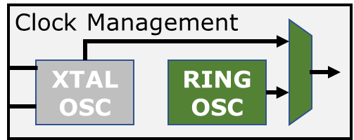
SoC
PULPino
RMU/POR
Zero-RISCY
SAR

Slide 5
Analog Peripherals
Power Management
Bandgap
Linear Regulators
Temp Sensor
ADC
MUX
RMU/POR
DAC
Comp
Clock Management
XTAL OSC
RING OSC

Slide 6
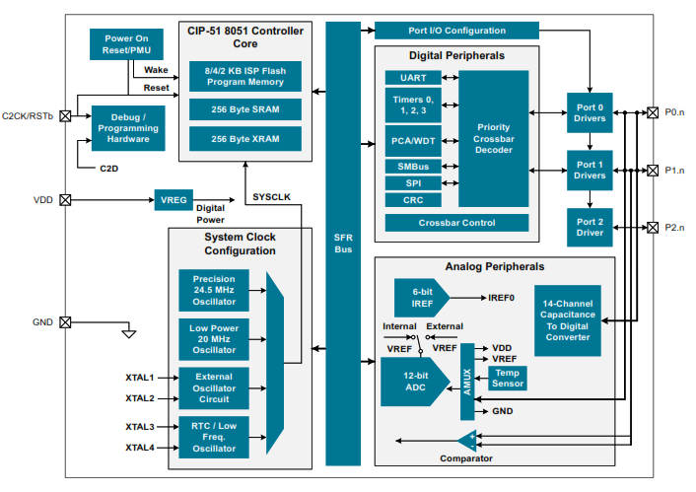
Silab’s 8-b Sleepy Bee Microcontroller

Slide 7
NB-IoT Radio
Digital Peripherals
ANT
SPI
DIO1
UART
I2C
DIO2
RST
RMU/POR
Core & Memory
Port Mapper
Pico RISC-V
Timer
DIO3
Power Management
<24V
SCAP DC-DC Converter
PWM
DIO4
VBAT
AHB
APB
3.3V
3.3V
Bridge
VREG1
SRAM
1k 32b
Linear Regulators
Analog Peripherals
AIO1
1.8V
1.8V
VREG2
Bandgap
AIO2
Temp Sensor
Clock Management
AIO3
XTL1
ADC
XTAL OSC
RING OSC
PLL
XTL2
MUX
AIO4
PHASE-I
FUTURE

Slide 8

PULPino Architecture

Slide 9
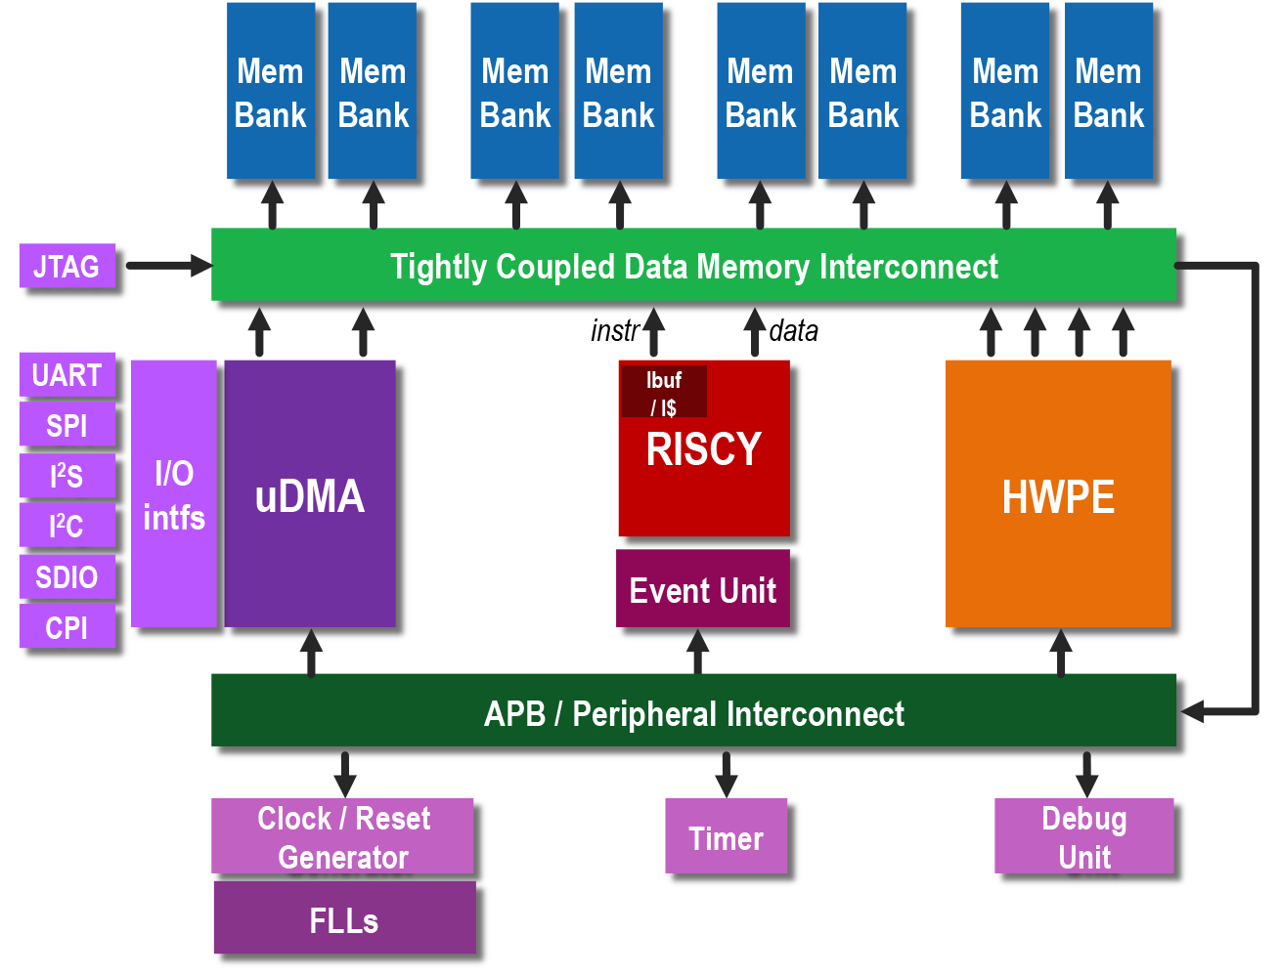
PULPissmo Architecture

Slide 10
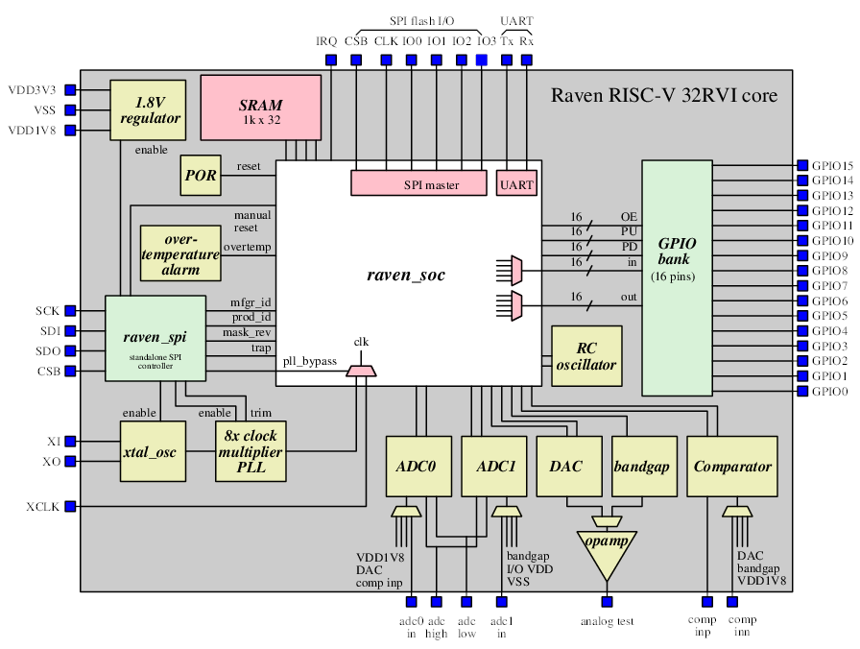

Slide 11
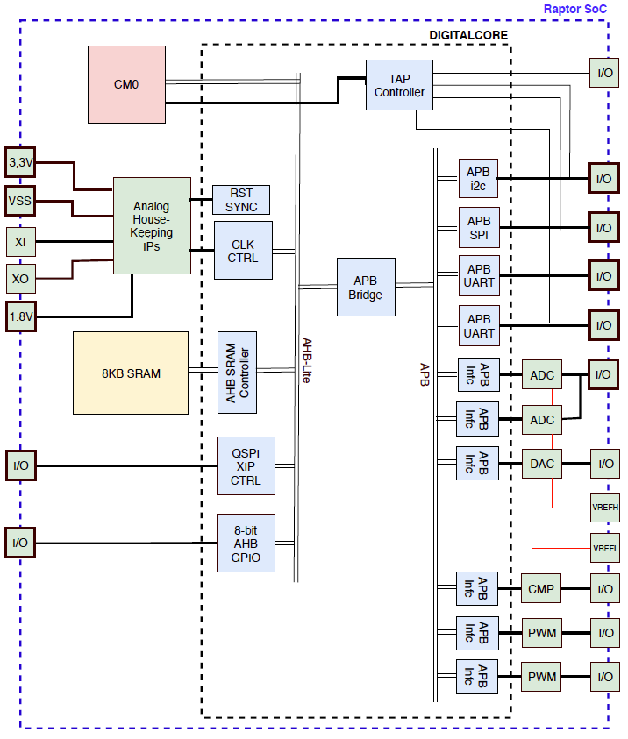
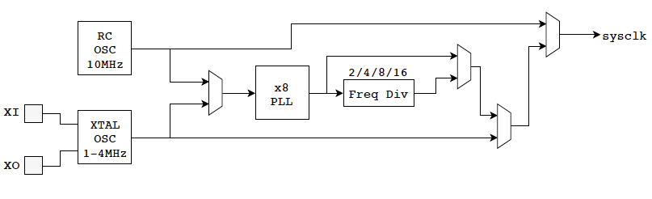

Slide 12
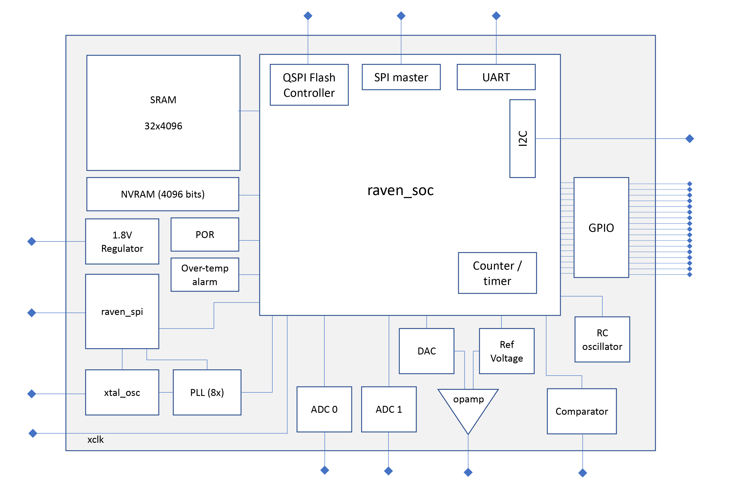

Slide 13
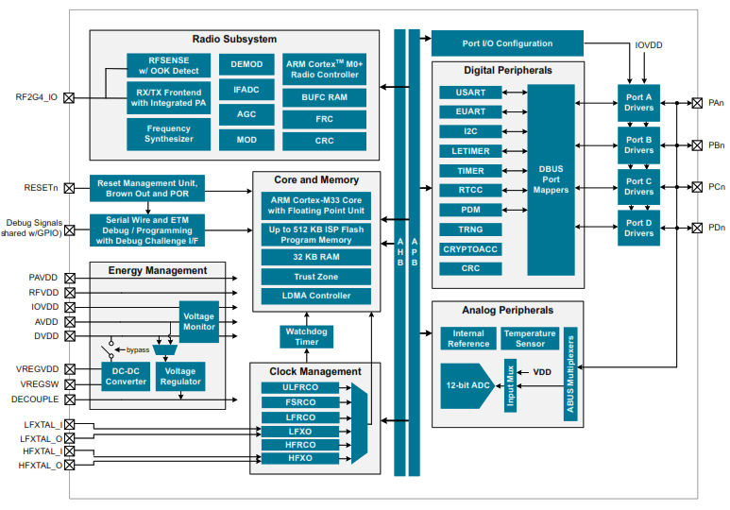

Slide 14
NB-IoT Radio
Digital Peripherals
ANT
SPI
DIO1
UART
I2C
DIO2
RST
RMU/POR
Core & Memory
Port Mapper
Pico RISC-V
Timer
DIO3
Power Management
<24V
SCAP DC-DC Converter
PWM
DIO4
VBAT
AHB
APB
3.3V
3.3V
Bridge
VREG1
SRAM
1k 32b
Linear Regulators
Analog Peripherals
AIO1
1.8V
1.8V
VREG2
Bandgap
AIO2
Temp Sensor
Clock Management
AIO3
XTL1
ADC
XTAL OSC
RING OSC
PLL
XTL2
MUX
AIO4
PHASE-I
PHASE-II
PHASE-III

Slide 15
NB-IoT Radio
Digital Peripherals
ANT
SPI
DIO1
UART
I2C
DIO2
RST
RMU/POR
Core & Memory
Port Mapper
Pico RISC-V
Timer
DIO3
Power Management
<24V
SCAP DC-DC Converter
PWM
DIO4
VBAT
AHB
APB
3.3V
3.3V
Bridge
VREG1
SRAM
1k 32b
Linear Regulators
Analog Peripherals
AIO1
1.8V
1.8V
VREG2
Bandgap
AIO2
Temp Sensor
Clock Management
AIO3
XTL1
ADC
XTAL OSC
RING OSC
PLL
XTL2
MUX
AIO4
PHASE-I
FUTURE

Slide 16
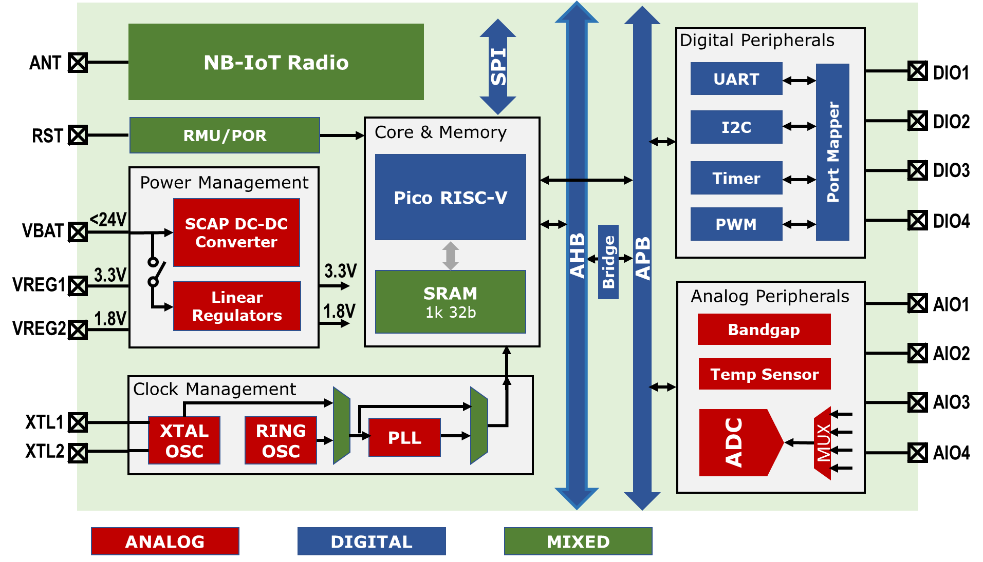

Slide 17
