Slide 2
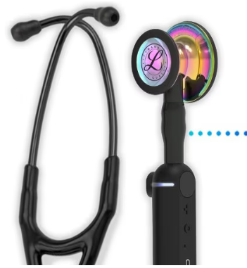

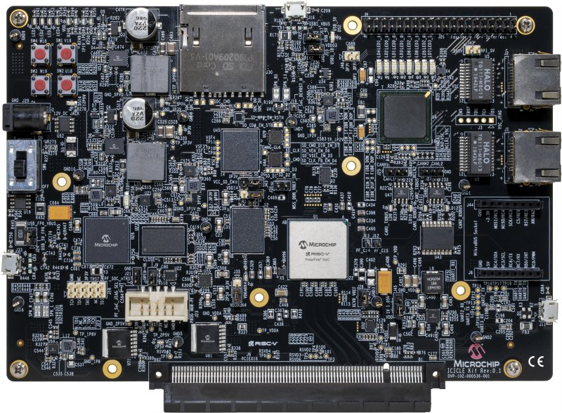
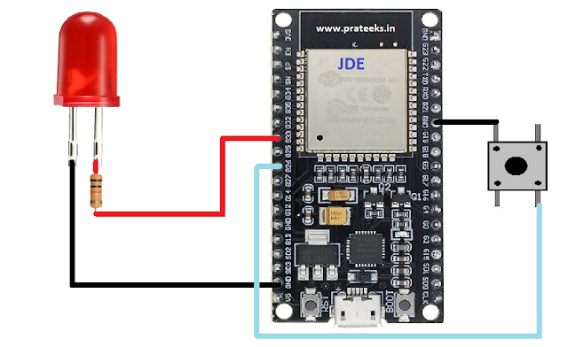

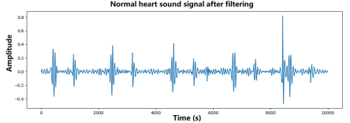

WiFi
Bluetooth
SPI
The 3M™ Littmann® CORE Digital Stethoscope
ESP 32
PolarFire® SoC FPGA Icicle Kit

Slide 4
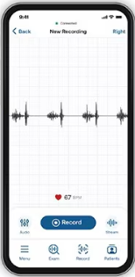
The 3M™ Littmann® CORE Digital Stethoscope

Slide 5

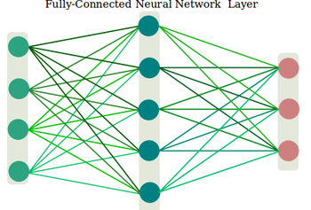
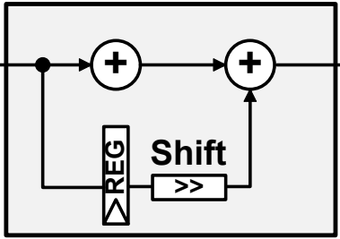
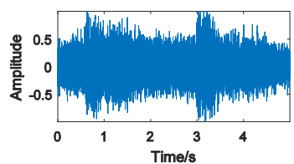
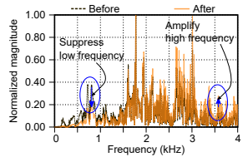
Hanning
frame[n-1]
frame[n]
frame[n+1]

Slide 6
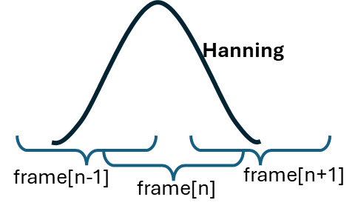
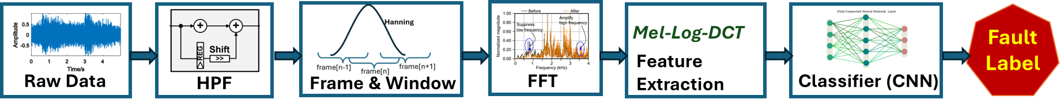
Mel-Log-DCT
Fault Label
Feature Extraction
Raw Data
HPF
Frame & Window
FFT
Classifier (CNN)

Slide 7
