Slide 2

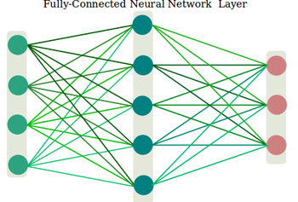
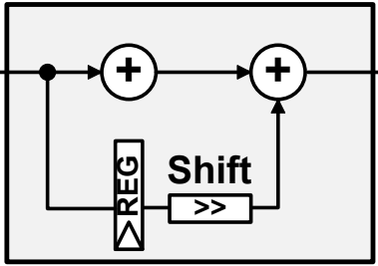
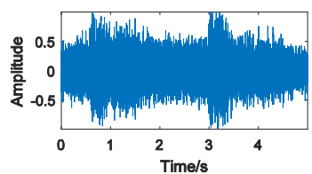
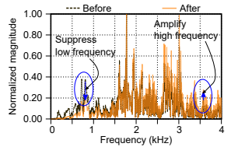
Hanning
frame[n-1]
frame[n]
frame[n+1]

Slide 3
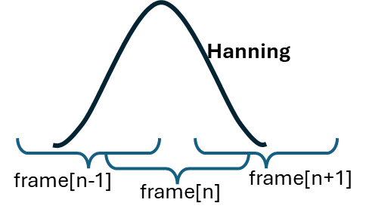

Mel-Log-DCT
Fault Label
Feature Extraction
Raw Data
HPF
Frame & Window
FFT
Classifier (CNN)

Slide 4
