Slide 1
Twizzer System
Shan Xue, Lu Qin, Qi Lou

Slide 2
Overview
Introduction
Design Logic
User Guidelines
Packages
Challenges
Highlights

Slide 3
Introduction
Goal of the project
Build a Twizzer system that allows creation of twizzes and the submission of solutions and reviews
Major functions for two user groups
Student (permission = STUDENT)
Download twiz problems from the server
Upload twiz solutions to the server
Download solutions of two assigned students
Upload reviews to the sever
Download the reviews to him/her
Change password
Instructor (permission = ADMIN)
Create twizzes
Automatic phase update
Add a new user
Get solutions and reviews of all the students
Tabulate student scores

Slide 4
Design Logic
Install executable files both on server and client with the one on the server side always running
The instructor controls the server
Students can always submit assignments before deadline via client interface
Supports maximally 128 student users at the same time
Resist to accept submissions after deadline

Slide 5
Design Logic
Data type we defined
data CheckPwdResult = STUDENT | ADMIN | NotMatch | UserNotExist
data Phase = Idle | Task | Review

Slide 6
Design Logic: Phase Control
Not all commands available at the same time, depends on the current phase
Idle
Task
Review
Timeline
/day
<T
ChangePassword
GetTwiz
ReadReview
T
ChangePassword
GetTwiz
SubmitSolution
(T+1)noon
ChangePassword
GetTwiz
GetSolution
SubmitReview
(T+2)noon
T: when the instructor creates the twiz
(T+1)noon: the deadline for solution submission
(T+2)noon: the deadline for review submission

Slide 7
Files specification on Server Side
File Name | Specification | Operations upon the file ( red for instructor’s operation blue for student’s operation )
Server.exe | An executable file which shall always be running
Accounts.txt | A text file including username, user password, permission level | Create new user Change password Change password
TwizLog.txt | A text file including twiz question index, solution deadline and review deadline. A new record will be created once admin user creates a new twiz. Solution deadline is the noon of the next day, review deadline is the following noon. | Create twiz

Slide 8
Files specification on Server Side
File Name | Specification | Operations upon the file ( red for instructor’s operations blue for student’s operations )
Twiz.hs | Twiz file created by instructor from a certain txt file | CreateTwiz
Score.csv | A csv file, scores students get from each twiz and reviews and total scores until latest twiz | CalculateScores
Solution_twiz-i_studnent-j.hs | A .hs file, homework solution submitted by student j for twiz i | submitSolution – by student-j
Review_twiz-i_studnent-j_studnent-k.txt | A text file, review comments for student k submitted by student j regarding twiz i | submitReview – by student-j

Slide 9
Files specification on Client Side
File Name | Specification | Operations change the file ( red for instructor’s operations blue for student’s operations )
Client.exe | If you want do something, click on it
Twiz-i.txt | A text file, a certain twiz question downloaded from server side. | getTwiz
Solution_twiz-i_student-j.hs | A .hs file, homework solution submitted by student j for twiz i | readSolution – by student-k

Slide 10
Files specification on Client Side
File Name | Specification | Operations change the file ( red for instructor’s operations blue for student’s operations )
Review_twiz-i_student-j_student-k.txt | A text file, review comments for student k submitted by student j regarding twiz i | readReview – by student-k
AllSolutions.txt | A .txt file, all the solutions included, separated by student names. | getAllSolutions
AllReviews.txt | A .txt file, all the solutions included, separated by student names. | getAllReviews

Slide 11
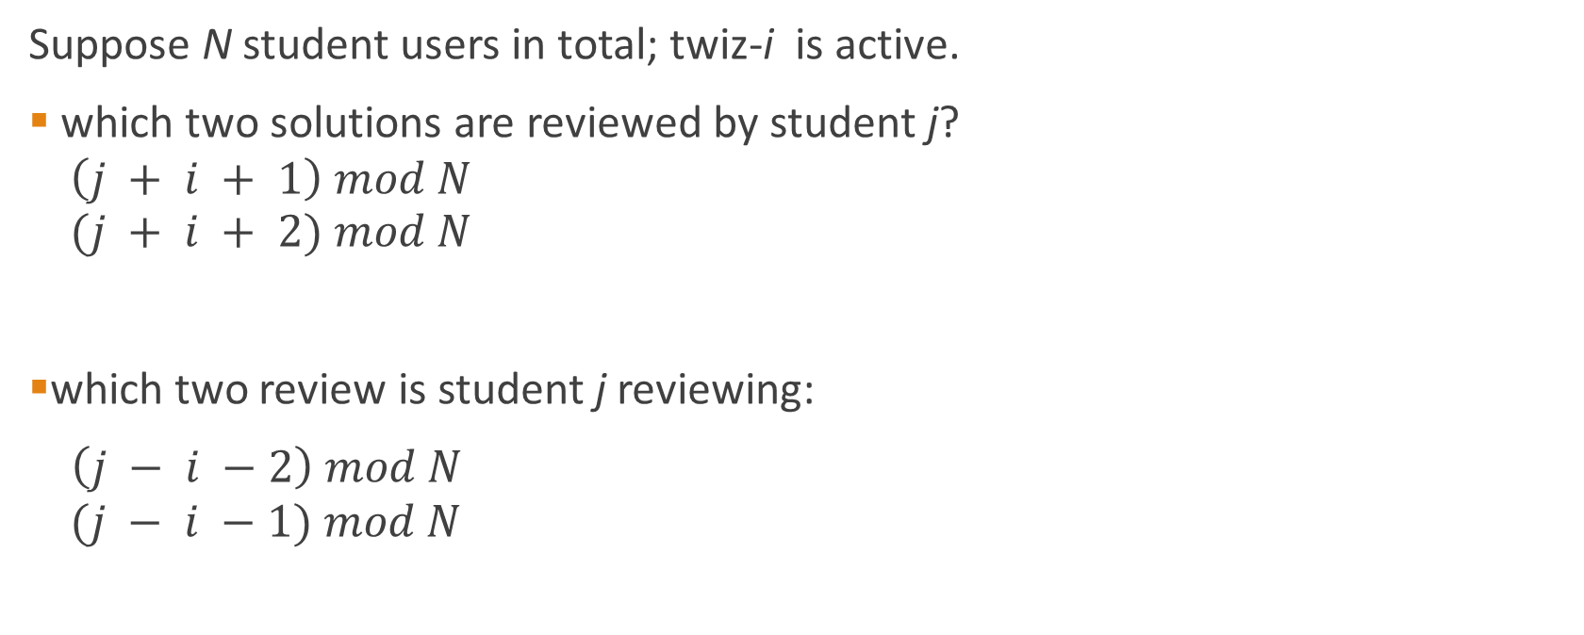
Design Logic: Reviews Assignment
Suppose N student users in total; twiz-i is active.
which two solutions are reviewed by student j?
$$\left(j + i + 1\right) mod N$$
$$(j + i + 2) mod N$$
which two review is student j reviewing:
$\left(j − i −2\right) mod N$
$$(j − i −1) mod N$$

Slide 12
User Guidelines: command list
Teacher | Student
ChangePassword Add an account CreateTwiz GetTwiz ReadAllSolution ReadAllReview CalculateScore | ChangePassword GetTwiz ReadReview SubmitSolution ReadSolution SubmitReview

Slide 13
User Guidelines: demo

Slide 14
Packages
Network
We use this package to build connect between server and client side, some example function we use from it:
Listening
Accept
connectTo
Concurrent
We use this package to allow several users operation at the same time
forkIO

Slide 15
Packages
System.IO
We use this package to deal with buffers depend on modes
hFlush
BlockBuffering/NoBuffering
Data.Time
We use this package to get current time, create any time including the date, and format the time into / from a string.
Data.csv
We use this package to create csv file.

Slide 16
Highlights
The system allows several students operating at the same time. (at most 128 users)
Easy to use, no need to install and no other external software needed.
No maintenance is needed on the server side. Just keep it running!
The instructor can manage users by adding accounts.
Any user can freely update their password
Easy for instructor to get students’ scores. No need to calculate, just create a csv file whenever you want, and you will get all the scores information from a single file clearly.
Provides different functions for students/common users at different phases.

