Slide 1
Sample Inlet
CCD
Laser 405 nm
M
M
alignment
M
Computer
DAQ
Pre-amp
V₃
V₂
ZA
V₁
PMT
MFC
S.
BPF
SPF
MFC
ZA
M
Scrubber
Shutter
Purge
Purge
Pump
Cavity Inlet
Exhaust
Lens
Cavity Outlet
Iris
M
LED 405 nm
M₁ M₂
M

Slide 2
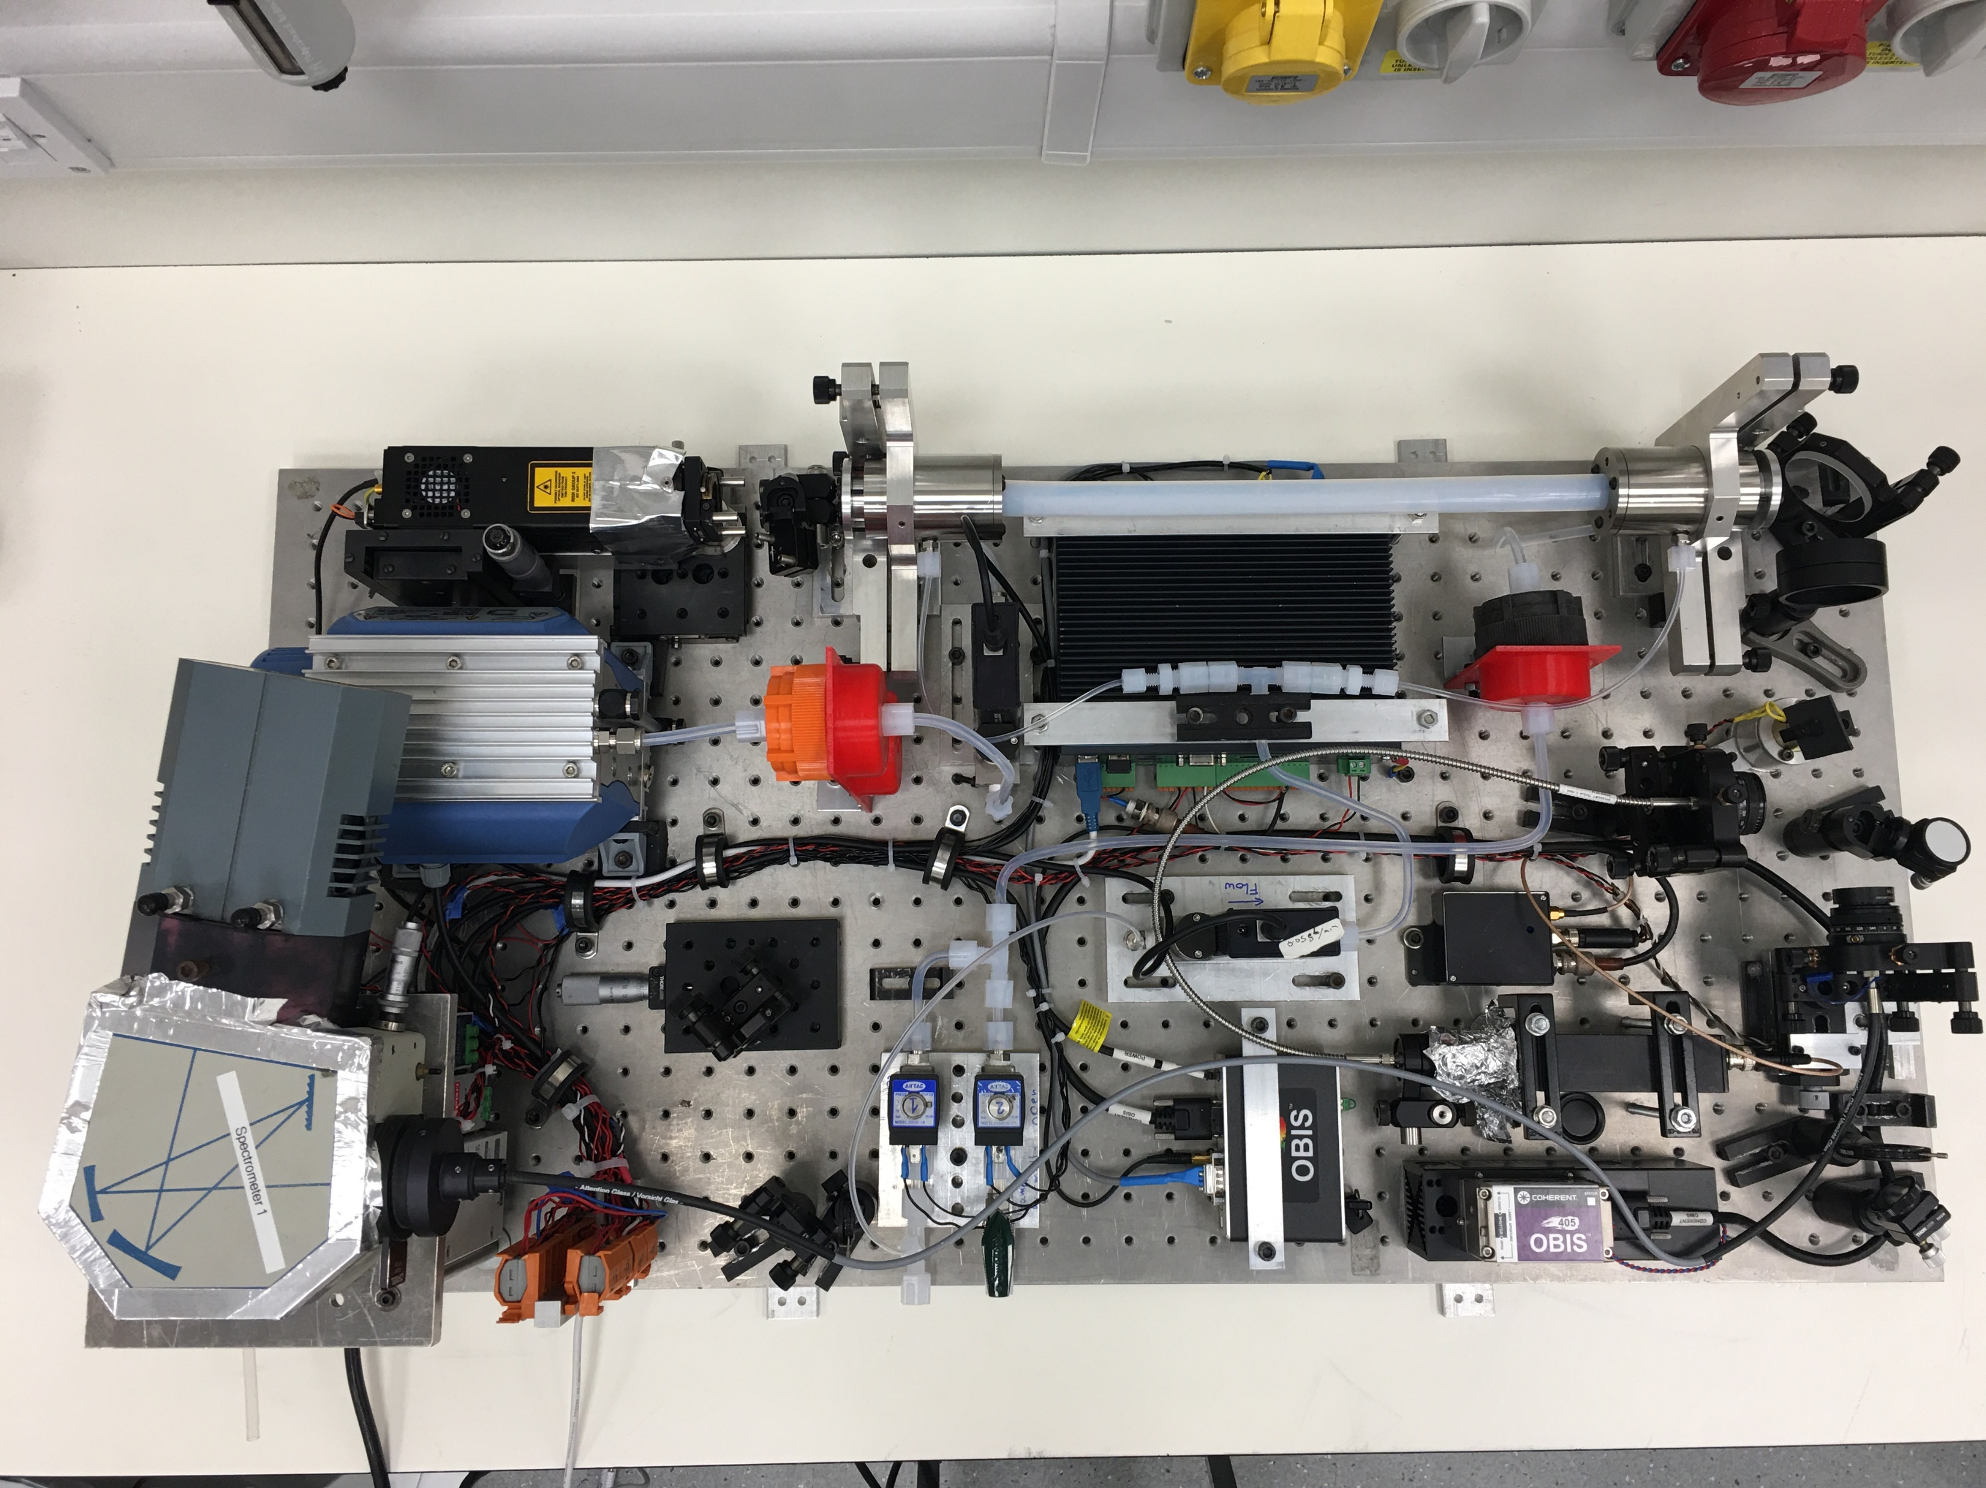

Slide 3
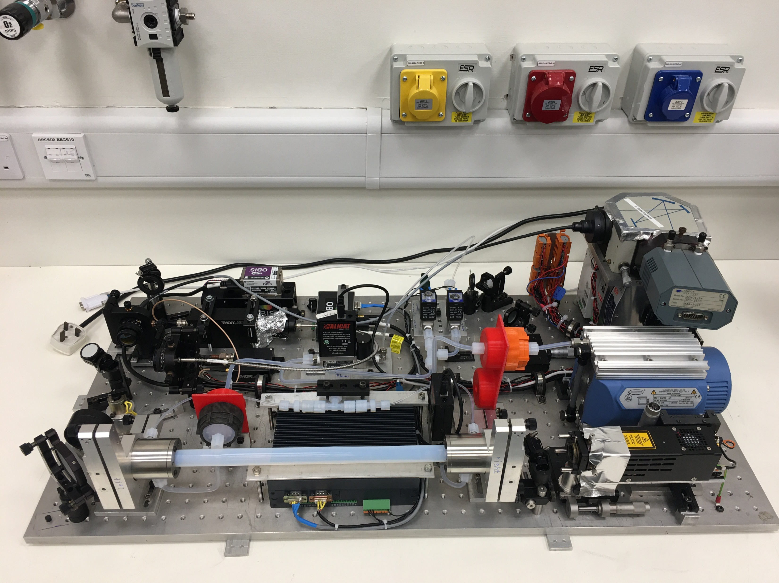

Slide 4
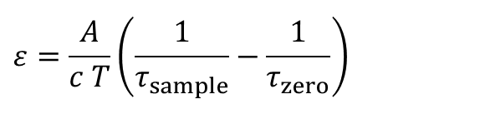
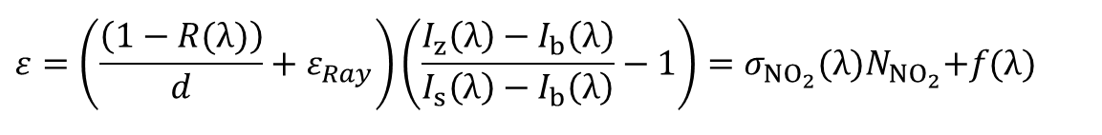
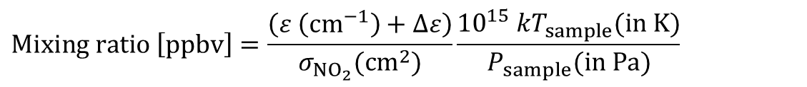
CRDS:
$$ε=\frac{A}{c T}\left(\frac{1}{τ_{sample}}−\frac{1}{τ_{zero}}\right)$$
$$Δε=σ_{Ray}\left(n_{air,sample}−n_{air,zero}\right)=\frac{σ_{Ray}}{k}\left(\frac{P_{sample}(Pa)}{T_{sample}(K)}−\frac{P_{zero}(Pa)}{T_{zero}(K)}\right)$$
$$Mixing ratio \left[ppbv\right]=\frac{\left(ε \left({cm}^{−1}\right)+Δε\right)}{σ_{{NO}_{2}}({cm}^{2})}\frac{{{10}^{15} kT}_{sample}(in K)}{P_{sample}(in Pa)}$$
CEAS:
$$ε=\left(\frac{\left(1−R(λ)\right)}{d}+ε_{Ray}\right)\left(\frac{I_{z}\left(λ\right)−I_{b}\left(λ\right)}{I_{s}\left(λ\right)−I_{b}\left(λ\right)}−1\right)=σ_{{NO}_{2}}{(λ)N}_{{NO}_{2}}+f(λ)$$
Cycle:
Background, Zero, Sample

