Slide 1
CSCI2520 Data Structures & Applications
Priority Queue & Binary Heap

Slide 2
Introduction
simple queues doesn’t work in some instances
  Prim’s algorithm
  Dijkstra’s algorithm
Priority Queue
is a data structure of items with keys(priorities) that supports two basic operations: insert a new item, and delete the item with the largest(smallest) key.
Page <number>

Slide 3
Priority Queue ADT
In practice, several other operations needed to maintain the queues under all the conditions.
A more complete set of operations:
  Construct a priority queue from n given items.
  Insert a new item
  Delete the maximum/minimum item
  Change the priority of an arbitrarily specified item
  Delete an arbitrarily specified item
  Join two priority queues into one large one.
Page <number>

Slide 4
Model of a Priority Queue
delmax(H)
Priority Queue H
insert(H)
Several possible implementations are possible:
  Simple linked list
  A sorted contiguous list
  An unsorted list
  Binary search tree
What will be the complexity of insert and delmax if the above data structures are used?
Page <number>

Slide 5
Priority Queue Implementations
Implementations of PQ ADT have widely varying performance:
 | insert | delmax | delete | findmax | change | join
ordered array | n | 1 | n | 1 | n | n
ordered list | n | 1 | n | 1 | n | n
unordered array | 1 | n | n | n | n | n
unordered list | 1 | n | n | n | n | 1
heap | lg n | lg n | lg n | 1 | lg n | n
Page <number>

Slide 6
Binary Heap (or Just Heap)
Heaps have two properties
  Structure property & Heap-order property
An operation on a heap can destroy one of the properties,
  A heap operation must not terminate until all heap properties are restored.
Structure Property
A heap is a binary tree that is completely filled, with the possible exception of the bottom level, which is always filled from left to right.
Such a tree is known as a complete binary tree.
Page <number>

Slide 7
Structure Property: Illustration
E
F
B
D
A
C
G
H
I
J
A Complete binary tree
Page <number>

Slide 8

Height of Heaps
A complete binary tree of height h has at least 2^{h} and at most 2^{h+1} - 1 nodes.
This implies that the height of a complete binary tree is
Because a complete binary tree is so regular, it can be represented in an array.
  This encourages a straight-forward pointer-free implementation.
Page <number>

Slide 9
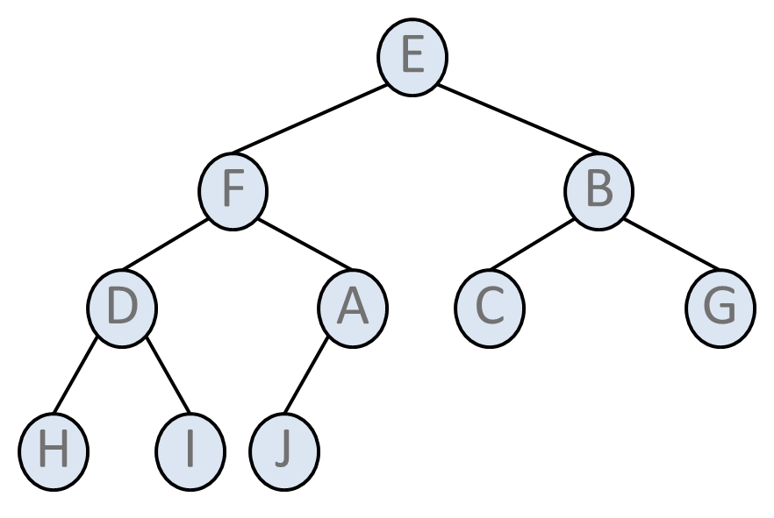
Array Implementation of Heap
 | E | F | B | D | A | C | G | H | I | J
0 | 1 | 2 | 3 | 4 | 5 | 6 | 7 | 8 | 9 | 10 | 11 | 12 | 13
Page <number>

Slide 10

Array Implementation of Heap
 | E | F | B | D | A | C | G | H | I | J
0 | 1 | 2 | 3 | 4 | 5 | 6 | 7 | 8 | 9 | 10 | 11 | 12 | 13
For any element in array position i,
  left child: position 2i
  right child: position (2i + 1),
  parent: position
No pointers are required, and the operations required to traverse the tree are extremely simple. (Note: bit shifting can be used)
The only problem is the estimation of the maximum heap size required in advance.
Page <number>

Slide 11
Heap Order Property
The other trick that enables operations to be performed quickly is the heap order property.
the largest/smallest element is placed at the root => we can find it in constant time.
Thus, findmax/findmin, now in constant time O(1).
In addition, the heap order property is slightly less strict than the search order in binary search tree.
Page <number>

Slide 12
Heap Order Property
Heap Order Property
Each node is larger(smaller) than or equal to the keys in all of that node’s children (if any).
Equivalently, the key in each node of a heap-ordered tree is smaller(larger) than or equal to the key in that node’s parent (if any).
If the parent is larger than its children, the heap is known as a max-heap.
If the parent is smaller than its children, the heap is known as a min-heap.
In the following, we consider min-heaps.
Page <number>

Slide 13
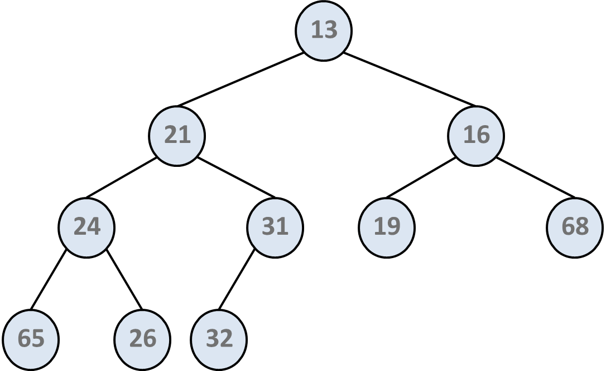
Heap: Example
Exercise: Write a max-heap with the same set of keys.
Page <number>

Slide 14
Heap: Insert
We create a hole in the next available location.
If x can be placed in the hole without violating the heap order, then we do so and are done.
Otherwise we bubble the hole up toward the root, until x can be placed in the hole.
This process is called bubble-up.
Page <number>

Slide 15
Insert: Example
13
21
16
24
31
19
68
up
65
26
32
14
 | 13 | 21 | 16 | 24 | 31 | 19 | 68 | 65 | 26 | 32 | 14
0 | 1 | 2 | 3 | 4 | 5 | 6 | 7 | 8 | 9 | 10 | 11 | 12 | 13
Page <number>

Slide 16
Insert: Example
13
21
up
16
24
14
19
68
65
26
32
31
 | 13 | 21 | 16 | 24 | 14 | 19 | 68 | 65 | 26 | 32 | 31
0 | 1 | 2 | 3 | 4 | 5 | 6 | 7 | 8 | 9 | 10 | 11 | 12 | 13
Page <number>

Slide 17
Insert: Example
13
stop
14
16
24
21
19
68
65
26
32
31
 | 13 | 14 | 16 | 24 | 21 | 19 | 68 | 65 | 26 | 32 | 31
0 | 1 | 2 | 3 | 4 | 5 | 6 | 7 | 8 | 9 | 10 | 11 | 12 | 13
Page <number>

Slide 18
Observations
The number of comparisons during insert is O(log n) if the element is the new minimum and is bubbled all the way up to the root.
It has been shown that 2.6 comparisons are required on average to perform an insert.
  The average insert moves an element up 1.6 levels.
Page <number>

Slide 19
Heap: delmin
Finding the minimum is easy; the hard part is removing it.
When the root is removed, a hole is created.
To maintain structure property, we need to trickle down the hole, by bubbling up the smaller child (of the hole) into the hole, until we can put the last element (x) in the hole while maintaining the heap-order property.
Page <number>

Slide 20
delmin: Example
Trickle down
13
14
16
19
21
24
68
65
40
32
31
 | 13 | 14 | 16 | 19 | 21 | 24 | 68 | 65 | 40 | 32 | 31
0 | 1 | 2 | 3 | 4 | 5 | 6 | 7 | 8 | 9 | 10 | 11 | 12 | 13
Page <number>

Slide 21
delmin: Example (2)
14
16
19
21
24
68
65
40
32
31
 | 14 | O | 16 | 19 | 21 | 24 | 68 | 65 | 40 | 32 | 31
0 | 1 | 2 | 3 | 4 | 5 | 6 | 7 | 8 | 9 | 10 | 11 | 12 | 13
Page <number>

Slide 22
delmin: Example (3)
14
19
16
21
24
68
65
40
32
31
 | 14 | 19 | 16 | O | 21 | 24 | 68 | 65 | 40 | 32 | 31
0 | 1 | 2 | 3 | 4 | 5 | 6 | 7 | 8 | 9 | 10 | 11 | 12 | 13
Page <number>

Slide 23
delmin: Example (4)
14
19
16
31
21
24
68
65
40
32
 | 14 | 19 | 16 | 31 | 21 | 24 | 68 | 65 | 40 | 32
0 | 1 | 2 | 3 | 4 | 5 | 6 | 7 | 8 | 9 | 10 | 11 | 12 | 13
Page <number>

Slide 24
Heap: Implementation (1)
Structure Declaration
typedef struct bst_s bst_t;
typedef struct heap_s {
int capacity;
int size;
int *e;
} heap_t;
Set of common operations
heap_t *heap_init(int max_e);
void heap_free(heap_t *h);
void heap_make_empty(heap_t *h);
void heap_insert(heap_t *h, int x);
int heap_delete_min(heap_t *h);
int heap_find_min(heap_t *h);
int heap_is_full(heap_t *h);
int heap_is_empty(heap_t *h);
void heap_print(heap_t *h);
Page <number>

Slide 25
Heap: Implementation (2)
heap_t *heap_init(int max_e){
heap_t *h = (heap_t *)malloc(sizeof(heap_t));
h->e = (int *)malloc((max_e + 1)* sizeof(int));
h->size = 0;
h->capacity = max_e;
h->e[0] = INT_MIN;
return h;
}
void heap_insert(heap_t *h, int x){
int i;
if (heap_is_full(h)){
fprintf(stderr, "The heap is full.\n");
exit(1);
}
for (i = ++h->size; h->e[i / 2] > x; i /= 2)
h->e[i] = h->e[i / 2];
h->e[i] = x;
}
Page <number>

Slide 26
Heap: Implementation (3)
int heap_delete_min(heap_t *h){
int i, child, min_e, last_e;
if (heap_is_empty(h)){
fprintf(stderr, "The heap is empty.\n");
exit(1);
}
min_e = h->e[1];
last_e = h->e[h->size--];
for (i = 1; i * 2 <= h->size; i = child){
/* Find smaller child */
child = i * 2;
if (child != h->size &&
h->e[child + 1] < h->e[child])
child++;
/* trickle the hole down one level */
if (last_e > h->e[child])
h->e[i] = h->e[child];
else break;
}
h->e[i] = last_e;
return min_e;
}
Page <number>

Slide 27
Other Heap Operations (min-heap)
findmin: Finding the minimum can be performed in constant time.
findmax: No help in finding the maximum
sort: There is no strict ordering information
  But can be used for sorting. (see heapsort)
decrease_key(P, ∆): fixed by bubble_up
increase_key(P, ∆): fixed by trickle_down
delete: fixed by bubble up and trickle down
build_heap
Page <number>

Slide 28
Observation on build_heap
Takes n keys and places them into an empty heap. Perform n successive inserts.
This will take O(n) average but O(n log n) worst-case.
One other way is to place the n keys into the tree in any order.
Then perform trickle_down on half of the nodes.
Sketch of build_heap
for (i = n / 2; i > 0; i--)
heap_trickle_down(i);
Page <number>

Slide 29
build_heap: Initial
15
8
4
3
1
7
11
10
2
9
6
5
12
14
13
 | 15 | 8 | 4 | 3 | 1 | 7 | 11 | 10 | 2 | 9 | 6 | 5 | 12 | 14 | 13
0 | 1 | 2 | 3 | 4 | 5 | 6 | 7 | 8 | 9 | 10 | 11 | 12 | 13 | 14 | 15
Page <number>

Slide 30
build_heap: trickle_down(7)
15
8
4
3
1
7
11
10
2
9
6
5
12
14
13
 | 15 | 8 | 4 | 3 | 1 | 7 | 11 | 10 | 2 | 9 | 6 | 5 | 12 | 14 | 13
0 | 1 | 2 | 3 | 4 | 5 | 6 | 7 | 8 | 9 | 10 | 11 | 12 | 13 | 14 | 15
Page <number>

Slide 31
build_heap: trickle_down(6,5,4)
15
8
4
3
1
7
11
10
2
9
6
5
12
14
13
 | 15 | 8 | 4 | 3 | 1 | 7 | 11 | 10 | 2 | 9 | 6 | 5 | 12 | 14 | 13
0 | 1 | 2 | 3 | 4 | 5 | 6 | 7 | 8 | 9 | 10 | 11 | 12 | 13 | 14 | 15
Page <number>

Slide 32
build_heap: trickle_down(3,2)
15
8
4
2
1
5
11
10
3
9
6
7
12
14
13
 | 15 | 8 | 4 | 2 | 1 | 5 | 11 | 10 | 3 | 9 | 6 | 7 | 12 | 14 | 13
0 | 1 | 2 | 3 | 4 | 5 | 6 | 7 | 8 | 9 | 10 | 11 | 12 | 13 | 14 | 15
Page <number>

Slide 33
build_heap: trickle_down(1)
15
1
4
2
6
5
11
10
3
9
8
7
12
14
13
 | 15 | 1 | 4 | 2 | 6 | 5 | 11 | 10 | 3 | 9 | 8 | 7 | 12 | 14 | 13
0 | 1 | 2 | 3 | 4 | 5 | 6 | 7 | 8 | 9 | 10 | 11 | 12 | 13 | 14 | 15
Page <number>

Slide 34
build_heap: Final
1
2
4
3
6
5
11
10
15
9
8
7
12
14
13
 | 1 | 2 | 4 | 3 | 6 | 5 | 11 | 10 | 15 | 9 | 8 | 7 | 12 | 14 | 13
0 | 1 | 2 | 3 | 4 | 5 | 6 | 7 | 8 | 9 | 10 | 11 | 12 | 13 | 14 | 15
Page <number>

Slide 35
Complexity of build_heap
To analyze the running time of build_heap, the simplest analysis is that n/2 nodes trickle down the tree O(height-of-tree) = O(log n) times, and thus the complexity is O(n log n)
However, we observe that every node at height h actually trickles down at most h times, instead of trickling down O(height-of-tree) times
This gives a tighter bound O(n)
Page <number>

Slide 36
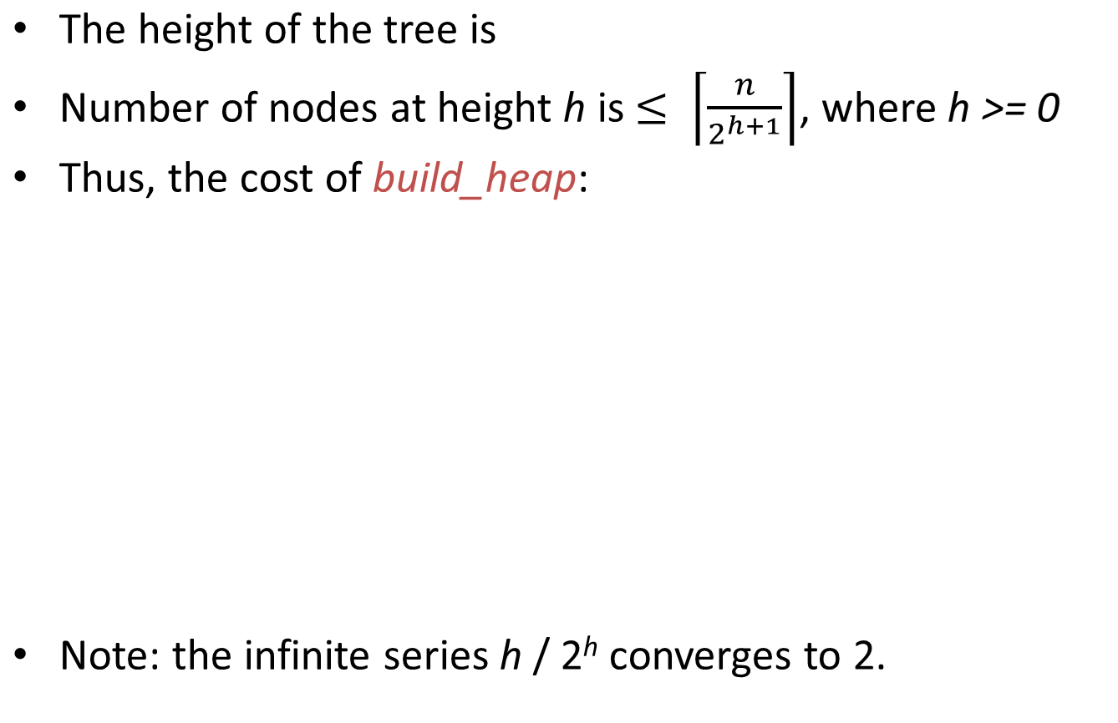
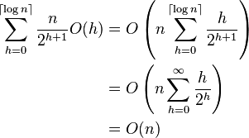
Complexity of build_heap
n/2^{h}
h
1
3
4
2
2
3
6
5
11
1
0
10
15
9
8
7
12
14
13
Page <number>

Slide 37
Heapsort
Priority queues can be used to sort in O(n log n) time.
The basic strategy is to
  (1) build a binary heap of n elements in O(n) time
  (2) perform n delete_min.
We record the minimum elements that leaves in a second array and copy the array back to complete the sorting.
Total running time is O(n) + n x O(log n) = O(n log n).
Page <number>

Slide 38
Tricks in Implementing Heapsort
The memory requirement is doubled since we need an extra array.
Avoid the second array by making use of the last cell in the array to store the value returned by delete_min.
  Using this strategy the array will contain the elements in decreasing sorted order after the last delete_min.
Suppose we stick to the more typical increasing order, we can change the heap ordering property so that the parent has a larger key than the child.
  We use a maxheap with a delete_max operation.
Page <number>

Slide 39
Heapsort Example (1)
Maxheap with its array representation. Execute delete_max.
97
53
59
26
41
58
31
 | 97 | 53 | 59 | 26 | 41 | 58 | 31
Page <number>

Slide 40
Heapsort Example (2)
The maxheap after delete_max.
59
53
58
26
41
31
 | 59 | 53 | 58 | 26 | 41 | 31 | 97
Page <number>

Slide 41
Heapsort Example (3)
The maxheap after delete_max.
58
53
31
26
41
 | 58 | 53 | 31 | 26 | 41 | 59 | 97
Page <number>

Slide 42
Heapsort Example (4)
The maxheap after delete_max.
53
41
31
26
 | 53 | 41 | 31 | 26 | 58 | 59 | 97
Page <number>

Slide 43
Heapsort Example (5)
The maxheap after delete_max.
41
26
31
 | 41 | 26 | 31 | 53 | 58 | 59 | 97
Page <number>

Slide 44
Heapsort Example (6)
The maxheap after delete_max.
31
26
 | 31 | 26 | 41 | 53 | 58 | 59 | 97
Page <number>

Slide 45
Heapsort Example (7)
The maxheap after delete_max.
26
 | 26 | 31 | 41 | 53 | 58 | 59 | 97
Page <number>

Slide 46
Heapsort Example (8)
The maxheap after delete_max.
 | 26 | 31 | 41 | 53 | 58 | 59 | 97
Page <number>

Slide 47
The k-selection Problem
Problem: Suppose you have a group of n numbers and would like to determine the k-th largest.
First Algorithm
  Build a max-heap for all numbers and it takes O(n).
  Keep delmax until we get the k-th value returned. k x O(log n).
  The total running time is O(n + k log n).
For small k then the running time dominated by the heap building operation and is O(n).
For larger values of k, the running time is O(k log n) time.
Page <number>

Slide 48
The k-selection Problem (2)
Second Algorithm
  Build a smaller min-heap of k elements.
  Then compare the remaining (n - k) numbers against the heap.
  If the new element is larger, it replaces the root, otherwise it is discarded.
  When the algorithm teminates, the heap contains the k largest numbers from the set.
To build a k-element the heap takes O(k).
The time for step 2 is
  O(1): to test if the element goes into the heap
  + O(log k): to delete the root and insert the new element if this is necessary
The total time is O(k + (n - k)log k) = O(n log k).
Page <number>
Notes:
This algorithm also gives a bound of n log n for finding the median.

Slide 49
Summary
Priority Queue ADT:
  Pick largest/smallest element + insert
Binary heap: structure & order properties
  Efficient array implementation
  findmax/findmin in constant time
  fixing heap properties in O(log n) time.
  O(n) heap construction
Heapsort : O(n log n) comparisons sorting
Application: k-selection problem
  reveal theoretical bound of O(n log n) in finding the median of a set of n numbers.
Page <number>

