Slide 1
CSCI2520 Tutorial 10: Topological Sort and Heap
LI Hui
hli@cse.cuhk.edu.hk
Slide Ack: modified based on the slides from CHEN Gengjie and LI Jinfeng

Slide 2
Outline
Topological Sort
Kahn's Algorithm
DFS-based Algorithm
Heap
Huffman Coding
Merge Sorted List

Slide 3
Topological Sort
Given a DAG G = (V , E), find an ordering of V, such that, for each edge (u, v) ∈ E, u precedes v in the ordering. The ordering is called a topological order.
B
C
A
F
D
E

Slide 4
Topological Sort
Any ordering in which all the arrows go to the right is a valid solution (may not unique).
B
C
A
F
D
E
A
B
C
D
E
F
Both are valid!
A
B
C
D
F
E

Slide 5
Topological Sort
Any ordering in which an arrow goes to the left is not a valid solution.
B
C
A
F
D
E
Invalid!
A
B
C
E
D
F

Slide 6
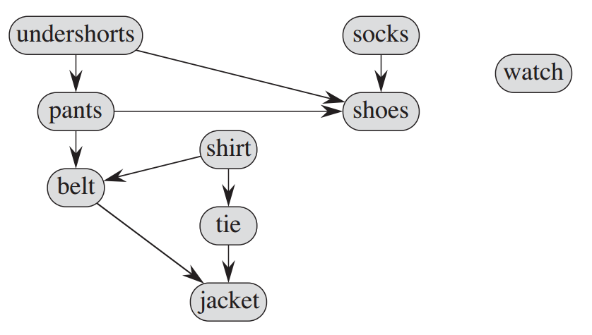
Toposort Examples
Getting dressed
Certain garments must be donned before others (e.g., socks before shoes).
Other items may be put on in any order (e.g., socks and pants).

Slide 7
Toposort Examples
Taking courses
In order to take a course, you must take all of its prerequisites first
In computer science,
Instruction scheduling
Determining the order of compilation tasks

Slide 8
Why DAG?
A directed graph with a cycle cannot be topologically sorted.
Question: why? Any ordering of B, C and D causes at least an arrow going to the left.
B
C
A
F
D
E

Slide 9
How to do it?
Hints:
Which one can be safely put as the first?
Or, DFS?
B
C
A
F
D
E

Slide 10
Kahn's Algorithm
Choose vertices in the same order as the eventual topological sort
Recursively find vertices without incoming edges

Slide 11
Kahn's Algorithm
A has no incoming vertex
B
C
A
F
D
E

Slide 12
Kahn's Algorithm
B
C
F
A
D
E

Slide 13
Kahn's Algorithm
C
F
A
B
D
E

Slide 14
Kahn's Algorithm
Both are OK
Both are OK
F
A
B
C
D
E

Slide 15
Kahn's Algorithm
A
B
C
F
D
E

Slide 16
Kahn's Algorithm
A
B
C
F
D
E

Slide 17
Kahn's Algorithm
A
B
C
F
D
E

Slide 18
Kahn's Algorithm Pseudocode
L ← Empty list that will contain the sorted elements
S ← Set of all nodes with no incoming edges
while S is non-empty do
remove a node n from S
add n to tail of L
for each node m with an edge e from n to m do
remove edge e from the graph
if m has no other incoming edges then
insert m into S
if graph has edges then
return error (graph has at least one cycle)
else
return L (a topologically sorted order)

Slide 19
Kahn's Algorithm Details
How to obtain in-degree information? Go through all edges in each round?

Slide 20
Kahn's Algorithm Details
How to obtain in-degree information? Go through all edges in each round? We can record and maintain an in-degree array…

Slide 21
Kahn's Algorithm Details
Which graph representation fits this algorithm better, adjacency matrix or adjacency list?

Slide 22
Kahn's Algorithm Details
Which graph representation fits this algorithm better, adjacency matrix or adjacency list? Adjacency list!
 | Adjacency matrix | Adjacency list
Is there an edge from v_{i} to v_{j}? | M[i][j] == 1? O(1) | Traverse L[i] O(d)
Find all vertices adjacent to v_{i}. | Traverse row O(n) | Traverse L[i] O(d)
How many edges are there in a graph? | Traverse M O(n²) | Traverse L O(n + e)

Slide 23
DFS-based Algorithm
Initiate DFS from arbitrary unvisited vertices until all vertices are visited.
Add a vertex into the front of the output list when its DFS is finished.

Slide 24
DFS-based Algorithm
Initiate DFS from B
dfs(B)
B
C
A
F
D
E
Output List:

Slide 25
DFS-based Algorithm
dfs(B)
dfs(C)
B
C
A
F
D
E
Output List:

Slide 26
DFS-based Algorithm
dfs(B)
dfs(C)
dfs(F)
B
C
A
F
D
E
Output List:

Slide 27
DFS-based Algorithm
DFS starting from F is finished
dfs(B)
dfs(C)
B
C
A
F
D
E
Output List:
F

Slide 28
DFS-based Algorithm
dfs(B)
dfs(C)
dfs(E)
B
C
A
F
D
E
Output List:
F

Slide 29
DFS-based Algorithm
dfs(B)
dfs(C)
B
C
A
F
D
E
DFS starting from E is finished
Output List:
E
F

Slide 30
DFS-based Algorithm
dfs(B)
dfs(C)
dfs(D)
B
C
A
F
D
E
Output List:
E
F

Slide 31
DFS-based Algorithm
dfs(B)
dfs(C)
B
C
A
F
D
E
DFS starting from D is finished
Output List:
D
E
F

Slide 32
DFS-based Algorithm
DFS starting from C is finished
dfs(B)
B
C
A
F
D
E
Output List:
C
D
E
F

Slide 33
DFS-based Algorithm
DFS starting from B is finished
B
C
A
F
D
E
Output List:
B
C
D
E
F

Slide 34
DFS-based Algorithm
Initiate DFS from A
B
C
A
F
D
E
Output List:
B
C
D
E
F

Slide 35
DFS-based Algorithm
DFS starting from A is finished
B
C
A
F
D
E
Output List:
A
B
C
D
E
F

Slide 36
DFS-based Algorithm Pseudocode
L ← Empty list that will contain the sorted nodes
while there are unmarked nodes do
select an unmarked node n
visit(n)
function visit(node n)
if n has a temporary mark then
stop (graph has at least one cycle)
if n is not marked (i.e. has not been visited yet) then
mark n temporarily
for each node m with an edge from n to m do
visit(m)
mark n permanently
add n to head of L

Slide 37
DFS-based Algorithm
Why it is correct?

Slide 38
DFS-based Algorithm
Why it is correct? When vertex v is added, all vertices depending on v are already in the output list: they were added

Slide 39
Practices
https://leetcode.com/problems/course-schedule/#/description
https://leetcode.com/problems/course-schedule-ii/#/description

Slide 40
Heap
Two properties (min heap is assumed):
structure property: complete binary tree
heap-order property: Each node is smaller than or equal to its children
Basic operations:
insert: O(?)
findmin: O(?)
delmin: O(?)
build_heap: O(?)

Slide 41
Heap
Two properties (min heap is assumed):
structure property: complete binary tree
heap-order property: Each node is smaller than or equal to its children
Basic operations:
insert: O(logn)
findmin: O(1)
delmin: O(logn)
build_heap: O(n)

Slide 42
Huffman Coding
To save storage space
To reduce data transmission cost
A type of statistical coding
Based on binary trees and min heaps

Slide 43
Exercise
Suppose that we have a 100,000 character data file to store. The file contains only 6 characters, appearing with the following frequencies:
Build Huffman code tree and decide their codes.
How many storage saved compared to ASCII code and shortest fixed-length code?
 | a | b | c | d | e | f
Frequency (%) | 45 | 13 | 12 | 16 | 9 | 5

Slide 44
Exercise 1.1 Solution
a
45
b
13
c
12
d
16
e
9
f
5
build_heap: Initial
45
13
12
16
9
5

Slide 45
Exercise 1.1 Solution
a
45
e
9
f
5
d
16
b
13
c
12
build_heap:
trickle_down(13, 12)
45
9
5
16
13
12

Slide 46
Exercise 1.1 Solution
f
5
e
9
c
12
d
16
b
13
a
45
build_heap:
trickle_down(45)
5
9
12
16
13
45

Slide 47
Exercise 1.1 Solution
c
12
b
13
a
45
d
16
delmin two times
12
14
13
45
f
5
e
9
16

Slide 48
Exercise 1.1 Solution
c
12
b
13
a
45
d
16
14
f
5
e
9
insert the new node
12
13
45
16
14

Slide 49
14
d
16
a
45
f
5
e
9
delmin two times
14
25
16
45
c
12
b
13

Slide 50
14
d
16
a
45
25
f
5
e
9
c
12
b
13
insert the new node
14
16
45
25

Slide 51
25
a
45
c
12
b
13
delmin two times
25
30
45
14
d
16
f
5
e
9

Slide 52
25
a
45
30
c
12
b
13
14
d
16
f
5
e
9
insert the new node
25
45
30

Slide 53
a
45
delmin two times
55
25
30
c
12
b
13
14
d
16
f
4
e
9

Slide 54
after ……
60
a
45
55
25
30
c
12
b
13
14
d
16
f
4
e
9

Slide 55
Exercise 1.1 Solution
Char | Coding
a | 0
b | 101
c | 100
d | 111
e | 1100
f | 1111
60
0
1
a
45
55
0
1
25
30
0
1
0
1
c
12
b
13
14
d
16
0
1
f
4
e
9

Slide 56
Exercise 1.2 Solution
Char | Code | Freq
a | 0 | 45
b | 101 | 13
c | 100 | 12
d | 111 | 16
e | 1100 | 9
f | 1111 | 5
How many storage saved compared to ASCII code and shortest fixed-length code?
Huffman: 100,000 × (0.45×1 + 0.13×3 + 0.12×3 + 0.16×3+ 0.09×4 + 0.05×4) = 224,000 bits
ASCII: 100,000 × 8 = 800,000 bits
Fixed-length: 100,000 × ceil(log₂6) = 300,000 bits
Savings are trivial and omitted here …

Slide 57
Huffman Coding
Question: why the decoding is unique?
Question: can we compress an image with Huffman coding?

Slide 58
Merge Sorted List
Task: merge k sorted linked lists and obtain a sorted list.
Simpler task first: if k = 2?
Question: what is the complexity of your algorithm? (Suppose their sizes are n₁ and n₂ respectively, and total length is n)

Slide 59
Merge Sorted List
Task: merge k sorted linked lists and obtain a sorted list.
Simpler task first: if k = 2? Recursively add the smaller head of the two lists to the output list until one list becomes empty, then append the remaining non-empty list to the output list.
Question: what is the complexity of your algorithm? O(n₁ + n₂)

Slide 60
Merge Sorted List
Task: merge k sorted linked lists and obtain a sorted list.
How to do this? Recursively add the smallest head of any list to the output list until only one list is not empty and then append?
Question: what is the complexity of your algorithm? How to obtain the smallest head?

Slide 61
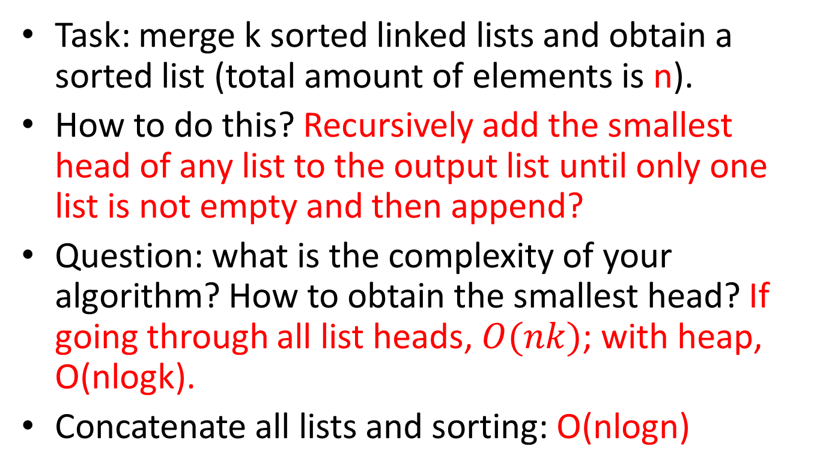
Merge Sorted List
Task: merge k sorted linked lists and obtain a sorted list (total amount of elements is n).
How to do this? Recursively add the smallest head of any list to the output list until only one list is not empty and then append?
Question: what is the complexity of your algorithm? How to obtain the smallest head? If going through all list heads, $O(nk)$; with heap, O(nlogk).
Concatenate all lists and sorting: O(nlogn)

Slide 62
Summary
Topological Sort
Kahn's Algorithm
DFS-based Algorithm
Heap
Huffman Coding
Merge Sorted List

