Slide 1
CSCI2520 Tutorial 1: C Programming Review
Pan Zhenyu
zypan24@cse.cuhk.edu.hk
Slide Ack: modified based on the slides from Li Hui

Slide 2
About me
Name: Pan Zhenyu
Email: zypan24@cse.cuhk.edu.hk
Office: SHB 120
Language: Mandarin, English

Slide 3
Notes
This course doesn't emphasize on programming language
This tutorial review C only because the lectures use C to explain some important data structure concepts
In all the exams and written assignments, you can use any programming language, or English

Slide 4
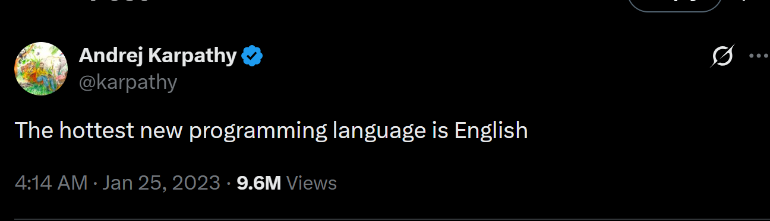
“life is short,you need python”
- Bruce Eckel
Source: https://x.com/karpathy/status/1617979122625712128

Slide 5





Useful Links
https://chat.qwen.ai/
https://grok.com/
https://chat.z.ai/
https://kimi.com/
chat.deepseek.com/
ChatGPT/Gemini/Claude… (Need Magic)

Slide 6
Outline
Pointer
Malloc
Typedef
Struct

Slide 7
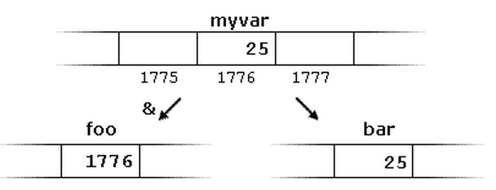

Pointer
Pointer variable
Store the address(like foo in the example)
Reference operator (&)
Get the address of another variable

Slide 8

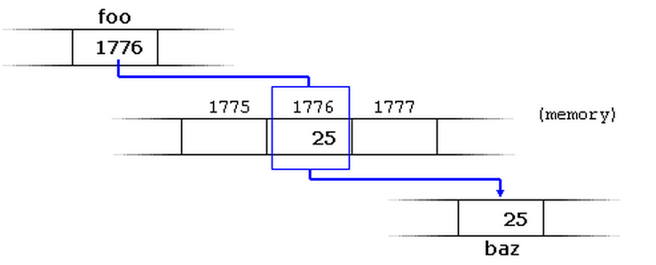
Pointer
Dereference operator (*)

Slide 9
Pointer
&
reference operator
read as “address of”
*
dereference operator
read as “value pointed to by”
Notes:
&: ampersand
*: asterisk

Slide 10
Exercise 1
What is the output?
int main()
{
int firstvalue = 5, secondvalue = 15;
int *p1, *p2;
p1 = &firstvalue;
p2 = &secondvalue;
*p1 = 10;
*p2 = *p1;
p1 = p2;
*p1 = 20;
cout << "firstvalue is " << firstvalue << '\n';
cout << "secondvalue is " << secondvalue << '\n';
return 0;
}

Slide 11

Exercise 1 Solution
int main()
{
int firstvalue = 5, secondvalue = 15;
int *p1, *p2;
p1 = &firstvalue; // p1 = address of firstvalue
p2 = &secondvalue; // p2 = address of secondvalue
*p1 = 10; // value pointed to by p1 = 10
*p2 = *p1; // value pointed to by p2 = value pointed to by p1
p1 = p2; // p1 = p2 (value of pointer is copied)
*p1 = 20; // value pointed to by p1 = 20
cout << "firstvalue is " << firstvalue << '\n';
cout << "secondvalue is " << secondvalue << '\n';
return 0;
}

Slide 12



Pointer & Array
equivalent

Slide 13
Exercise 2
What is the output?
int main()
{
int numbers[5];
int * p;
p = numbers; *p = 10;
p++; *p = 20;
p = &numbers[2]; *p = 30;
p = numbers + 3; *p = 40;
p = numbers; *(p + 4) = 50;
for (int n = 0; n<5; n++)
cout << numbers[n] << ", ";
return 0;
}

Slide 14
Malloc
Allocate memory dynamically
Question: how to allocate memory “statically”? why need to allocate memory dynamically?
int k = 1000;
int *d;
d = (int*) malloc (sizeof(int)*k);
int k = 1000;
char *c;
c = (char*) malloc (sizeof(char)*k);
Notes:
Dynamic allocation enables flexible data structures like linked lists and resizable buffers, but requires careful manual memory management to avoid leaks or dangling pointers. In short: use static allocation for small, fixed-size data; use dynamic allocation when you need flexibility, size, or longevity.
int n;
scanf("%d", &n);
int *data = (int*) malloc(n * sizeof(int)); // allocate space for n integers
// ... use data ...
free(data); // must manually free to avoid memory leaks
In Python, you don’t need to worry about static vs dynamic allocation, stack vs heap, or manual memory management like in C. The language handles it all automatically through garbage collection and high-level data structures—so you can focus on solving problems, not managing memory

Slide 15

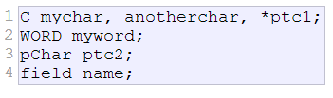
Typedef
Type aliases
Question: why type aliases?
typedef existing_type new_type_name;
field as char[50]

Slide 16
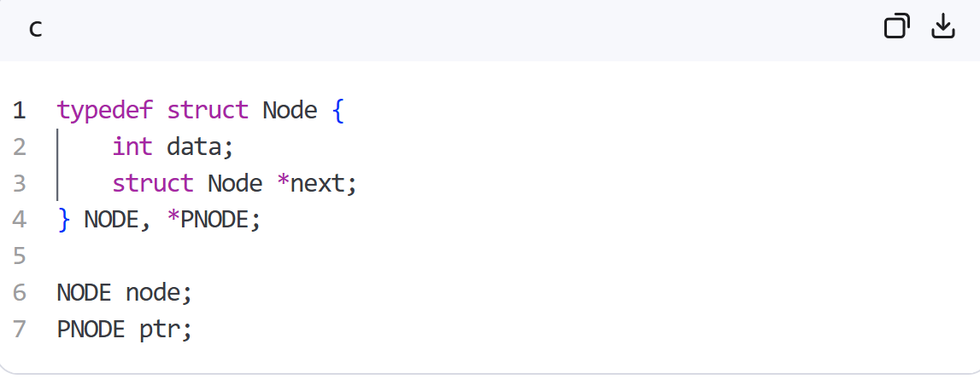
Typedef
Why type aliases?
reduce the length of long or confusing type names

Slide 17
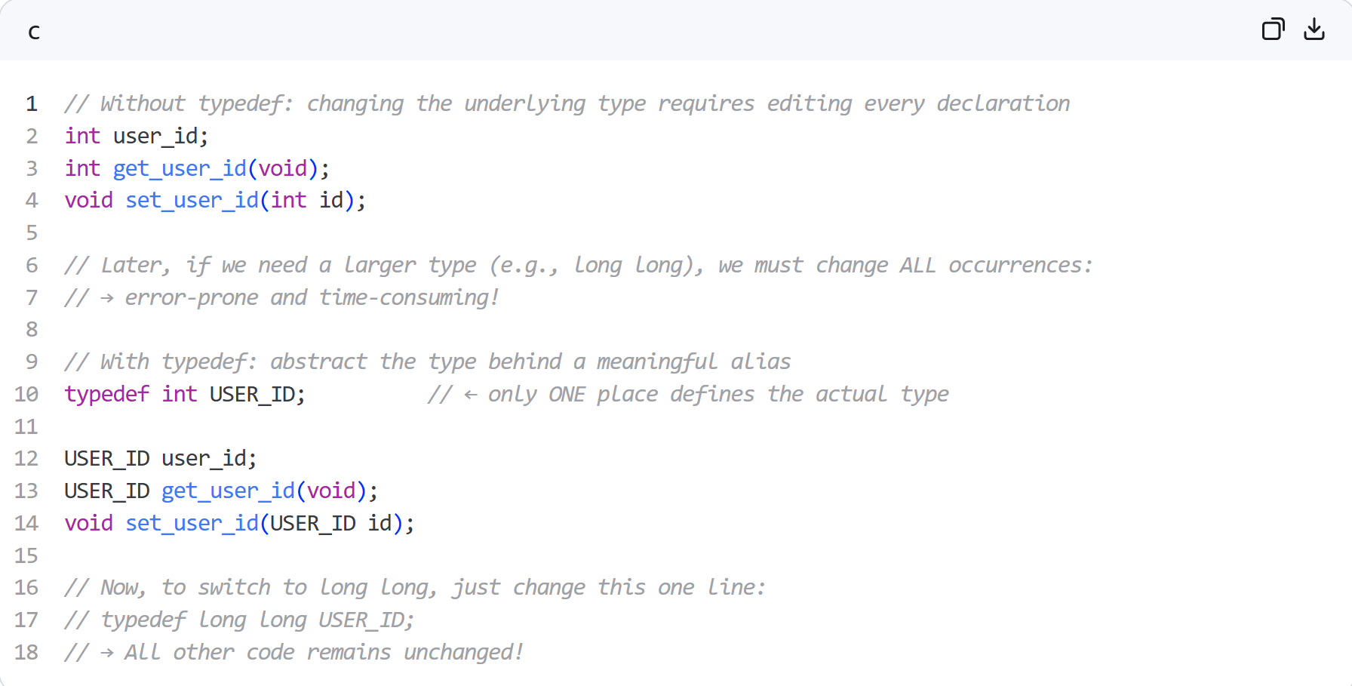
Typedef
Why type aliases?
abstract programs from the underlying types they use

Slide 18
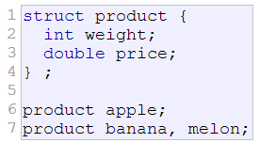

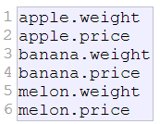
Struct
Data structure: a group of data elements (members) grouped together under one name.
Access the object’s members:

Slide 19
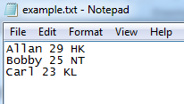
Exercise 3
typedef struct Student_Data Sdata;
struct Student_Data
{
char name[50];
int age;
char address[50];
};
int main()
{
Sdata *p;
p = (Sdata*)malloc(sizeof(Sdata));
FILE *fp = fopen(“example.txt”, ”r”);
fscanf(fp, ”%s %d %s”, p->name, &p->age, p->address);
free(p);
fclose(fp);
return 0;
}

Slide 20
Exercise 4.1
What is the output?
void exchange(int a, int b)
{
int temp = a;
a = b;
b = temp;
}
void main()
{
int a = 3, b = 7;
printf("Before exchanging: a=%d, b=%d\n", a, b);
exchange(a, b);
printf("After exchanging: a=%d, b=%d\n", a, b);
}

Slide 21
Exercise 4.2
What is the output?
void exchange(int *a, int *b)
{
int temp = *a;
*a = *b;
*b = temp;
}
void main()
{
int a = 3, b = 7;
printf("Before exchanging: a=%d, b=%d\n", a, b);
exchange(&a, &b);
printf("After exchanging: a=%d, b=%d\n", a, b);
}

Slide 22
Exercise 4.3
What is the output?
void exchange(int *a, int *b)
{
int* temp = a;
a = b;
b = temp;
}
void main()
{
int a = 3, b = 7;
printf("Before exchanging: a=%d, b=%d\n", a, b);
exchange(&a, &b);
printf("After exchanging: a=%d, b=%d\n", a, b);
}

Slide 23
Exercise 4.4
What is the output?
void exchange(int& a, int& b)
{
int temp = a;
a = b;
b = temp;
}
void main()
{
int a = 3, b = 7;
printf("Before exchanging: a=%d, b=%d\n", a, b);
exchange(a, b);
printf("After exchanging: a=%d, b=%d\n", a, b);
}

Slide 24
Summary
Pointer
Malloc
Typedef
Struct
Reference: http://www.cplusplus.com/

Slide 25

Help Us Shape Your Learning Experience!
https://docs.google.com/forms/d/e/1FAIpQLSeQae3jZ9up030JrhCl7LyjZAr3PGCvO0NQo0zzIhaL0jOeOg/viewform?usp=header

