Slide 1
CSCI2520 Tutorial 3: Hashtable
Pan Zhenyu
zypan24@cse.cuhk.edu.hk
Slide Ack: modified based on the slides from Li Hui

Slide 2
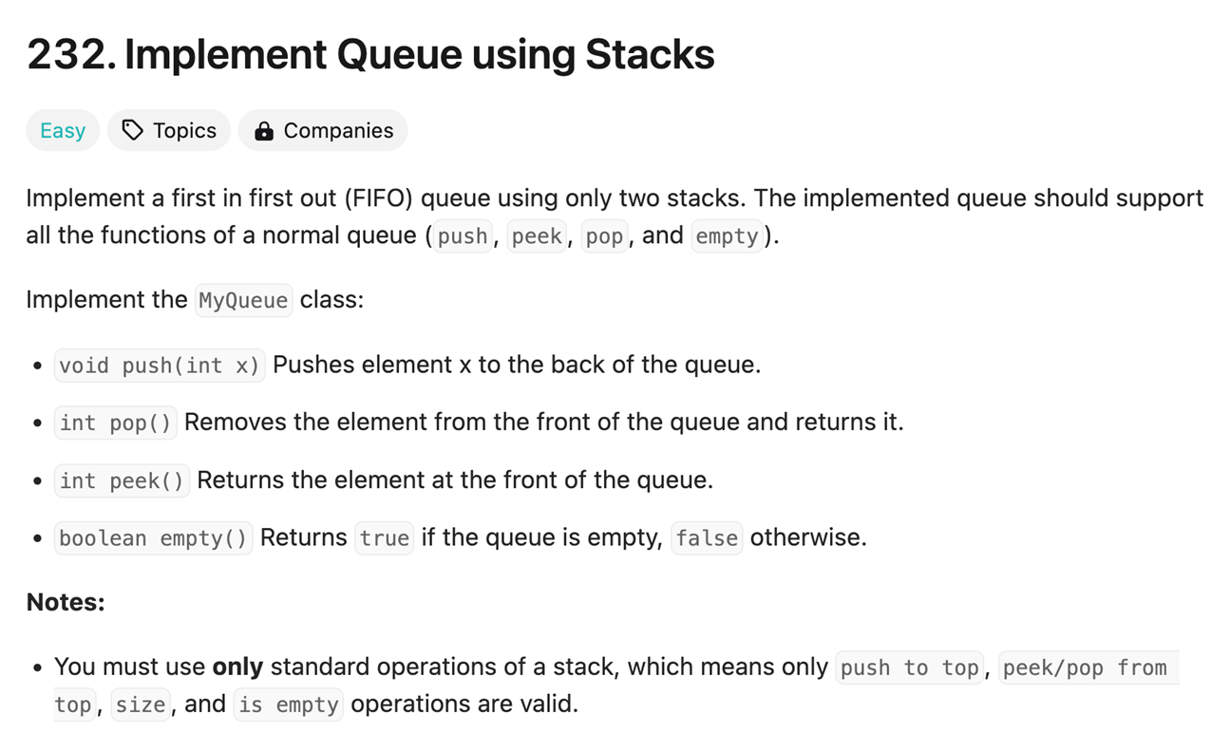
Recap

Slide 3
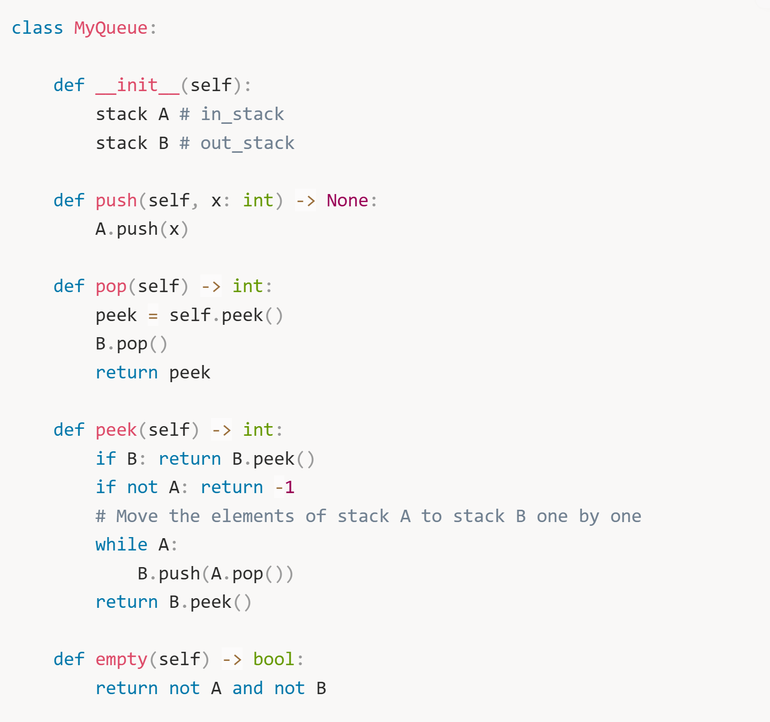

Slide 4
Outline
Hashtable
Hash function
Collision
Open addressing
Chaining

Slide 5
Hashtable
Hashtable is a data structure for implementing dictionary operations: insert, search, and delete.
A hashtable is a symbol table that applies a hash function on a given key to look up the corresponding value in the table
Fundamental operations include:
Insert: insert a particular value for a specified key
Look up: retrieve the corresponding value for a specified key
Notes:
std::map, std::unordered_map

Slide 6
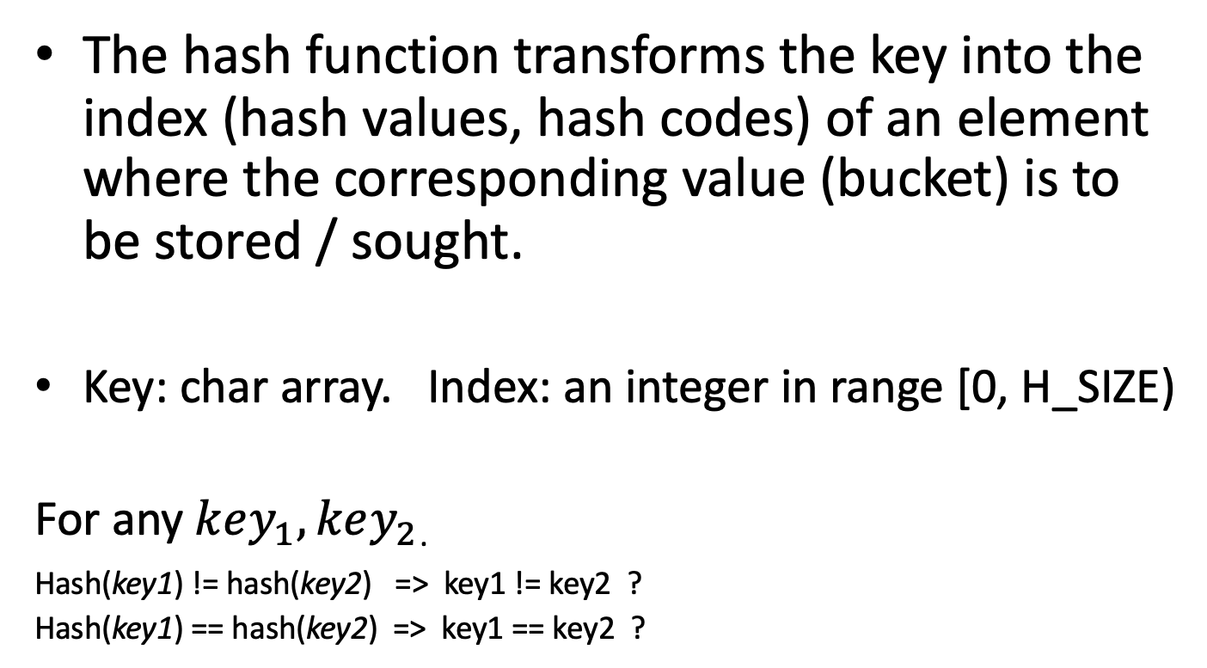
Hash Function
The hash function transforms the key into the index (hash values, hash codes) of an element where the corresponding value (bucket) is to be stored / sought.
Key: char array. Index: an integer in range [0, H_SIZE)
For any$key_{1}, key_{2}$.
Hash(key1) != hash(key2) => key1 != key2 ?
Hash(key1) == hash(key2) => key1 == key2 ?
Hash(key) = index
Notes:
Yes;
NO, mapping a char array to a int is a many to one mapping

Slide 7
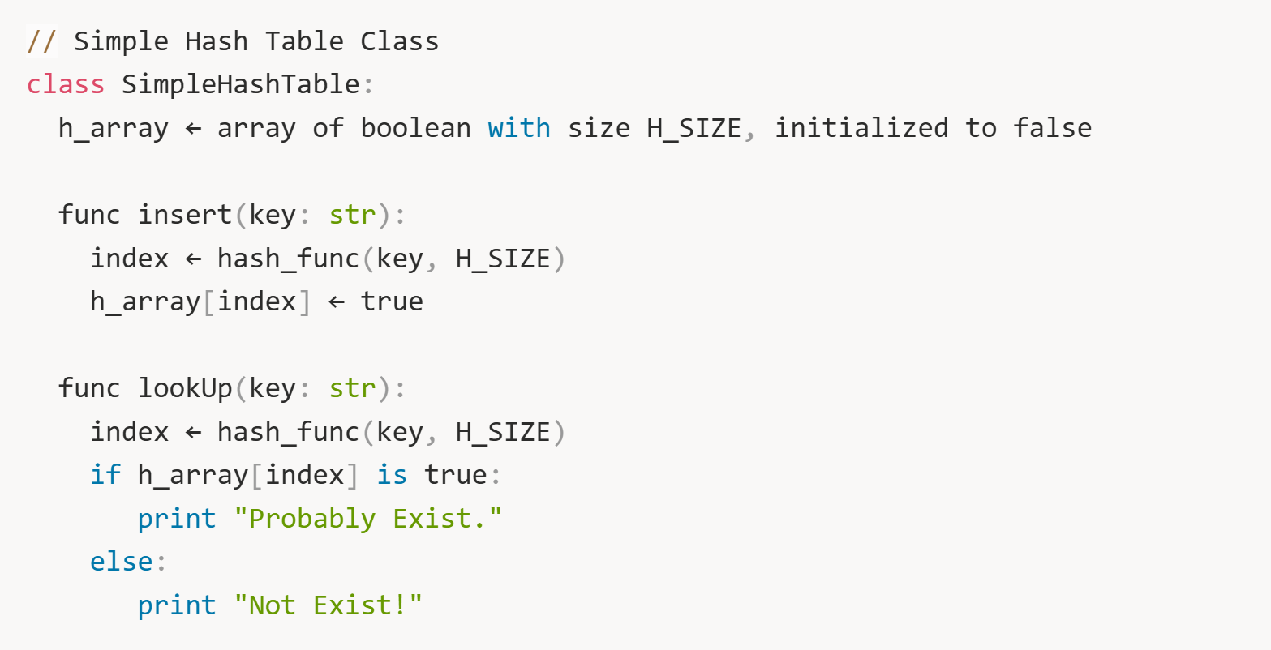
Hashtable
A very simple approach for Hashtable:
Notes:
We know the defineition

Slide 8
Hash Function
Properties of good hash function:
correct (produce a number within the range)
reduce the number of collisions
evenly distributes the keys into buckets
quick to compute

Slide 9
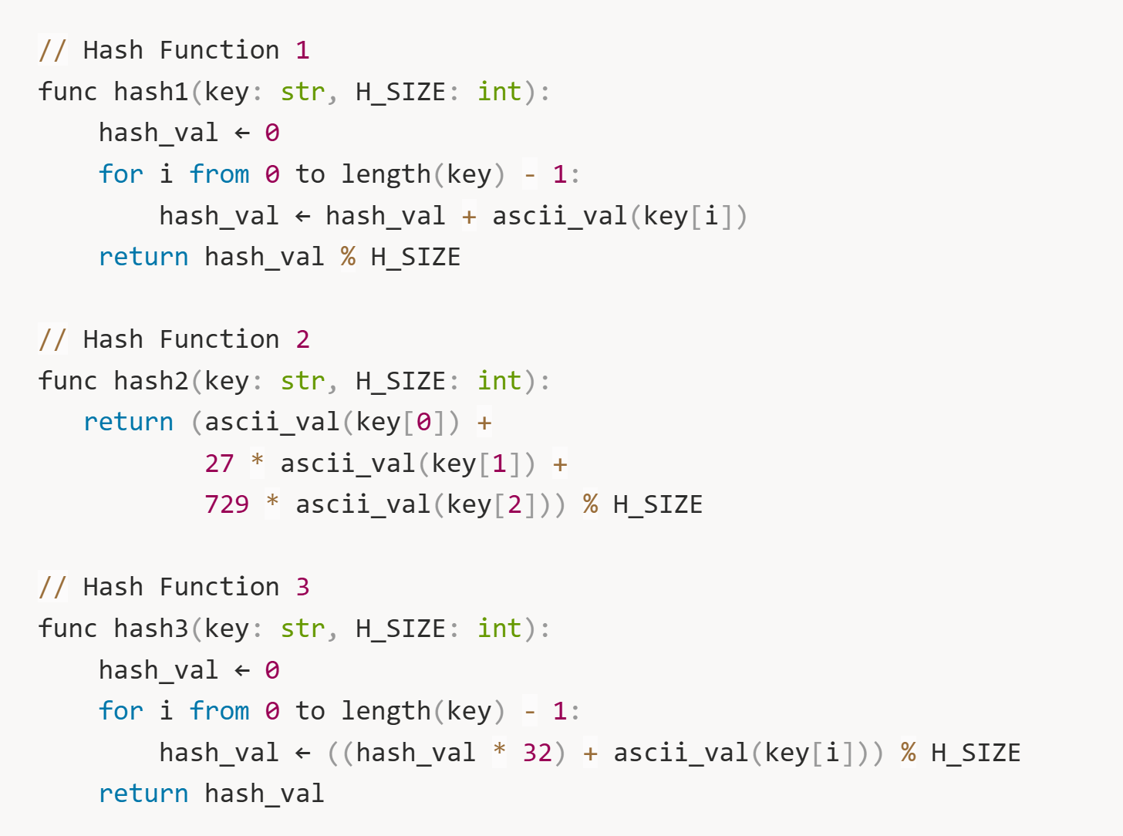
Exercise 1
Discuss the pros and cons of the hash functions

Slide 10
Collision in Hashing
Collision: two keys may hash to the same slot
Handle Collision in Hashing
Open Addressing
Chaining

Slide 11
Open Addressing
If a collision occurs, alternate cells are tried until an empty cell is found
Let h₀ = Hash(key)
If h₀ collides,
probe h₁ = (h₀ + F(1)) % H_SIZE.
If h₁ collides,
probe h₂ = (h₀ + F(2)) % H_SIZE.
If h₂ collides,
probe h₃ = (h₀ + F(3)) % H_SIZE.
…

Slide 12
Linear Probing
Linear probing is a collision resolution method using F(i)=i (sequential search).
Probe h₀ = Hash(key).
Probe h₁ = (h₀ + 1) % H_SIZE.
Probe h₂ = (h₀ + 2) % H_SIZE.
Probe h₃ = (h₀ + 3) % H_SIZE.
…
Until an empty bucket is found.
Insert the entry at the empty bucket.

Slide 13
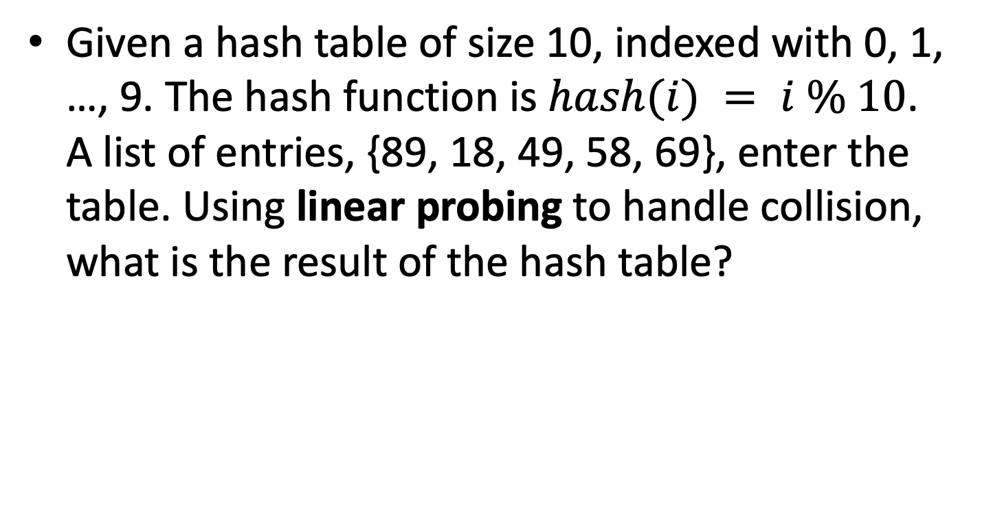
Exercise 2
Given a hash table of size 10, indexed with 0, 1, …, 9. The hash function is $hash(i) = i \% 10$. A list of entries, {89, 18, 49, 58, 69}, enter the table. Using linear probing to handle collision, what is the result of the hash table?

Slide 14
Exercise 2 Solution
Bucket | Value
0
1
2
3
4
5
6
7
8
9
$$hash(i) = i \% 10$$
{89, 18, 49, 58, 69},
F(i)=i

Slide 15
Exercise 2 Solution
Bucket | Value
0 | 49
1 | 58
2 | 69
3
4
5
6
7
8 | 18
9 | 89
$$hash(i) = i \% 10$$
{89, 18, 49, 58, 69},
F(i)=i

Slide 16
Quadratic Probing
Quadratic probing is a collision resolution method that eliminates the primary clustering problem of linear probing. The popular choice is F(i)=i².
Probe h₀ = Hash(key).
Probe h₁ = (h₀ + 1) % H_SIZE.
Probe h₂ = (h₀ + 4) % H_SIZE.
Probe h₃ = (h₀ + 9) % H_SIZE.
Probe h₄ = (h₀ + 16) % H_SIZE.
…

Slide 17
Exercise 3
Given a hash table of size 10, indexed with 0, 1, …, 9. The hash function is h(i) = h(i) % 10. A list of entries, {89, 18, 49, 58, 69}, enter the table. Using quadratic probing to handle collision, what is the result of the hash table?

Slide 18
Exercise 3 Solution
Bucket | Value
0
1
2
3
4
5
6
7
8
9
$$hash(i) = i \% 10$$
{89, 18, 49, 58, 69},
F(i)=i²

Slide 19
Exercise 3 Solution
Bucket | Value
0 | 49
1
2 | 58
3 | 69
4
5
6
7
8 | 18
9 | 89
$$hash(i) = i \% 10$$
{89, 18, 49, 58, 69},
F(i)=i²

Slide 20
Double Hashing Collision Handle Method
Double hashing uses another hash function Hash₂ to handle collision
h₀ = Hash(key, N_{buckets})
h₁ = (h₀ + 1 × Hash₂(key, N_{buckets})) % N_{buckets}
h₂ = (h₀ + 2 × Hash₂(key, N_{buckets})) % N_{buckets}
h₃ = (h₀ + 3 × Hash₂(key, N_{buckets})) % N_{buckets}
…
Performance is better than linear and quadratic probing in general, but it requires 2 hash functions.
F(i) = i × Hash₂(key, N_{buckets})

Slide 21
Exercise 4
Given a hash table of size 10, indexed with 0, 1, …, 9. The hash function is h(i) = i % 10. A list of entries, {89, 18, 49, 58, 69}, enter the table. Using double hashing with hash function h’(i) = 7 – (i % 7), to handle collision, what is the result of the hash table?
What would happen if 23 is added into the result hash table?

Slide 22
Exercise 4 Solution
Bucket | Value
0 | 69
1
2
3 | 58
4
5
6 | 49
7
8 | 18
9 | 89

Slide 23
Chaining
In chaining, we put all elements that hash to the same slot in a linked list
Slot j contains a header node of the list that stores all elements that are hashed to j.
buckets
K
Notes:
Open Addressing
Chaining

Slide 24
Exercise 5
Insert 36, 18, 72, 43, 6, 10, 5, 15 one by one
table size: 8
hash function: key % table size
collision: chaining

Slide 25
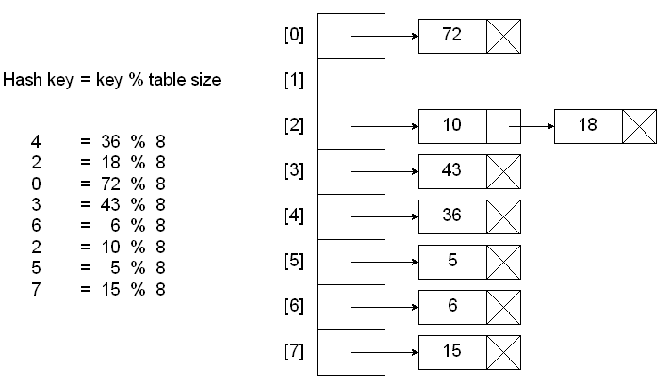
Exercise 5 Solution

Slide 26
Double Hash Function
Double hash function uses two hash function Hash₁ Hash₂ to represent the hash value
Less collision than single hashing
Hash(key)= combine(Hash₁(key), Hash₂(key))

Slide 27
Exercise 6
How to calculate the intersection of two sets of integers?
Input: two sets A₁, A₂
A₁ = {4, 5, 6, 7, 1, 2, 300, 8, 9, 10}
A₂ = {10, 11, 12, 8, 600}
Output: {8, 10}

Slide 28
Exercise 6 Solution
Method
build a hashtable H for A₁
look up every element of A₂ in H
expected comparison operations: n₁ + n₂ (assuming uniform hashing)

