Slide 1
CSCI2520 Tutorial 9: Graph
Pan Zhenyu
zypan24@cse.cuhk.edu.hk
Slide Ack: modified based on the slides from Li Hui

Slide 2
Outline
Graph Traversal
DFS
BFS
Minimum Spanning Tree
Prim’s
Kruskal
Shortest Path
Dijkstra

Slide 3
Depth First Search (DFS)
DFS is an algorithm for traversing or searching tree or graph data structures.
1. Select a root node
2. Explores as far as possible along each branch before backtracking
Usually use a stack to keep track of node path
Use a bool array to tag visited

Slide 4
Depth First Search
Start at node A
Current stack [A]
B
C
A
F
D
E

Slide 5
Depth First Search
Current node B
Current stack [A, B]
B
C
A
F
D
E

Slide 6
Depth First Search
Current node C
Current stack [A, B, C]
B
C
A
F
D
E

Slide 7
Depth First Search
Current node F
Current stack [A, B, C, F]
B
C
A
F
D
E

Slide 8
Depth First Search
Current node F
Current stack [A, B, C, F]
F don’t have children! Backtracking
B
C
A
F
D
E

Slide 9
Depth First Search
Current node C
Current stack [A, B, C]
B
C
A
F
D
E

Slide 10
Depth First Search
Current node D
Current stack [A, B, C, D]
Find other children of C
B
C
A
F
D
E

Slide 11
Depth First Search
Current node E
Current stack [A, B, C, D, E]
B
C
A
F
D
E

Slide 12
Depth First Search
Current node E
Current stack [A, B, C, D, E]
Backtracking
B
C
A
F
D
E

Slide 13
Depth First Search
Current node D
Current stack [A, B, C, D]
Backtracking
B
C
A
F
D
E

Slide 14
Depth First Search
Current node C
Current stack [A, B, C]
Backtracking
B
C
A
F
D
E

Slide 15
Depth First Search
Current node B
Current stack [A, B]
Backtracking
B
C
A
F
D
E

Slide 16
Depth First Search
Current node A
Current stack [A]
Backtracking
B
C
A
F
D
E

Slide 17
Depth First Search
Stack is empty, DFS done!
Current stack []
B
C
A
F
D
E

Slide 18
Exercise 1
Implement the following function
The definition of nodeCDT is as follows
Func DepthFirstSearch(nodes: list)
struct nodeCDT {
id: int
neighbors: list
# neighbors’ Node ID
}

Slide 19
Exercise 1 Solution
visited: list # list of Boolean
Func visit(curr: int):
visited[curr] = true
n: nodeADT = nodes[curr];
# do something
for neighbor_id in n.neighbors)
if (!visited[neighbor_id]):
visit(neighbor_id)
Func DepthFirstSearch(nodes: list):
for int i = 0 to (nodes.size() – 1):
visited[i] = false
i = i + 1
visit(0)

Slide 20
Breadth First Search (BFS)
BFS is an algorithm for traversing or searching tree or graph data structures.
1. Select a root node
2. Explores all nodes at the present depth prior to moving on at the next depth level
Usually use a queue to keep track of children
Use a bool array to tag visited

Slide 21
Breadth First Search
Start at node A
Current queue [A]
B
C
A
F
D
E

Slide 22
Breadth First Search
Current node A
Current queue [A, B, D]
B
C
A
F
D
E

Slide 23
Breadth First Search
Current node B
Current queue [B, D, C]
B
C
A
F
D
E

Slide 24
Breadth First Search
Current node D
Current queue [D, C, E]
B
C
A
F
D
E

Slide 25
Breadth First Search
Current node C
Current queue [C, E, F]
B
C
A
F
D
E

Slide 26
Breadth First Search
Current node E
Current queue [E, F]
B
C
A
F
D
E

Slide 27
Breadth First Search
Current node F
Current queue [F]
B
C
A
F
D
E

Slide 28
Breadth First Search
Queue is empty, BFS done!
Current queue []
B
C
A
F
D
E

Slide 29
Exercise 2
Implement the following function
The definition of nodeCDT is as follows
Func BreadthFirstSearch(nodes: list)
struct nodeCDT {
id: int
neighbors: list
# neighbors’ Node ID
}

Slide 30
Exercise 2 Solution
Func BreadthFirstSearch(nodes: list):
visited: list # list of Boolean
for int i = 0 to (nodes.size() – 1):
visited[i] = false
i = i + 1
Queue<nodeADT> q
q.enqueue(nodes[0])
while (!q.isEmpty()):
n: nodeADT = q.pop()
// do something
for neighbor_id in n.neighbors:
if (!visited[neighbor_id]):
q.enqueue(nodes[neighbor_id])
visited[n.id] = true

Slide 31
Prim’s Algorithm (MST)
Prim’s algorithm is a greedy algorithm that’s finds a MST for a weighted undirected graph.
Building this tree one vertex at a time
1. Start from an arbitrary vertex
2. Adding the cheapest possible connection from the tree to another vertex

Slide 32
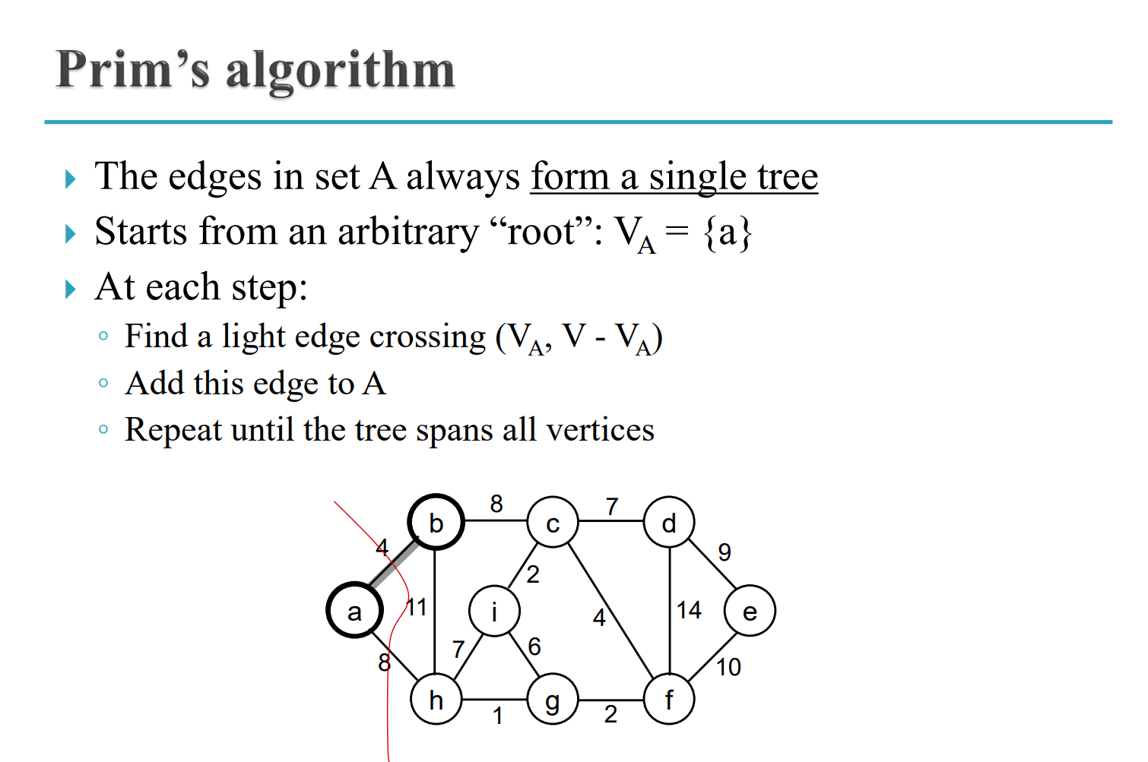

Slide 33
Prim’s Algorithm (MST)
Consider the following graph
Start at node A
B
3
C
1
A
2
7
8
5
D
6
E

Slide 34
Prim’s Algorithm (MST)
Start at node A
Edge priority queue
[(A-B, 1), (A-D, 5)]
B
3
C
1
A
2
7
8
5
D
6
E

Slide 35
Prim’s Algorithm (MST)
Append B to MST
Edge priority queue
[(B-D, 2), (B-C, 3), (A-D, 5)]
B
3
C
1
A
2
7
8
5
D
6
E

Slide 36
Prim’s Algorithm (MST)
Append D to MST
Edge priority queue
[(B-C, 3), (A-D, 5), (D-E, 6), (D-C, 7)]
B
3
C
1
A
2
7
8
5
D
6
E

Slide 37
Prim’s Algorithm (MST)
Append C to MST
Edge priority queue
[(A-D, 5), (D-E, 6), (D-C, 7), (C-E, 8)]
B
3
C
1
A
2
7
8
5
D
6
E

Slide 38
Prim’s Algorithm (MST)
Append E to MST (ignore edge (A-D, 5))
Edge priority queue
[(A-D, 5), (D-E, 6), (D-C, 7), (C-E, 8)]
B
3
C
1
A
2
7
8
5
D
6
E

Slide 39
Prim’s Algorithm (MST)
Ignore the rest edges. Find MST Done!
Edge priority queue
[]
B
3
C
1
A
2
7
8
5
D
6
E

Slide 40
Kruskal’s Algorithm (MST)
Find an MST of an undirected weighted graph.
A greedy algorithm
1. Sort the edges.
2. In each step it adds the next lowest-weight edge that will not form a cycle to the minimum spanning forest.

Slide 41
Kruskal’s Algorithm (MST)
Sort the edges.
[(A-B), (B-D), (B-C), (A-D), (D-E), (C-D), (C-E)]
B
3
C
1
A
2
7
8
5
D
6
E

Slide 42
Kruskal’s Algorithm (MST)
Add edge (A-B)
[(A-B), (B-D), (B-C), (A-D), (D-E), (C-D), (C-E)]
B
3
C
1
A
2
7
8
5
D
6
E

Slide 43
Kruskal’s Algorithm (MST)
Add edge (B-D)
[(A-B), (B-D), (B-C), (A-D), (D-E), (C-D), (C-E)]
B
3
C
1
A
2
7
8
5
D
6
E

Slide 44
Kruskal’s Algorithm (MST)
Add edge (B-C)
[(A-B), (B-D), (B-C), (A-D), (D-E), (C-D), (C-E)]
B
3
C
1
A
2
7
8
5
D
6
E

Slide 45
Kruskal’s Algorithm (MST)
Add edge (D-E)
[(A-B), (B-D), (B-C), (A-D), (D-E), (C-D), (C-E)]
B
3
C
1
A
2
7
8
5
D
6
E

Slide 46
Kruskal’s Algorithm (MST)
All Node find, MST Done!
[(A-B), (B-D), (B-C), (A-D), (D-E), (C-D), (C-E)]
B
3
C
1
A
2
7
8
5
D
6
E

Slide 47
Dijkstra (Shortest Path)
Finding the shortest paths between nodes in a weighted graph.
While not all vertices are visited
Pick the unvisited vertex v whose current best cost is minimum.
For any other vertex u that can be reached cheaper via v
Update the current best cost and path of u.

Slide 48
Exercise 3
Given a n*m matrix and each node has a weight. You are required to find a path starting from top-left point M[1][1] to the bottom-right point M[n][m] meanwhile minimize path weight. Some node cannot be visit.
1
2
5
1
4
1
N
N
1
2
1
1

Slide 49
Exercise 3 Solution
We can construct a graph contains n*m nodes
Connect v[i][j] with v[i][j+1] and v[i+1][j]
Avoid the node in boundary and the node cannot be visited
Run Dijkstra from v[1][1], get the result v[n][m].
1
2
5
1
4
1
N
N
1
2
1
1

Slide 50
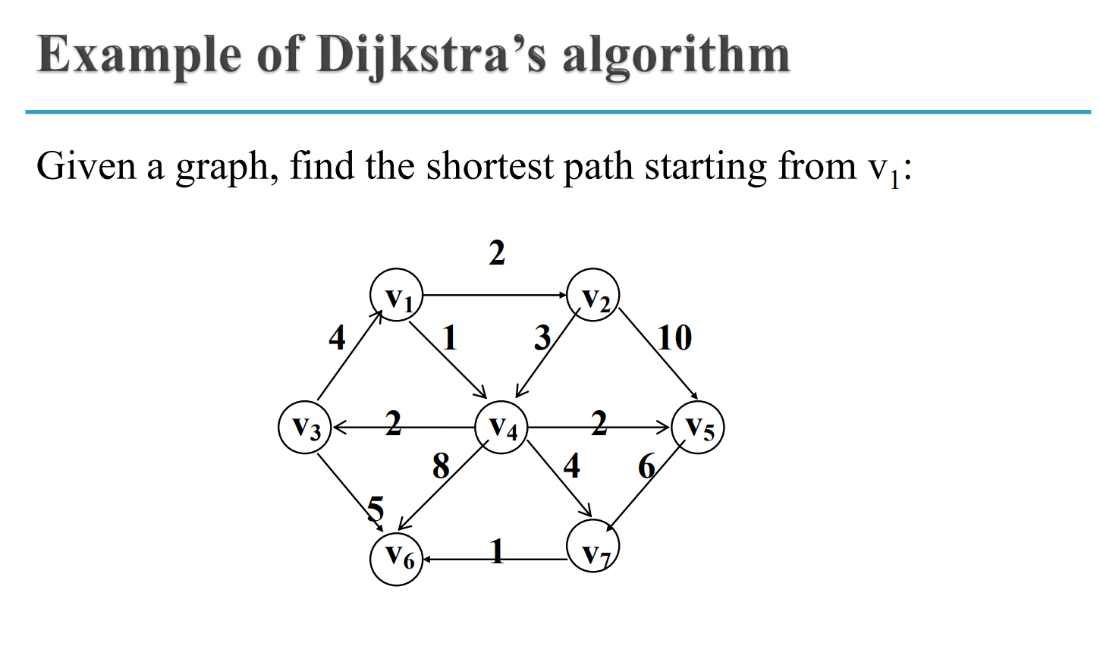
Exercise 4

Slide 51
Summary
Graph Traversal
DFS
BFS
Minimum Spanning Tree
Prim’s
Kruskal
Shortest Path
Dijkstra

