Slide 1
CSC2520 Data Structures & Applications
Supplement to DFS & BFS
By Matthew Tang Wai Chung

Slide 2
Exploring a Maze
How to explore a maze without getting lost?
  Unroll a ball of string → always find way out
How to ensure we explore every part of the maze (treasure hunting)?
  Do not retrace steps unless we have to
  We need to mark places that we have been
Maze Properties
Lights (initially off) in every intersections
Doors (initially close) at both ends of every passage
Windows on doors that the light is strong enough we can whether see another end is lit or not
Page <number>
Notes:
Adopt from Sedgewick: “Algorithm in C”

Slide 3

Maze Example
light
Page <number>

Slide 4
Trѐmaux Exploration
If there is no closed doors at the current intersection, go to step (3).
Otherwise, open any closed door and leave it open.
If you see another the other end is already lighted, try another door.
Otherwise, follow the passage and unroll the string as you go, turn on the light and go to step (1).
If all the doors are open, check whether you are back to the start point. If so, stop.
If not, use the string to go back. Rolling the string as you go, and look for another closed door (repeat step (1)).
Page <number>

Slide 5
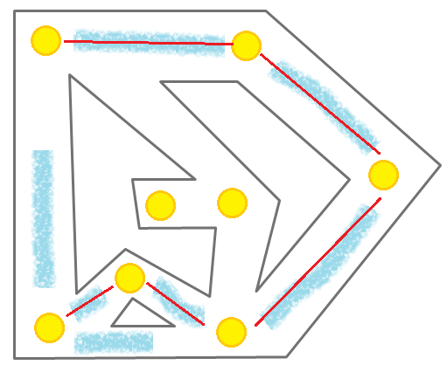
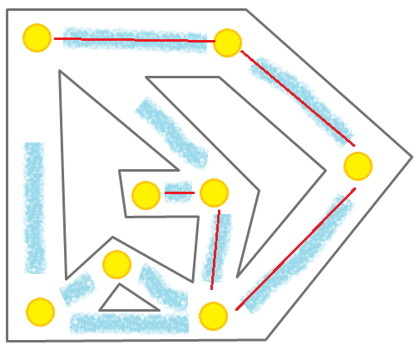
Trѐmaux Exploration: Illustration
string
Page <number>

Slide 6
Depth-First Search
The strategy in depth-first search (DFS) is to search deeper in the graph whenever possible.
We explore out of the most recent discovered vertex v that still has unexplored edges leaving it.
When all v's edges have been explored, the search backtracks to explore edges leaving the vertex from which v is discovered.
If any discovered vertices remain, then one of them is selected as a new source and the search is repeated.
The entire process is repeated until all vertices are discovered.
Page <number>

Slide 7
Depth-First Search (2)
Vertices are colored during the search to indicate their state.
Initially white, a vertex is grayed when it is discovered in the search, and is blackened when it is finished.
DFS timestamps each vertex twice: the first d[v] when v is discovered, and the second f[v] when the vertex is blackened.
The timestamps are useful in many algorithms and helpful in reasoning about the behavior of DFS.
Page <number>
Notes:
One example is topological sort.

Slide 8
DFS: Code
Initialization: O(|V|)
For each white vertex in the graph, we start the recursive call dfs_visit(). O(|V|)
35 void graph_dfs(graph_t *g){
36 int i;
38 color = (char *)malloc(g->n * sizeof(int));
39 d = (int *)malloc(g->n * sizeof(int));
40 f = (int *)malloc(g->n * sizeof(int));
41 p = (int *)malloc(g->n * sizeof(int));
42
43 for (i = 0; i < g->n; i++){
44 color[i] = DFS_WHITE;
45 p[i] = DFS_NULL;
46 }
47 time = 0;
48 for (i = 0; i < g->n; i++)
49 if (color[i] == DFS_WHITE)
50 dfs_visit(g, i);
Page <number>

Slide 9
DFS: Code (2)
Actual routine: mark vertex gray. And continue traverse down every white vertex appears on Adj[u].
When we are done with this vertex, mark it black.
16 static void dfs_visit(graph_t *g, int u){
17 node_t *t;
18 int v;
19 color[u] = DFS_GRAY;
20 d[u] = time++;
21 printf("DFS: %d GRAYED\n", u);
23 for (t = g->adj[u]->next; t != NULL; t = t->next){
24 v = t->data;
25 if (color[v] == DFS_WHITE){
26 p[v] = u;
27 dfs_visit(g, v);
28 }
29 }
30 color[u] = DFS_BLACK;
31 printf("DFS: %d BLACKENED\n", u);
32 f[u] = ++time;
33 }
Page <number>

Slide 10
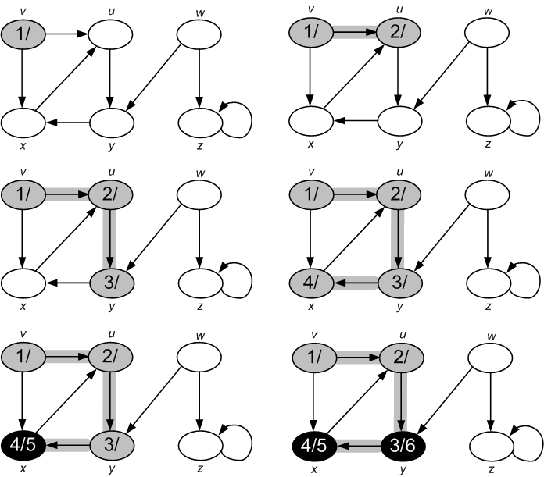
DFS: Example
Page <number>

Slide 11
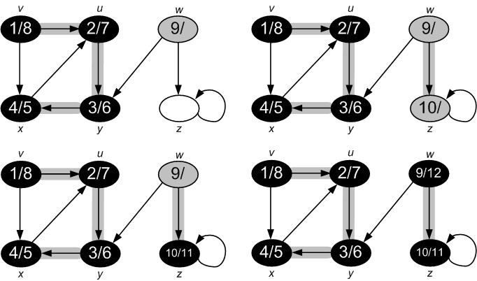
DFS: Example (2)
Page <number>

Slide 12
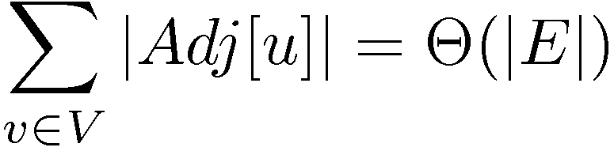
DFS: Analysis
Initializations and first loop execute in Θ(|V|) time. dfs_visit() executes once for each vertex.
Inside dfs_visit(), the loop executes |Adj[v]| times. Since
The total cost of line 23-28 is Θ(|E|).
The running time of DFS is Θ(|V| + |E|).
Page <number>

Slide 13
Breadth-First Search
Breadth-first search (BFS) is one of the simplest algorithms for searching a graph.
Given a graph G = (V, E), we pick a distinguished source vertex s, BFS systemically explores the edges of G to discover every vertex that is reachable from s.
It computes the distance (smallest number of edges) from s to each reachable vertex.
Works on both directed or undirected graphs.
Breadth: discovers all vertices at distance k from s before discovering any vertex at distance k + 1.
Page <number>

Slide 14
Vertex Coloring in BFS
To keep track of progress, breadth-first search colors each vertex white, gray or black.
A vertex is discovered the first time, it will be marked non-white (gray or black).
Grey and black are used to make sure the search proceeds in a breadth-first manner.
If (u, v)ϵ E and vertex u is black, then vertex v is gray or black.
Gray vertices may have adjacent white vertices and represents the frontier between discovered and undiscovered vertices.
Page <number>

Slide 15
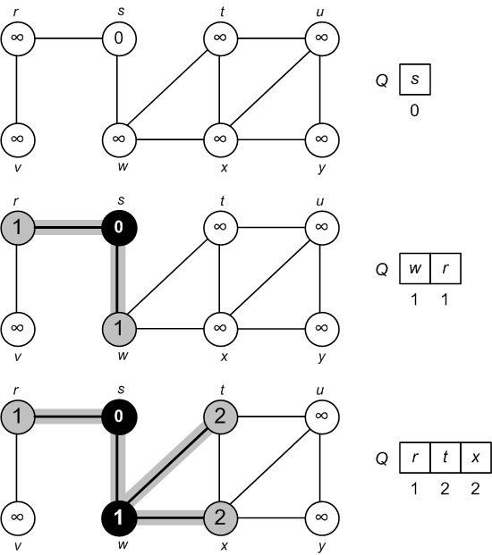
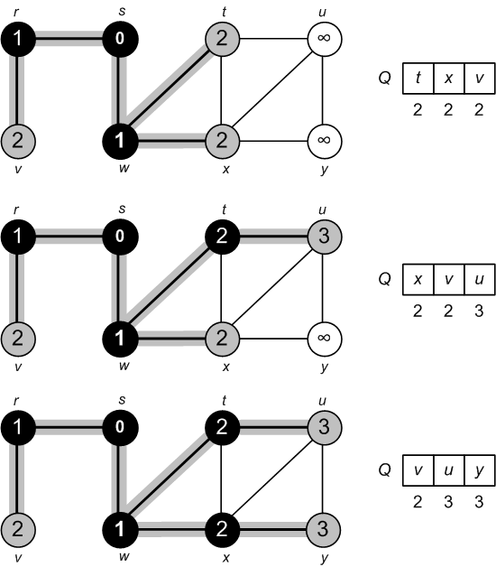
BFS: Example
Page <number>

Slide 16
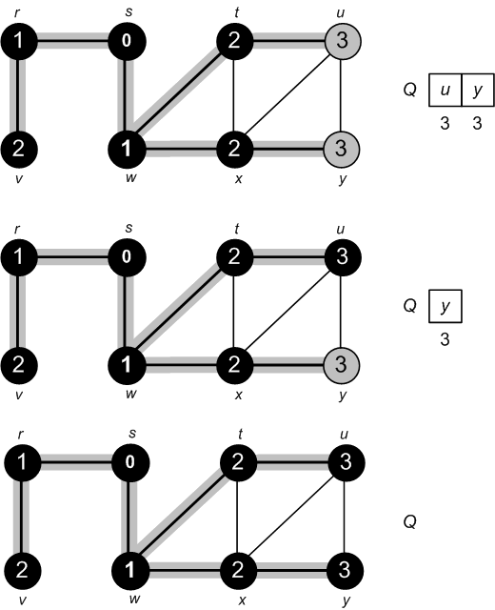
BFS: Example (2)
Page <number>

Slide 17
BFS: Code (1)
Variables: color: colors; d: distances; p: predecessors
We need a queue to keep track on the vertices that are on the frontier (initially contains s only).
13 void graph_bfs(graph_t *g, int s){
14 int i;
15 int u, v;
16 queue_t *q = queue_create(g->n);
17 char *color = (char *)malloc(g->n * sizeof(int));
18 int *d = (int *)malloc(g->n * sizeof(int));
19 int *p = (int *)malloc(g->n * sizeof(int));
20
21 for (i = 0; i < g->n; i++){
22 color[i] = BFS_WHITE;
23 d[i] = BFS_INFINITY;
24 p[i] = BFS_NULL;
25 }
26 color[s] = BFS_GRAY;
27 d[s] = 0;
28 queue_enq(q, s);
Page <number>

Slide 18
BFS: Code (2)
Line 34-35: Take a vertex u from the queue, go through Adj[u] and find all vertices v connected to u.
If v is white, mark it gray (new frontier) and enqueue v.
Line 39: The distance of v is 1 more than that of u.
29 while (!queue_is_empty(q)){
30 list_t *list; node_t *t;
31 u = queue_deq(q);
32 list = g->adj[u];
33 for (t = list->next; t != NULL; t = t->next){
34 v = t->data;
35 if (color[v] == BFS_WHITE){
36 color[v] = BFS_GRAY;
37 d[v] = d[u] + 1;
38 p[v] = u;
39 queue_enq(q, v);
40 printf("BFS: %d GRAYED\n", v);
41 }
42 }
43 color[v] = BFS_BLACK;
44 printf("BFS: %d BLACKENED\n", u);
45 }
Page <number>

Slide 19
BFS: Analysis
Initialization: O(|V|)
Check on line 35 makes sure every node is enqueued and dequeued once.
Since enqueue and dequeue run in O(1) time, the total time devoted to queue operations is O(|V|)
The adj. list of each node is traversed at most once, thus the total time is scanning the adj. lists is the sum of lengths of all lists = O(|E|).
Total running time is O(|V| + |E|).
NOTE: BFS computes shortest-path distances δ(s, v), i.e. the min. number of edges in any path from vertex s to v.
Page <number>

