Slide 1



Envoy
Subject:
Service Oriented Architectures
Professor: Dragan Stojanović
Students:
Milan Stanković 16893
Aleksandar Stamenković 16874
ENVOY IS AN OPEN SOURCE EDGE AND SERVICE PROXY, DESIGNED FOR CLOUD-NATIVE APPLICATIONS

Slide 2
Content
Introduction & characteristics
Demo architecture
Theory
API and service setup
Envoy setup

Slide 3

Characteristics
Originally built at Lyft
High performance C++ distributed proxy
Designed for single services and applications
Designed for large microservice "service mesh" architectures
Large community / widely adopted
Not only an API Gateway
L7 Routing (L3/L4 proxy at its core)
TLS (HTTPS) Termination
Retries
Load Balancing

Slide 4
Demo architecture
Docker Compose
Beverage API
:5002 / 80
Envoy
:9901
:10000
Client
Food API
:5001 / 80
Envoy.yaml

Slide 5
Direct Pattern
Good for small Microservices Applications
Not great for SPA’s, Mobile App Endpoints (Chatty round trips to multiple endpoints with many requests at the same time
What happens when you add more services? Clients directly coupled to Microservices
Client 1
Client 2
Service 1
Service 3
Service 2
Service 4

Slide 6
API Gateway Pattern
Client 1
Client 2
Replace multiple calls & acts as a “reverse proxy”
Platforms Routing
Separate out cross-cutting concerns, e.g.:
Authentication
Load Balancing
Static Content
API Gateway
Service 1
Service 3
Service 2
Service 4

Slide 7
API Gateway: Anti-Pattern?
Dangers of becoming bloated monolith
Single point of failure
Violating the autonomy of the Microservices (couples them)
Solve by segregating gateways along:
Business Boundaries
Client App Types (Backend for Frontend – BFF)
Client 1
Client 2
API Gateway
Service 1
Service 3
Service 2
Service 4

Slide 8
How envoy works
Listener
0.0.0.0 : 8001
Filters
Routes
Clusters
Endpoint
address : port

Slide 9
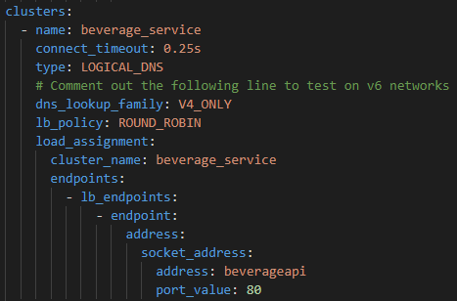
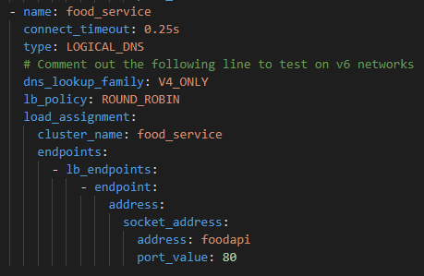
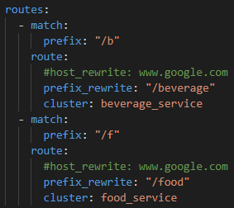
envoy.yaml implementation
Clusters
Cluster 1
Cluster 2
Routes

Slide 10


Used by

Slide 11
Features
ADVANCED LOAD BALANCING
Envoy supports advanced load balancing features including automatic retries, circuit breaking, global rate limiting, request shadowing, zone local load balancing, etc.
OUT OF PROCESS ARCHITECTURE
Envoy is a self contained, high performance server with a small memory footprint. It runs alongside any application language or framework.
APIS FOR CONFIGURATION MANAGEMENT
Envoy provides robust APIs for dynamically managing its configuration.
HTTP/2 AND GRPC SUPPORT
Envoy has first class support for HTTP/2 and gRPC for both incoming and outgoing connections. It is a transparent HTTP/1.1 to HTTP/2 proxy.
OBSERVABILITY
Deep observability of L7 traffic, native support for distributed tracing, and wire-level observability of MongoDB, DynamoDB, and more.

Slide 12
References
https://www.envoyproxy.io
https://www.youtube.com/channel/UCIMRGVXufHT69s1uaHHYJIA

