Slide 1

KMB689: Big Data for Business Applications
Seminar 10
Clustering
Instructor: Prof. Gun-woong Lee
Korea University Business School
Notes:
KMB689 Wk10 Block 1 | mapping: R1 | source: BUSS256 source slide 1; KMB689 source slide 1 branding

Slide 2
Today’s Outline
1.1 여는 이야기 — 감독 신조와 오늘의 기준
1.2 군집분석 직관 — 크기와 프로파일
1.3 DBSCAN — 밀도·핵심·경계·잡음
1.4 이 사례가 요구하는 판단
1.5 관리자의 군집 검증 5문
Notes:
KMB689 Wk10 Block 1 | mapping: R2 | source: BUSS256 source slide 2; Wk10 deck plan §4

Slide 3
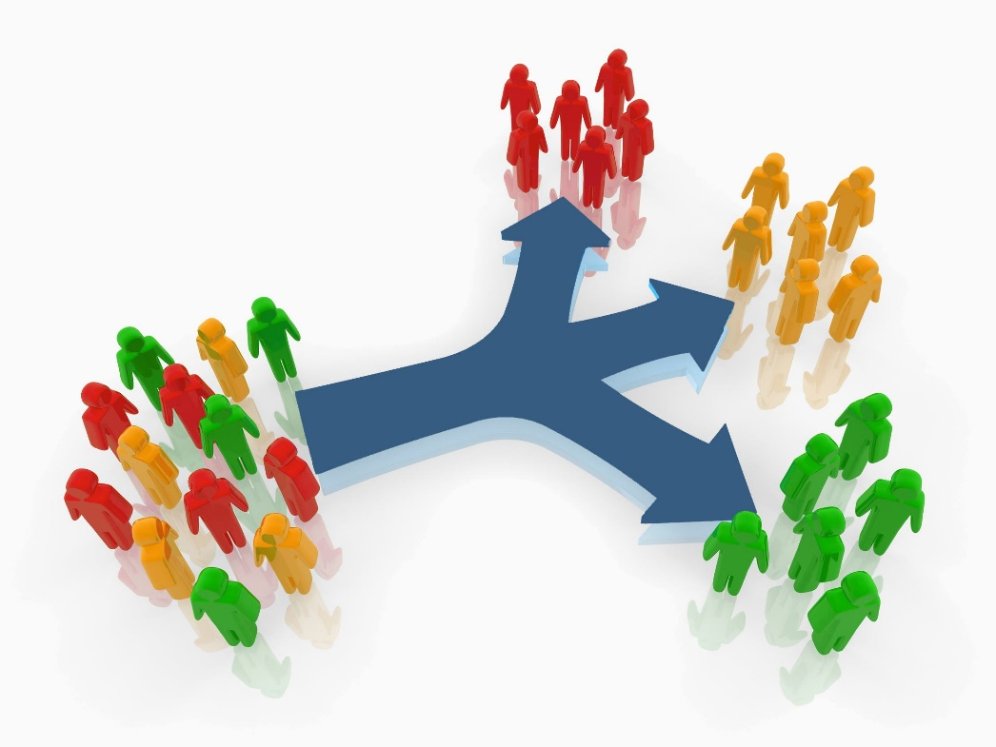
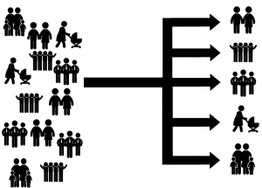
Clustering and Business Problems
Clustering is searching for patterns in complex data
  Patterns can lead to business decisions
Clustering is useful whenever diverse and varied data can be exemplified by a much smaller number of groups.
Marketing: Help marketers discover distinct groups in their customer bases, and then use this knowledge to develop targeted marketing programs
Bank/Internet Security: fraud/spam pattern discovery
Notes:
KMB689 Wk10 Block 1 | mapping: R5+R6 | source: BUSS256 source slides 5 and 6; exact source strings retained

Slide 4
1.1 · HOOK
감독 신조 recap
1
기준을 세운다
2
AI에게 시킨다
3
검증한다
4
결정한다
→
→
→
분석을 직접 하지 말고, 결과를 읽고 검증한 뒤 결정한다.
Notes:
KMB689 Wk10 Block 1 | mapping: N1 | source: MBA_S10_Block1_LectureNotes_KR.md §1.1

Slide 5
1.1 · STANDARD
오늘의 기준 두 개
①
각 군집의 실제 프로파일
어떤 변수가 높은가
②
잡음 비중
얼마나 많은 점이 어느 군집에도 안 들었나
이름은 해석이지 데이터가 아니다.
Notes:
KMB689 Wk10 Block 1 | mapping: N2 | source: MBA_S10_Block1_LectureNotes_KR.md §1.1

Slide 6
1.1 · OBJECTIVES
오늘의 목표 네 개
군집분석(clustering)이 무엇인지 — 비지도 그룹화 — 안다.
DBSCAN의 핵심점·경계점·잡음점을 읽는다.
한 군집을 크기 + 프로파일로 읽고, 잡음 비중을 확인한다.
AI가 군집을 과잉 명명하거나 잡음을 숨겼는지 잡는다.
Notes:
KMB689 Wk10 Block 1 | mapping: N3 | source: MBA_S10_Block1_LectureNotes_KR.md §1.1

Slide 7
Clustering
Clusters: groups of similar items/objects
Clustering is an unsupervised data-mining task that divides the data into clusters.
  Goal: Partitioning the data into sub datasets without any guidance
  Clustering is not driven by some pre-specified target characteristics.
  Clustering is used for knowledge discovery rather than prediction
Clustering is guided by the principle that the objects within a cluster should be very similar to each other, but the objects in different clusters are not so similar.
  Group the data so that the related elements are placed together!
Example: Do our customers naturally fall into different groups?
  Do we understand who our customers are?
  Can we develop better products, better marketing campaigns, better sales methods, or better customer service by understanding the natural grouping?
Notes:
KMB689 Wk10 Block 1 | mapping: R4 | source: BUSS256 source slide 4; exact source slide retained

Slide 8
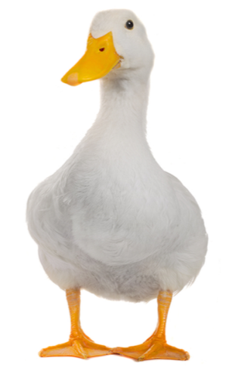
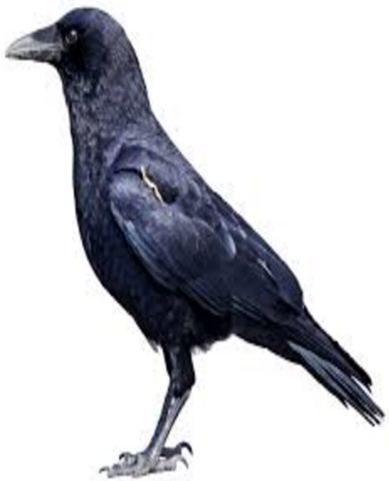
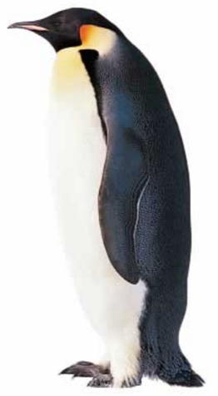
Similarity
  Clustering groups the data so that the related elements are placed together (i.e., similarity)
  What is similarity?
    Person A and Person B have the same weight and height, but different incomes?
    Are they similar?
  To illustrate the difficulties involved in judging similarity, consider your answer to the following question:
    Which is more similar to a duck; a crow or a penguin?
    Similarity between two objects is highly relying on their specific attributes!
Am I similar to
or
?
Notes:
KMB689 Wk10 Block 1 | mapping: R9 | source: BUSS256 source slide 9; exact source slide retained

Slide 9
Similarity and Distance
Annual Incomes
A: 10K
10K
90K
B: 20K
C: 100K
80K
Notes:
KMB689 Wk10 Block 1 | mapping: R10 | source: BUSS256 source slide 10; exact source slide retained

Slide 10
Similarity and Distance
In Data Science
  Similarity between objects = Distance (in numbers) between objects
  The closer two objects are in the space defined by the features, the more similar they are
Can we measure the similarity or distance between objects directly?
Consider two instances from credit application data
Attribute | Person A | Person B
Age | 23 | 40
Years at current address | 2 | 10
Residential Status(1=Owner, 2=Renter) | 2 | 1
Gender (1=Female, 2=Male) | 1 | 1
$$DAB=\sqrt{{(40−23)}^{2}+{\left(10−2\right)}^{2}+{\left(1−2\right)}^{2}+{\left(1−1\right)}^{2}}$$
Notes:
KMB689 Wk10 Block 1 | mapping: R11 | source: BUSS256 source slide 11; exact source slide retained

Slide 11
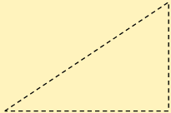
Euclidean Distance
How to compute the shortest distance between tow dots?
Pythagorean Theorem =
  Euclidean distance gives the linear distance between any two points in n-dimensional space.
  It is a generalization of the Pythagorean theorem.
(x1, x2)
x2
(0, 0)
x1
Euclidean Distance allows us to measure the similarity between objects having multiple attributes.
Notes:
KMB689 Wk10 Block 1 | mapping: R12+R13 | source: BUSS256 source slides 12 and 13; source strings retained verbatim

Slide 12
The Problem with Correlation
Attribute | Person A | Person B
x1 | 5 | 51
x2 | 4 | 42
x3 | 3 | 33
x4 | 2 | 24
x5 | 1 | 15
The correlation between Person A and Person B
is +1.0 which implies a perfect association.
  They are indistinguishable from one another looking at the correlation coefficient.
But are the customers really similar?
Notes:
KMB689 Wk10 Block 1 | mapping: R15 | source: BUSS256 source slide 15; source strings retained verbatim

Slide 13
Variable Standardization
Raw distance measures are highly influenced by scale of measurements.
A common practice employed prior to any analysis using distance calculations is to normalize or z-score standardize the variables so that each utilizes the same range.
  To avoid a problem in which some variables come to dominate solely because they have a large range of values than the other
  Note: Cluster analysis requires a data frame containing only numeric variables!
Notes:
KMB689 Wk10 Block 1 | mapping: R17+R20 | source: BUSS256 source slides 17 and 20; source strings retained verbatim

Slide 14
Variable Standardization
Attribute / Variable | Person A | Person B
Age | 15 | 50
Heights | 186 | 172
Daily income | $10 | $1,000
$$DAB=\sqrt{{(50−15)}^{2}+{\left(172−186\right)}^{2}+{(1000−10)}^{2}}$$
Notes:
KMB689 Wk10 Block 1 | mapping: R18 | source: BUSS256 source slide 18; exact source slide retained

Slide 15
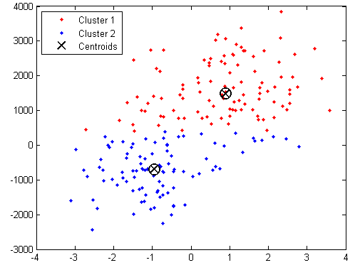
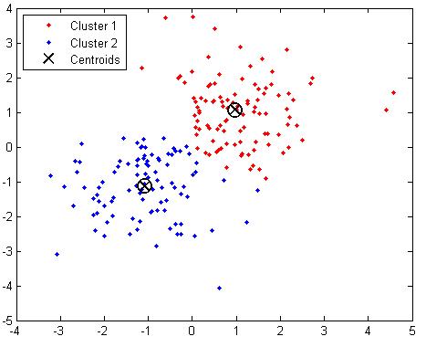
Example: Variable Standardization
Scale of a variable can influence the clustering outcomes !
Before Standardization
(Highly spreading out)
After Standardization
(Less spreading out)
Notes:
KMB689 Wk10 Block 1 | mapping: R19 | source: BUSS256 source slide 19; exact source slide retained

Slide 16
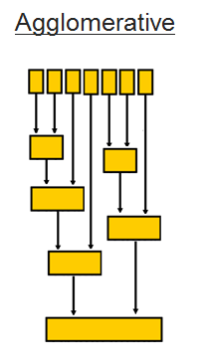
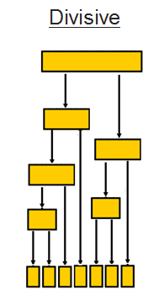
Hierarchical Methods
Given the input set S, the goal is to produce a hierarchy in which nodes represent subsets of S.
Observations are merged or split based on their similarities.
Agglomerative Methods (from N to 1 cluster)
  Begin with n-clusters (each record its own cluster)
    Consider every observation as a separate cluster at the beginning
  Keep joining records into clusters until one cluster is left (the entire data set)
  Most popular
Divisive Methods (from 1 to N clusters)
  Start with one all-inclusive cluster
  Repeatedly divide into smaller clusters until it has same number of clusters to the number of observations (N)
N Clusters
1 Cluster
1 Cluster
N Clusters
Notes:
KMB689 Wk10 Block 1 | mapping: R24+R25 | source: BUSS256 source slides 24 and 25; source strings retained verbatim

Slide 17
1.2 · READ THE RESULT
군집을 읽는 법 — 크기 + 프로파일
SIZE
이 군집에 몇 개의 점(고객)이 들었나
PROFILE
표에서 z값이 높은 변수를 찾는다
NAME
프로파일 수치로 방어된 뒤 붙인다
→
→
근거 변수를 못 대면 그 이름은 허구다.
Notes:
KMB689 Wk10 Block 1 | mapping: N4 | source: MBA_S10_Block1_LectureNotes_KR.md §1.2; 신규 — 포크 원본 부재

Slide 18
Clustering Algorithms
  Popular Clustering Algorithms
    Hierarchical
    k-means
    k-medoids
    Fuzzy c-means
  Different ways of measuring similarity
DBSCAN — density-based
Notes:
KMB689 Wk10 Block 1 | mapping: R23 | source: BUSS256 source slide 23; DBSCAN added from S10 blueprint §1.3

Slide 19
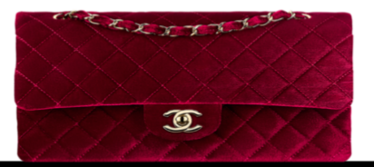
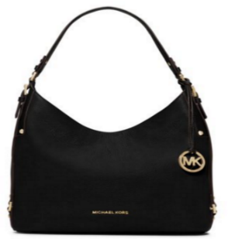
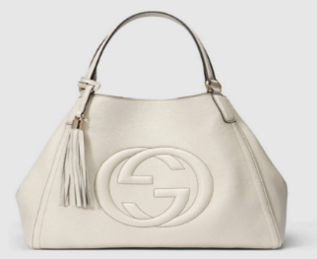

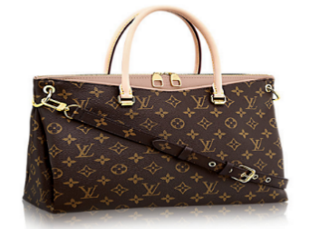
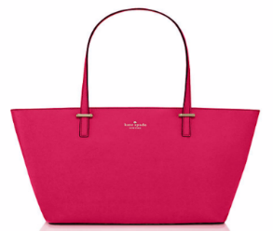
K-Means Clustering
It requires us to specify the number of cluster (=K)beforehand.
  K can be determined by your purpose or domain knowledge
It partitions the observations into K number of clusters.
Product | Country | Price | Size | Strap | Color | Logo | Purpose
GC | 1 | 1 | 3 | 1 | 1 | 1 | 1
CH | 1 | 3 | 1 | 2 | 2 | 1 | 2
LV | 1 | 2 | 3 | 1 | 2 | 1 | 1
HM | 1 | 4 | 2 | 2 | 1 | 0 | 2
MK | 0 | 0.5 | 3 | 1 | 2 | 2 | 1
KS | 0 | 0.3 | 2 | 2 | 1 | 2 | 1
K=3
Notes:
KMB689 Wk10 Block 1 | mapping: R53+R56+R60 | source: BUSS256 source slides 53, 56 and 60; exact source strings retained

Slide 20
1.3 · DBSCAN
빽빽한 곳을 군집으로 본다
DBSCAN
Density-Based Spatial Clustering
거리만이 아니라 주변의 밀도를 읽는다.
점들이 빽빽하게 모인 곳을 군집으로 본다.
Notes:
KMB689 Wk10 Block 1 | mapping: N5 | source: MBA_S10_Block1_LectureNotes_KR.md §1.3

Slide 21
1.3 · DBSCAN
핵심·경계·잡음 개념도
×
epsilon
×
minPts
×
핵심(core) — 주변에 이웃이 충분히 많은 점
경계(border) — 핵심점 근처의 점
잡음(noise) — 어느 군집에도 안 드는 점
Notes:
KMB689 Wk10 Block 1 | mapping: N6 | source: MBA_S10_Clustering_blueprint.md §1.3; editable native concept diagram

Slide 22
1.3 · DBSCAN
군집 개수를 미리 정하지 않는다
k-means
K를 먼저 지정
모든 점을 어떤 군집엔가 배정
DBSCAN
밀도에서 군집 수가 자연히 나옴
어느 군집에도 안 드는 점을 따로 표시
≠
Notes:
KMB689 Wk10 Block 1 | mapping: N7 | source: MBA_S10_Block1_LectureNotes_KR.md §1.3; BUSS256 source slides 53 and 60 contrast

Slide 23
1.3 · DBSCAN
파라미터 둘이 결과를 좌우한다
epsilon
반경
얼마나 가까워야 ‘이웃’인가
minPts
최소 이웃 수
핵심점이 되려면 이웃이 몇 개 필요한가
값을 바꾸면 군집 수와 잡음 비중이 달라진다.
Notes:
KMB689 Wk10 Block 1 | mapping: N8 | source: MBA_S10_Block1_LectureNotes_KR.md §1.3 and §1.4

Slide 24
1.3 · DBSCAN
반드시 물어라
얼마나 많은 데이터가
잡음(noise)인가?
이 점은 어느 무리에도 안 든다 — 결과가 말하는 중요한 정보다.
Notes:
KMB689 Wk10 Block 1 | mapping: N9 | source: MBA_S10_Block1_LectureNotes_KR.md §1.3

Slide 25
How to Determine the Number of Clusters
There is no rule or theory determining the optimal number of clusters!
The number of clusters depends on your purpose or domain knowledge!
  If you have experience in identifying the number of clusters for the products, you will need to have that number of product groups.
  If your boss asked you to have 3 clusters of clients, 3 clusters would be optimal.
  If you have limited marketing budget, smaller number of customer segments would be relevant.
Notes:
KMB689 Wk10 Block 1 | mapping: R50+R63 | source: BUSS256 source slides 50 and 63; exact source strings retained verbatim

Slide 26
Interpretation
Goal: obtain meaningful and useful clusters
Caveats:
  (1) Random chance can often produce apparent clusters
  (2) Different cluster methods produce different results
Solutions:
Obtain summary statistics
Also review clusters in terms of variables not used in clustering
Label the cluster (e.g. “Gold Customers” ,” Silver Customers”, and “Bronze Customers”)
Notes:
KMB689 Wk10 Block 1 | mapping: R62 | source: BUSS256 source slide 62; exact source slide retained

Slide 27
1.4 · JUDGMENT
(가) 잡음 무시 — 1차 함정
AI: ‘깔끔한 N개 세그먼트입니다.’
관리자: 그래서 전체의 몇 %가
어느 세그먼트에도 안 들었나?
잡음 비중을 놓치면 세분화가 실제보다 깔끔하다고 착각한다.
Notes:
KMB689 Wk10 Block 1 | mapping: N10 | source: MBA_S10_Block1_LectureNotes_KR.md §1.4(가)

Slide 28
1.4 · JUDGMENT
(나) 사후 이름 붙이기 검증
AI가 붙인 이름이 실제 프로파일을 대표하는가?
좋은 이름의 규칙
프로파일 수치로 방어 가능해야 한다
근거 변수를 못 대면 그 이름은 허구다.
Notes:
KMB689 Wk10 Block 1 | mapping: N11 | source: MBA_S10_Block1_LectureNotes_KR.md §1.2 and §1.4(나)

Slide 29
1.4 · JUDGMENT
(나′) 중복 군집을 다른 이름으로
군집 A
프로파일 X
군집 B
사실상 같은 프로파일 X
다른 이름 ≠ 다른 근거
프로파일이 사실상 같은 두 군집을 다른 세그먼트로 나누지 않았나?
Notes:
KMB689 Wk10 Block 1 | mapping: N12 | source: MBA_S10_Block1_LectureNotes_KR.md §1.4(나)

Slide 30
1.4 · JUDGMENT
균형점 — 문제는 방법이 아니라 해석
DBSCAN의 강점
어느 군집에도 안 드는 점을 잡음으로 정직하게 표시한다
해석의 문제
AI가 결과를 ‘깔끔한 세분화’로 과장한다
결과를 정직하게 읽어야 한다.
Notes:
KMB689 Wk10 Block 1 | mapping: N13 | source: MBA_S10_Block1_LectureNotes_KR.md §1.4 균형점

Slide 31
Validating Clusters
다섯 질문으로 결과를 판정한다
Notes:
KMB689 Wk10 Block 1 | mapping: R61 | source: BUSS256 source slide 61; title retained verbatim

Slide 32
1.5 · CHECKLIST
관리자의 군집 검증 5문
① 각 군집의 실제 프로파일은 무엇인가 — 높은 z값은 무엇이며, z≈0만 있으면 어떻게 판정할 것인가?
② 얼마나 많은 점이 잡음(무군집)인가 — AI가 그걸 숨겼나?
③ AI 이름이 프로파일을 대표하는가 — z≈0만인 프로파일이나 중복 군집을 과잉 명명하지 않았나?
④ 파라미터(epsilon·minPts)는 왜 이 값인가 — 바꾸면 달라지나?
⑤ 세분화로 인과·행동을 단정하지 않았나 — 비지도·관찰 결과인가?
Notes:
KMB689 Wk10 Block 1 | mapping: N14 | source: MBA_S10_Block1_LectureNotes_KR.md §1.5; approved two-stage profile-reading questions

Slide 33
1.5 · READING CAUTION
산점도는 36차원의 2D 투영
36개 관심사
군집 결과
2차원 산점도
큰 그림
PCA →
2D에서 점들이 겹쳐 보여도 ‘같은 군집’이라는 뜻이 아니다 — 진짜 판정은 프로파일 표로 한다.
Notes:
KMB689 Wk10 Block 1 | mapping: N15 | source: MBA_S10_Block1_LectureNotes_KR.md §1.5; MBA_S10_Clustering_blueprint.md §5

Slide 34
1.5 · BRIDGE
이제 실제 사례로 간다
AI가 자신 있게 내놓은
‘5개 세그먼트’가
관리자의 군집 검증 5문을
통과하는지 직접 검증하자.
Notes:
KMB689 Wk10 Block 1 | mapping: N16 | source: MBA_S10_Block1_LectureNotes_KR.md §1.5 closing bridge

Slide 35
Summary
Cluster analysis is an exploratory tool. Useful only when it produces meaningful clusters
Hierarchical clustering gives visual representation of different levels of clustering
  On other hand, due to non-iterative nature, it can be unstable, can vary highly depending on settings, and is computationally expensive
K-means clustering is computationally cheap and more stable; requires user to define k
Can use both methods
Be wary of chance results; data may not have definitive “real” clusters
Notes:
KMB689 Wk10 Block 1 | mapping: R64 | source: BUSS256 source slide 64; source strings retained verbatim; S10 lecture notes balance point

