Slide 1
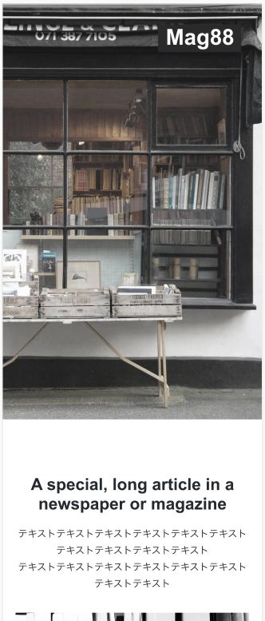
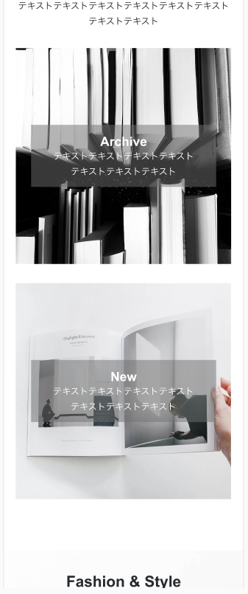
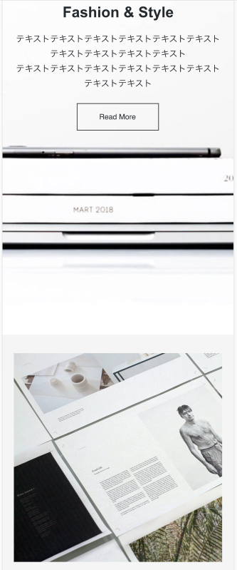
header
Section id #article
Section id
#fasion_style
Section id #header
<h1>
main
Div class article_flex
<h2>
class=section_title
background-image: url(”img/mainvisual.jpg ");
Alt=”Mag88”
img/logo.svg
flex
main
<p>
<a><img>
background-image: url(”img/. ");
Alt=“Magazine-archive ”
Img/Magazine-archive
<h3>
<form><a>
Div class form button
<p>
<img>
Div class fasion
img/mainvisual.jpg
background-image: url(”img/. ");
Alt=“Magazine-new ”
Img/Magazine-new
<h3>
Section id #catalog
flex
<p>
Section id #article
main
<h2>class=section_title
<img>
Img/catalog
<p>

Slide 2
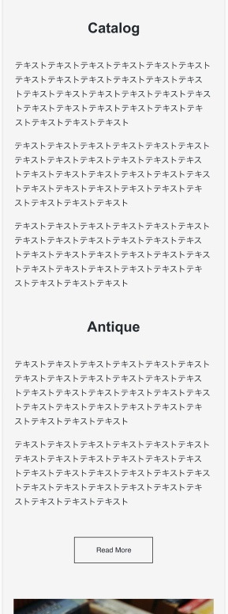
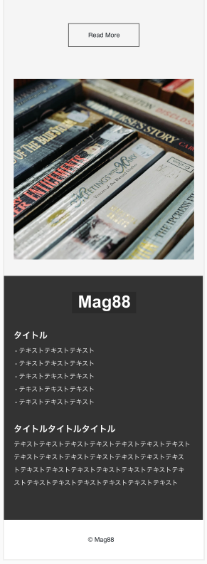
Section id #catalog
main
main
<h2>
class=section_title
Section id #antique
<ul><li>
<img>
<ul><li>
Img/antique
<ul><li>
Section id #anticue
Section id #footer
flex
img/logo.svg
Div class
footerlogo
flex
<h2>
class=section_title
<img>
<h2>
class=footer_title
<ul><li>
<ul><li>
<ul><li>
<h2>
class=footer_title
<p>
<form><a>
Div class form button
footer
<p>

Slide 3
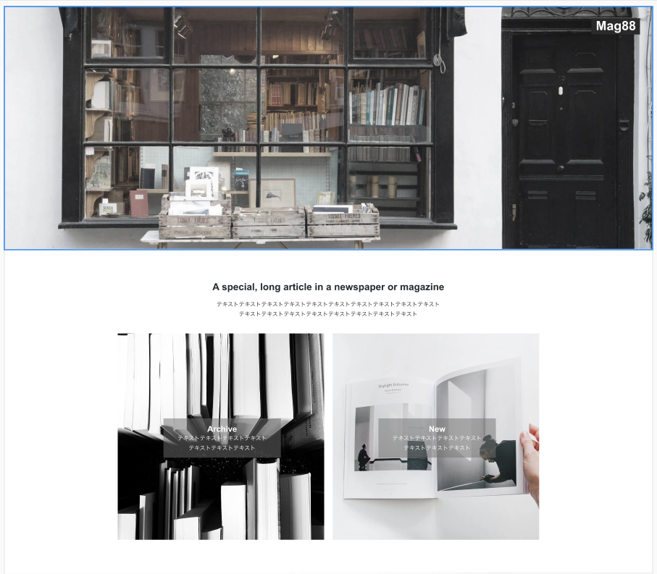
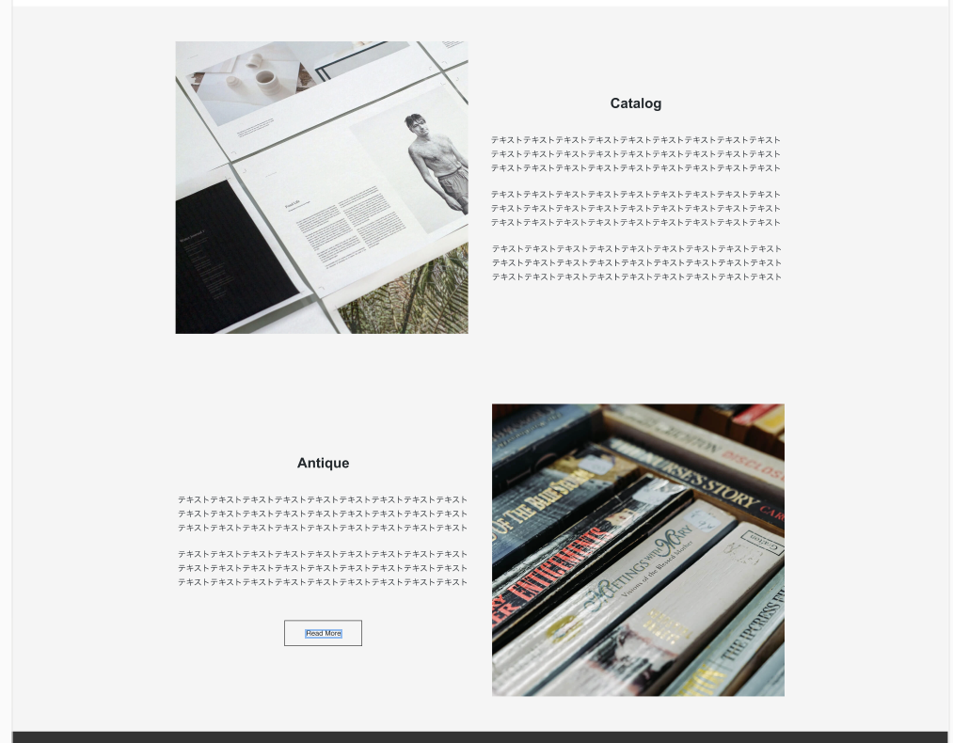

header
main
Section id #catalog
<h1>
flex
Section id #header
<h2>
class=section_title
background-image: url(”img/mainvisual.jpg ");
Alt=”Mag88”
img/logo.svg
<a><img>
<img>
<ul><li>
<ul><li>
img/mainvisual.jpg
Img/catalog
<ul><li>
main
<h2>class=section_title
<p>
Section id #antique
flex
Section id
#article
<h2>
class=section_title
Img/Magazine-archive
Img/Magazine-new
<h3>
<h3>
<ul><li>
Img/ antique
Div class article_flex
<ul><li>
flex
<p>
<p>
background-image: url(”img/. ");
Alt=“Magazine-archive ”
background-image: url(”img/. ");
Alt=“Magazine-new ”
<form><a>
<img>
Div class form button
Section id
#fasion_style
<h2> class=section_title
<p>
Div class form button
<form><a>
<img>
Div class fasion

Slide 4
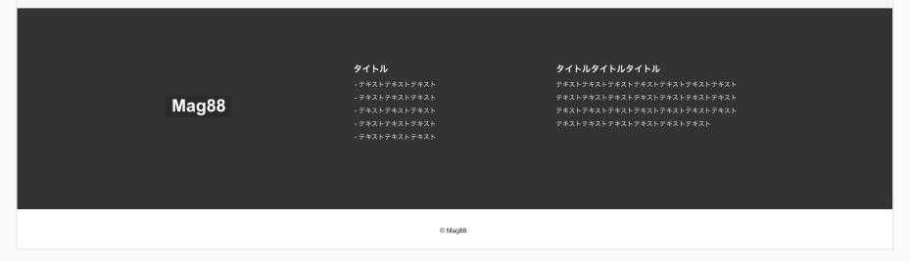
Section id #footer
flex
<h2>
class=footer_title
Div class
footerlogo
<h2>
class=footer_title
<ul><li>
<p>
img/logo.svg
<img>
footer
<p>

Slide 5
