Slide 1
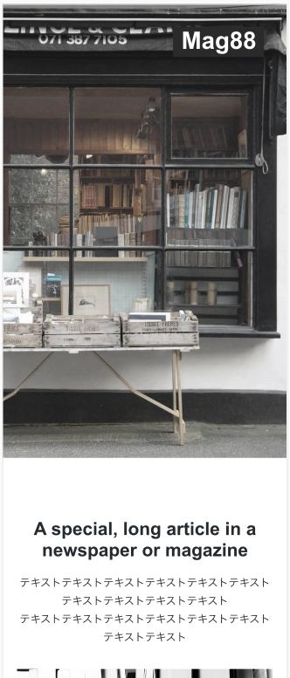
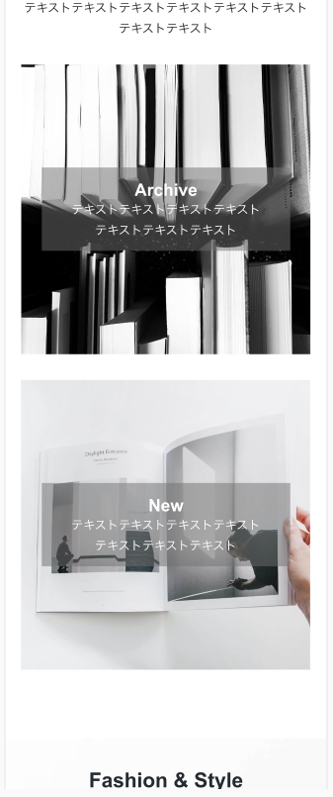
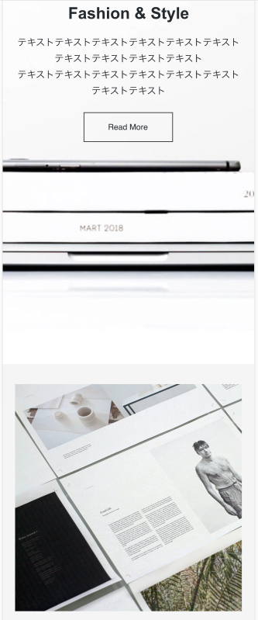
header
Section id #article
Section id
#fasion_style
<h2>
class=section_title
Section id #header
<h1> class=logo
main
Div class article_flex
main
Id全域に背景
img/logo.svg
PC: Flex
Div class fasion
<a><img>
Div class archive(背景のためのdiv)
<p>
background-image: url(”img/mainvisual.jpg ");
background-position: center;
background-size: cover;
Alt=”Mag88”
<a class=button>
<span>
background-image: url(”img/. ");
Alt=“Magazine-archive ”
<p>
Class=article_title
background-image: url(”img/. ");
Alt=“Magazine-archive ”
Img/Magazine-archive
img/mainvisual.jpg
Div class new
background-image: url(”img/. ");
Alt=“Magazine-new ”
<span>
Section id #catalog
PC: Flex
<p>
Class=article_title
Section id #article
main
<h2>class=section_title
<img>
Img/Magazine-new
Img/catalog
<p>

Slide 2
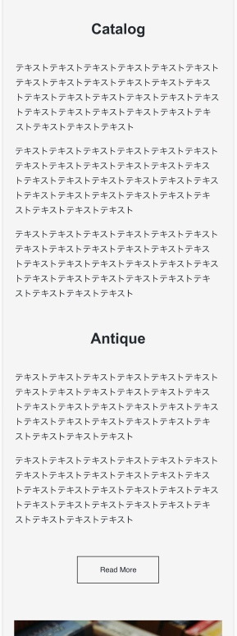
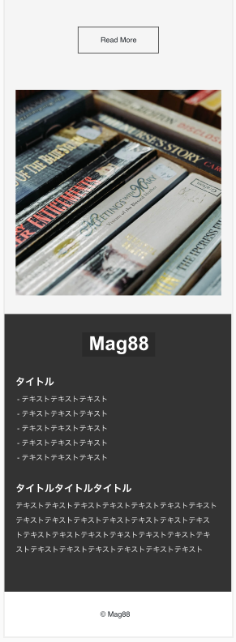
Section id #catalog
main
main
<h2>
class=section_title
Section id #antique
<ul><li>
<img>
<ul><li>
Img/antique
<ul><li>
Section id #footer
Div class
footerlogo
Section id #anticue
PC: flex
PC: flex
img/logo.svg
<img>
<h2>
class=section_title
<h2>
class=footer_title
<ul><li>
<ul><li>
<ul><li>
<h2>
class=footer_title
<p>
Div
背景とフレックスのため
のdiv
<a class=button>
footer
<p>

Slide 3
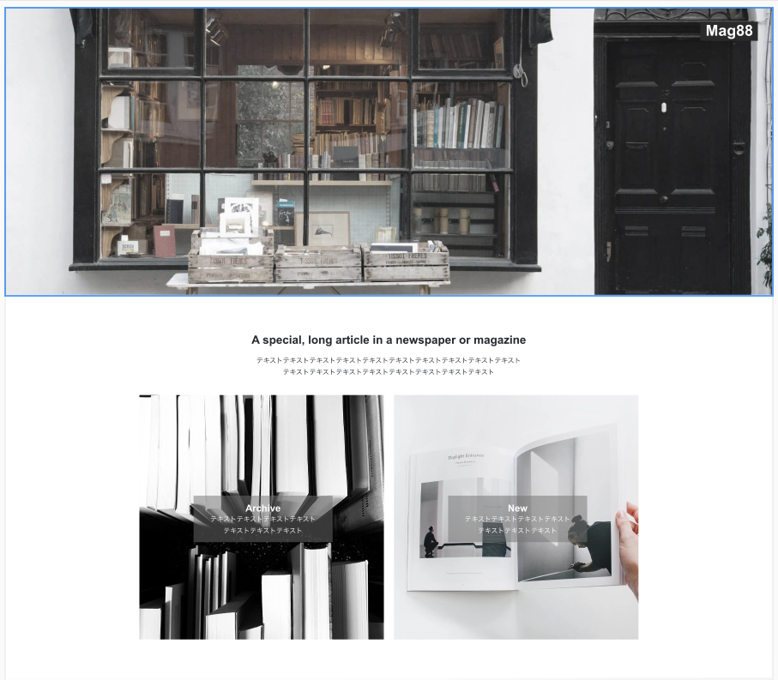
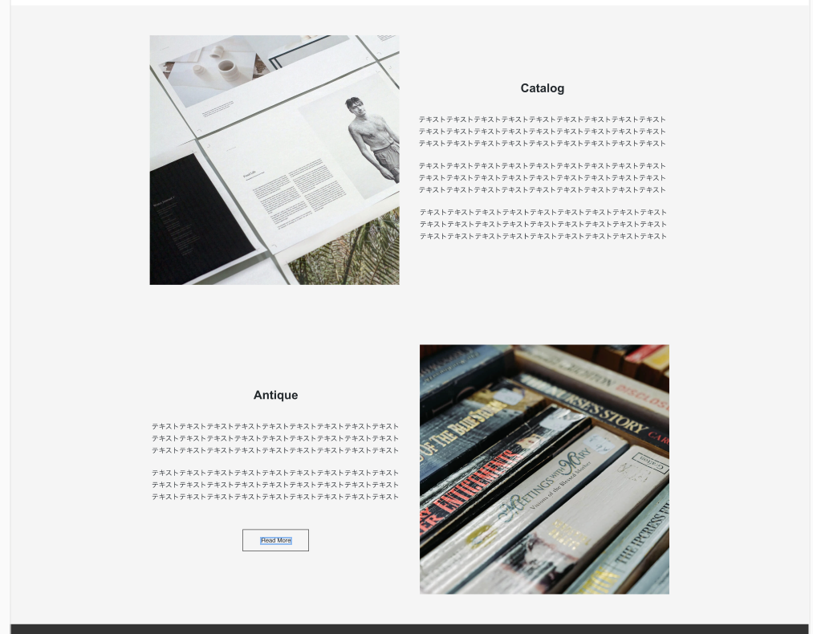
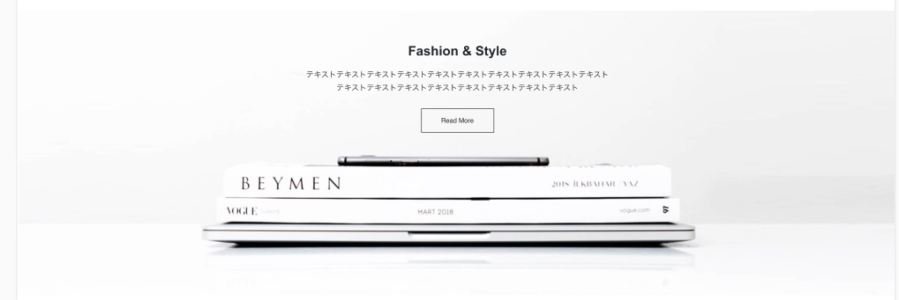
header
main
Section id #catalog
<h1>
flex
Section id #header
<h2>
class=section_title
background-image: url(”img/mainvisual.jpg ");
Alt=”Mag88”
img/logo.svg
<a><img>
<img>
<ul><li>
<ul><li>
img/mainvisual.jpg
Img/catalog
<ul><li>
main
<h2>class=section_title
<p>
Section id #antique
flex
Section id
#article
<h2>
class=section_title
Img/Magazine-archive
Img/Magazine-new
<h3>
<h3>
<ul><li>
Img/ antique
Div class article_flex
<ul><li>
flex
<p>
<p>
background-image: url(”img/. ");
Alt=“Magazine-archive ”
background-image: url(”img/. ");
Alt=“Magazine-new ”
<form><a>
<img>
Div class form button
Section id
#fasion_style
<h2> class=section_title
<p>
<a class=button>
<img>
Div class fasion

Slide 4
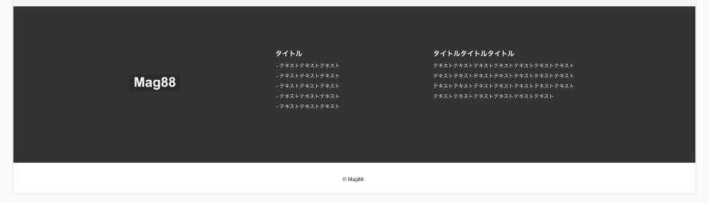
Section id #footer
Div 背景とフレックスのためのdiv
flex
<h2>
class=footer_title
Div class
footerlogo
<h2>
class=footer_title
<ul><li>
<p>
img/logo.svg
<img>
footer
<p>

Slide 5
