Slide 1
How 4D managed to deliver v15, our most stable .0 version ever!
A secret peek into 4D’s development team.
4D Summit 2016

Slide 2
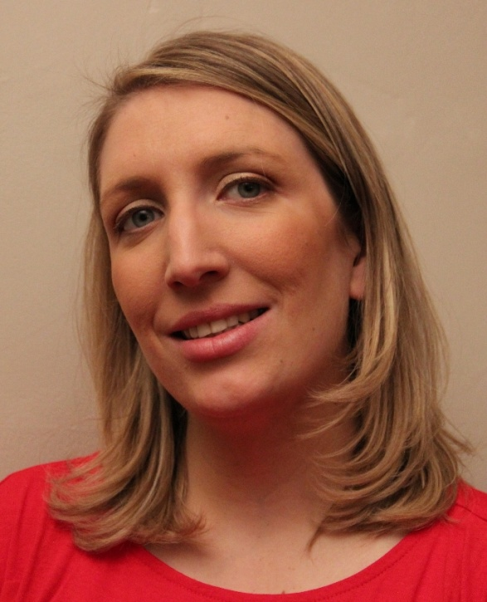
Caroline Briaud
4D Program Team Leader
Notes:
For those who do not know me yet, I am Caroline Briaud.
I joined 4D in July, 2013 as the Program Team Leader in the 4D Engineering.
One of my main task when I joined 4D has been to help the other Engineering managers with the new process definition and application within 4D’s engineering teams.
And now this session is about our results, about 2 years after.

Slide 3
Content
Introduction
Key principles
4D Product lines
Notes:
After a quick introduction, I will explain what the main Agile key principles that we followed in our 4D Engineering internal processes to deliver a better product and achieve our goal of having the most stable .0 version ever.
Finally, we’ll talk more into details about the 2 different 4D product lines and I’ll give you some recommendations.
Of course, we’ll try to keep some time at the end for your questions.

Slide 4
Introduction

Slide 5
Introduction
New SW dev process for about 2 years
Based on Agile methods
Moving process
Notes:
As announced during last 4D Summit in San Antonio/Paris, a new software development process has been put in place inside 4D Engineering for about 2 years now
Based on Agile methodologies. This is only inspired, we do not hesitate to create our own process to make sure it is adapted to our constraints; we are following them “by the book”.
This is a moving process, we are refining it on regular basis

Slide 6
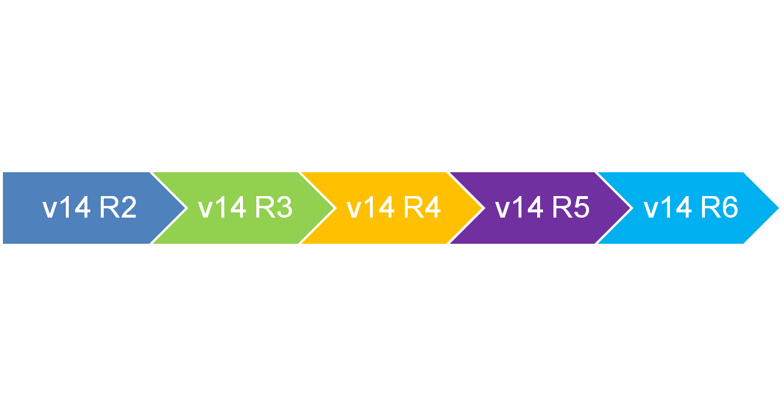

What is v15.0 ?
4D v15
Notes:
v15.0 has been released on July 2015, this is the first major version taking advantage of this new development process.
It is just the addition of the all the features released from v14 R2 (June 2014), R3, R4, R5 + a new step. v15.0 is basically v14 R6, it has just been « rebranded ». It is just a matter of naming.

Slide 7
v15 is a success !
More than 60 new features while keeping stability
Better adoption rate than before
Can start from .0, no need to wait for .3 or .4
Higher quality than v14
4D v15
Notes:
Here is the result : 4D v15 is a success !
We achieved to implement more than 60 new features and keep the stability. It was our goal with the R-release program.
We already have a much better adoption rate than v14
We managed to avoid the “wait until .3 or .4” effect. As we said during the keynote, we already have customers (even OEMs) who started already to deploy 15.1.
We also have a better quality than v14 ; and we will keep going, v16 will be better than v15.
So – what I will present you now are the key principles that we followed to reach that point and have a version really usable from .0.

Slide 8
Key principles
Notes:
What I will explain after are the main Agile key principles and how we took them into account in 4D Engineering processes to deliver a better product and achieve our goal of having the most stable .0 version ever.

Slide 9
Key principles
Understand the need
Do small steps
Early feedback
Test early and frequently
Done means DONE !
Release Train

Slide 10

1. Understand the need

Slide 11
Customer need
Customers usually express the solution they imagine, not their need
When misunderstood, leads to time & money wasting
1. Understand the need
Notes:
We realized that the most of customers are never expressing the need but the solution they imagine to meet their need.
By example, I need this new selector in this new 4D command and the command would do that.
So the basis for us is to have the customer expressing what he really need. Then we can think about the better solution to answer this need.
Understanding the need is essential as it avoids to deliver a new feature after weeks/months of work and the customer at the end is saying this is useless. This is frustrating, waste of money, etc…

Slide 12
Customer need
Write the User Story
Captures the “who”, “what” and “why”
As a <role>, I want <goal/desire>
so that <benefit>
1. Understand the need
Notes:
To make sure we understand the customer need, we write the User Story.
For each new feature, we start by writing the “user story” using as much as possible the customer words.
The User Story captures the "who", "what" and "why". It should NOT tell the “how”.
User Story has a very formal format : "As a <role>, I want <goal/desire> so that <benefit>"

Slide 13
User Stories examples
As a 4D Developer, I need a mean to define dynamic fields so that my data model is easier to manage.
As an end-user, I want to log in my 4D application using the same password than my Windows session so that it is easier to remember.
1. Understand the need
Notes:
Let’s take 2 User Story examples :
User story #1 : « As a 4D Dev, … manage»
The answer to this user story is the object field type that has been added to v15.
User story #2 : « As an end-user, … remember»
The answer to this user story is the LDAP LOGIN command that has been added to v15.
Sometimes, a single functionality can be related to several user stories. In that case, we make sure that all user stories have been answered by the proposed implementation.

Slide 14
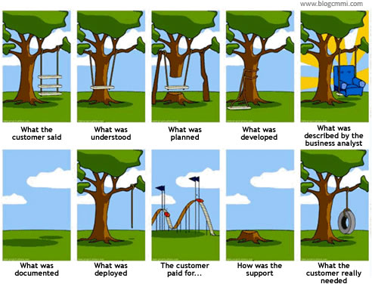
Communication is important
1. Understand the need
Notes:
Creating software requires a lot of communication.
During the feature process lifecycle, it is important that we keep talking to the customer. We need to evaluate with the customer what we are creating on regular basis.
Is it truly what the customer wanted? Will the proposed implementation really be useful in the end ?

Slide 15
Be the customer voice
The Product Owner is the customer voice
The PO contacts the customer to review
  User Story
  Functional requirements
1. Understand the need
Notes:
To make sure we are continuously evaluating with the customer, we have thought about bringing to the 4D Headquarter to Le Pecq every customer for every feature that we start to work on and keep him with 4D Engineering during the whole time of the feature implementation. Then we realized it is maybe a bit difficult to organize ☺
It means we need to have a customer representative inside 4D Engineering. This is the role of the Product Owner. He is the customer voice inside the Engineering.
He is responsible of understanding the need from the feature request. That feature request can come from many places : feature request reported by our Business Managers, from forum on forum.4d.fr, TAOW, people talking to us at the Summit during a coffee break , etc…
The PO is in charge of writing the user story & the functional requirements.
Sometimes, the feature request is pretty simple to understand and the PO can do it pretty easily.
Sometimes, when it is a complex request, the PO goes back to the customer to review and validate both User Story & Functional Spec
Once the feature is ready, the customer is contacted again to beta test the feature (we’ll talk into details about this later in the presentation)

Slide 16






They are the customer voice !
1. Understand the need
Adrien
Roland
Vanessa
Gildas
Notes:
The PO are actually from the 4D Program Team. I wanted to show you they are real person behind the role.
BTW, Roland & Adrien are here in Portland. You may run into them at the next coffee break !
OR
BTW, the whole team is here in Paris. You may run into them at the next coffee break !

Slide 17

2. Do small steps

Slide 18
Do small steps
Deliver small, incremental releases and iterate
Continuous review and adaptation
Avoid “tunnel effect” as in traditional methodology (waterfall)
2. Do small steps
Notes:
Agile development projects are delivered in small pieces : delivering small, incremental releases and iterating.
Based on the principle of iteration: continuous review and adaptation (see early testing section – coming next)
Avoid “tunnel effect” from waterfall project management methods where it is impossible to correctly estimate the workload because of the development complexity.

Slide 19
Small steps at 4D
Timebox: a few days to 2 weeks max
Cut big developments into slices
EPICs = set of user stories
    4D Write Pro
    Re-architecture of double-clickable app
    Preemptive 4D processes…
2. Do small steps
Notes:
Divide project/features into short, self-contained time units. The development workload is always between a few days and 2 weeks, never exceeding 3 weeks.
Cut development into several phases and each phase shall answer one or several user story(ies).
EPICs : 4D Write Pro, re-architecture of 4D engined application to be read only, Preemptive 4D processes, object fields…
Example of 4D Write Pro : show roll-out phases part of EPIC.

Slide 20


4D Write Pro EPIC
4D v15
  Rendering Engine
  Doc creation, HTML export
  Manage selections (by prog)
  Manage attributes (by prog)
  Import of 4D Write legacy doc
  Send 4DWP doc by email
  Persistent custom attributes
  Stringify 4DWP object
4D v15 R4
  Storage on disk
  Export formats
  Manage header & footer
  Print documents
4D v15 R2
4D v15 Rx
2. Do small steps
  4DWP doc storage in database
  Print 4DWP form object
  …
  …
4D v15 R3
4D v15 Rx
Notes:
In traditional “software development” processes, we would have announced at a 4D Summit that we started to work on 4D Write Pro. Then we would have come back 2 or 3 years later, saying “4D Write pro” is available, : this is it, use it now. Following the Agile methodology, we have cut the development into small slices (less than 2 weeks of dev max)
Each phase is one or a set of small user stories
4D Write Pro is an EPIC (large set of user stories)

Slide 21

3. Early feedback

Slide 22
Early Feedback
Deliver only working solution to allow user feedback
Validate assumptions
Fix design issues as soon as possible
3. Early feedback
Notes:
Each feature answers one of a set of user stories and what is delivered always has to be a working solution, so we can gather user feedback.
Doing small steps avoids spending weeks/months to implement something and we could finally realize it was based on a wrong assumption (not usable). It is better to realize that as early as possible.
Getting early feedback also allows the introduction of new ideas at an early stage

Slide 23
Early Feedback
Need user feedback during beta test
  Allow detection of regression in a customer context
  Allow design changes without introducing compatibility issues
3. Early feedback
Notes:
For us getting early feedback means getting feedback during the beta test phase.
2 benefits for us:
Detect regression. Fixing regression is our TOP PRIORITY during the beta test phase, we are fully available to do so.
Same thing for design issue. We have some room to still do some design chnages without having to worry about compatibility.

Slide 24
Early Feedback (design change)
Example:
  Find in array (array ; value {; > or <} {; start})
  Find in sorted array ( array ; value ; > or < {; posFirst {; posLast}} )
3. Early feedback
Notes:
We have a pretty good example of a design change that we have done during the beta test phase, thanks to some user feedback :
For v14 R4 we were working on a feature request about having a mean to perform binary search in an array.
For the beta version announcement, we released the feature with the following implementation : we had modified the existing command Fin in array by adding a new parameter that says in what order the array is sorted.
Then we had some user feedback that the command was working fine BUT the complete user story was not only “I want to search for a value in an array using a binary search”.
The complete user story was “I want to search for a value in an array using a binary search and get the position where the element should be inserted if it has not been found “.
So we have worked on a new implementation very quickly (easy as it was still fresh in the developer’s mind) and we have added a new command Find in sorted array that returns the position for insertion.

Slide 25
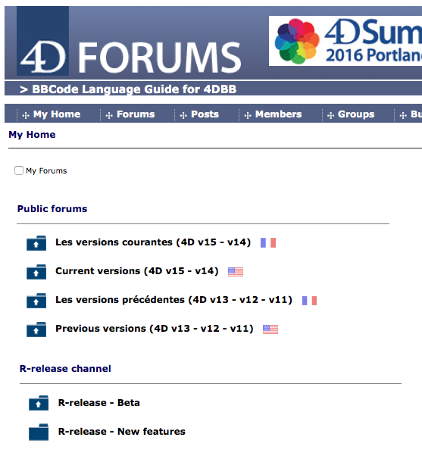


Feedback during beta test
“R-release – Beta” forum
Beta versions announcement
Beta builds download
New feature presentation & examples
3. Early feedback
Notes:
Now that you are convinced that it is very important for us to get your feedback about our new features, let me explain exactly where you can give your feedback.

Slide 26
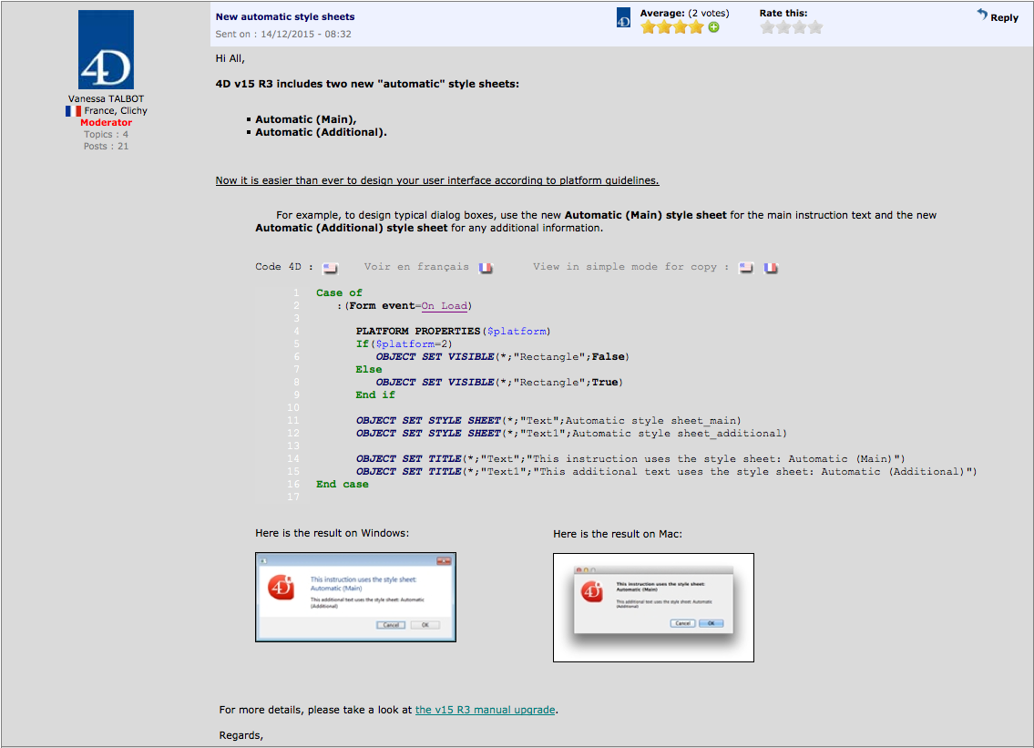
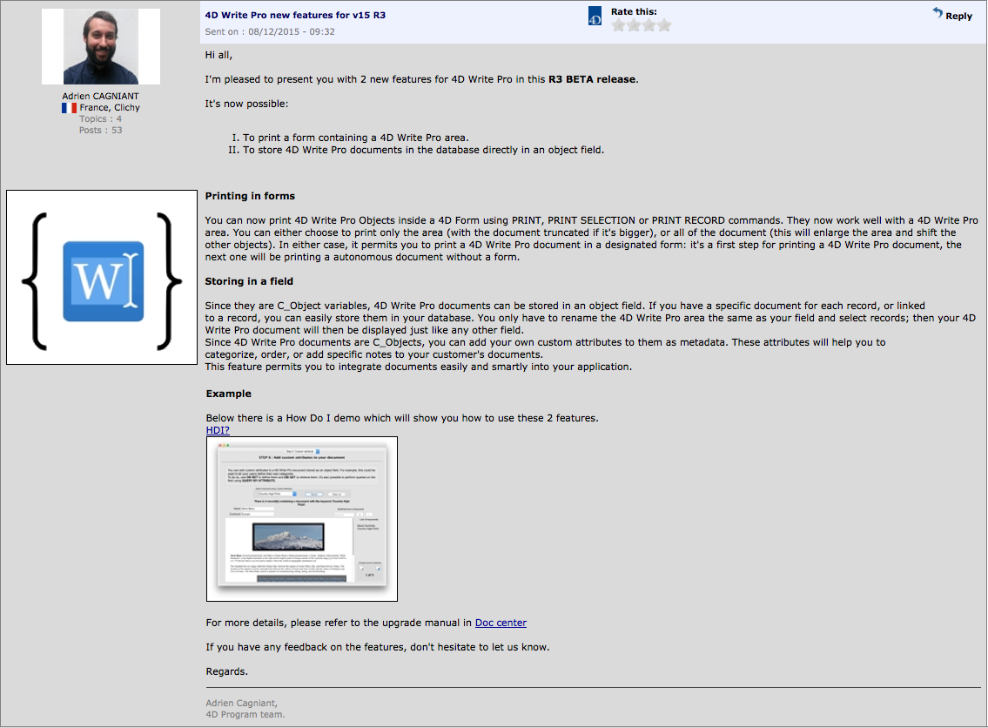
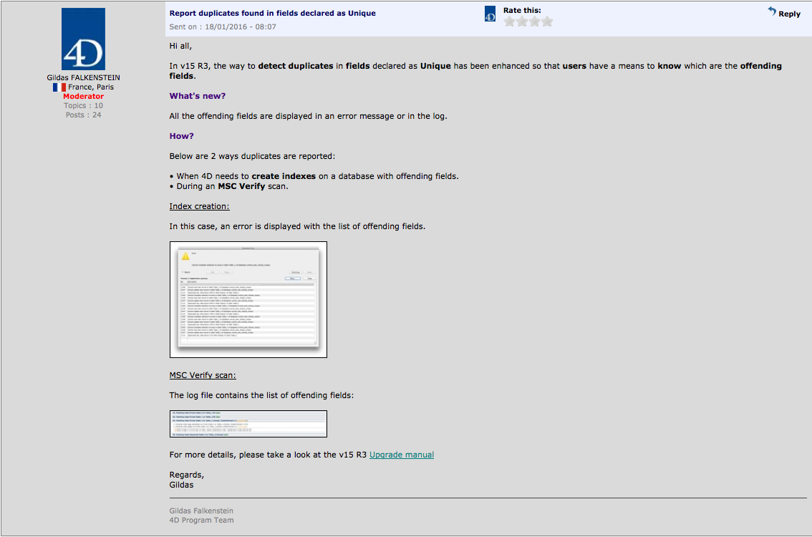
Feature presentation on 4D forum
3. Early feedback

Slide 27

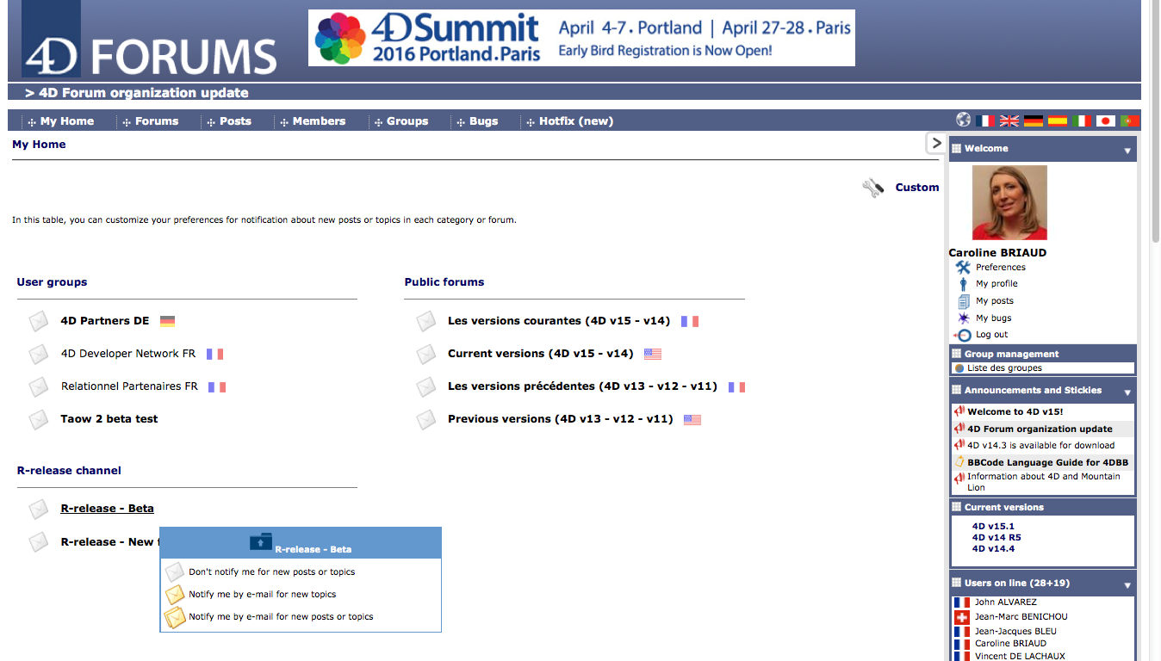

Subscribe to the beta forum
Get info by email (new / all topics)
3. Early feedback
Notes:
To be notified when a new beta release is available, or to receive the messages presenting the new features, you can subscribe to the R-release beta forum.
Go to « Custom » menu,
You can choose to be notified by email for either only new posts or for all posts.
Note: you can also do it through the « preference menu ».

Slide 28

Feedback during beta test
Who already downloaded a R-release beta version ?
Who already started the version to play with it ?
Who already tried to convert his application ?
Who is already registered to this forum ?
3. Early feedback
Who knew there are messages presenting the new features ?
Notes:
QUESTION TO THE AUDIENCE:
This is a great occasion today for me to have all of you in this room to gather some feedback in live !
[ask questions and note counts] :
- Who already downloaded a R-release beta version ?
- Who already started the version to play with it ?
Who already tried to convert his application to a beta version of R-release ?
Who is already registered to this forum ?
Who knew there are messages presenting the new features ?

Slide 29
Feedback during beta test
If the answers to each question in the list is “NO”…
… Why ?
3. Early feedback
Notes:
QUESTION TO THE AUDIENCE:
[Take a note of main reasons given]

Slide 30
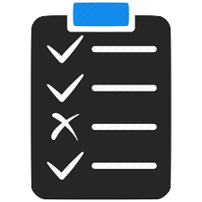
4. Test early and often

Slide 31
Test early & often
Developers committed to testing
Write automated unit tests
Run automated tests as often as possible
Fixing a bug early is cheaper
4. Test early and often
Notes:
In agile development, we must not test the software once everything has been fished as it would be done in “waterfall” projects. The software must be continuously tested throughout its development.
To do so, our developers are now heavily committed to testing: for each feature, they must write automated unit tests to validate their code.
Test is no more a matter of QA team only. The dev team has also the responsibility of validating its own work.
The automation is very important as we must be able to run the tests as often as possible.
In fact we are running our automated test everyday for every new build.
It allows to detect early regression : the earlier you find a bug, the cheaper it is to fix it.
If a regression has been introduced in the software, and that we found it the day after. It is pretty easy to go through the different commits from the dev to find where the issue is coming from.
Imagine you need to do the same investigation not the day after but 3 months after, for a team of 10 developers…not so easy !

Slide 32

5. Done means DONE !

Slide 33
Definition of “Done”
Agree on the definition of “Done” with the stakeholders
Complete a feature before moving to the next
5. Done means DONE!
Notes:
The “done” shall be clearly defined and accepted by the team & all the stakeholders. In our process, we have what we call a “Kick-off meeting” where we have everybody around the table so that we agree on what will be done and when we consider it as finished.
Another rule : As multiple features can be developed in parallel in a team situation, we make sure that each developer does not move on to a new feature until the last one is shippable.

Slide 34


6. Release Train

Slide 35
Release Train
The schedule doesn’t change
Quality is fixed, scope is variable
Only ready features
6. Release Train
Notes:
4D R-release concept is based on what we call a ‘release train’.
The train departs the station and arrives at the next destination on a reliable schedule.
The schedule is known and doesn’t change. Quality is fixed, scope is variable.
The R-release train is leaving every 3, months or so. And only fully ready features stay on the train (ready means it is a working solution : it has been tested, it is documented, it can be demonstrated)

Slide 36
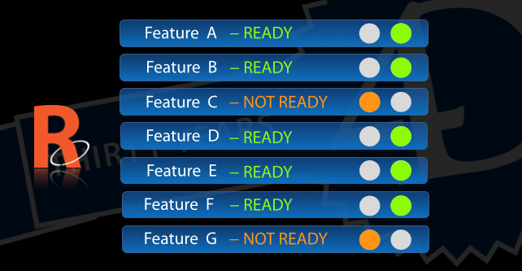
Feature Activation/Deactivation
6. Release Train
Notes:
Maybe some of you recalls this slide that I presented at 4D Summit 2014.
Before the train leaves, we check what are the features that are ready then we ship it and deactivate all the others.
Feature activation/deactivation mechanism: a C++ compilation flag / a dynamic verification (is version = TNV) when 4D code is used / or combination of both
It has to be possible to deactivate the feature at any time during development if needed

Slide 37
Key principles (summary)
Understand the need
Do small steps
Early feedback
Test early and frequently
Done means DONE !
Release Train

Slide 38
4D product lines

Slide 39




Product Lines
R-releases
“.x” versions
…
v14 R2
v14 R5
v14.0
v14.1
v14.2
v14.3
v14.4
BETA
v15.0
v15.1
v15 R2
v15 R3
v15 R4
Notes:
R-releases :
Very first R-release was v14 R2 that was shipped back in June 2014
Latest R release is v15 R4 which is currently beta
Please remind that you have access to the R-release versions if you have either a 4D Maintenance program or through Partner licenses provided through 4D Partner program
Classic ‘dot’ release as always.

Slide 40
Advantages per product line
R-releases
“.x” versions
New features
Fixed scope
Stability
Migration workload
Smooth migration
Deploy often
Notes:
“classic” dot releases : v15.0, v15.1 …
Advantage: Stability from the feature point of view: no scope change, only bug fixes. (kind of stability)
Drawback: Need work for migration to next major release
R-releases :
Advantage: New features provided
Advantage: Stability (restricted bug fix integration)
Advantage: Smooth migration to next major release (only one more step)
Drawback: Follow R-release cycle means auto-update.

Slide 41
R-release or Not ?
What is the best option ?
This is YOUR choice, you are the best to decide !
Notes:
What is the best option : Choose R-release for dev ? For deployment ? Stay with .x release ?
This is your choice. You are the one who can decide what is best according to your business/technical constraints.

Slide 42
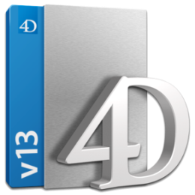
Our recommendations
Want to take the R-release train ?
  First make your application work with v15.x
  Then move to v15 Rx
Convert to v15.0
Non-reg. testing
Convert to v15 NB
Test bug fixes
Convert to v15 Rx
Non regression testing
Use new features
v13.5
v15.x
v15.x NB
v15 Rx
Notes:
If you want to step into the R-release train, we recommend to follow a 2-step process :
First migrate to the latest dot releases (15.1, soon 15.2) to make sure your application work then migrate to R-release (avoid falling into “old” bugs which will take time to get a fix in a R-release, you can get quick fix into a NB).
Then migrate to v15 Rx

Slide 43
Our recommendations
Test early with v15 Rx beta to get early fixes (before final)
4D is doing it !
BETA

Migrating internal tools to the current R-release beta version
Notes:
R-release beta versions are stable enough to be used for development. We recommend at least that our 4D developers start using the beta for their development and do not wait until the final version. In case a regression is found, it will allow to have their bugs fixed before the R-release is going final.
BTW, we are eating our own dog food : we are migrating our own internal systems (e.g. Doc center, TAOW, 4D Forum etc…) to the latest R-release beta version. It shows you that we are pretty confident in our beta version !

Slide 44

Our recommendations
Possibility to go back to 15.x
    No compatibility break inside R-release (only major)
    Comment code containing new commands
Notes:
It is always possible to go back to 15.x because
We always try not to introduce compatibility breaks inside R-releases, we try to keep it to the next major release. So far, we have been able to do so.
If you use new commands only available in 15 Rx but not in 15.x, you can still comment your new code (of course your new cool feature will be disabled) but everything will be working fine with 15.x

Slide 45
References
Scrum-ban & Release Train
http://www.solutionsiq.com/what-is-scrumban/
http://www.deloittedigital.com/us/blog/scrumban-a-different-way-to-be-agile
http://scaledagileframework.com/agile-release-train/
Chrome release cycle & process
https://ftagada.wordpress.com/2011/01/19/chromium-release-management-explained/
http://www.chromium.org/developers/tech-talk-videos/release-process
4D forum:
http://forums.4d.com/
Notes:
Everything I explained before about our processes is based on Agile methodologies, inspired from Scrum-ban (mix of Scrum and Kanban). You can fond more details on the following links.

Slide 46
Questions ?

Slide 47
Thank you !

Slide 48



Feature management
Bug feature B
Bug feature D
Bug feature A
Bug feature C
Bug feature C
Features currently under development:
Feature A
Feature B
Feature C
Feature D
Main
[INTERNAL]
v15 R3
v15 R4
Feature A
Feature A
Feature B
Feature B
Feature C
Feature D
Notes:
Bug v14 #1: fixed in main, then integrated to v14. The fix will be available in the next nightly build v14 on the forum and in the next minor release of v14 (e.g. 14.3)
Bug v14 #1 is fixed in main, then the fix is naturally present in 14 R5 branch once it is created.
R branches are dead after about 3 months

Slide 49

Bug management
Features currently under development:
Feature A
Feature B
Feature C
Feature D
Bug v15
Bug v15
Main
[INTERNAL]
v15 R3
v15 R4
v15
v15.0
V15.1
Notes:
Explain reason why we are not integrating everything to R branches
* STABILITY = Avoid side effects
* Tests several weeks
* …
Bug v14#1: fixed in main, then integrated to v14. The fix will be available in the next nightly build v14 on the forum and in the next minor release of v14 (e.g. 14.3)
Bug v14#1 is fixed in main, then the fix is naturally present in 14 R5 branch once it is created.
R branches are dead after about 3 months

Slide 50




R-release timeline
Dev
QA
Program
Beta
Builds
Beta test phase (10 weeks)
Collect functional feedback
Upgrade internal systems to Rx version in production
Feature deactivation
& Unit test
Monitor quality via forum
Formal verification
(2 weeks)
Packaging
& FTP
(1 w.)
Automatic test execution
(2 weeks)
Bug fixing
CTQs
15 weeks
Branch creation
Final release
Notes:
Verification or validation ?

