Slide 1

The Rise of the Truck
Notes:
Good morning. My analysis of the BEA sales data reveals a compelling story about the American automotive market, one that's not just a sales trend but a fundamental shift in consumer preference. Today, I want to present a narrative that follows a classic story arc, showing how a period of stability was shattered and ultimately led to a new reality for the industry

Slide 2
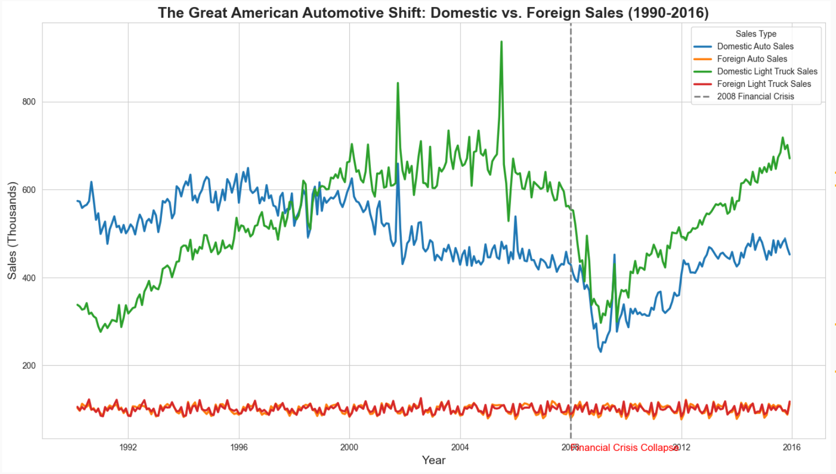
Notes:
From 1990 to the mid-2000s, autos and light trucks enjoyed a remarkable period of parity. As you can see from this first slide, sales for both vehicles followed similar trajectories, with combined sales consistently over a million units. The choice between a sedan and a light truck was a matter of personal preference, not market dominance.“
The conflict begins with the 2008 financial crisis, marked by this gray dotted line. The data shows an unprecedented sales collapse for both vehicles. This was a brutal conflict for the entire industry. However, the true climax of our story is in the recovery. As the economy slowly rebounded, autos and light trucks embarked on two very different paths.

Slide 3
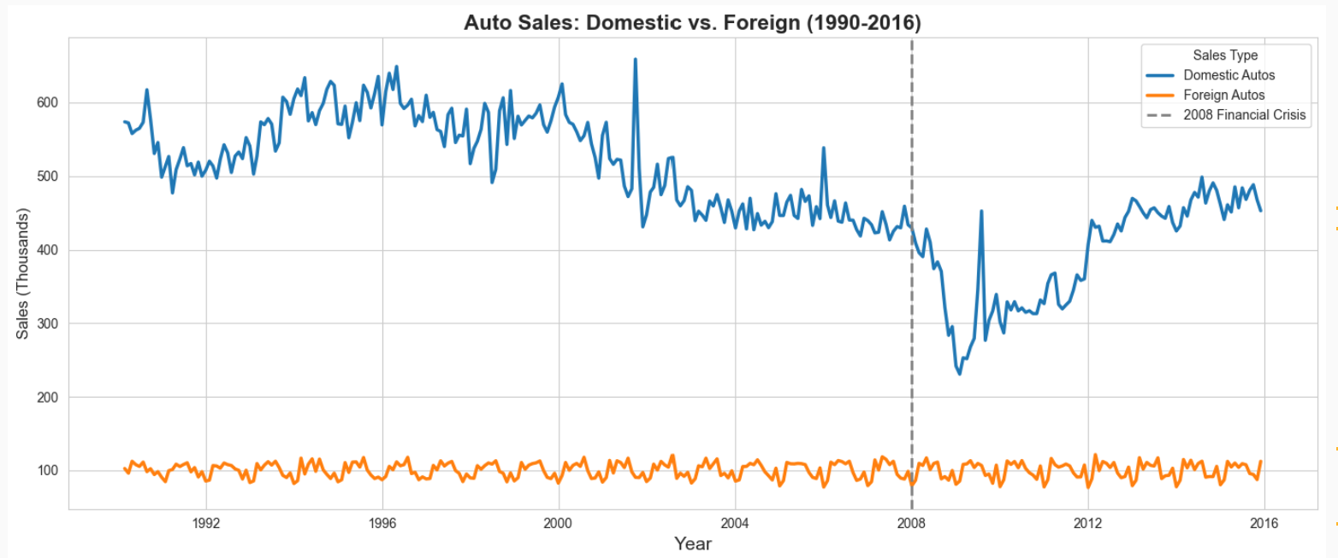
Notes:
Now, let's look closer at autos. Sales rebounded weakly and then plateaued, never fully regaining their pre-crisis volume. The traditional car, burdened by a shrinking demand, has not recovered to its former strength

Slide 4
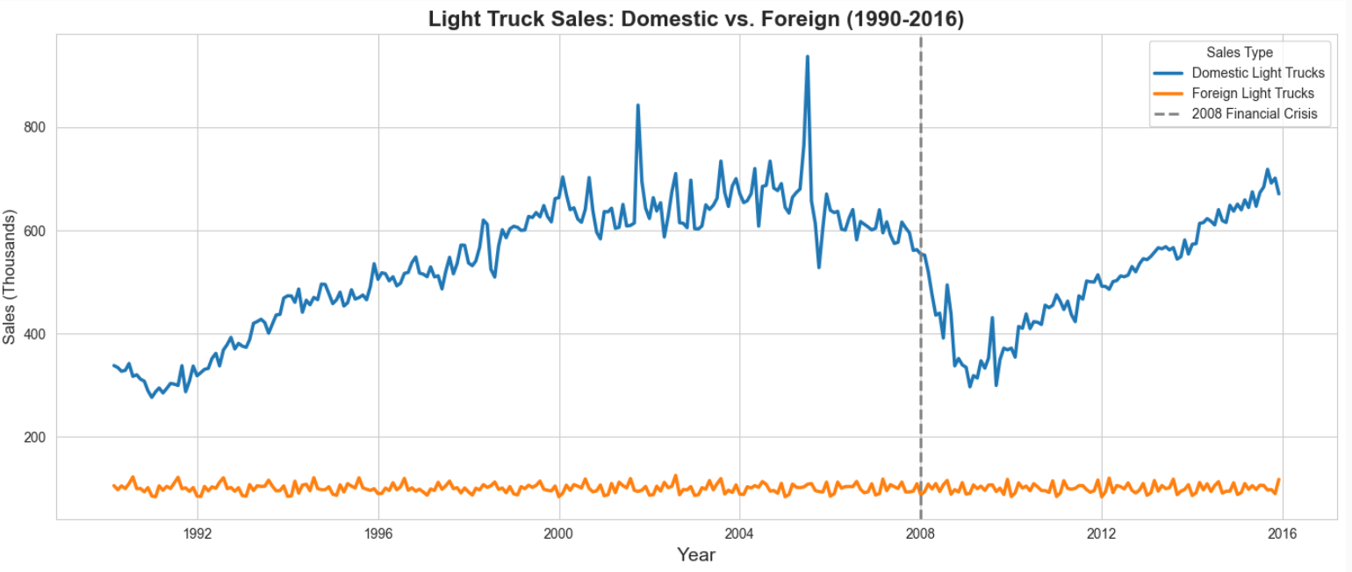
Notes:
In contrast, light trucks showed stunning resilience. Sales not only recovered but eventually surpassed their previous peak, accelerating their growth from 2010 onward. This is the new market leader.
The resolution is clear: the crisis did not just create a temporary dip; it permanently reset consumer behavior. The era of parity is over. The American consumer has spoken, and they prefer the utility, space, and versatility of a truck.

Slide 5
Thank you
Notes:
For NADA, this is more than just a trend; it's the new reality. The data suggests that dealers should focus their strategies on light trucks, as they are the key drivers of sales growth. This isn't just about selling more light trucks; it's about understanding the demographic shift that prefers their features and targeting them accordingly. The recovery shows that the light truck segment is robust, and it's where the future of the American automotive market lies.

