Slide 1
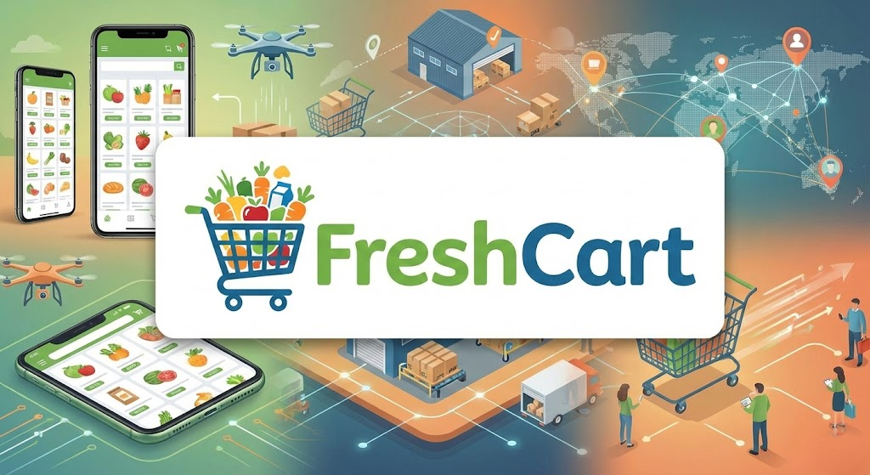
AI-Driven Churn Prevention
End-to-End Machine Learning Solution for Customer Retention in E-Commerce
Securing $1.6M in Annual Revenue
Murat IYIGUN
November 2025

Slide 2
The Challenge & Opportunity
The Business Problem
The Problem: Our customer churn rate has surged from 18% to 23% in the last 6 months.
The Cost: Every lost customer represents an average revenue loss of
approximately $150/month.
Traditional Blind Spot: Traditional marketing methods lack accuracy,
meaning high-risk users are not efficiently identified. This leads to inefficient
"spray and pray" campaigns.
The Opportunity: Our ML-driven system (LightGBM) detects subtle churn
signals early, such as velocity and basket shrinkage.

Slide 3
Our Solution: The Early Warning System
How the AI Works
Goal: To predict customers at risk of churning 14 days in advance, providing the marketing team a critical two-week window for intervention.
AI Technology: The system is powered by state-of-the-art Machine Learning
algorithms (LightGBM), moving beyond simple rule-based logic to recognize
complex churn signals.
Key Monitoring Features: The model monitors crucial behavioral patterns,
including purchase frequency, basket size trends, and product diversity.
Top Predictor: Purchase Velocity (A sudden drop in ordering speed) is
the 1 predictor of churn.
Data Foundation: We built this intelligent Early Warning System by analyzing
over 3 Million historical orders.

Slide 4
Intervention Strategy and Cost
Action Plan and Budget
Campaign Cost: We require approval for a pilot marketing budget of approximately ~$150,000 (Incentives) per year for retention campaigns.
Inactivity Risk (Recency): Risk increases by 60% if a customer hasn't ordered
in the last 30 days.
Targeted Incentives:
  Velocity Drop: Targeted "We miss you" coupons are recommended.
  Basket Shrinkage: Free shipping offers on the next order can counteract
  gradual basket size reduction.
Integration Requirement: The execution of these automated, personalized
interventions requires IT support for CRM integration.

Slide 5
Financial Impact & Model Reliability
The Value Proposition
Revenue Secured (Projected): ~1,760,000/year (Alsocitedas 1,850,000).
Net Profit: After campaign costs, the project delivers an expected
~ $1.61 Million / year in net profit/additional retained revenue.
Business Strategy Focus: We optimized the model to prioritize Recall
(catching churners) over Precision.
High Catch Rate: The model successfully identifies 81 out of every
100 potential churners (81% Recall).
Why 81% Recall Matters: In churn prediction, a False Negative (missing
a customer who leaves) is much costlier than a False Positive (giving a discount
to an active customer).

Slide 6
Financial Summary and Status
Key Metrics Overview
Opportunity Highlight: Identifying at-risk customers 14 days in advance allows us to intervene proactively and retain them.
Net Profit: ~$1.7 Million in additional retained revenue per year.
Return on Investment (ROI): The projected ROI is approximately ~1070% .
Simple ROI Metric: For every 1spent on the campaign,we save 11.
Project Status: The project is technically complete, validated, and achieves
a strong predictive capability score (ROC-AUC of 0.7644).

Slide 7
Operationalization and Key Drivers
Integration and Why Customers Leave
System Workflow: The system runs every night to identify "High-Risk" customers and feed this data to marketing systems.
Predictive Power: The model is highly reliable, analyzing over 3 Million
historical orders.
Top 3 Churn Drivers (Key Drivers): The model identifies the main reasons
customers leave:
  Decrease in order frequency (Purchase Velocity)
  Reduction in average basket value
  Days Since Last Order (Recency)
Technical Status: The project is technically complete, validated, and
achieves a 77% AUC score.

Slide 8
Conclusion and Call to Action
The Ask
Key Highlight Recap: Projected Annual Revenue Protection: $1.8 Million.
Value Proposition: We have built an intelligent, validated "Early Warning
System" that successfully identifies customers who are about to leave.
Recommendation (Call to Action):
  Launch a 1-month Pilot Program (A/B Test) immediately to measure
  the real-world impact and confirm ROI projectionsDays Since Last Order
  (Recency).
  Authorize IT resources for integrating the daily risk scores into the
  CRM/Marketing automation workflow.

