Slide 1


EEG-based Emotion Recognition Using Domain Adaptation Network
Bao-Liang Lu
Center for Brain-Like Computing and Machine Intelligence
Department of Computer Science & Engineering
Key Lab. of Shanghai Education Commission for Intelligent Interaction and Cognitive Engineering
Shanghai Jiao Tong University

Slide 2
Why Transfer Learning
Problem of conventional classification strategies
Presume that the training and testing data are independently and identically distributed (i.d.d).
Ignore the inherent variability among subjects.

Slide 3
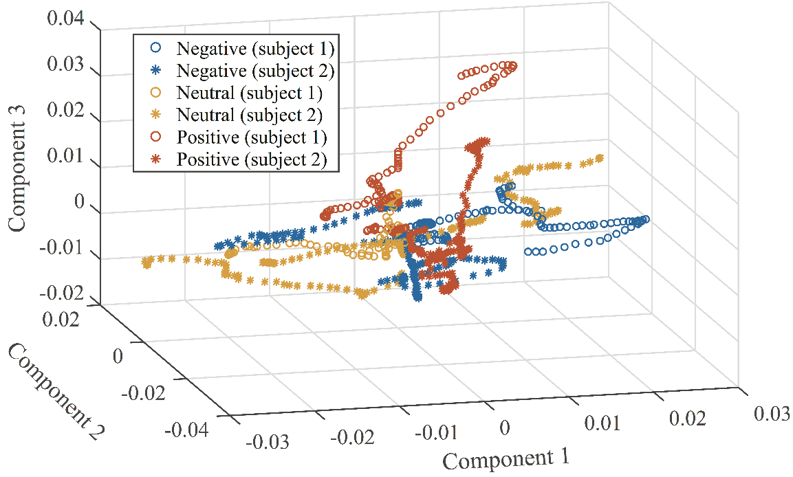
Why Transfer Learning
Problem of conventional classification strategies
Presume that the training and testing data are independently and identically distributed (i.d.d).
Ignore the inherent variability among subjects.
Visualization of EEG features of two sample subjects with three classes of emotions in 3- dimensional space.

Slide 4
Why Transfer Learning
Problem of conventional classification strategies
Presume that the training and testing data are independently and identically distributed (i.d.d).
Ignore the inherent variability among subjects.
Reality
Conditional probability distributions between source and target domain are the same.
Domain discrepancy can be reduced to learn a more robust classifier
Transferability of deep neural network shown in computer vision

Slide 5
Why Transfer Learning
Problem of conventional classification strategies
Presume that the training and testing data are independently and identically distributed (i.d.d).
Ignore the inherent variability among subjects.
Reality
Conditional probability distributions between source and target domain are the same.
Domain discrepancy can be reduced to learn a more robust classifier.
Transferability of deep neural network shown in computer vision.
Idea
Adopt domain adaptation network to reduce the domain variance.

Slide 6
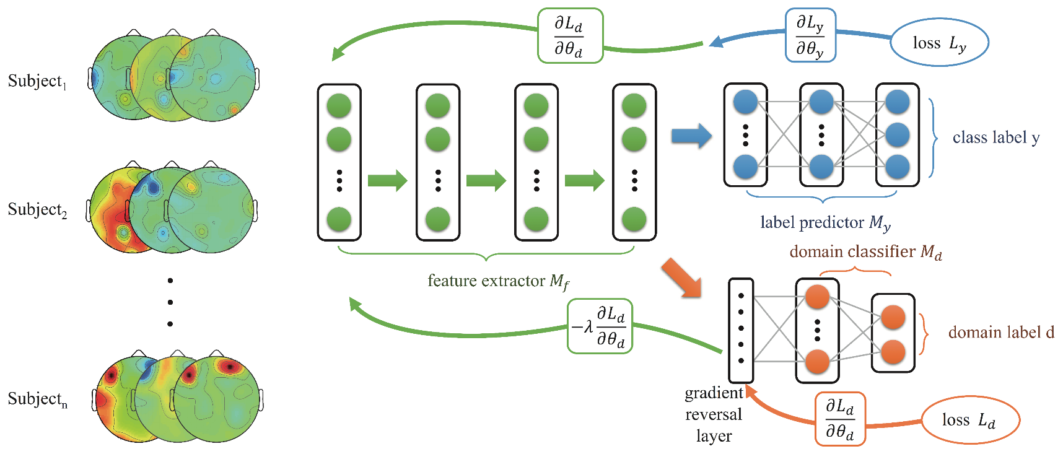
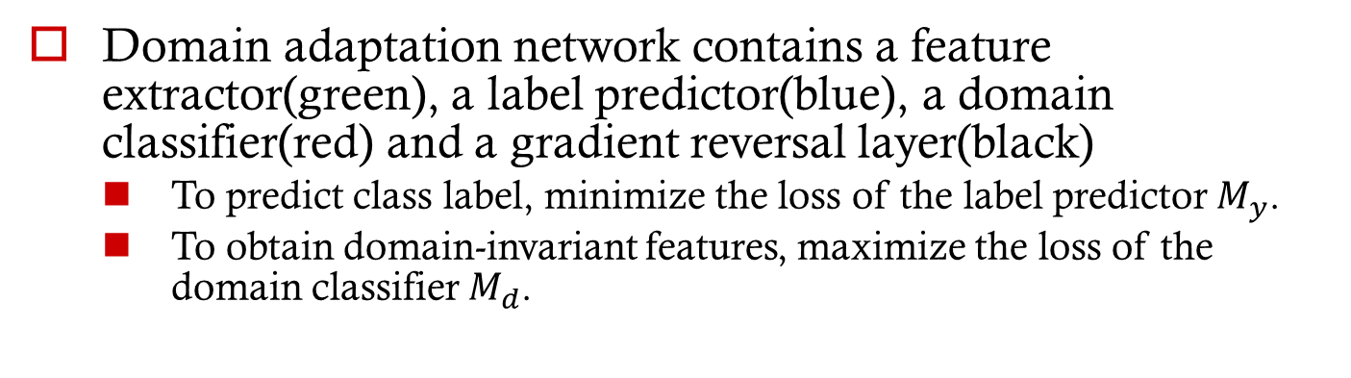
Model
Domain adaptation network contains a feature extractor(green), a label predictor(blue), a domain classifier(red) and a gradient reversal layer(black)
To predict class label, minimize the loss of the label predictor $M_{y}$.
To obtain domain-invariant features, maximize the loss of the domain classifier $M_{d}$.

Slide 7
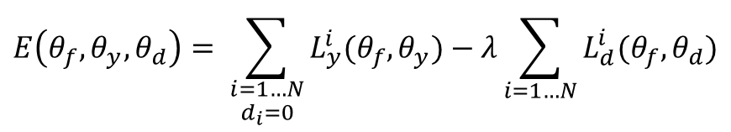

Model
Loss function
$$E\left(θ_{f},θ_{y},θ_{d}\right)= \sum_{\begin{aligned}i=1…N \\ d_{i}=0\end{aligned}}{L_{y}^{i}(θ_{f},θ_{y})}−λ\sum_{i=1…N}{L_{d}^{i}(θ_{f},θ_{d})}$$
$$θ_{f}←θ_{f}−μ\left(\frac{∂L_{y}^{i}}{∂θ_{f}}−λ\frac{∂L_{d}^{i}}{∂θ_{f}}\right)$$
$$θ_{y}←θ_{y}−μ\frac{∂L_{y}^{i}}{∂θ_{y}}$$
$$θ_{d}←θ_{d}−μ\frac{∂L_{d}^{i}}{∂θ_{d}}$$

Slide 8
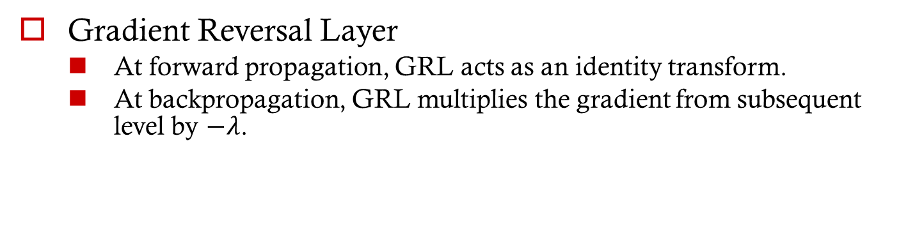
Model
Gradient Reversal Layer
At forward propagation, GRL acts as an identity transform.
At backpropagation, GRL multiplies the gradient from subsequent level by $−λ$.

Slide 9
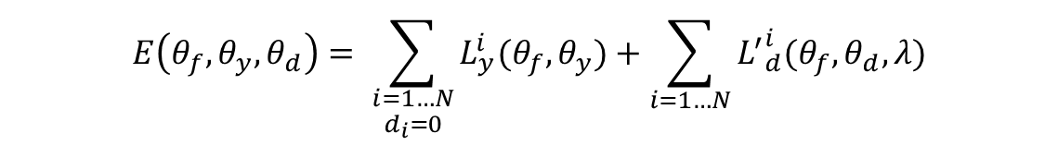
Model
Loss function
$$E\left(θ_{f},θ_{y},θ_{d}\right)= \sum_{\begin{aligned}i=1…N \\ d_{i}=0\end{aligned}}{L_{y}^{i}(θ_{f},θ_{y})}+\sum_{i=1…N}{{L^{′}}_{d}^{i}(θ_{f},θ_{d},λ)}$$

Slide 10
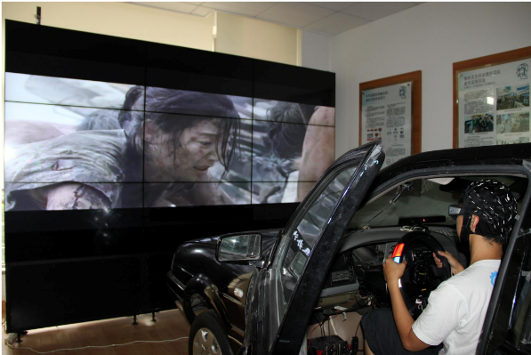
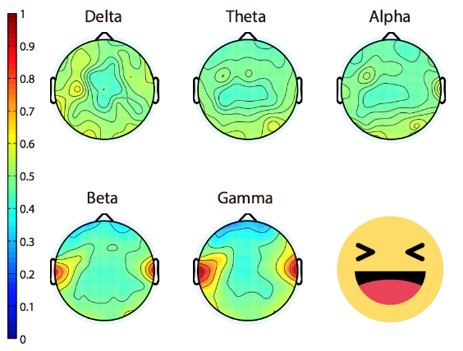
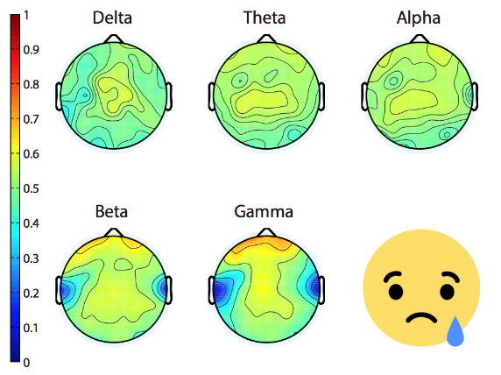
SEED
SJTU Emotion EEG Dataset (SEED)
Gathered from 15 subjects, 7 males and 8 females.
Each subject is stimulated by 15 emotional movie chips.
Recorded with ESI NeuroScan System from 62-channel electrode cap according to the international 10-20 system.
Stimuli
Three emotion states (negative, neutral, and positive)
Each movie clip is about 4 minutes long, a 15 s hint before each clip and a 10 s feedback after each clip.

Slide 11
Previous Methods
Transfer Component Analysis (TCA)
Learn a transformation and project the domain to a reproducing kernel Hilbert space (RKHS).
Differences between source and target distributions can be reduced and the data properties can be preserved.
Kernel Principle Component Analysis (KPCA)
A nonlinear form of Principle Components in high dimension space using kernel trick.
After calculating the principle components, classification can be done using standard classifier such as SVM.
Transductive Parameter Transfer (TPT)
Learn a mapping from source domain data-points to a target parameter space.
Multiple classifiers are learned on each source domain data using linear Support Vector Machine (lSVM) and Multioutpout Support Vector Regression (M-SVR) is utilized to learn a mapping function.

Slide 12
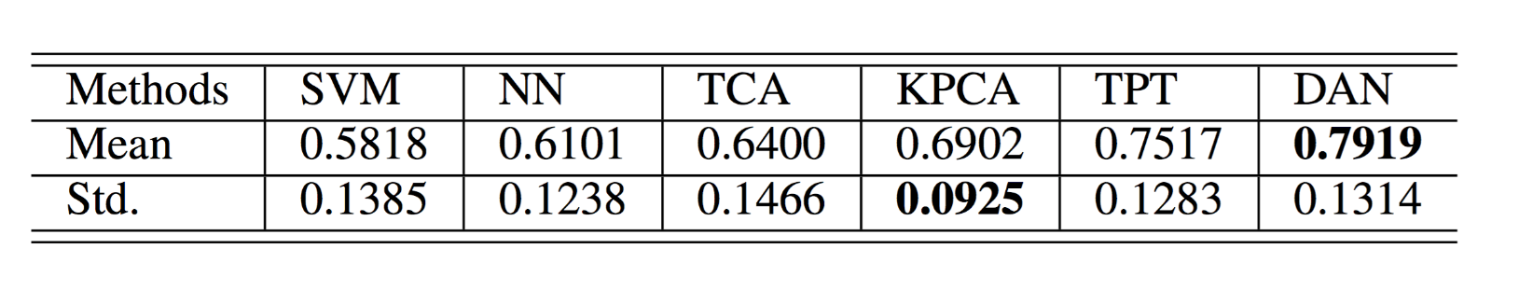
Experiment Result
Baselines (SVM & NN)
Perform the lowest accuracy because of the domain variance
TCA & KPCA
Extract latent component to improve the accuracy
TPT
Transfer the classifiers from source domain to target domain to further improve the performance
DAN
Achieves the best result because of domain-invariance and feature-discriminativeness

Slide 13
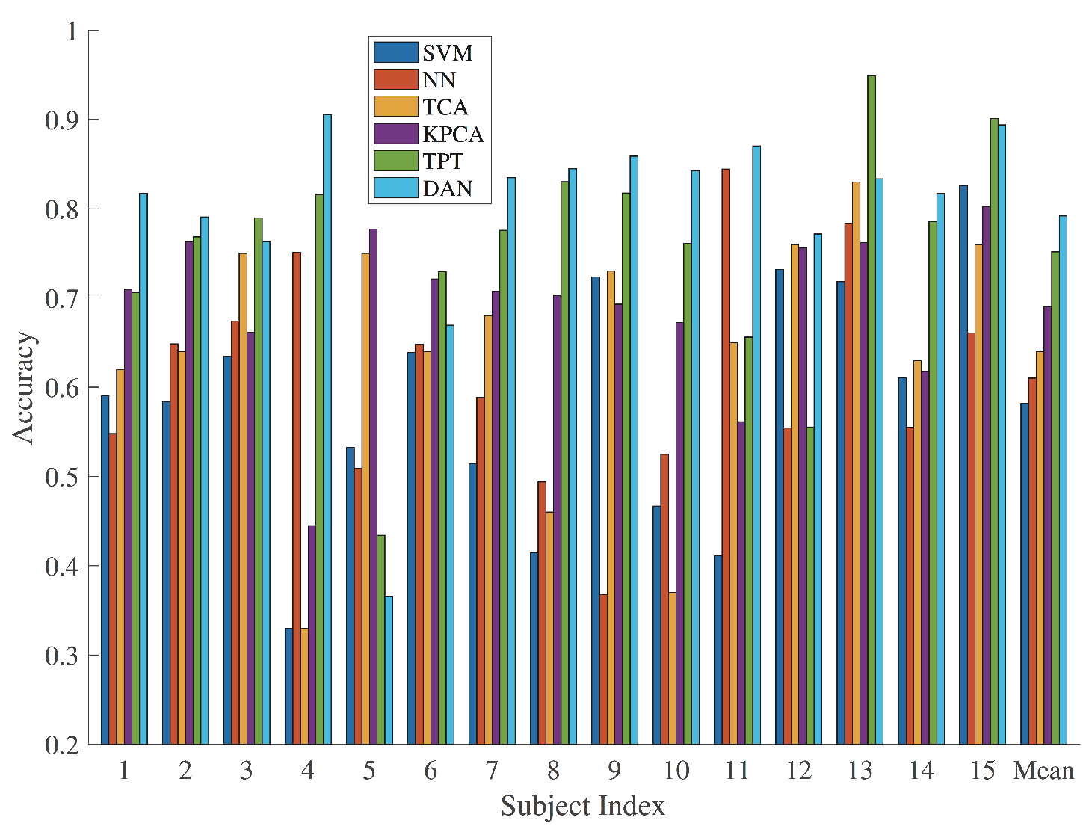
Experiment Result
DAN outperforms all the previous methods in 10 out of 15 subjects and achieves the best result for mean accuracy.

Slide 14
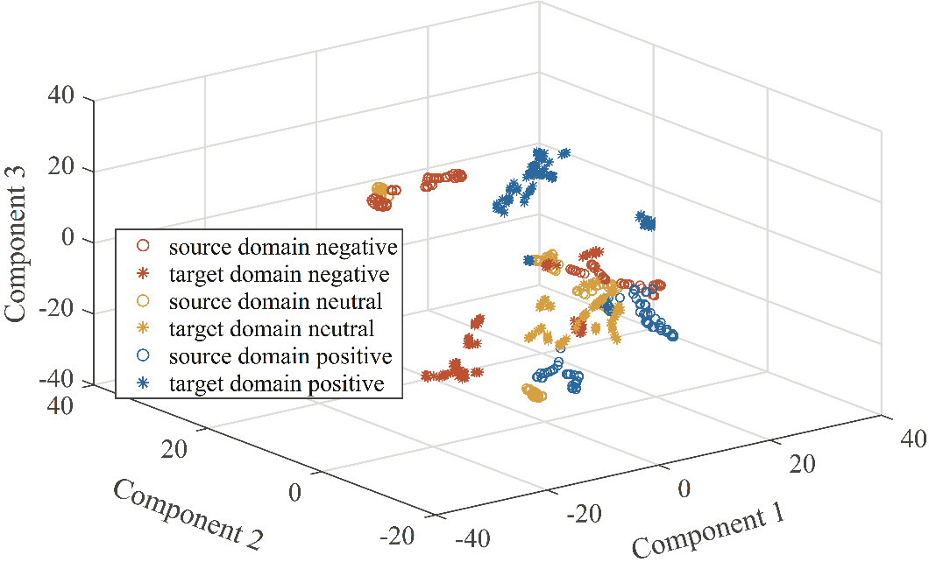
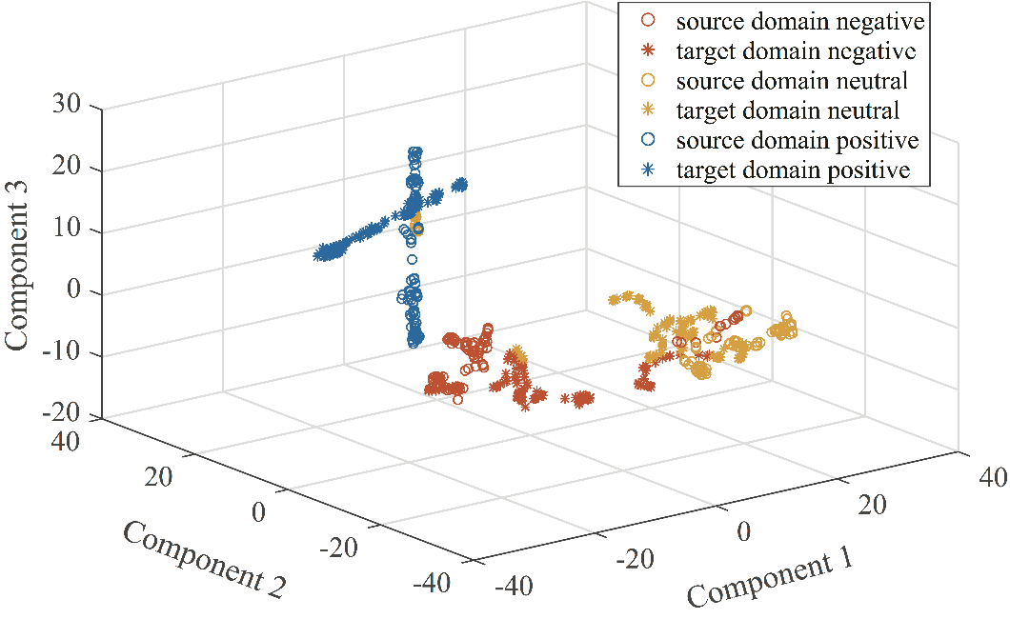
Virtues of Domain Adaptation Network
NN
Visualize using t-SNE
DAN
Feature discriminativenesss
With NN features, the datapoints are not discriminative enough, while with DAN features, all of the three emotion states can be evidently distinguished.

Slide 15
Virtues of Domain Adaptation Network
NN
Visualize using t-SNE
DAN
Domain invariance
NN features from different subjects are scattered in three emotion states, while DAN features are aligned much better between source and target domains.

Slide 16
Summary
Conclusion
DAN outperforms previous models (SVM, NN, TCA, KPCA, TPT) in SEED and achieved 21.01% increase compared with SVM.
DAN extracts domain-invariant features compared with normal neural network.
Future work
Apply to more categories of emotions.
Adapt for subjects from different culture backgrounds.

Slide 17
Thank you !
17

