Slide 1
JHU CAREY · GENERATIVE AI · PHASE 3
PriceIQ
A pricing decision agent grounded in 100,000 real e-commerce orders.
Kangchun Sun · Tao Cheng · Maoyuan Li 2026

Slide 2
THE PROBLEM
A correct pricing answer needs four kinds of evidence the LLM cannot fabricate.
QUANTITATIVE
CONTEXTUAL
Price elasticity β with a confidence interval — measured, not guessed.
Holiday proximity. Weather. Seasonality. Each is a separate signal.
A single prompt cannot run OLS. A multi-step agent with typed tools can.
PriceIQ
Problem 02

Slide 3
ARCHITECTURE
Two agents, five tools, one kill switch.
Planner
Sonnet 4.5 · XML few-shot
JSON plan
Executor
Haiku 4.5 · tool_use loop
SQL
Olist SQLite
OLS
Elasticity β
Demand
Holidays + season
Weather
OpenWeather
Simulator
3-scenario CI
Recommendation + verbatim causal caveat
Sonnet plans, Haiku executes. $0.029 / query — 53% cheaper than all-Sonnet, 20 pts more accurate than all-Haiku.
PriceIQ
Architecture 03

Slide 4
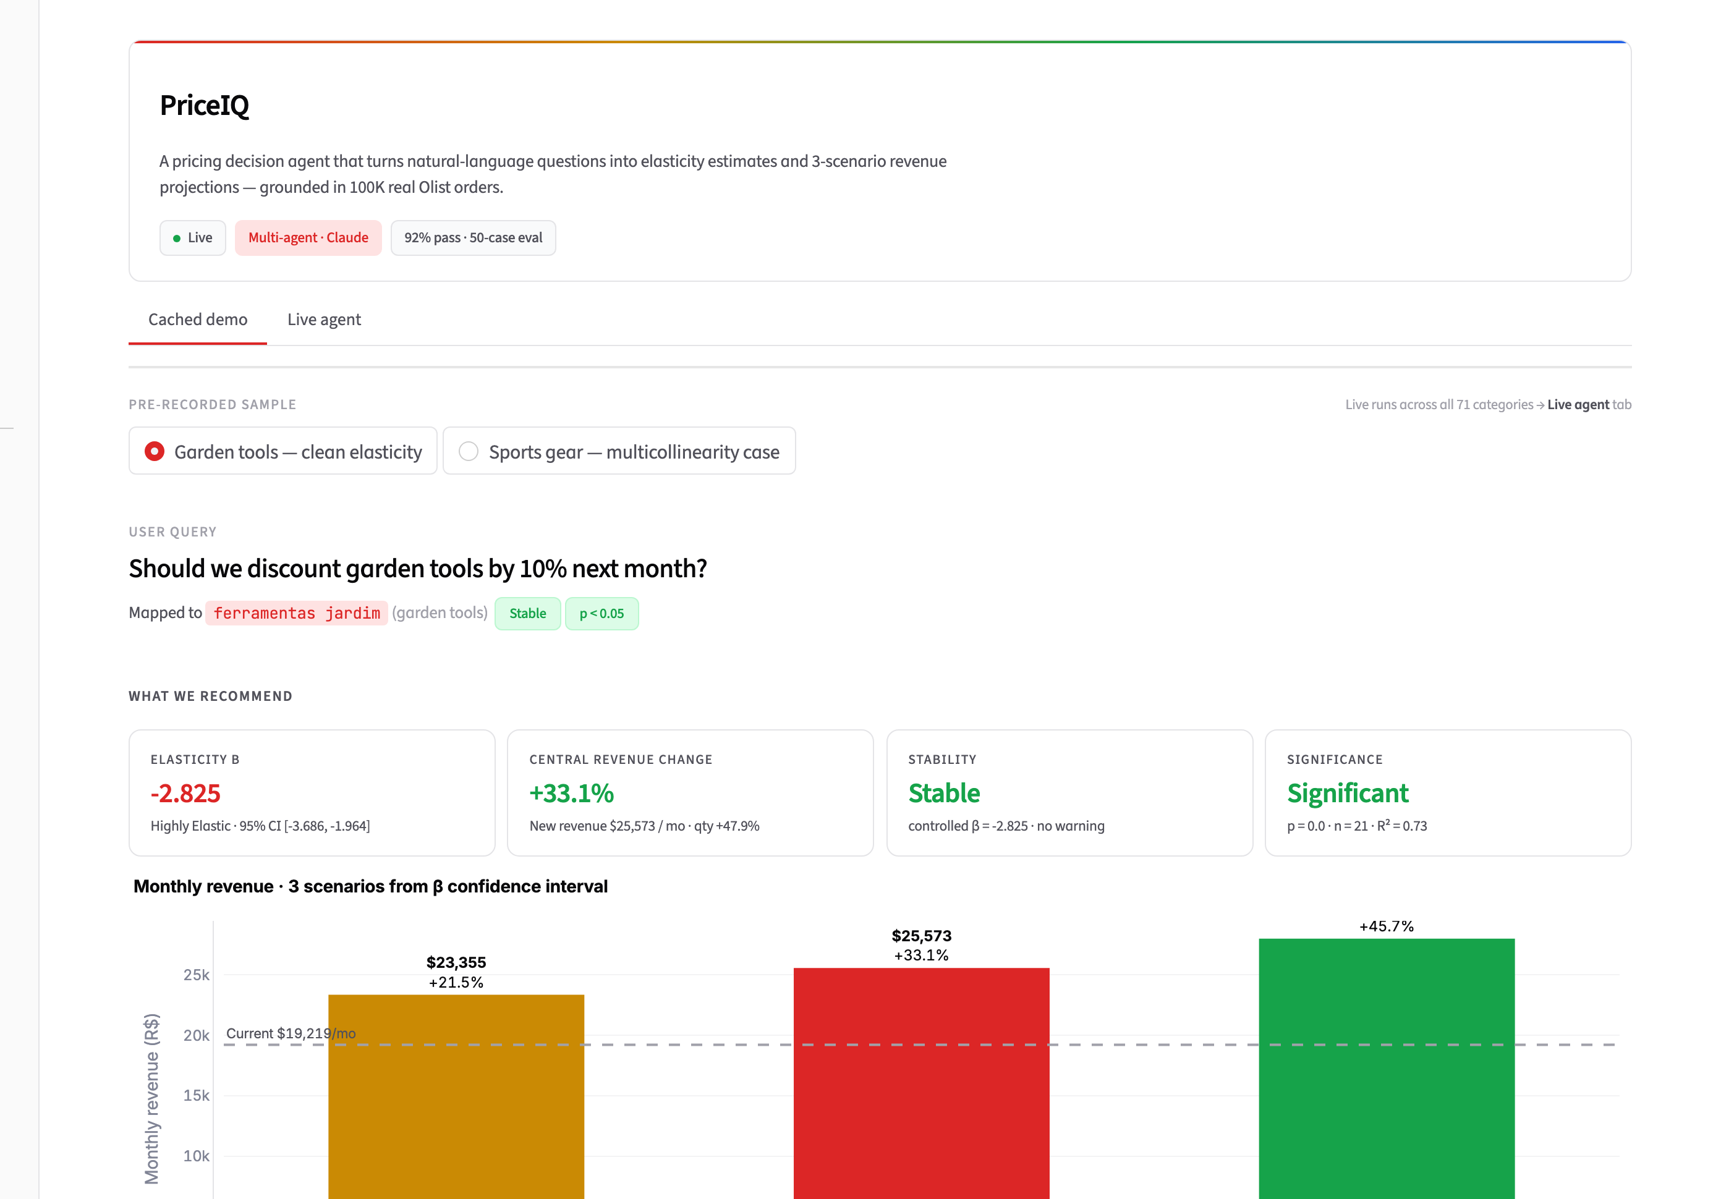
LIVE DEMO · GARDEN TOOLS −10%
5 tools fire in 31 seconds. Three revenue scenarios.
STREAMLIT · CACHED DEMO TAB
+33%
CENTRAL SCENARIO
Revenue lift, 95% CI +21% to +46%
DRIVERS
β = −2.83 · highly elastic Mother's Day demand × 1.16 Rain headwind × 0.94
PriceIQ
Demo 04

Slide 5
REASONING RIGOR · PROMPT VERSION CONTROL
Same query, two prompts.
V1
V2
3 of 5 tools called
5 of 5 tools called
SQL
OLS
Demand
Weather
Simulate
SQL
OLS
Demand
Weather
Simulate
Plan skips demand and weather. Answer correct in direction but missing context — Shortcut Bias.
Same query plus 5 worked examples + 11-category list. Plan completes the full pipeline. +45% cost, complete context.
In agent design, the prompt is not a hint — it's a contract. Without examples, the LLM honors the letter of the spec but not the intent.
PriceIQ
PVC story 05

Slide 6
EVALUATION · 50 CASES · LLM-AS-JUDGE · 3-RUN CONSISTENCY
92% pass rate at $0.029 per query.
COST PER PASS
$0.029
PASS RATE
vs $0.062 all-Sonnet · vs $0.016 all-Haiku (76% pass)
92%
CATEGORY CONSISTENCY
97%
46 of 50 · judge score 4.3 / 5
same query → same category across 3 runs
Multicollinearity warning: 100% on relevant cases. Causal caveat: included on every successful run.
PriceIQ
Eval & FinOps 06

Slide 7
HONEST FAILURES
Six logged. Four fixed in this phase.
FIXED
OPEN · ACKNOWLEDGED
F-01 Memory threshold confused mid-loop — raised 8K → 30K, added explicit "finalize NOW" instruction. F-02 Multicollinearity flipped β sign — reduced 7 predictors to 2, added diagnostic + fallback.
F-06 Out-of-scope query "weather in Tokyo?" mapped to telefonia instead of refusing. Tool 1's found:False recovered the run, ~$0.005 wasted. Fix in v3 prompt — deferred.
Full log: Failure_Log_Phase2.md Red-team: RT-01..RT-04 in Phase2_Final_Report §5.
PriceIQ
Failures 07

Slide 8
THANK YOU
Questions?
ph 2
22 deliverables · 9 .py + 9 .md + 2 .json + 1 .ipynb + 1 .txt
demo
streamlit run app.py
eval
eval_suite.run_full_eval(n=50, consistency_runs=3)
Sun · Cheng · Li JHU Carey · Generative AI · 2026

