Slide 1

Employee Information System
Presented By:
Reeti Shrestha
5218/13

Slide 2

Introduction to the Organization
Software development company established since 2010
Situated at Putalisadak
Designs, develops and deploys software for different scale of enterprises

Slide 3

Introduction to the System
Developed in HTML, JSP and MYSQL
Dynamic system with responsive web
Manage list of employees in a company
Information can be easily retrieved
Manages employees details such as salary, address

Slide 4

Objectives
Easy management of employee information
Time and effort effectiveness
Easily accessible
User friendly
Add, view and update the record of the employee

Slide 5






Tools Used

Slide 6
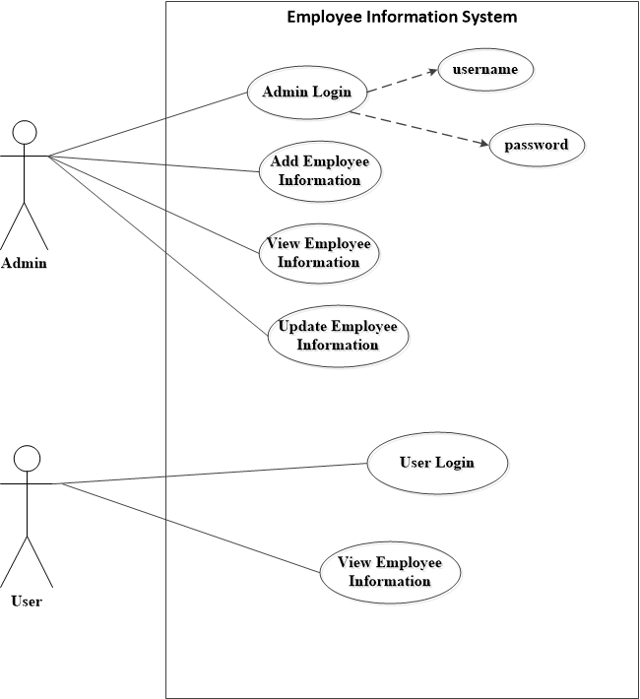
Use case

Slide 7
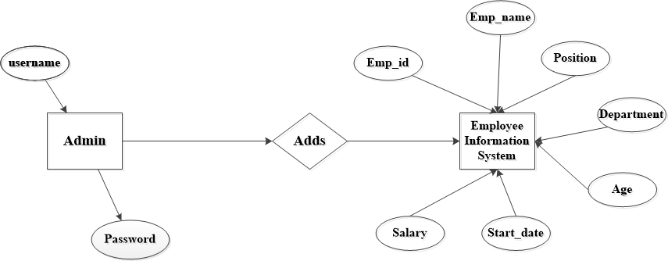
ER Diagram

Slide 8
System Architecture

Slide 9
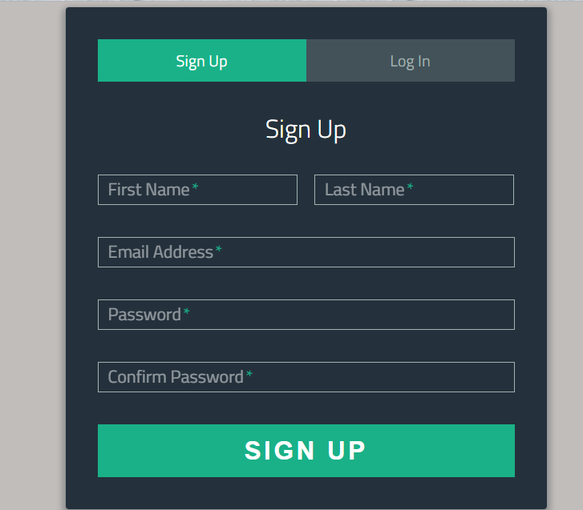
Screenshots

Slide 10
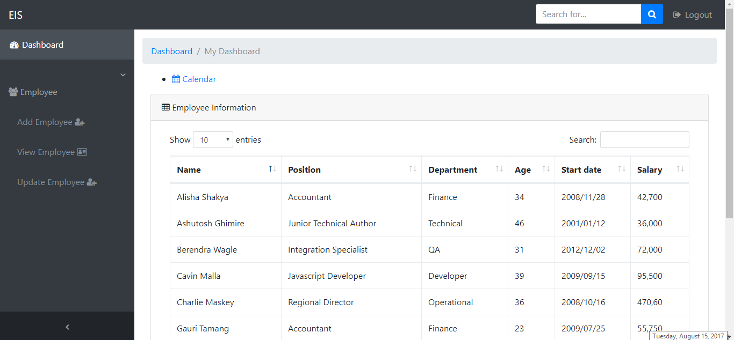
Screenshots

Slide 11

Conclusion
Easier to use and user friendly
Consists of detailed information regarding employees
Easily accessible
Keep track of records of employees

Slide 12


