Slide 1
Mobile customer services management
Presented by: Md. Tofazzal Hosen
Md. Mizanur Rahman
Farzana kuddus
Presented To: Supta Richard Philip
senior lecturer, Department of CSE
, City University Bangladesh

Slide 2
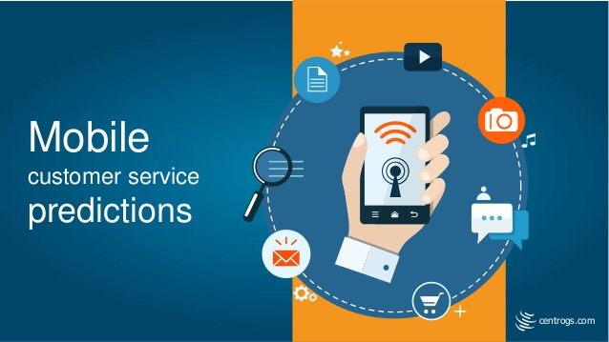
Introduction: With a growing number of consumers now viewing mobile devices as their primary means of communication with the contact center, it is becoming increasingly key for businesses to ensure that customers using mobile devices have a quality experience when they reach out to businesses – regardless of the specific communications platform they opt to use.
This provided customer to solved hardware related problem of mobile.
This also provides software related issue of mobile.
Its help customer to get warranty services which provide by mobile company.

Slide 3
How do mobile customer service apps work?
Mobile customer service apps provide an efficient and convenient way to find information, get answers and contact customer service, which can help reduce contact center workload and costs.
Mobile customer service apps allow a company to transform its app from being purely transactional to providing cross-channel service conversations. Agents have a full customer history and view of customer preferences via the app and are able to provide a personalized experience for each customer.
This enables customers to see the menus and prompts instantly rather than having to wait to hear them, allowing them to tap their way quickly through the menu levels, thereby reducing the overall interaction cycle time.
Customers also have the option to book a call-back either as soon as an agent is available or within a specified time window. Customers can also elect to start a web chat or to send a request for information (which could result in an email being sent to the contact center queue for auctioning).

Slide 4
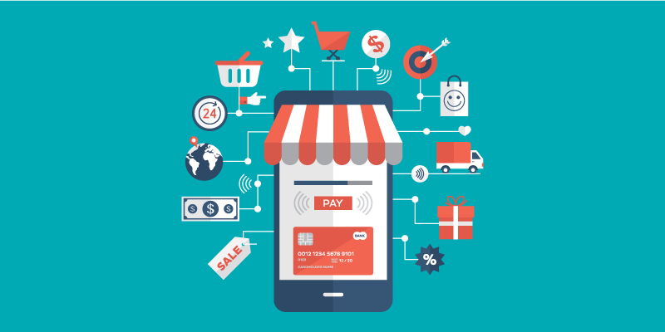
Economic Feasibility:
Businesses from all corners of the world, offering a ridiculous range of products, have begun migrating from the physical world of handing out leaflets, printing advertisements, and hanging billboards, to the mobile realm. And you should too.
And maybe that’s been the case in the past. But if you want to prepare for the future and start seeing the massive benefits right out the gate, you’ll need a mobile app.

Slide 5
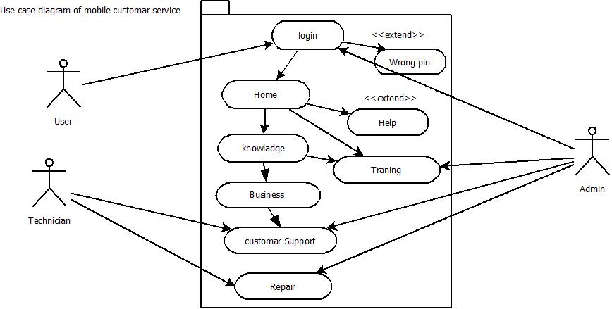
Use case diagram for mobile customer services

Slide 6
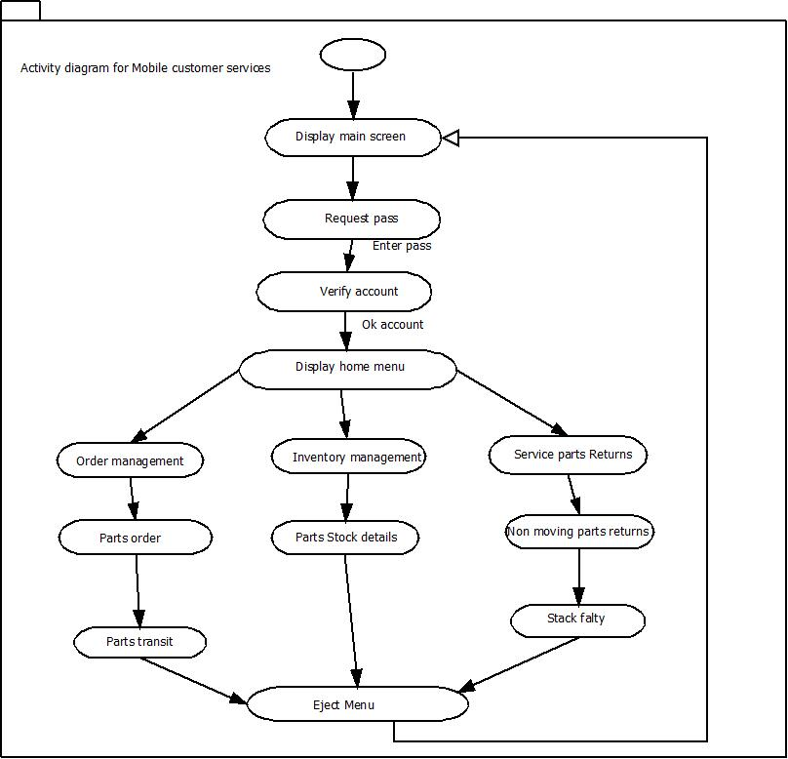
Activity diagram for mobile customer services

