Slide 1
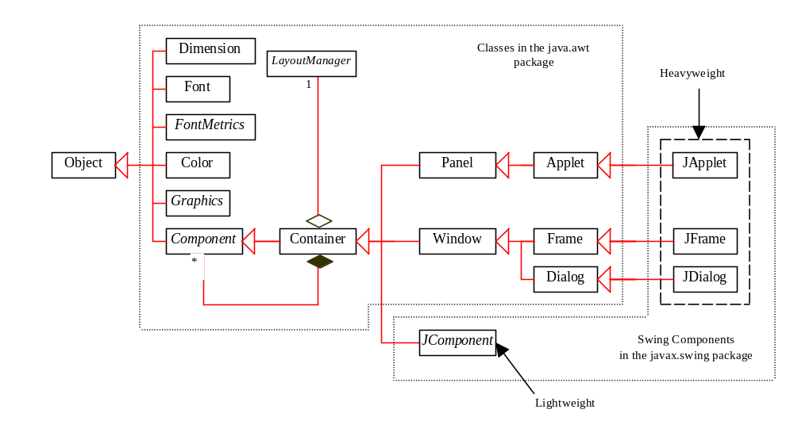
GUI Class Hierarchy (Swing)

Slide 2
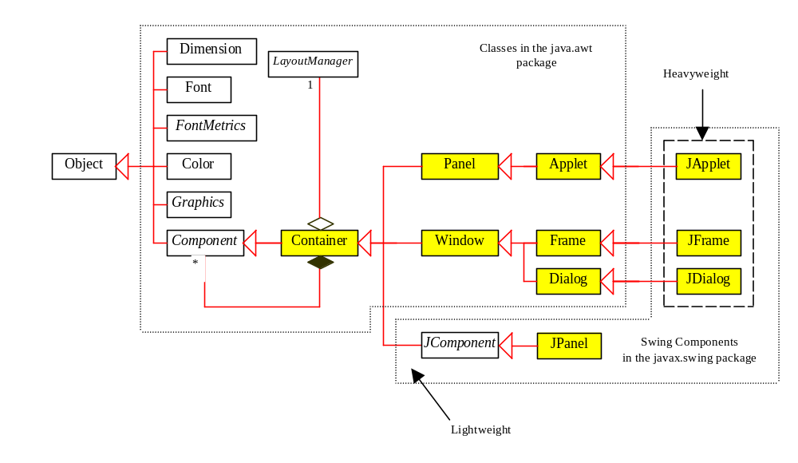
Container Classes
Container classes can contain other GUI components.

Slide 3
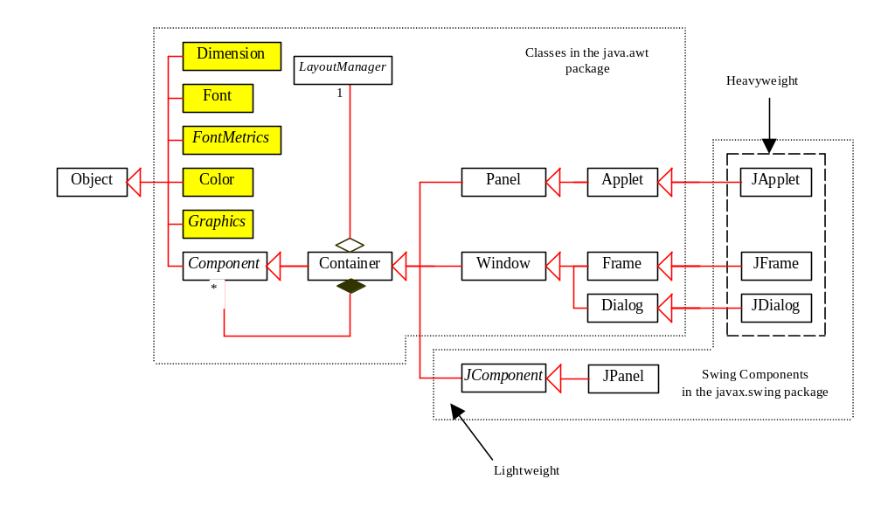
GUI Helper Classes
The helper classes are not subclasses of Component. They are used to describe the properties of GUI components such as graphics context, colors, fonts, and dimension.

Slide 4
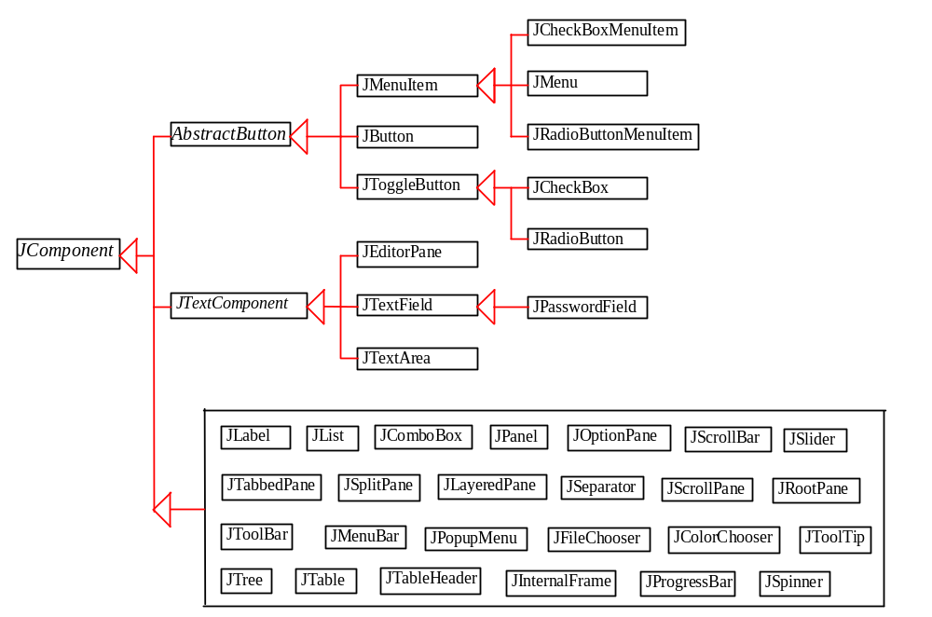
Swing GUI Components

Slide 5
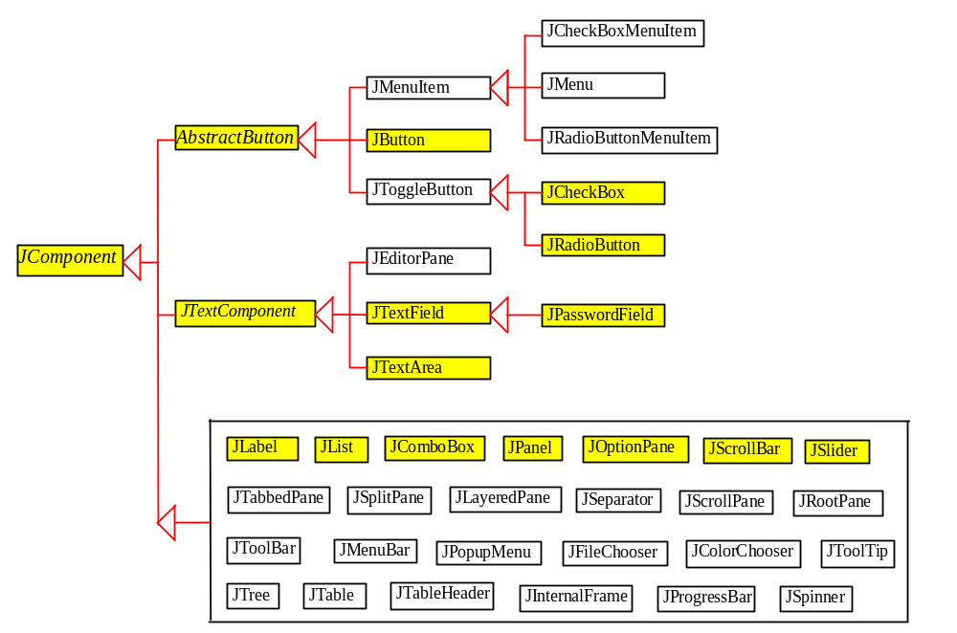
Components Covered in the Core Version

Slide 6
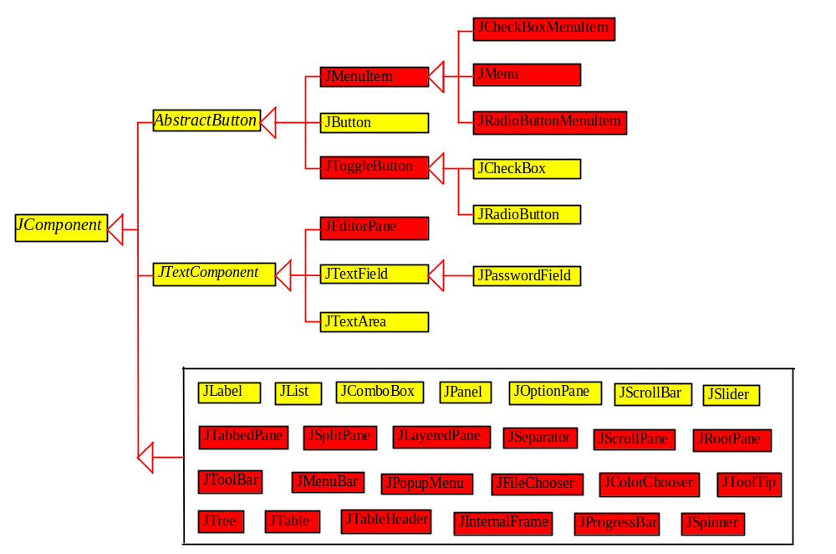
Components Covered in the Comprehensive Version

Slide 7
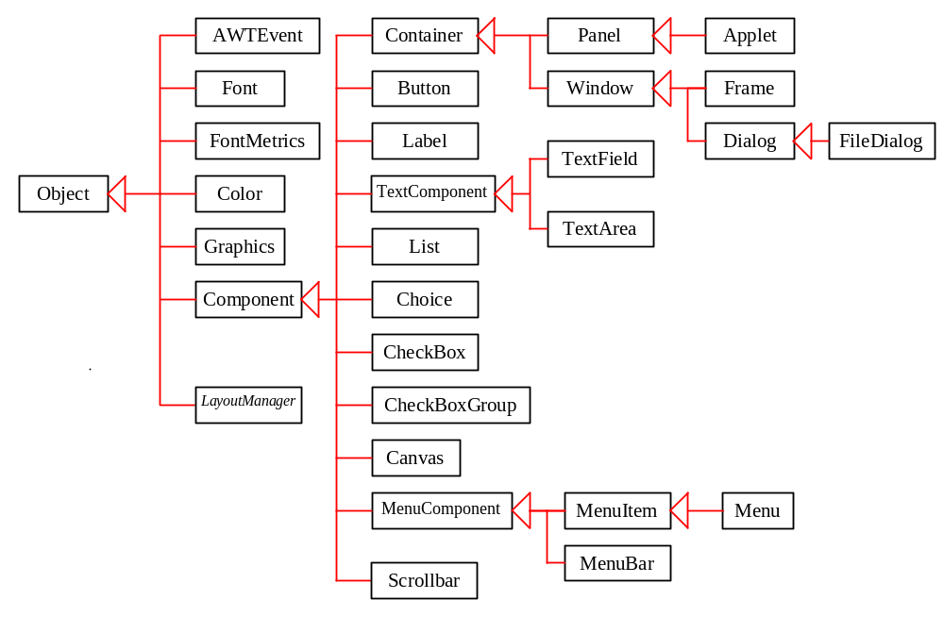
AWT (Optional)

