Slide 1


Slide 2
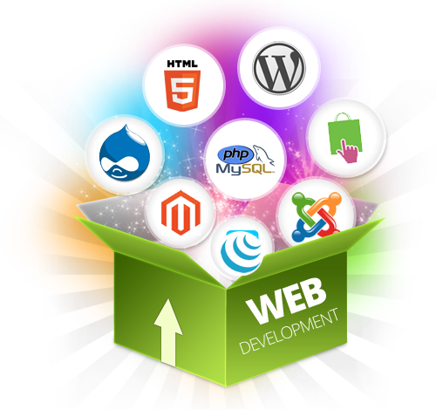
LECTURE 32: INTRO TO WEB DEVELOPMENT
Objectives:
Basic Web Application Model Web Development Frameworks/Languages
Resources:
Web Frameworks
Popular Frameworks
10 Things to Know
Angular
React
Knockout
Videos:
Rest
Postman
Chrome Developer Tools

Slide 3
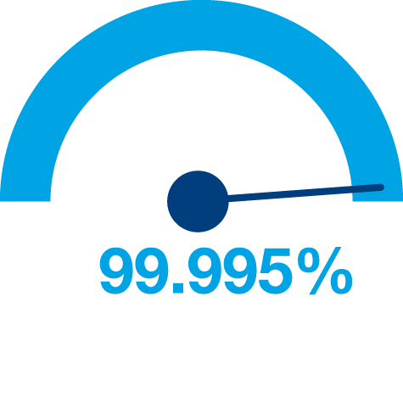

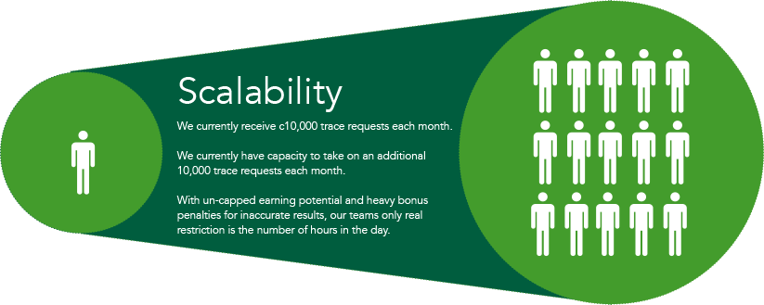


Principles of Web Design
Availability
Performance
Reliability
Scalability
Manageability
Cost
Notes:
Availability: The uptime of a website is absolutely critical to the reputation and functionality of many companies. For some of the larger online retail sites, being unavailable for even minutes can result in thousands or millions of dollars in lost revenue, so designing their systems to be constantly available and resilient to failure is both a fundamental business and a technology requirement. High availability in distributed systems requires the careful consideration of redundancy for key components, rapid recovery in the event of partial system failures, and graceful degradation when problems occur.
Performance: Website performance has become an important consideration for most sites. The speed of a website affects usage and user satisfaction, as well as search engine rankings, a factor that directly correlates to revenue and retention. As a result, creating a system that is optimized for fast responses and low latency is key.
Reliability: A system needs to be reliable, such that a request for data will consistently return the same data. In the event the data changes or is updated, then that same request should return the new data. Users need to know that if something is written to the system, or stored, it will persist and can be relied on to be in place for future retrieval.
Scalability: When it comes to any large distributed system, size is just one aspect of scale that needs to be considered. Just as important is the effort required to increase capacity to handle greater amounts of load, commonly referred to as the scalability of the system. Scalability can refer to many different parameters of the system: how much additional traffic can it handle, how easy is it to add more storage capacity, or even how many more transactions can be processed.
Manageability: Designing a system that is easy to operate is another important consideration. The manageability of the system equates to the scalability of operations: maintenance and updates. Things to consider for manageability are the ease of diagnosing and understanding problems when they occur, ease of making updates or modifications, and how simple the system is to operate. (I.e., does it routinely operate without failure or exceptions?)
Cost: Cost is an important factor. This obviously can include hardware and software costs, but it is also important to consider other facets needed to deploy and maintain the system. The amount of developer time the system takes to build, the amount of operational effort required to run the system, and even the amount of training required should all be considered. Cost is the total cost of ownership.

Slide 4
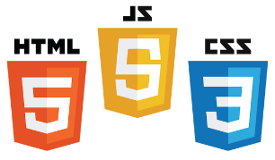
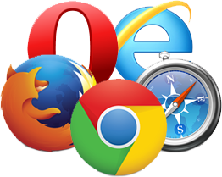
Core Components of Web Applications
Server
Client
API
Front End
Database
Browser
Internet
Logic
JSON
Media Cache
UI (Front End (DOM, Framework))
Request Layer (Web API)
Back End (Database, Logic)
Notes:
Break down into front end and back end

Slide 5
Frontend development

Slide 6
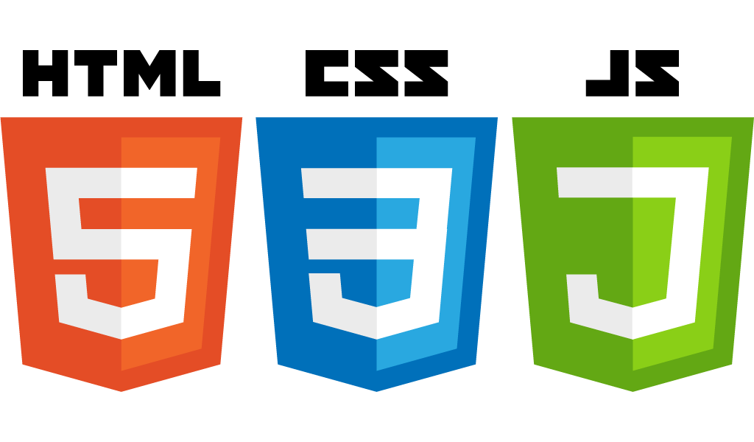
Front End Languages
HTML/CSS
Javascript
Java (applets)
What is the most popular?
Answer: Javascript/HTML/CSS is the only real option for front-end native languages and is basically the standard. But there are many variations on JavaScript that are used.
Notes:
Javascript adoption with ES6, ‘don’t forget about babel’
Node.js:
Swift 2: Apples vision for modern web programming
Go: growing in popularity with startups
TypeScript: Beauty of statically type Javascript (PS: Microsoft Technology)

Slide 7

DOM (Document Object Model)
Document Object Model makes every addressable item in a web application an Object that can be manipulated for color, transparency, position, sound and behaviors.
Every HTML Tag is a DOM object

Slide 8
DOM (Document Object Model)
CSS
DOM
JavaScript
HTML
Notes:
HTML: Creates the DOM
CSS: Decorates the DOM
JavaScript: Modifies the DOM Dynamically
Back End Language: (PHP, Python, Ruby, F#): Generates the DOM on the fly

Slide 9
What is a Framework?
Software Framework designed to reduce overhead in web development
Types of Framework Architectures
Model-View-Controller (MVC)
Push vs Pull Based
Most MVC Frameworks user push-based architecture “action based” (Django, Ruby on Rails, Symfony, Stripes)
Pull-based or “component based” (Lift, Angular2, React)
Three Tier Organization
Client (Usually the browser running HTML/Javascipt/CSS)
Application (Running the Business Logic)
Database (Data Storage)
Types of Frameworks
Server Side: Django, Ruby on Rails
Client Side: Angular, React, Vue
Notes:
MVC: separated (data model, logic, user interface)
Push-based frameworks use actions that do the required processing, and then "push" the data to the view layer to render the results
component-based: These frameworks start with the view layer, which can then "pull" results from multiple controllers as needed.

Slide 10
Framework
Framework
CSS
DOM
JavaScript
HTML
Notes:
HTML: Creates the DOM
CSS: Decorates the DOM
JavaScript: Modifies the DOM Dynamically
Back End Language: (PHP, Python, Ruby, F#): Generates the DOM on the fly

Slide 11



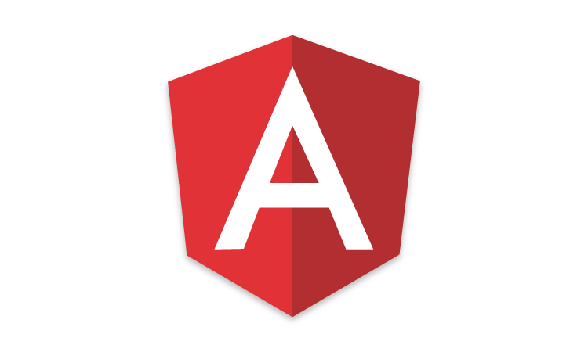

Javascript Frameworks
AngularJS/Angular 2
ASP.net
React
Polymer 1.0
Ember.js
Vue.js

Slide 12
MVC (Model View Controller)
A Web Application Development Framework
Model (M):
Where the data for the DOM is stored and handled)
This is where the backend connects
View (V):
Think of this like a Page which is a single DOM
Where changes to the page are rendered and displayed
Control (C):
This handles user input and interactions
Buttons
Forms
General Interface

Slide 13
MVC Model
Controller
Update
Notify
Update
User Action
Model
View

Slide 14
BACKEND development

Slide 15
What is a Backend?
All of the awesome that runs your application.
Web API
Connection layer between the frontend and backend
Connected through API calls (POST, GET, PUT, etc. )
Transmit Content from the Backend to the Frontend commonly in JSON Blobs
Service Architecture that drives everything (Where all the logic is)

Slide 16
What is a WebAPI?
The intermediate layer between front end and back-end systems
A “must have” if your APIs will be consumed by third-party services
Attention to details:
How consumable is the API (signature, content negotiation)?
Does it comply with standards (response codes, etc.)?
Is it secure?
How do you handle multiple versions?
Is it truly RESTful?

Slide 17
Representational State Transfer (REST)
Client-server
Stateless
Resource-based (vs. remote procedure call)
HTTP methods (GET, POST, PUT, DELETE)
Side Effects
It’s a style, not a standard
Don’t hate on HATEOAS

Slide 18
WebAPI Terms
GET – “read”
POST – “insert” (collection)
PUT – “replace”
DELETE – “remove”
PATCH – “update”
Custom (proceed with caution)

Slide 19
Web Status Codes
200 – OK – things are great (return the item)
201 Created – after POST (HATEOAS – return location)
204 No Content (i.e. successful DELETE)
400 – Bad Request (validation error, missing parms, etc.)
401 – Unauthorized – Who are you?
403 – Forbidden – No soup for you
404 – Not Found

Slide 20
What is Angular
MVC Structure
Framework
Single Page Application (SPA)
Client Side Template
Testing

Slide 21
Building Blocks
Directives
Component – Templates (HTML), Styles (CSS), & Logic (JavaScript)
Attribute – Styling HTML
Structural – Manipulating HTML
Data Flow
Interpolation – Variable Printing in Templates
Event Binding – Trigger Events
2-Way Binding – Variables updated in real time
Providers
Services
Reusable Logic
Data Storing and Manipulation
Libraries

Slide 22
Component Directives
"…reusable building blocks for an application"
Components have:
HTML
CSS
JavaScript
Component
Template (HTML)
Styles (CSS)
Class (JavaScript)
Notes:
"…reusable building blocks for an application"

Slide 23
History
JavaScript – 1995
Netscape
ECMAScript Standard – June 1997
Garret coins Ajax - 2005
Prototype, Dojo, jQuery –ECMAScript 5 – 20092005/2006
JSON Support

Slide 24
History
AngularJS – 2009
React – 2011
Facebook NewsFeed
React – 2013
Open Sourced
AngularJS 2.0 – Announced Sept 2014
Breaking changes
ECMAScript 6 – June 2016

Slide 25
AngularJS
From the fine folks at Google
AngularJS 1.x – Google JavaScript library for development
AngularJS 2.x – Called Angular
Angular is a Framework
Angular is opinionated
Angular has code in your markup
Angular is HTML centric

Slide 26

Not The Same
Angular is a Framework. React is a Library

Slide 27
Angular – Why
Mobile First
Standards focused
Performance
Virtual Dom
Web Components

Slide 28
Component Angular
import { Component } from 'angular2/core';
@Component({
selector: 'foo-Div',
templateUrl: 'app/foo.html',
styleUrls: [ 'app/foo.css' ]
})
export class Foo {
public message = 'Foo!';
}

Slide 29
Templates and Databinding
Angular separate HTML file
React HTML is in render method
JSX allows for HTML like
Angular has one way and two way data binding
{{element.name}}
<input type="text" [(ngModel)]="inputFieldName" id="id1" />
React is stateless, no two way binding
This.state.inputFieldName

Slide 30

Rise of the Responsive Single Page App

Slide 31
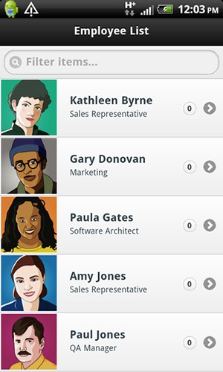
Responsive
Uniﬁed across experiences
Can be embedded as mobile app
Better deployment and & maintanence
Mobile users need to get access to everything
Image: http://coenraets.org/blog/wp-­‐content/uploads/2011/10/directory11.png

Slide 32
Single-­‐page Applications (SPA)
Web app that ﬁts on a single web page
Fluid UX, like desktop app
Examples like Gmail, Google maps
Html page contains mini-­‐views (HTML Fragments) that can be loaded in the background
No reloading of the page,
Requires handling of browser history, navigation and bookmarks

Slide 33
JavaScript
SPAs are implemented using JavaScript and
HTML

Slide 34
Challenges in SPA
DOM Manipulation
How to manipulate the view eﬃciently?
History
What happens when pressing back button?
Routing
Readable URLs?
Data Binding
How bind data from model to view?
View Loading
How to load the view?
Lot of coding! You could use a framework instead ...

Slide 35
Single-page Application
Single page apps typically have
“application like” interaction
dynamic data loading from the server-side API
fluid transitions between page states
more JavaScript than actual HTML
They typically do not have
support for crawlers (not for sites relying on search traffic)
support for legacy browsers (IE7 or older, dumbphone browsers)

Slide 36
SPAs Are Good For …
“App-like user experience”
Binding to your own (or 3rd party) RESTful API
Replacement for Flash or Java in your web pages
Hybrid (native) HTML5 applications
Mobile version of your web site
The SPA sweet spot is likely not on web sites, but on content-rich cross-platform mobile apps

Slide 37
PJAX
Pjax is a technique that allows you to progressively enhance normal links on a page so that clicks result in the linked content being loaded via Ajax and the URL being updated using HTML5 pushState, avoiding a full page load.
In browsers that don't support pushState or that have JavaScript disabled, link clicks will result in a normal full page load. The Pjax Utility makes it easy to add this functionality to existing pages.

Slide 38
SPAs and Other Web App Architectures
 | Server-side | Server-side + AJAX | PJAX | SPA
What | Server round-trip on every app state change | Render initial page on server, state changes on the client | Render initial page on server, state changes on server, inject into DOM on client-side | Serve static page skeleton from server; render every change on client-side
How | UI code on server; links & form posting | UI code on both ends; AJAX calls, ugly server API | UI code on server, client to inject HTTP, server API if you like | UI code on client, server API
Ease of development
UX & responsiveness
Robots & old browsers
Who’s using it? | Amazon, Wikipedia; banks, media sites etc. | Facebook?; widgets, search | Twitter, Basecamp, GitHub | Google+, Gmail, FT; mobile sites, startups

Slide 39
Angular JS
Single Page App Framework for JavaScript
Implements client-­‐side MVC pattern
– Separation of presentation from business logic and presentation state
No direct DOM manipulation, less code
Support for all major browsers
Supported by Google
Large and fast growing community

Slide 40
AngularJS – Main Concepts
Templates
Directives
Expressions
Data binding
Scope
Controllers
Modules
Filters
Services
Routing

Slide 41
Anatomy of a Backbone SPA
Application as a ‘singleton’ reference holder
Router handles the navigation and toggles between views
Models synchronize with Server API
Bulk of the code in views
All HTML in templates

Slide 42
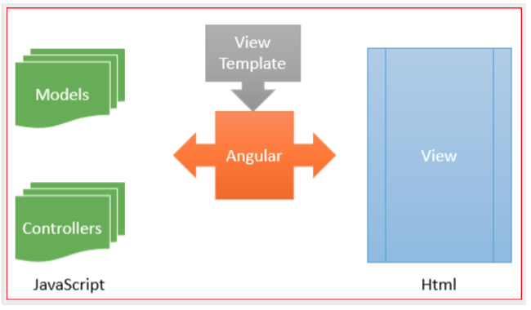
Architecture

Slide 43
SPA Client-Server Communication
HTML and all the assets are loaded in first request
Additional data is fetched over XMLHTTPRequest
If you want to go real-time, WebSockets (socket.io) can help you

Slide 44
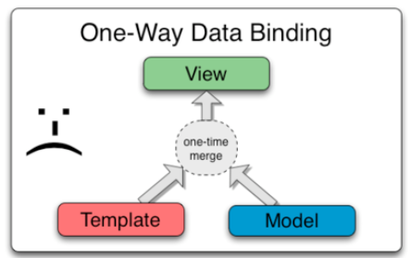
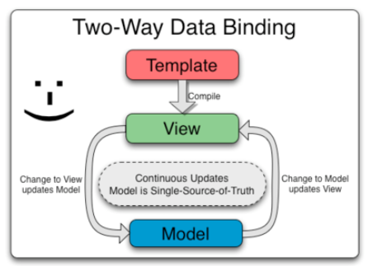
HOW IT WORKS?

Slide 45
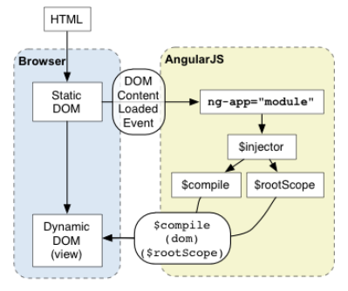
HOW IT WORKS?

Slide 46
Basic Concepts
1) Templates
HTML with additional markup, directives, expressions, ﬁlters ...
2) Directives
Extend HTML using ng-app, ng-bind, ng-model
3) Filters
Filter the output: filter, orderBy, uppercase
4) Data Binding
Bind model to view using expressions {{ }}

Slide 47

First Example – Template
<!DOCTYPE html>
<html>
<head>
<title>Title</title>
<meta charset="UTF-8" />
<style media="screen"></style>
<script src="https://ajax.googleapis.com/ajax/libs/angularjs/1.4.8/angular.min.js"></script>
</head>
<body>
<div ng-app>
<!-- store the value of input field into a variable name -->
<p>Name: <input type="text" ng-model="name"></p>
<!-- display the variable name inside (innerHTML) of p -->
<p ng-bind="name"></p>
</div>
</body>
</html>
Template

Slide 48
2) Directives
Directives apply special behavior to attributes or elements in HTML
Attach behaviour, transform the DOM
Some directives
ng-app
Initializes the app
ng-model
Stores/updates the value of the input ﬁeld into a variable
ng-bind
Replace the text content of the speciﬁed HTML with the value of given expression

Slide 49
About Naming
AngularJS HTML Compiler supports multiple formats
ng-bind
Recommended Format
data-ng-bind
Recommended Format to support HTML validation
ng_bind, ng:bind, x-ng-bind
Legacy, don't use

Slide 50
Lot of Built in Directives
ngApp
ngClick
ngController
ngModel
ngRepeat
ngSubmit
ngDblClick
ngMouseEnter
ngMouseMove
ngMouseLeave
ngKeyDown
ngForm

Slide 51
2) Expressions
Angular expressions are JavaScript-­‐like code snippets that are usually placed in bindings
{{ expression }}.
Valid Expressions
– {{ 1 + 2 }}
– {{ a + b }}
{{ items[index] }}
Control ﬂow (loops, if) are not supported!
You can use ﬁlters to format or ﬁlter data

Slide 52
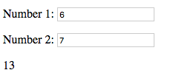




Example
<!DOCTYPE html>
<html>
<head>
<title>Title</title>
<meta charset="UTF-8" />
<style media="screen"></style>
<script src="https://ajax.googleapis.com/ajax/libs/angularjs/1.4.8/angular.min.js"></script>
</head>
<body>
<div ng-app>
<p>Number 1: <input type="number" ng-model="number1"></p>
<p>Number 2: <input type="number" ng-model="number2"></p>
<!-- expression -->
<p>{{ number1 + number2 }}</p>
</div>
</body>
</html>
Directive
Directive
Expression

Slide 53
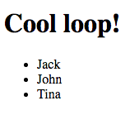
ng-­‐init and ng-­‐repeat directives
<!DOCTYPE html>
<html data-ng-app="">
<head>
<title>Title</title>
<meta charset="UTF-8" />
<script src="https://ajax.googleapis.com/ajax/libs/angularjs/1.4.8/angular.min.js"></script>
</head>
<body>
<div data-ng-init="names = ['Jack', 'John', 'Tina']">
<h1>Cool loop!</h1>
<ul>
<li data-ng-repeat="name in names">{{ name }}</li>
</ul>
</div>
</body>
</html>

Slide 54
3) Filter
With ﬁlter, you can format or ﬁlter the output
Formatting
currency, number, date, lowercase, uppercase
Filtering
filter, limitTo
Other
orderBy, json

Slide 55
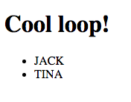



Using Filters -­‐ Example
<!DOCTYPE html>
<html data-ng-app="">
<head>
<title>Title</title>
<meta charset="UTF-8" />
<style media="screen"></style>
<script src="https://ajax.googleapis.com/ajax/libs/angularjs/1.4.8/angular.min.js"></script>
</head>
<body>
<div data-ng-init="customers = [{name:’tina'}, {name:’jack'}]">
<h1>Cool loop!</h1>
<ul>
<li data-ng-repeat="customer in customers | orderBy:'name'">
{{ customer.name | uppercase }}</li>
</ul>
</div>
</body>
</html>
Filter
Filter

Slide 56
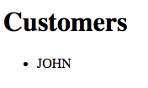
Using Filters -­‐ Example
<!DOCTYPE html>
<html data-ng-app="">
<head>
<title>Title</title>
<meta charset="UTF-8" />
<style media="screen"></style>
<script src="https://ajax.googleapis.com/ajax/libs/angularjs/1.4.8/angular.min.js"></script>
</head>
<body>
<div data-ng-init=
"customers = [{name:'jack'}, {name:'tina'}, {name:'john'}, {name:'donald'}]">
<h1>Customers</h1>
<ul>
<li data-ng-repeat="customer in customers | orderBy:'name' | filter:'john'">{{ customer.name | uppercase }}</li>
</ul>
</div>
</body>
</html>

Slide 57
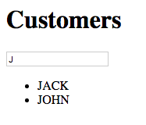
Using Filters – User Input Filters the Data
<!DOCTYPE html>
<html data-ng-app="">
<head>
<title>Title</title>
<meta charset="UTF-8" />
<style media="screen"></style>
<script src="https://ajax.googleapis.com/ajax/libs/angularjs/1.4.8/angular.min.js"></script>
</head>
<body>
<div data-ng-init=
"customers = [{name:'jack'}, {name:'tina'}, {name:'john'}, {name:'donald'}]">
<h1>Customers</h1>
<input type="text" data-ng-model="userInput" />
<ul>
<li data-ng-repeat="customer in customers | orderBy:'name' | filter:userInput">{{ customer.name | uppercase }}</li>
</ul>
</div>
</body>
</html>

Slide 58
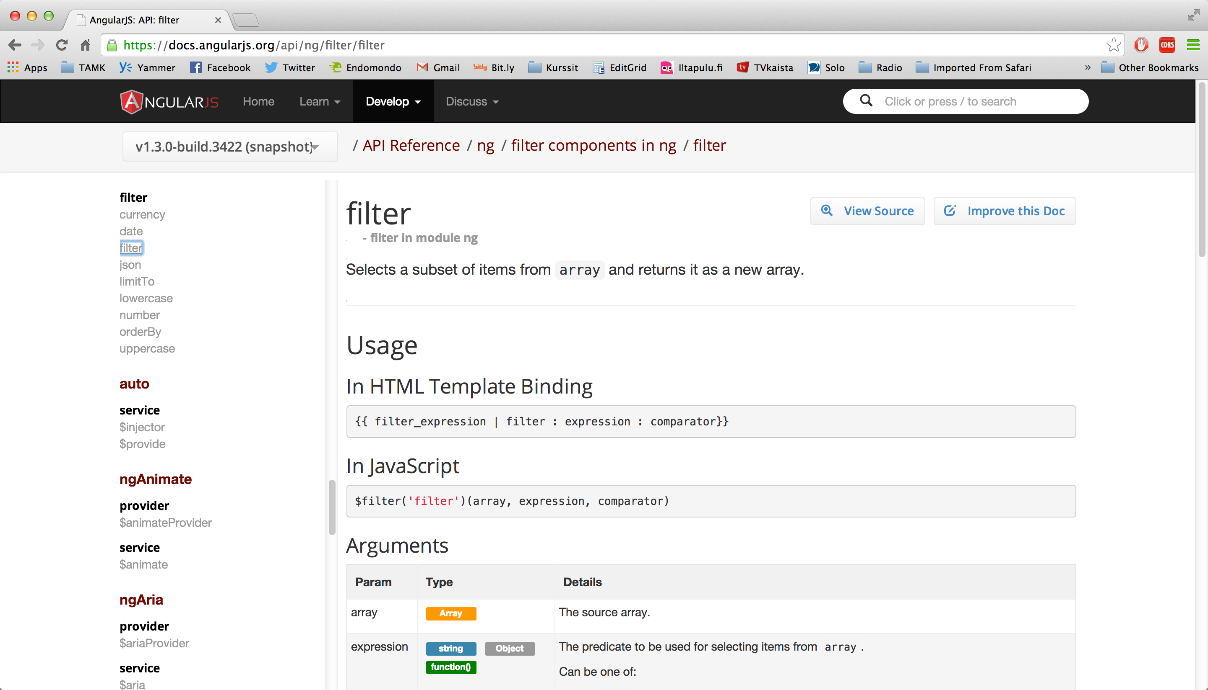
API Reference
https://docs.angularjs.org/api/ng/filter/filter

Slide 59
VIEWS, CONTROLLERS, SCOPE

Slide 60
Model – View -­‐ Controllers
Controllers provide the logic behind your app.
– So use controller when you need logic behind your UI
AngularJS apps are controller by controllers
Use ng-­‐controller to deﬁne the controller
Controller is a JavaScript Object, created by
standard JS object constructor

Slide 61
Model – View -­‐ Controllers
a controller is a JavaScript function
○ It contains data
○ It specifies the behavior
○ It should contain only the business logic needed for a single view.

Slide 62





View, Controller and Scope
View
(html fragment)
Controller
$scope
$scope is an object that can be used to communicate between
View and Controller

Slide 63
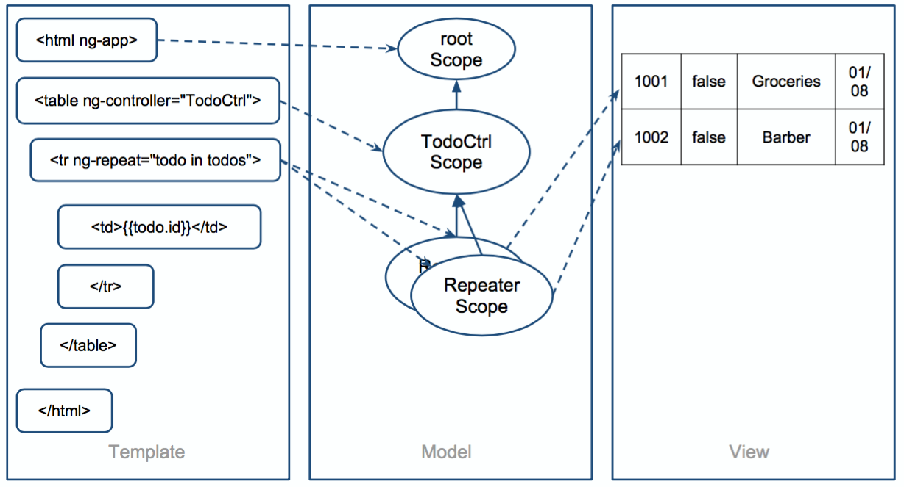
Scope

Slide 64
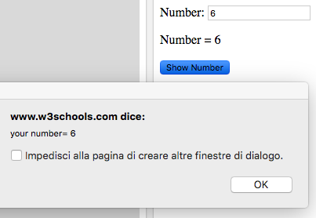
<!DOCTYPE html>
<html>
<head>
<title>Title</title>
<meta charset="UTF-8" />
<style media="screen"></style>
<script src="https://ajax.googleapis.com/
ajax/libs/angularjs/1.4.8/angular.min.js">
</script>
</head>
<body>
<div data-ng-app="myApp" data-ng-controller="NumberCtrl">
<p>Number: <input type="number" ng-model="number"></p>
<p>Number = {{ number }}</p>
<button ng-click="showNumber()">Show Number</button>
</div>
<script>
var app = angular.module('myApp', []);
app.controller('NumberCtrl', function($scope) {
$scope.number = 1;
$scope.showNumber = function(){
window.alert( "your number= " + $scope.number );
};
});
</script>
</body>
</html>

Slide 65
Modules
Module is an reusable container for diﬀerent features of your app
– Controllers, services, ﬁlters, directives...
If you have a lot of controllers, you are
polluting JS namespace
Modules can be loaded in any order
We can build our own ﬁlters and directives!

Slide 66
When to use Controllers
Use controllers
set up the initial state of $scope object
add behavior to the $scope object
Do not
Manipulate DOM (use databinding, directives)
Format input (use form controls)
Filter output (use ﬁlters)
Share code or state (use services)

Slide 67
App Explained
App runs inside ng-app (div)
AngularJS will invoke the constructor with a
$scope – object
$scope is an object that links controller to the view

Slide 68
MODULES, ROUTES, SERVICES

Slide 69
Example: Own Filter
// declare
a module
var myAppModule = angular.module('myApp',
[]);
// configure the module.
// in this example we will create a greeting myAppModule.filter('greet', function() {
return function(name) {
filter
return 'Hello,
};
});
' + name + '!';

Slide 70
HTML using the Filter
<div
ng-app="myApp">
<div>
{{ 'World'
| greet }}
</div>
</div>

Slide 71
Template for Controllers
// Create new module 'myApp' using angular.module method.
// The module is not dependent on any other module
var myModule = angular.module('myModule',
[]);
myModule.controller('MyCtrl', function ($scope) {
// Your controller code here!
});

Slide 72
Creating a Controller in Module
var myModule = angular.module('myModule',
[]);
myModule.controller('MyCtrl', function ($scope) {
var model = { "firstname": "Jack",
"lastname": "Smith" };
$scope.model = model;
$scope.click = function() {
alert($scope.model.firstname);
};
});

Slide 73



<!DOCTYPE html>
<html>
<head>
<title>Title</title>
<meta charset="UTF-8" />
<style media="screen"></style>
<script
<script
src="../angular.min.js"></script> src="mymodule.js"></script>
This is now the model object from MyCtrl. Model object is shared with view and controller
</head>
<body>
<div ng-app="myModule"
<div ng-controller="MyCtrl">
<p>Firstname: <input type="text" ng-model="model.firstname"></p>
<p>Lastname: <input type="text" ng-model="model.lastname"></p>
<p>{{model.firstname + " " + model.lastname}}</p>
<button ng-click="click()">Show Number</button>
</div>
</div>
</body>
</html>

Slide 74
ROUTING

Slide 75
Routing
Since we are building a SPA app, everything happens in one page
How should back-­‐button work?
How should linking between "pages" work?
How about URLs?
Routing comes to rescue!

Slide 76


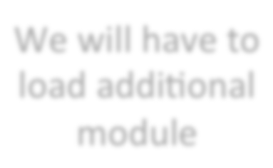



<html data-ng-app="myApp">
<head>
<title>Demonstration of Routing - index</title>
<meta charset="UTF-8" />
<script
<script
<script
</script>
</head>
src="../angular.min.js" type="text/javascript"></script> src="angular-route.min.js" type="text/javascript"></script> src="myapp.js" type="text/javascript">
We will have to load additional module
<body>
<div data-ng-view=""></div>
</body>
</html>
The content of this will change dynamically

Slide 77
// This module is dependent on ngRoute. Load ngRoute
// before this.
var myApp = angular.module('myApp', ['ngRoute']);
// Configure routing. myApp.config(function($routeProvider) {
// Usually we have different controllers for different
// In this demonstration, the controller does nothing.
$routeProvider.when('/', {
templateUrl: 'view1.html', controller: 'MySimpleCtrl' });
views.
$routeProvider.when('/view2', {
templateUrl: 'view2.html', controller: 'MySimpleCtrl' });
$routeProvider.otherwise({ redirectTo: '/' });
});
// Let's add a new controller to MyApp myApp.controller('MySimpleCtrl', function ($scope) {
});

Slide 78
Views
view1.html:
<h1>View 1</h2>
<p><a
href="#/view2">To
View
2</a></p>
view2.html:
<h1>View 2</h2>
<p><a
href="#/view1">To
View
1</a></p>

Slide 79
Working in Local Environment
If you get "cross origin requests are only supported for HTTP" ..
Either
1) Disable web security in your browser
2) Use some web server and access ﬁles http://..
To disable web security in chrome
taskkill /F /IM chrome.exe
"C:\Program Files (x86)\Google\Chrome\Application
\chrome.exe" --disable-web-security --allow-file-access- from-files

Slide 80
EXERCISE 4: ROUTING

Slide 81
Services
View-­‐independent business logic should not be in a controller
Logic should be in a service component
Controllers are view speciﬁc, services are app-­‐spesiﬁc
We can move from view to view and service is still alive
Controller's responsibility is to bind model to view. Model can be fetched from service!
Controller is not responsible for manipulating (create, destroy, update) the data. Use Services instead!
AngularJS has many built-­‐in services, see
http://docs.angularjs.org/api/ng/service
Example: $http

Slide 82













Services
ViewCustomers
(html fragment)
ModifyCustomers
(html fragment)
$scope
$scope
ViewCustomersCtrl
ModifyCustomerCtrl
Service

Slide 83
AngularJS Custom Services using Factory
// Let's add a new controller to MyApp. This controller uses Service! myApp.controller('ViewCtrl', function ($scope, CustomerService) {
$scope.contacts = CustomerService.contacts;
});
// Let's add a new controller to MyApp. This controller uses Service! myApp.controller('ModifyCtrl', function ($scope, CustomerService) {
$scope.contacts = CustomerService.contacts;
});
// Creating a factory object that contains services for the
// controllers. myApp.factory('CustomerService', function() {
var factory = {};
factory.contacts = [{name: "Jack", salary: 3000}, {name: "Tina", salary: 5000}, {name: "John", salary: 4000}];
return factory;
});

Slide 84
Also Service
// Service
// Service
//
is instantiated
with new – keyword.
function
can use "this" and the return
value is this.
myApp.service('CustomerService', function() { this.contacts =
 | [{name: | "Jack", | salary: | 3000},
 | {name: {name: | "Tina", "John", | salary: salary: | 5000}, 4000}];
});

Slide 85
AJAX + REST

Slide 86
AJAX
Asynchronous JavaScript + XML
XML not needed, very oden JSON
Send data and retrieve asynchronously from server in background
Group of technologies
HTML, CSS, DOM, XML/JSON, XMLHttpRequest object and JavaScript

Slide 87
$http – example (AJAX) and AngularJS
<script type="text/javascript">
var myapp = angular.module("myapp", []);
myapp.controller("MyController", function($scope, $http) {
$scope.myData = {};
$scope.myData.doClick = function(item, event) {
var responsePromise = $http.get("text.txt");
responsePromise.success(function(data, status, headers, config) {
$scope.myData.fromServer = data;
});
responsePromise.error(function(data, status, headers, config) { alert("AJAX failed!");
});
}
} );
</script>

Slide 88
RESTful
Web Service APIs that adhere to REST architectural constrains are called RESTful
Constrains
Base URI, such as http://www.example/resources
Internet media type for data, such as JSON or XML
Standard HTTP methods: GET, POST, PUT, DELETE
Links to reference reference state and related resources

Slide 89
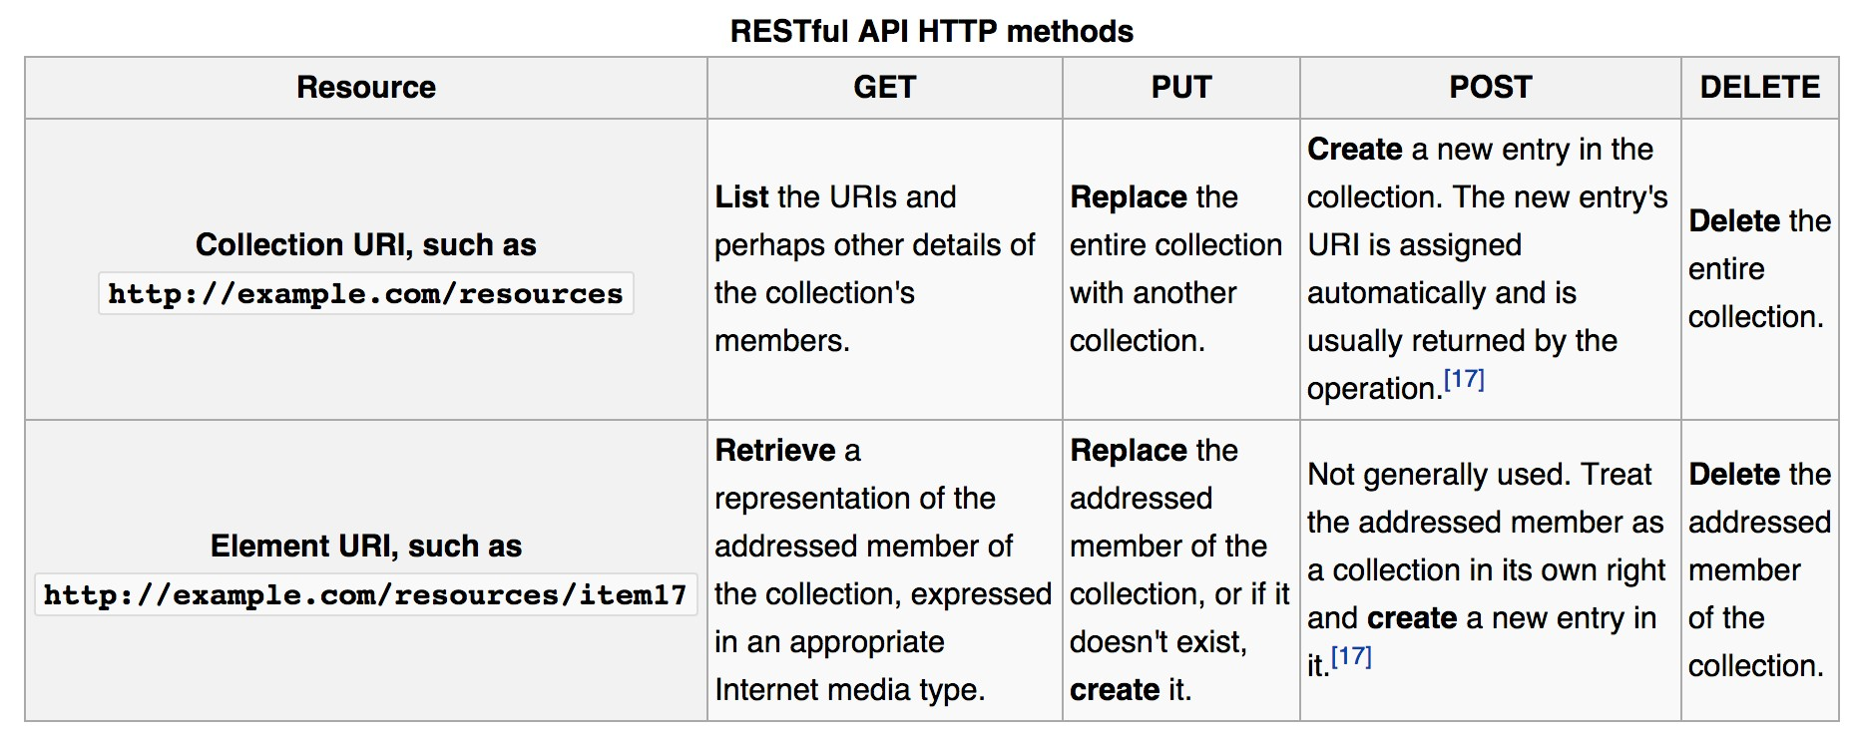
RESTful API HTTP methods (wikipedia)

Slide 90
AJAX + RESTful
The web app can fetch using RESTful data from server
Using AJAX this is done asynchronously in the background
AJAX makes HTTP GET request using url ..
– http://example.com/resources/item17
.. and receives data of item17 in JSON ...
.. which can be displayed in view (web page)

Slide 91
Example: Weather API
Weather information available from
wunderground.com
You have to make account and receive a key
To get Helsinki weather in JSON
http://api.wunderground.com/api/your-key/ conditions/q/Helsinki.json

Slide 92
{
"response": { "version": "0.1",
"termsofService": "http:\/\/www.wunderground.com\/weather\/api\/d\/terms.html",
"features": { "conditions": 1
}
},
"current_observation": { "image": {
"url": "http:\/\/icons.wxug.com\/graphics\/wu2\/logo_130x80.png", "title": "Weather Underground",
"link": "http:\/\/www.wunderground.com"
},
"display_location": {
"full": "Helsinki, Finland", "city": "Helsinki",
"state": "", "state_name": "Finland", "country": "FI", "country_iso3166": "FI", "zip": "00000",
"magic": "1",
"wmo": "02974",
"latitude": "60.31999969",
"longitude": "24.96999931",
"elevation": "56.00000000"
},

Slide 93


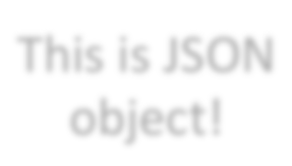
<!DOCTYPE html>
<html>
<head>
<script src="../angular.min.js" type="text/javascript"></script>
<title></title>
</head>
<body data-ng-app="myapp">
<div data-ng-controller="MyController">
<button data-ng-click="myData.doClick(item, $event)">Get Helsinki Weather</button><br /> Data from server: {{myData.fromServer}}
</div>
<script type="text/javascript">
var myapp = angular.module("myapp", []);
This is JSON object!
myapp.controller("MyController", function($scope, $http) {
$scope.myData = {};
$scope.myData.doClick = function(item, event) {
var responsePromise = $http.get("http://api.wunderground.com/api/key/conditions/ q/Helsinki.json");
responsePromise.success(function(data, status, headers, config) {
$scope.myData.fromServer = "" + data.current_observation.weather +
" " + data.current_observation.temp_c + " c";
});
responsePromise.error(function(data, status, headers, config) {
alert("AJAX failed!");
});
}
} );
</script>
</body>
</html>

Slide 94
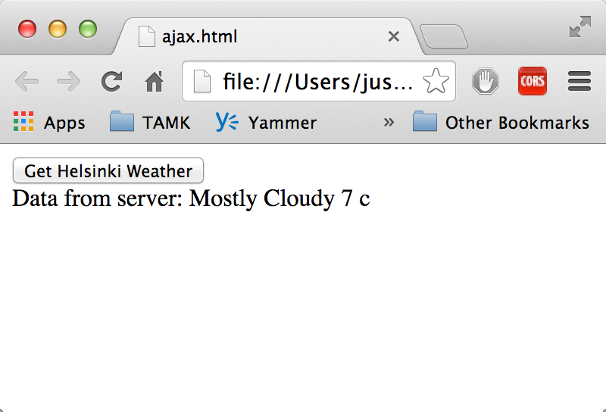
View after pressing the Button

Slide 95
$resource
Built on top of $http service, $resource is a factory that lets you interact with RESTful backends easily
$resource does not come bundled with main Angular script, separately download
– angular-resource.min.js
Your main app should declare dependency on the ngResource module in order to use
$resource

Slide 96
Getting Started with $resource
$resource expects classic RESTful backend
– http://en.wikipedia.org/wiki/ Representational_state_transfer#Applied_t o_web_services
You can create the backend by whatever technology. Even JavaScript, for example Node.js
We are not concentrating now how to build the backend.

Slide 97
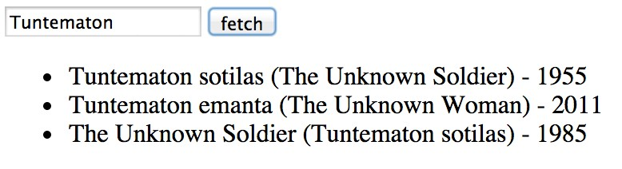
Using $resource on GET
// Load ngResource before this
var restApp = angular.module('restApp',['ngResource']);
restApp.controller("RestCtrl", function($scope, $resource) {
$scope.doClick = function() {
var title = $scope.movietitle;
var searchString = 'http://api.rottentomatoes.com/api/ public/v1.0/movies.json?apikey=key&q=' + title + '&page_limit=5';
var result = $resource(searchString);
var root = result.get(function() {
$scope.movies = root.movies;
});
// {method:'GET'
}
});

Slide 98
$resource methods
$resource contains convenient methods for
get ('GET')
save ('POST')
query ('GET', isArray:true)
remove ('DELETE')
Calling these will invoke $http (ajax call) with the speciﬁed http method (GET, POST, DELETE), destination and parameters

Slide 99






Passing Parameters
:title -­‐> parametrized URL template
// Load ngResource before this
var restApp = angular.module('restApp',['ngResource']);
restApp.controller("RestCtrl", function($scope, $resource) {
$scope.doClick = function() {
var searchString = 'http://api.rottentomatoes.com/api/public/ v1.0/movies.json?apikey=key&q=:title&page_limit=5';
var result = $resource(searchString);
var root = result.get({title: $scope.movietitle}, function() {
$scope.movies = root.movies;
});
}
Giving the parameter from
$scope
});

Slide 100






Using Services
Controller responsible for binding
// Load ngResource before this
var restApp = angular.module('restApp',['ngResource']);
restApp.controller("RestCtrl", function($scope, MovieService) {
$scope.doClick = function() {
var root = MovieService.resource.get({title: $scope.movietitle},
function() {
$scope.movies = root.movies;
});
}
});
Service responsible for the resource
restApp.factory('MovieService', function($resource) { factory = {};
factory.resource = $resource('http://api.rottentomatoes...&q=:title&page_limit=5');
return factory;
});

Slide 101





Simple Version
Just call get from MovieService
// Load ngResource before this
var restApp = angular.module('restApp',['ngResource']);
restApp.controller("RestCtrl", function($scope,
$scope.doClick = function() {
var root = MovieService.get({title:
function() {
$scope.movies = root.movies;
MovieService) {
$scope.movietitle},
});
}
Returns the resource
});
restApp.factory('MovieService', function($resource) {
return $resource('http://api.rottentomatoes...&q=:title&page_limit=5');;
});

Slide 102
ANIMATIONS AND UNIT TESTING

Slide 103
AngularJS Animations
Include ngAnimate module as dependency
Hook animations for common directives such as ngRepeat, ngSwitch, ngView
Based on CSS classes
– If HTML element has class, you can animate it
AngularJS adds special classes to your html-­‐ elements

Slide 104
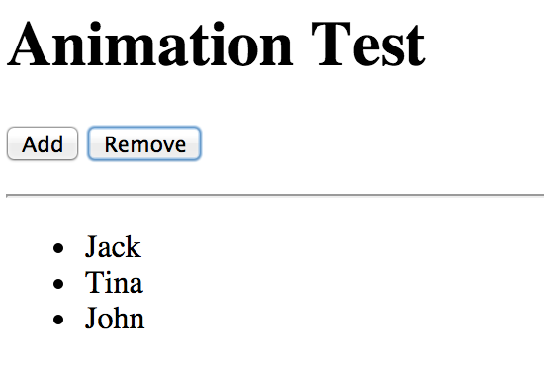



Example Form
<body ng-controller="AnimateCtrl">
<button ng-click="add()">Add</button>
<button ng-click="remove()">Remove</button></p>
<ul>
<li ng-repeat="customer in customers">{{customer.name}}</li>
</ul>
</body>
Adds and Removes names

Slide 105
Animation Classes
When adding a new name to the model, ng-­‐ repeat knows the item that is either added or deleted
CSS classes are added at runtime to the repeated element (<li>)
When adding new element:
<li class="... ng-enter ng-enter-active">New Name</li>
When removing element
<li class="... ng-leave ng-leave-active">New Name</li>

Slide 106
Directives and CSS
Event | Starting CSS | Ending CSS | Directives
enter | .ng-­‐enter | .ng-­‐enter-­‐active | ngRepeat, ngInclude, ngIf, ngView
leave | .ng-­‐leave | .ng-­‐leave-­‐active | ngRepeat, ngInclude, ngIf, ngView
move | .ng-­‐move | .ng-­‐move.active | ngRepeat

Slide 107
Example CSS
/* starting animation */
.ng-enter {
-webkit-transition: 1s; transition: 1s;
margin-left: 100%;
}
/* ending animation */
.ng-enter-active {
margin-left: 0;
}
/* starting animation */
.ng-leave {
-webkit-transition: 1s; transition: 1s;
margin-left: 0;
}
/* ending animation */
.ng-leave-active {
margin-left: 100%;
}

Slide 108
Test Driven Design
Write tests ﬁrsts, then your code
AngularJS emphasizes modularity, so it can be easy to test your code
Code can be tested using several unit testing frameworks, like QUnit, Jasmine, Mocha ...

Slide 109
QUnit
Download qunit.js and qunit.css
Write a simple HTML page to run the tests
Write the tests

Slide 110
<!DOCTYPE html>
<html>
<head>
<meta charset="utf-8">
<title>QUnit Example</title>
<link rel="stylesheet" href="qunit-1.10.0.css">
<script src="qunit-1.10.0.js"></script>
</head>
<body>
<div id="qunit"></div>
<script type="text/javascript">
function calculate(a, b) {
return a + b;
}
test(
ok( calculate(5,5) === 10,
ok( calculate(5,0) === 5, ok( calculate(-5,5) === 0,
});
"calculate test", function() {
);
);
);
"Ok!"
"Ok!"
"OK!"
</script>
</body>
</html>

Slide 111
Three Assertions
Basic
ok( boolean [, message]);
If actual == expected
equal( actual, expected [, message]);
if actual === expected
deepEqual( actual, expected [, message));
Other
http://qunitjs.com/cookbook/#automating- unit-testing

Slide 112
Testing AngularJS Service
var myApp = angular.module('myApp', []);
// One service myApp.service('MyService', function() {
this.add =
return
};
function(a, b) { a + b;
});
/* TESTS */
var injector = angular.injector(['ng', 'myApp']);
QUnit.test('MyService', function() {
var MyService = injector.get('MyService'); ok(2 == MyService.add(1, 1));
});

Slide 113
WRAPPING UP

Slide 114
Web Development
Web development is the creation of dynamic web applications. Examples of web applications are social networking sites like Facebook or e-commerce sites like Amazon.
Web Development
Front-end Development
Back-end Development
Two broad divisions of web development –
front-end development (also called client-side development)
back-end development (also called server-side development).

Slide 115
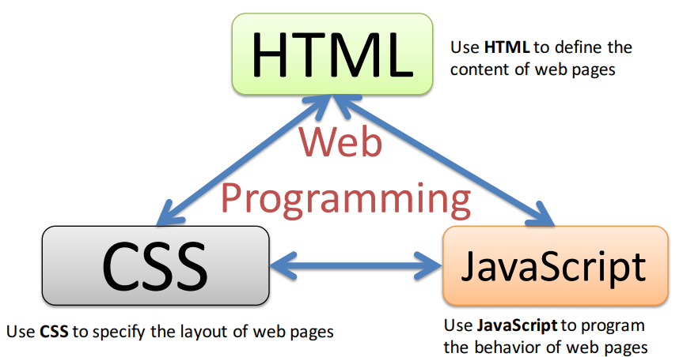
Front-End Development
Constructing what a user sees when they load a web application – the content, design and how you interact with it.
Done with three codes – HTML, CSS and JavaScript.

Slide 116
Back-End Development
Back-end development controls what goes on behind the scenes of a web application. A back-end often uses a database to generate the front-end.
Back-end scripts are written in many different coding languages and frameworks, such as…
Java
Node.js
Python
PHP
Ruby on Rails
ASP.NET

Slide 117
Latest trends in Web Development
Real time applications
Progressive web applications
Blockchain
Push Notification With Websites
Single-Page Websites
Virtual reality (VR)
Mobile friendly website
Chatbots, AI, and machine learning

Slide 118

Javascript

Slide 119
What is JavaScript ?
Interpreted, client-side, event-based, object oriented scripting language
Used to add dynamic interactivity to your web pages.
Written in plain text, like HTML, XML, Java, PHP In this code
JavaScript is not Java, though both languages look similar when written.
Java is a full featured and comprehensive programming language similar to C or C++, and although JavaScript can interact with Java web applications, the two should not be confused

Slide 120

JavaScript - Syntax
JS can be implemented using JavaScript statements that are placed within the <script>... </script>.
Script tag takes two important attributes −
Language - Specifies what scripting language you are using
Type - To indicate the scripting language in use and its value should be set to "text/javascript".

Slide 121
Advantages of JavaScript
Less server interaction
Immediate feedback to the visitors
Increased interactivity
Richer interfaces
JavaScript is an easy language to learn
Easy to debug and test
Platform independent
Event-Based Programming language

Slide 122
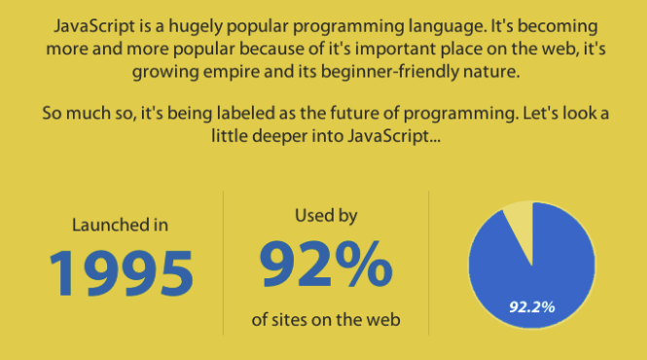
Why javascript is the future of programming?

Slide 123
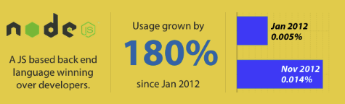
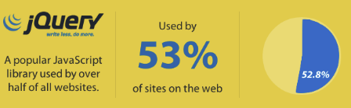
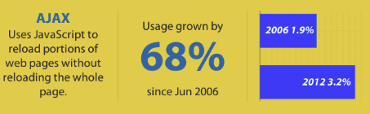
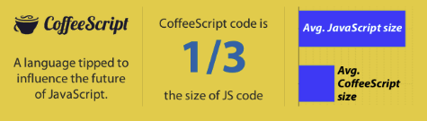
Why javascript is the future of programming?

Slide 124
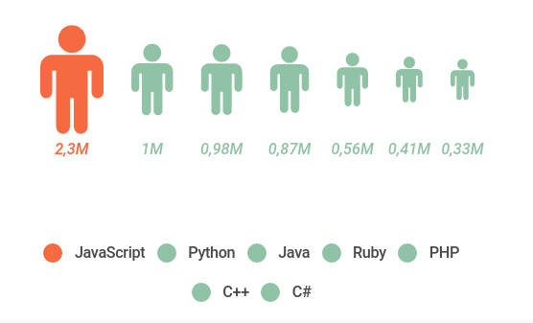
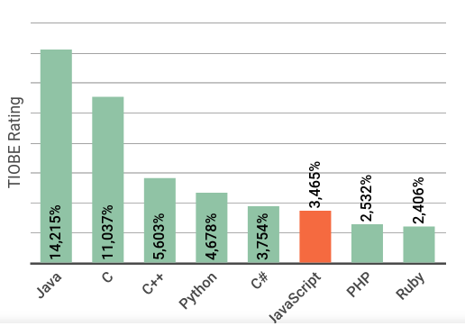
Career Scope of JS
GitHub Octoverse
Most popular languages on GitHub by opened pull requests (displayed in millions).
TIOBE Rating: (January 2018)
The TIOBE rating is an indicator of the popularity of programming languages.

Slide 125
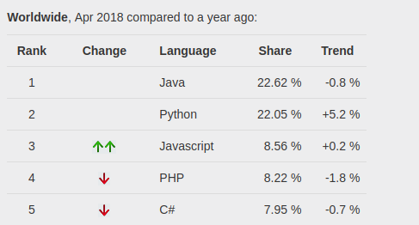
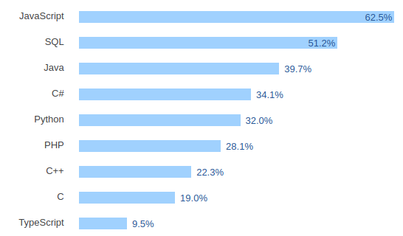
Career Scope of JS
PYPL PopularitY of Programming Language (April 2018)
The PYPL PopularitY of Programming Language Index is created by analyzing how often language tutorials are searched on Google.
Stack Overflow Developer Survey 2018

Slide 126

Angular JS

Slide 127
What is AngularJS
AngularJS is a client side JavaScript MVC framework to develop a dynamic web application. AngularJS was originally started as a project in Google but now, it is open source framework.

Slide 128
Why AngularJS
Structure, Quality and Organization
Lightweight ( < 36KB compressed and minified)
Free
Separation of concern
Modularity
Extensibility & Maintainability
Reusable Components

Slide 129
Features of AngularJS
Two-way Data Binding – Model as single source of truth
Directives – Extend HTML
MVC
Dependency Injection
Testing
Deep Linking (Map URL to route Definition)
Server-Side Communication

Slide 130
MVC
Model (Data)
View (UI)
Notifies
Changes
Notifies
Controller (Logic)
Model
JS Objects
View
DOM
Controller
JS Classes

Slide 131
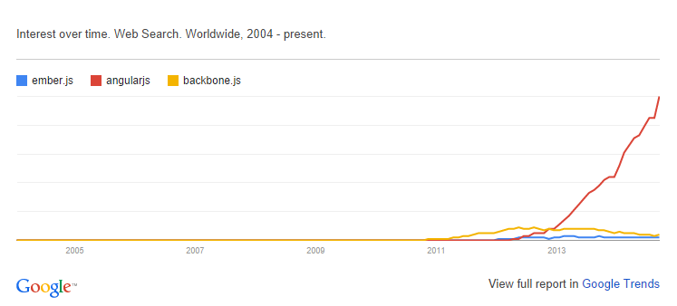
Other Javascript Frameworks
BackboneJS
EmberJS

Slide 132
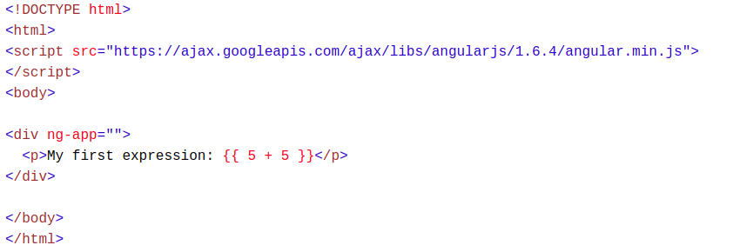
Expressions
AngularJS expressions can be written inside double braces: {{ expression }}.
AngularJS expressions can also be written inside a directive: ng-bind="expression".
Example {{ 5 + 5 }} or {{ firstName + " " + lastName }}

Slide 133
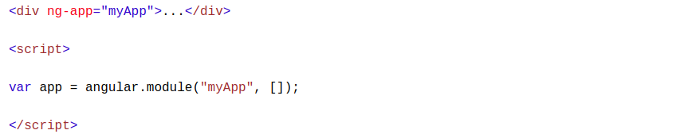
Modules
An AngularJS module defines an application.
The module is a container for the different parts of an application.
The module is a container for the application controllers.
Controllers always belong to a module.

Slide 134
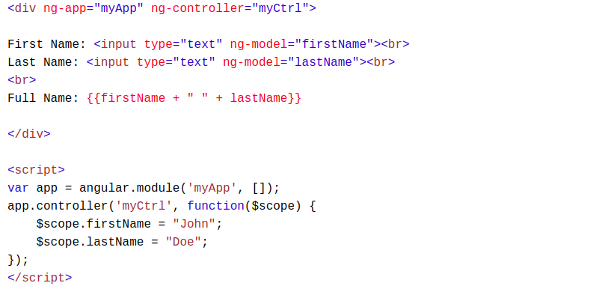
Controllers
AngularJS controllers control the data of AngularJS applications.
AngularJS controllers are regular JavaScript Objects.
The ng-controller directive defines the application controller

Slide 135

Services
In AngularJS, a service is a function, or object, that is available for, and limited to, your AngularJS application.
AngularJS has about 30 built-in services. One of them is the $location service.
The $location service has methods which return information about the location of the current web page

Slide 136

Filters
currency Format a number to a currency format.
date Format a date to a specified format.
filter Select a subset of items from an array.
json Format an object to a JSON string.
limitTo Limits an array/string, into a specified number of elements/characters.
lowercase Format a string to lower case.
number Format a number to a string.
orderBy Orders an array by an expression.
uppercase Format a string to upper case.

Slide 137

Scope
The scope is the binding part between the HTML (view) and the JavaScript (controller).
The scope is an object with the available properties and methods.
The scope is available for both the view and the controller.

Slide 138

Node JS

Slide 139
What is NodeJs
A JavaScript runtime environment running Google Chrome’s V8 engine
A server-side solution for JS
Compiles JS, making it really fast
Runs over the command line
Designed for high concurrency
Without threads or new processes
Never blocks, not even for I/O
Uses the CommonJS framework
Making it a little closer to a real OO language

Slide 140
Node JS vs Apache
It is fast
It can handle tons of concurrent requests
It is written in JavaScript (which means you can use the same code server side and client side)
Platform | Number of request per second
PHP ( via Apache) | 3187,27
Static ( via Apache ) | 2966,51
Node.js | 5569,30

Slide 141

Creating Node.js Application
Execute the main.js to start the server as below

Slide 142

REPL Terminal
REPL stands for Read Eval Print Loop
Node comes bundled with a REPL environment. It performs the following tasks −
Read − Reads user's input, parses the input into JavaScript data-structure, and stores in memory.
Eval − Takes and evaluates the data structure.
Print − Prints the result.
Loop − Loops the above command until the user presses ctrl-c twice.

Slide 143
Node Package Manager (NPM)
Node Package Manager (NPM) provides two main functionalities −
Online repositories for node.js packages/modules which are searchable on search.nodejs.org
Command line utility to install Node.js packages, do version management and dependency management of Node.js packages.
Installing Modules using NPM
npm install <Module Name>

Slide 144
Wrapping UP
AngularJS is a modular JavaScript SPA framework
Lot of great features, but learning curve can be hard
Great for CRUD (create, read, update, delete) apps, but not suitable for every type of apps
Works very well with some JS libraries (JQuery)

Slide 145
Why & What - TypeScript

Slide 146
Why TypeScript?
Superset of JavaScript
Modular
Scalable Application Structure
Strong Typing
Tooling Support
EcmaScript 6 Standards

Slide 147
What is TypeScript?
Strongly Typed
Classes
Interfaces
Generics
Modules
Type Definitions
Compiles to JavaScript
EcmaScript 6 Features

