Slide 1

Introduction to Spring Framework

Slide 2
Framework
What is a Framework?
Frameworks are large prewritten code to which you add your own code to solve a problem in a specific domain.
You make use of a framework by calling its methods, inheritance and supplying “call-backs” listeners.
Example - Java’s Swing and AWT classes. Those have a huge amount of code to manage the user interface and there is inversion of control.

Slide 3
Spring Framework
What is a Spring Framework?
Spring is an open source framework created to address the complexity of enterprise application development.
Creates high performing, easily testable, reusable code and handles the infrastructure so you can focus on application.
One of the chief advantages of the Spring framework is its layered architecture, which allows you to be selective about which of its components you use while also providing a cohesive framework for J2EE application development.

Slide 4
Features Of Spring Framework
Spring is a Framework of Frameworks
Lightweight
Layered Architecture
Predefined Templates
Fast Development
MVC Framework
Inversion Of Control (IOC)
Aspect Oriented Programming (AOP)
Data Access Framework
JDBC Abstraction Layer
Logging

Slide 5
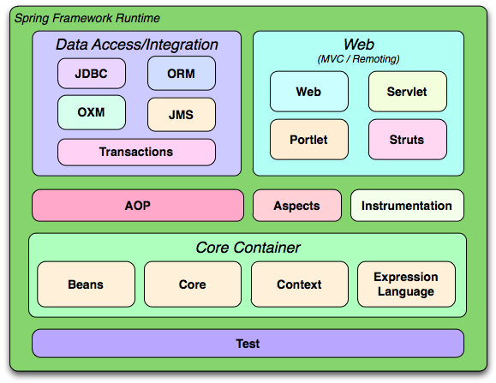
Overview of the Spring Framework

Slide 6
Spring Framework Architecture
The Spring framework is a layered architecture which consists of several modules.
All modules are built on the top of its core container.
It's modular architecture enables integration with other frameworks without much difficulties.
Consists of around 20 modules which are generalized into Core Container, Data Access/ Integration, Web, AOP (Aspect Oriented Programming), Instrumentation, and Test. All the modules have their own functionalities that are utilized to build an application.

Slide 7
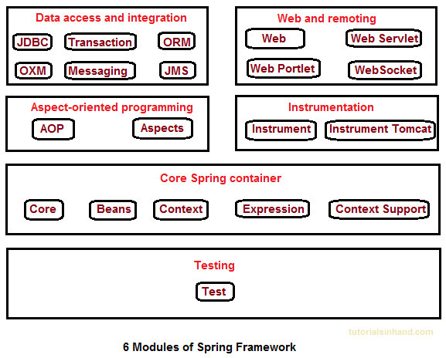
Spring Framework Modules

Slide 8
Spring Framework Modules
Core Container
Spring Core: This module is the core of the Spring Framework. It provides implementation for features like IoC (Inversion of Control) and Dependency Injection with singleton design pattern.
Spring Bean: This module provides implementation for the factory design pattern through BeanFactory.
Spring Context: This module is built on the solid base provided by the Core and the Beans modules and is a medium to access any object defined and configured.
Spring Expression Languages (SpEL): This module is an extension to expression language supported by Java server pages. It provides a powerful expression language for querying and manipulating an object graph, at runtime.

Slide 9
Spring Framework Modules
AOP Module
Spring AOP module provides interceptors to intercept an application, for example, when a method is executed, you can add extra functionality before or after the method execution.
Spring AOP's approach to AOP differs from that of most other AOP frameworks. The aim is to provide a close integration between AOP implementation and Spring IoC, not to provide the most complete AOP implementation.

Slide 10
Spring Framework Modules
Spring Data Access/ Integration
JDBC: This module provides JDBC abstraction layer which eliminates the need of repetitive and unnecessary exception handling overhead.
ORM: ORM stands for Object Relational Mapping. This module provides consistency/portability to our code regardless of data access technologies based on object oriented mapping concept.
OXM: OXM stands for Object XML Mappers. It is used to convert the objects into XML format and vice versa. The Spring OXM provides an uniform API to access any of these OXM frameworks.
JMS: JMS stands for Java Messaging Service. This module contains features for producing and consuming messages among various clients.
Transaction: This module supports programmatic and declarative transaction management for classes that implement special interfaces and for all your POJOs. All the enterprise level transaction implementation concepts can be implemented in Spring by using this module.

Slide 11
Spring Framework Modules
Web Module
Web: This module using servlet listeners and a web-oriented application context, provides basic web-oriented integration features and the initialization of the IoC container.
Web-Servlet: This module contains Model-View-Controller (MVC) based implementation for web applications. It provides all other features of MVC, including UI tags and data validations.
Web-Socket: This module provides support for WebSocket based and two-way communication between the client and the server in web applications.
Web-Portlet: This module is also known as Spring-MVC-Portlet module. It provides the support for Spring based Portlets and provides MVC implementation to be used in a portlet environment.

Slide 12
Spring Framework Modules
Test Module
This module supports the testing of Spring components with JUnit or TestNG. It provides consistent loading of Spring ApplicationContexts and caching of those contexts.

Slide 13
Spring Framework Advantages
Templates : Provides predefined templates for JDBC, Hibernate, JPA etc., thus reducing your effort of writing too much code.
Loose Coupling : Because of dependency injection feature, your code becomes loosely coupled.
Lightweight : Works on POJOs (Plain Old Java Object) which makes your application lightweight.
Declarative : Programming through aspects, common conventions and provides declarative support for transactions, validation, caching and formatting.

Slide 14
Spring Framework Advantages
Fast Development : Using Spring Framework, the development of Java Enterprise Edition (JEE) applications became faster.
Strong Abstraction : It provides strong abstraction to Java Enterprise Edition (JEE) specifications.
Maintainability : Reusable Code and Open Source. Eliminating boilerplate code with aspects and template.
Testing : Testing a Spring Application is so easy for DI and no server needs to run the application.

Slide 15
Key Component - IoC Inversion Of Control
Concept of application development.
“Don't call us, we'll call you.”
Dependency Injection is form of IoC.

Slide 16
Key Component - DI Dependency Injection
The technology that actually defines spring (Heart of Spring).
When applying DI, the objects are given their dependencies at creation time by some external entity that coordinates each object in the system. In other words, dependencies are injected into objects.
“Don't call around for your dependencies, we'll give them to you when we need you”.
Exist in two form:
1. Constructor Injection
2. Setter Inject

Slide 17
Key Component - DI Dependency Injection
Dependency Injection helps us to keep our classes as independent as possible.
Increase reuse by applying low coupling.
Easy Testing.
More Understandable.

Slide 18
Key Component - DI Dependency Injection
An injection is the passing of dependency (a service) to a dependent object (a client).
Passing the service to the client, rather than allowing a client to build or find the service, is the fundamental requirement of the pattern.
“Dependency Injection is a pattern where the container passes objects by name to other objects, via either constructors, properties or factory methods.”

Slide 19
Key Component – DI & IoC Relationship between DI and Inversion of Control
In software engineering, inversion of Control (IoC) describes a design in which custom-written portions of a computer program receive the flow of control from a generic reusable library.
The Inversion of Control (Ioc) is a general concepts, and it can be expressed in many
different ways and dependency Injection is merely one concrete example of
Inversion of Control.

Slide 20
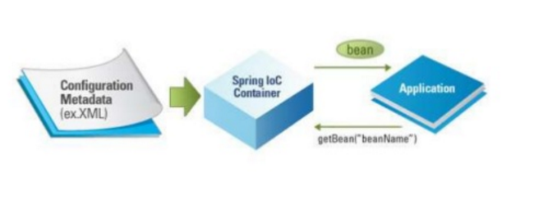
Key Component – IoC Ioc Container
The spring container (IoC Container) is at the core of the Spring Framework.
The Container will create the objects, wire them together, configure them, and manage their complete lifecycle from creation till destruction.

