Slide 1
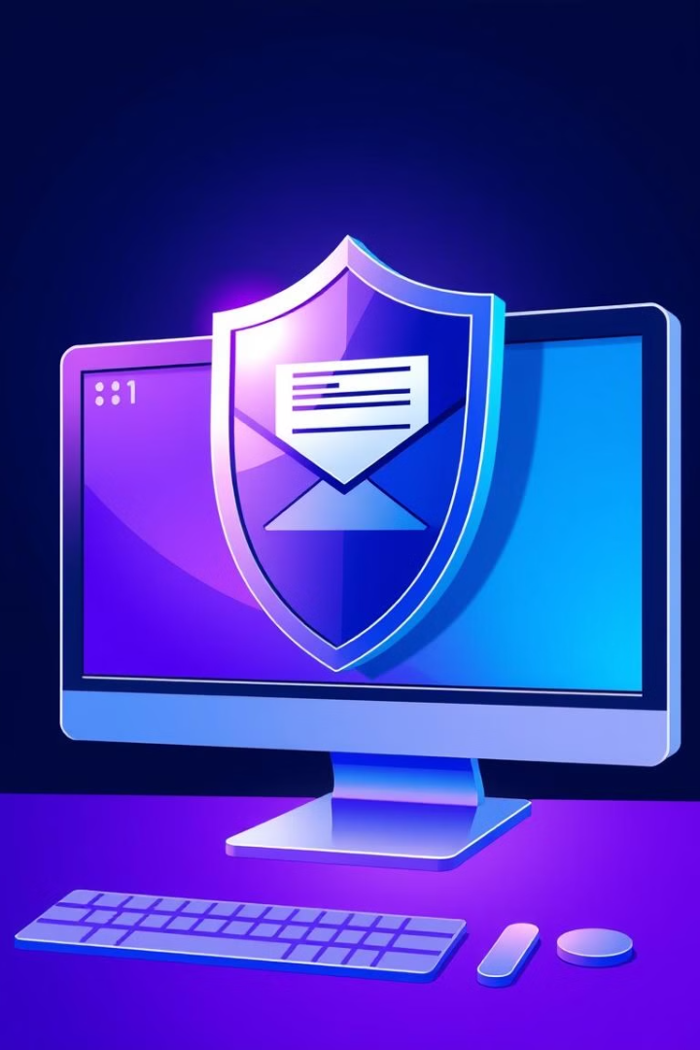
Phishing Awareness Training
Learn to recognize and prevent phishing attacks. Stay safe online by understanding common cyber threats.
A Guide by Muhammad Izaz Haider

Slide 2
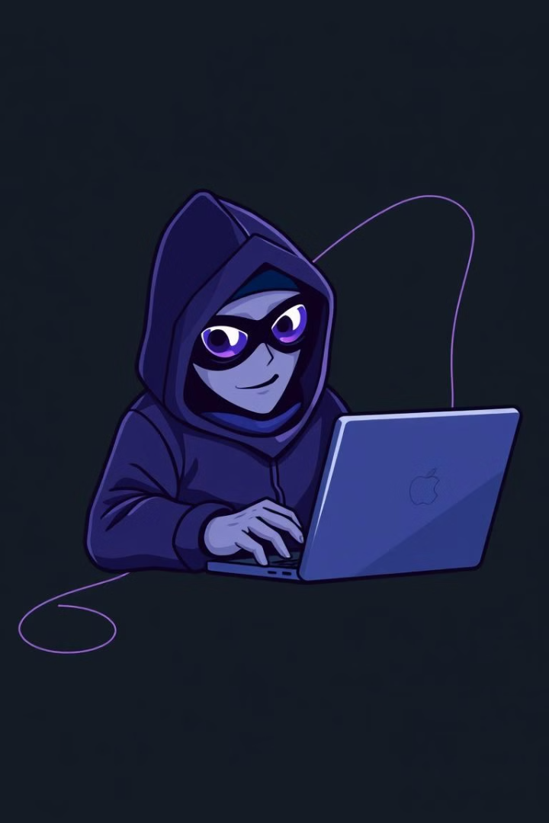
What is Phishing?
Phishing is a deceptive cyberattack where criminals pose as trustworthy entities to steal your personal information. They often mimic familiar brands like banks, retailers, or social media sites. These attacks usually occur through email, text messages, or fake websites designed to trick you into entering usernames, passwords, credit card numbers, or other sensitive data.
For example, you might receive an email claiming to be from your bank, asking you to update your account details through a provided link. The link leads to a fake website that looks identical to your bank's, and any information you enter is sent directly to the phisher. Always verify the legitimacy of requests before providing any personal information.

Slide 3
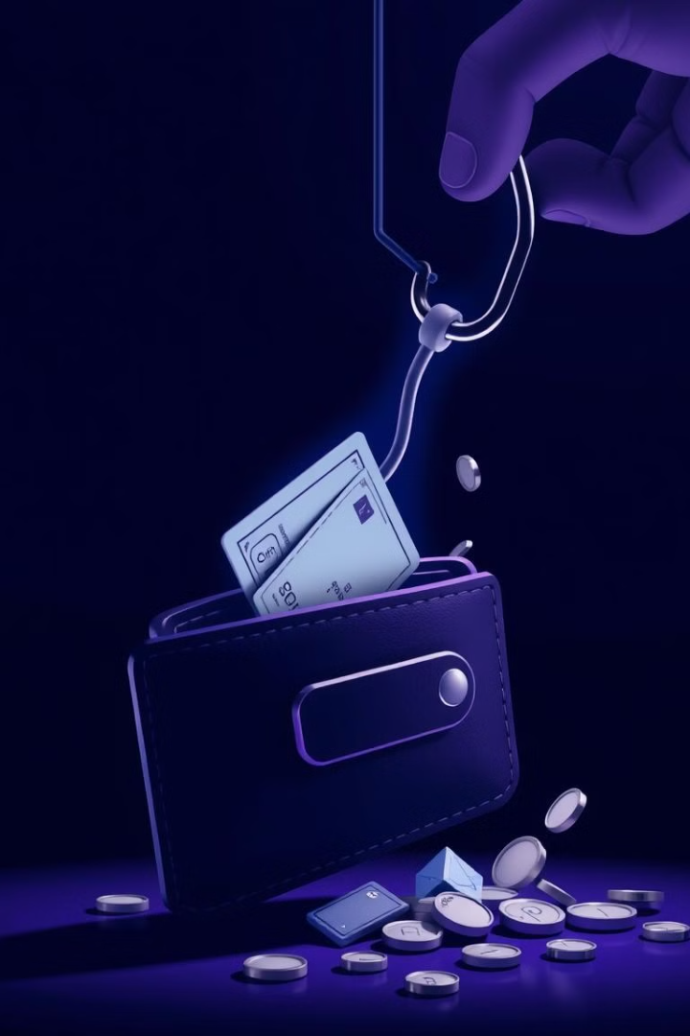
Why is Phishing Dangerous?
Identity Theft
Financial Loss
Compromised personal information can lead to identity theft. Stolen data can be used to open fraudulent accounts or obtain unauthorized credit.
Phishing can lead to financial loss through unauthorized access to accounts. Scammers may steal credentials to make unauthorized purchases or drain your accounts.
Malware Installation
Malicious attachments can install malware on your devices, compromising device security. Attackers can steal data, monitor activities, or take control of your system. Ransomware can encrypt your files and demand payment for their release.

Slide 4
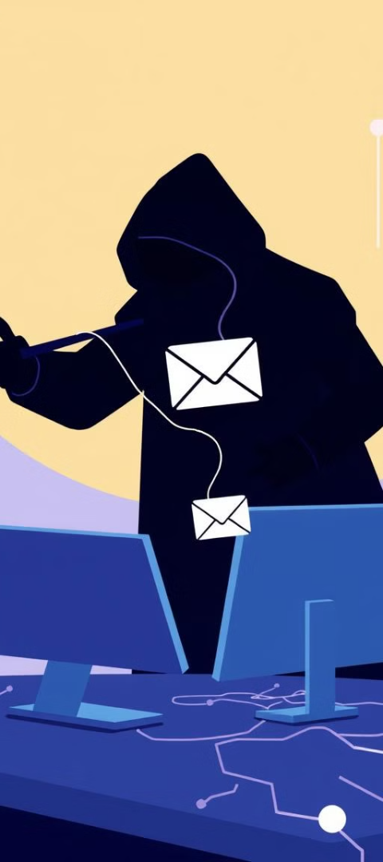
Common Types of Phishing
Email Phishing
Attackers disguise emails as official communication to deceive recipients.
Spear Phishing
Highly targeted attacks crafted to trick specific individuals.
Smishing/Vishing
Phishing attempts via SMS or phone calls to gain sensitive information.
Clone Phishing
Attackers create copies of legitimate emails with malicious replacements.

Slide 5
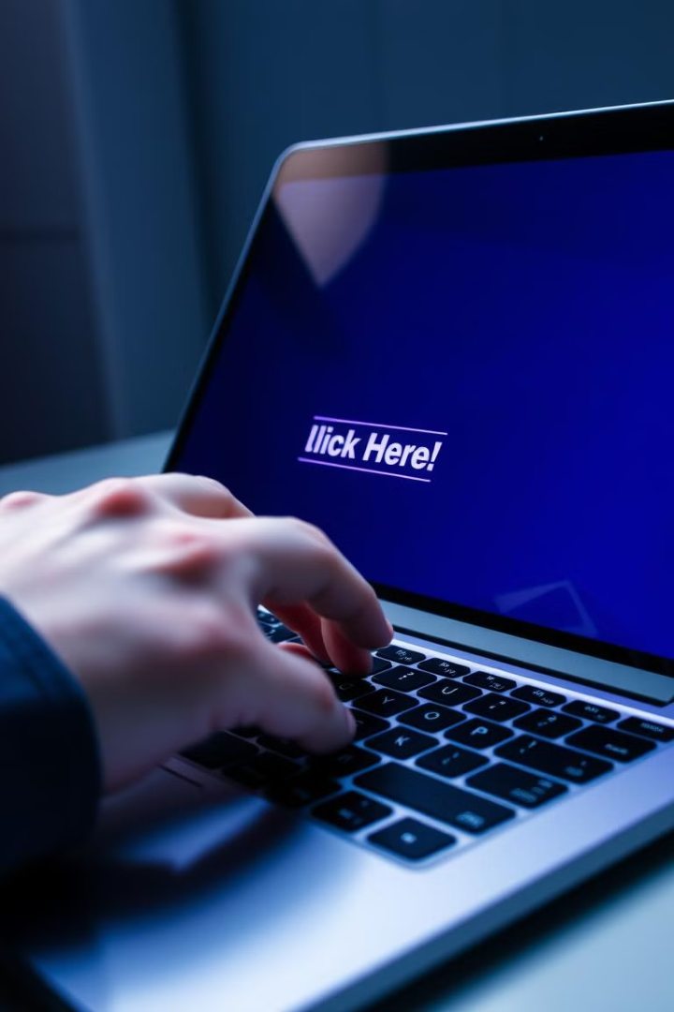




Recognizing a Phishing Email
Sender Address
Check for suspicious addresses.
Urgent Language
Be wary of pressure tactics.
Grammar Errors
Poor grammar is a red flag.
Malicious Links
Hover before clicking.

Slide 6
Phishing Website Red Flags
Altered URLs
1
Hackers create fake websites with URLs that look similar to real ones, often replacing or swapping letters. Always double-check the web address before clicking on any link.
No HTTPS
2
Legitimate websites use HTTPS for secure data encryption, while phishing sites often lack it. Always look for a padlock icon in the address bar before entering sensitive information.
Poor Design
3
Phishing websites often have low-quality layouts, spelling mistakes, and excessive pop-ups. If a website looks suspicious or unprofessional, avoid entering any personal details.

Slide 7

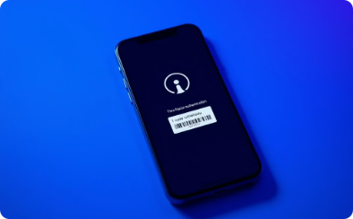
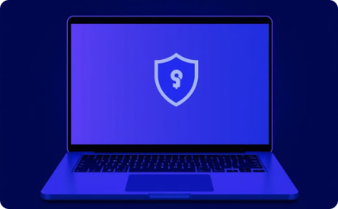
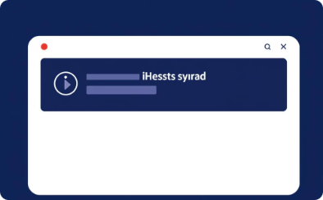
Protect Yourself from Phishing
Think Before Clicking
Enable 2FA
Secure Devices
Report Attempts
Carefully consider the legitimacy of links and attachments before interacting with them.
Add an extra layer of security to your accounts using two-factor authentication.
Keep your devices protected with the latest security software and updates.
Help protect others by reporting phishing attempts to the appropriate authorities.

Slide 8
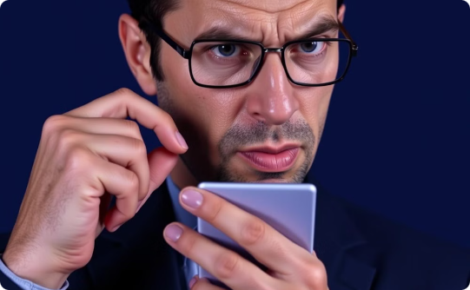
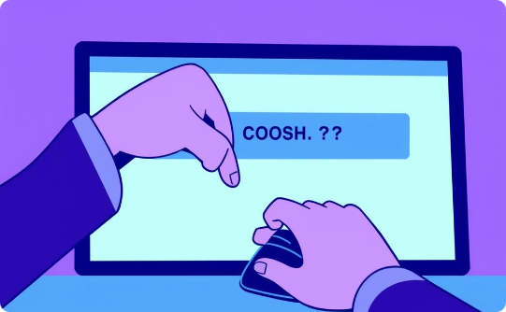
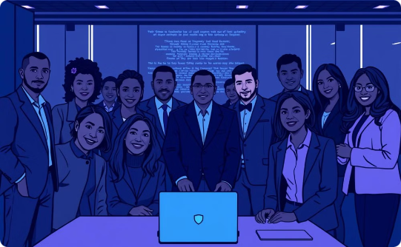
Final Tips for Phishing Awareness
Verify Senders
Think Before Clicking
Share the Knowledge
Double-check sender details before responding to any email.
Avoid clicking links or downloading attachments from unverified sources.
Help create a safer online environment by sharing these tips with friends and family.
Online safety starts with awareness. By staying vigilant and sharing this knowledge, we can create a more secure digital environment for everyone.

