Slide 1
AI Analyst Report
File ID: 28

Slide 2
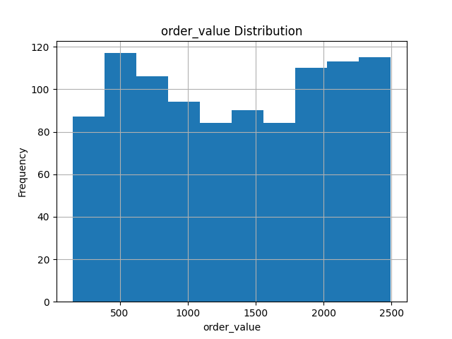
e1cbac24-ee86-4c8d-9c55-45ec54e1638b_order_value_hist.png

Slide 3
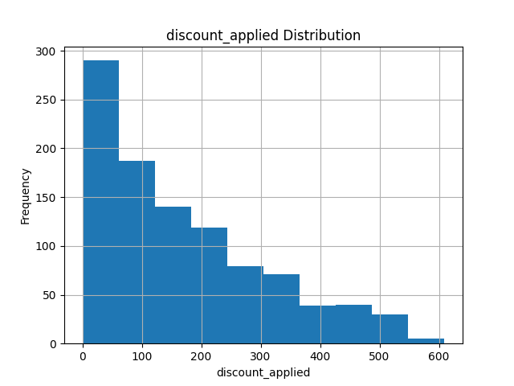
e1cbac24-ee86-4c8d-9c55-45ec54e1638b_discount_applied_hist.png

Slide 4
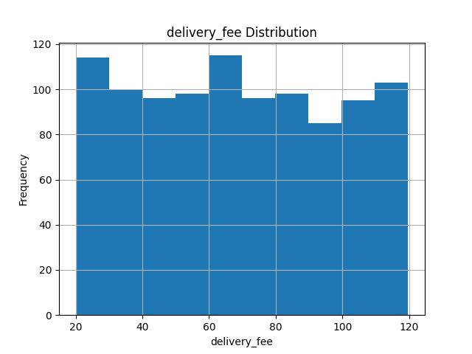
e1cbac24-ee86-4c8d-9c55-45ec54e1638b_delivery_fee_hist.png

Slide 5
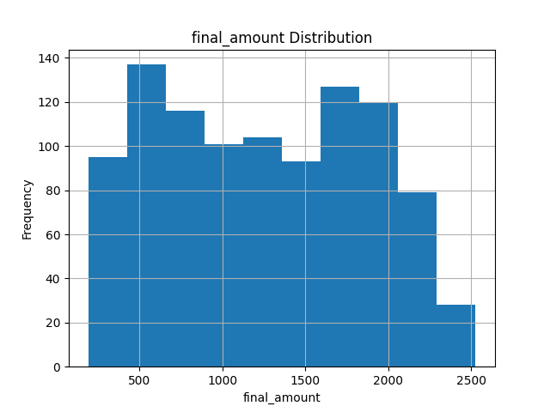
e1cbac24-ee86-4c8d-9c55-45ec54e1638b_final_amount_hist.png

Slide 6
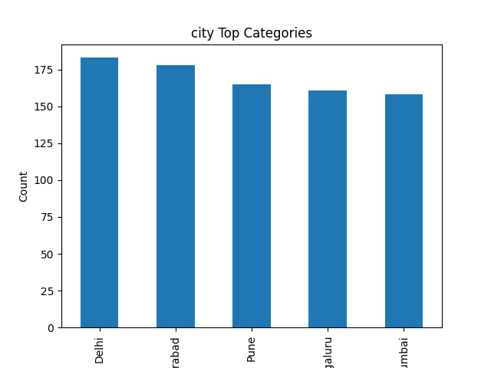
e1cbac24-ee86-4c8d-9c55-45ec54e1638b_city_bar.png

Slide 7
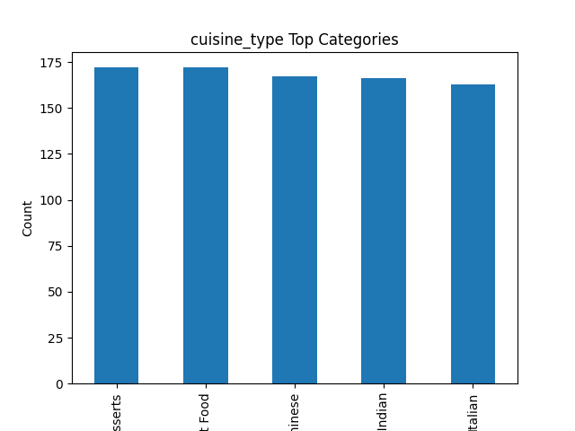
e1cbac24-ee86-4c8d-9c55-45ec54e1638b_cuisine_type_bar.png

Slide 8
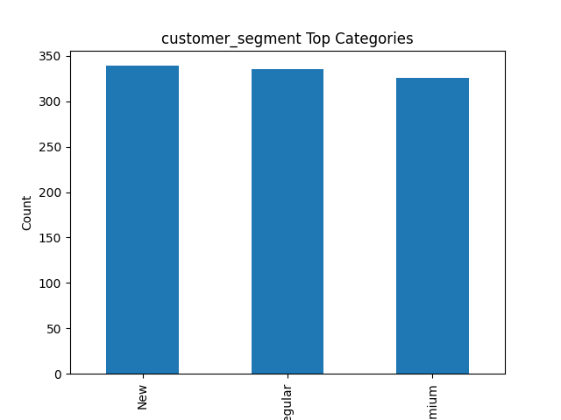
e1cbac24-ee86-4c8d-9c55-45ec54e1638b_customer_segment_bar.png

Slide 9
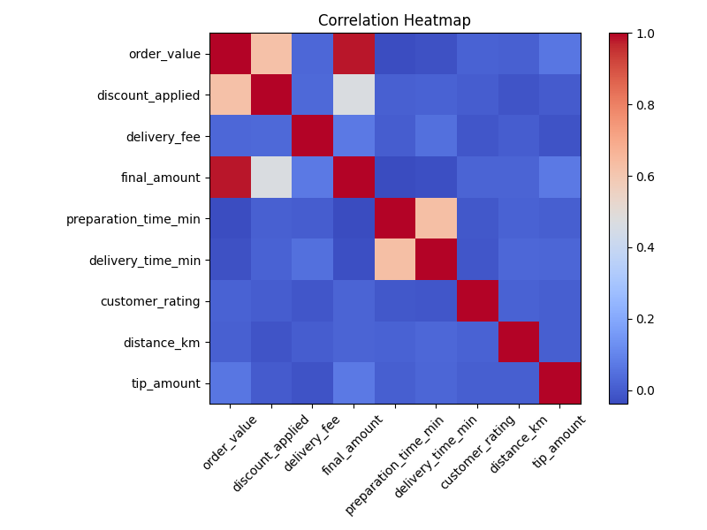
e1cbac24-ee86-4c8d-9c55-45ec54e1638b_heatmap.png

Slide 10
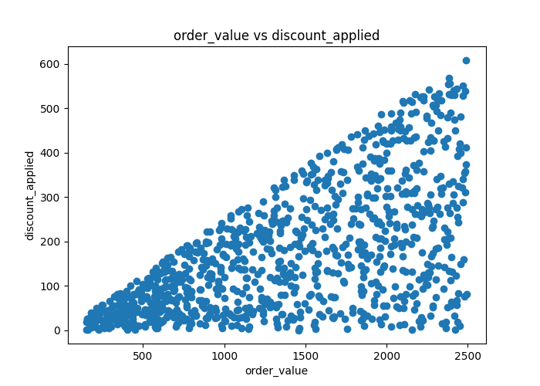
e1cbac24-ee86-4c8d-9c55-45ec54e1638b_scatter.png

Slide 11
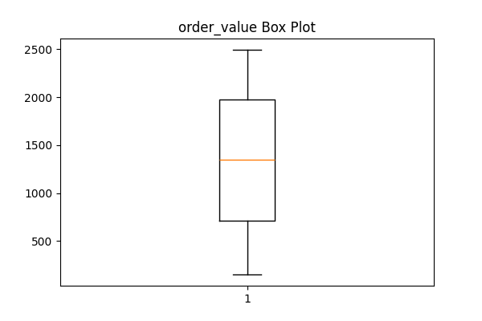
e1cbac24-ee86-4c8d-9c55-45ec54e1638b_order_value_boxplot.png

Slide 12
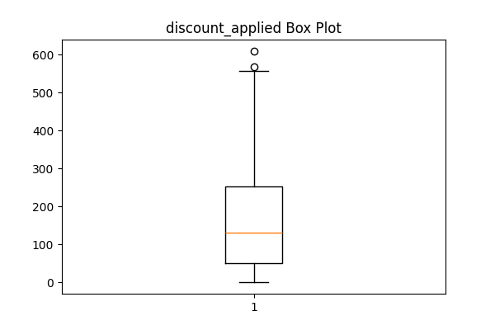
e1cbac24-ee86-4c8d-9c55-45ec54e1638b_discount_applied_boxplot.png

Slide 13
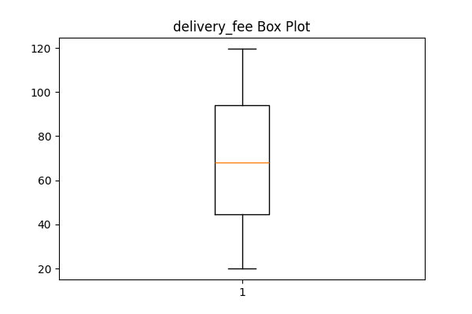
e1cbac24-ee86-4c8d-9c55-45ec54e1638b_delivery_fee_boxplot.png

Slide 14
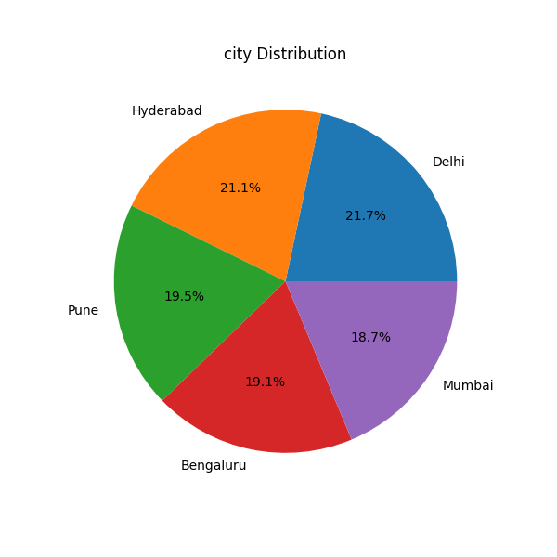
e1cbac24-ee86-4c8d-9c55-45ec54e1638b_city_pie.png

Slide 15
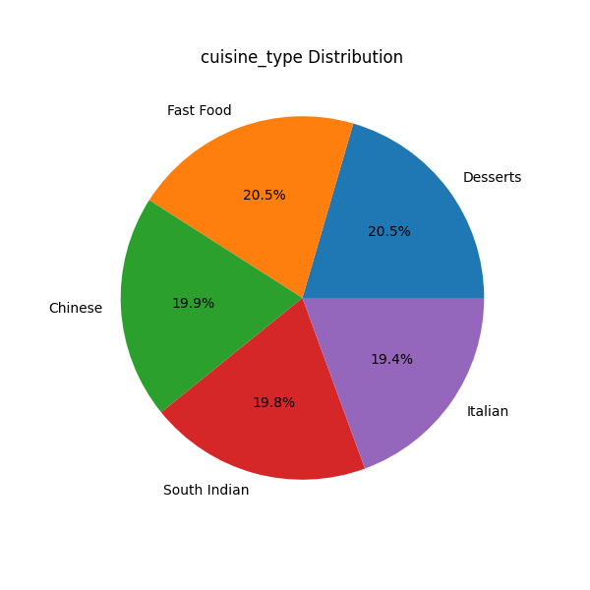
e1cbac24-ee86-4c8d-9c55-45ec54e1638b_cuisine_type_pie.png

Slide 16
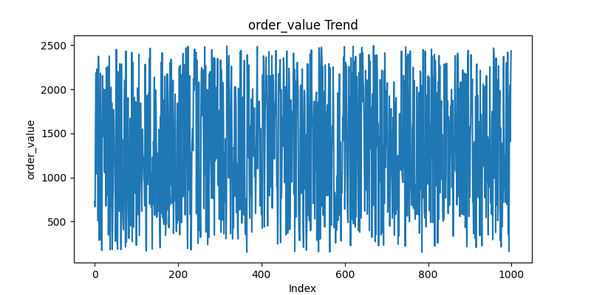
e1cbac24-ee86-4c8d-9c55-45ec54e1638b_order_value_line.png

Slide 17
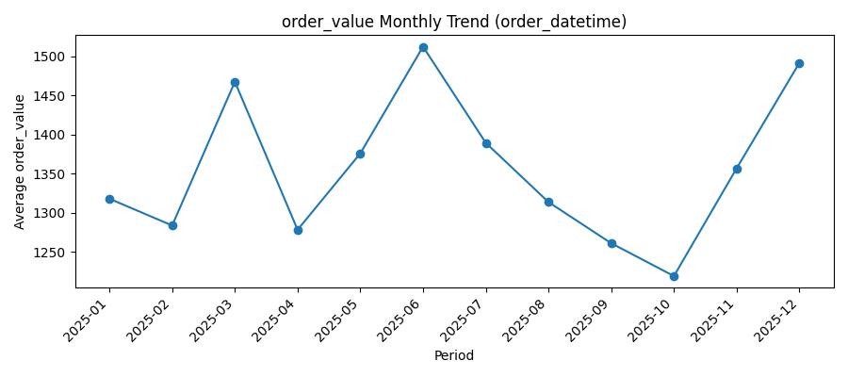
e1cbac24-ee86-4c8d-9c55-45ec54e1638b_order_value_time_trend.png

