Slide 1
AI Analyst Report
File ID: 29

Slide 2
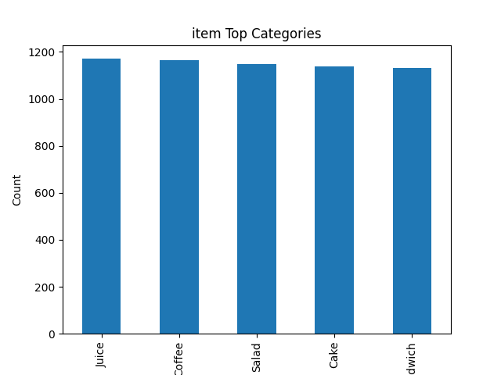
5acd333d-ed10-4744-bdd1-bd2eb03f44fc_item_bar.png

Slide 3
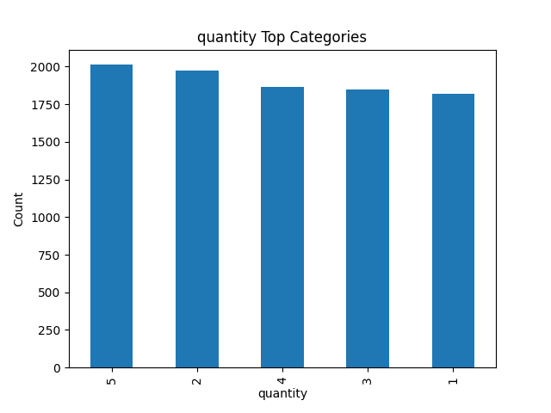
5acd333d-ed10-4744-bdd1-bd2eb03f44fc_quantity_bar.png

Slide 4
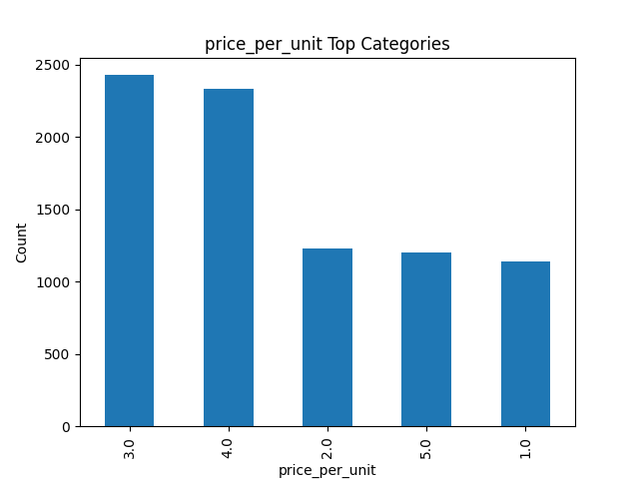
5acd333d-ed10-4744-bdd1-bd2eb03f44fc_price_per_unit_bar.png

Slide 5
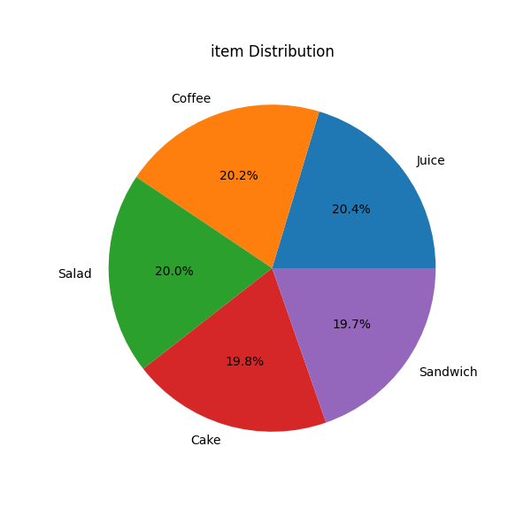
5acd333d-ed10-4744-bdd1-bd2eb03f44fc_item_pie.png

Slide 6
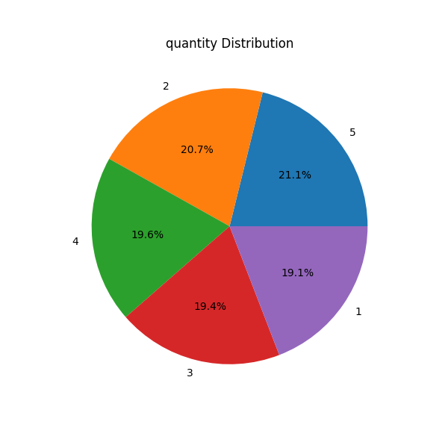
5acd333d-ed10-4744-bdd1-bd2eb03f44fc_quantity_pie.png

