Slide 1
AI Analyst Report
File ID: 30

Slide 2
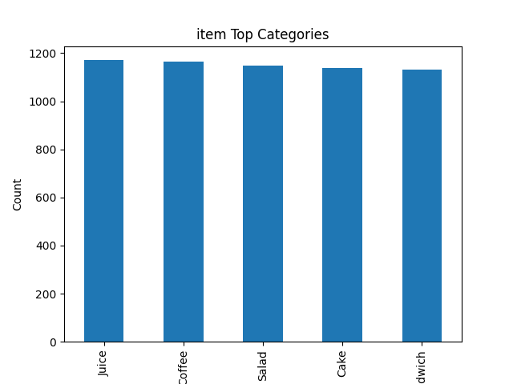
4b8bb9d5-43a1-4f0b-82af-f7b0724dad8e_item_bar.png

Slide 3
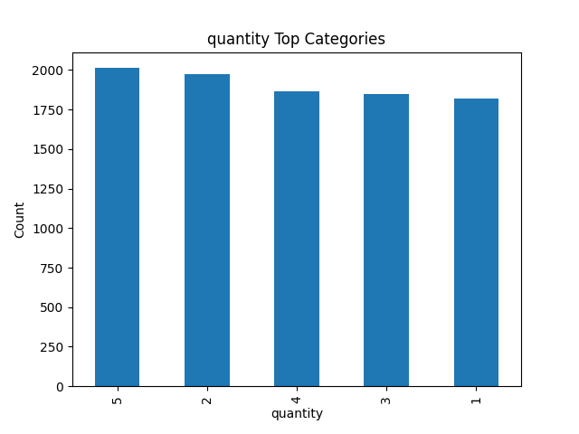
4b8bb9d5-43a1-4f0b-82af-f7b0724dad8e_quantity_bar.png

Slide 4
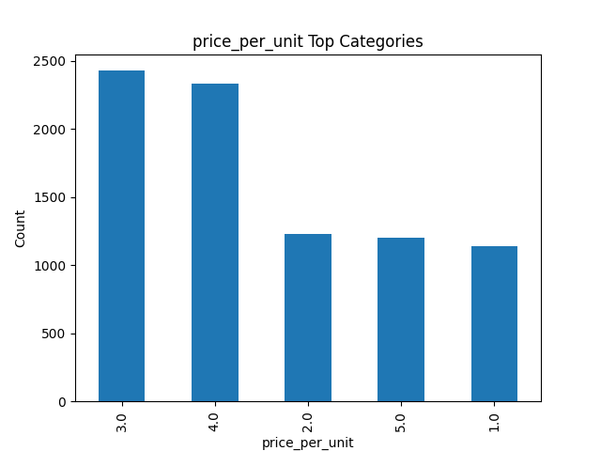
4b8bb9d5-43a1-4f0b-82af-f7b0724dad8e_price_per_unit_bar.png

Slide 5
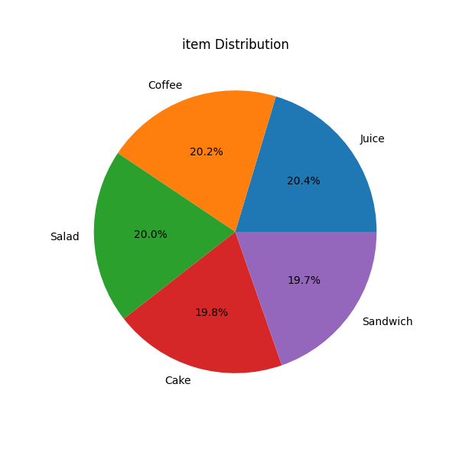
4b8bb9d5-43a1-4f0b-82af-f7b0724dad8e_item_pie.png

Slide 6
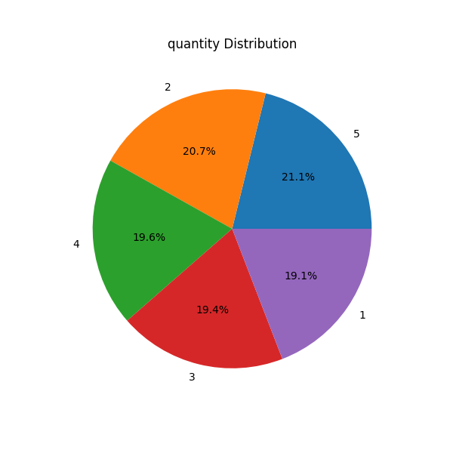
4b8bb9d5-43a1-4f0b-82af-f7b0724dad8e_quantity_pie.png

