Slide 1
AI Analyst Report
File ID: 31

Slide 2
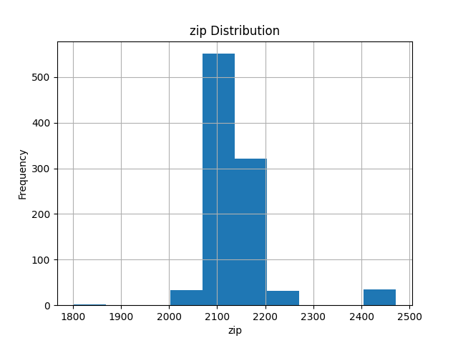
2734a530-db6b-4b5a-9aa7-9b067c16ab17_zip_hist.png

Slide 3
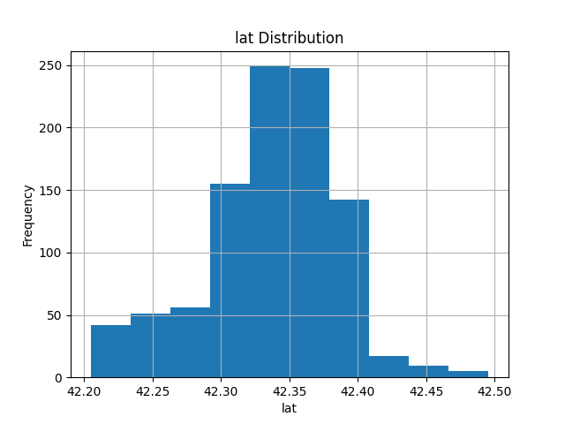
2734a530-db6b-4b5a-9aa7-9b067c16ab17_lat_hist.png

Slide 4
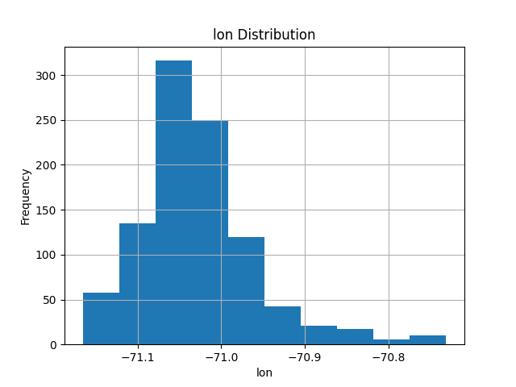
2734a530-db6b-4b5a-9aa7-9b067c16ab17_lon_hist.png

Slide 5
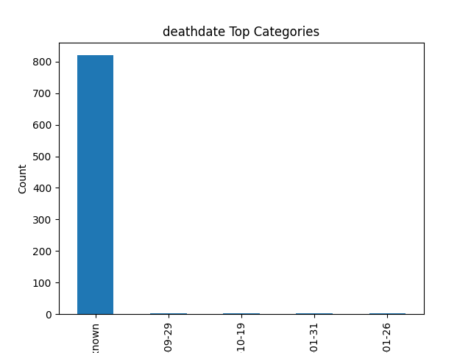
2734a530-db6b-4b5a-9aa7-9b067c16ab17_deathdate_bar.png

Slide 6
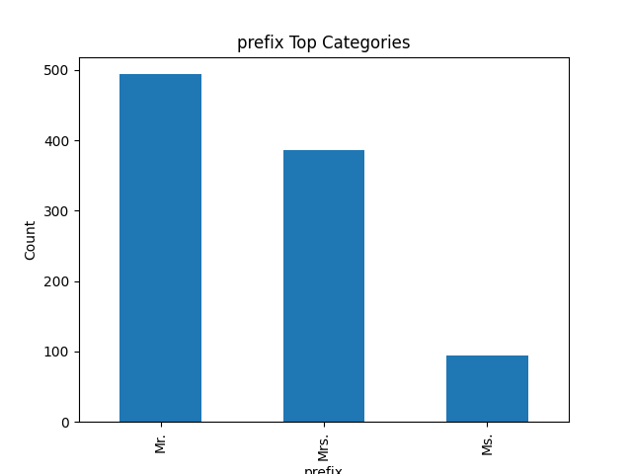
2734a530-db6b-4b5a-9aa7-9b067c16ab17_prefix_bar.png

Slide 7
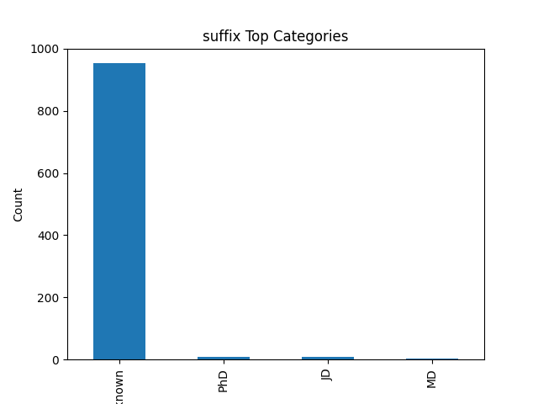
2734a530-db6b-4b5a-9aa7-9b067c16ab17_suffix_bar.png

Slide 8
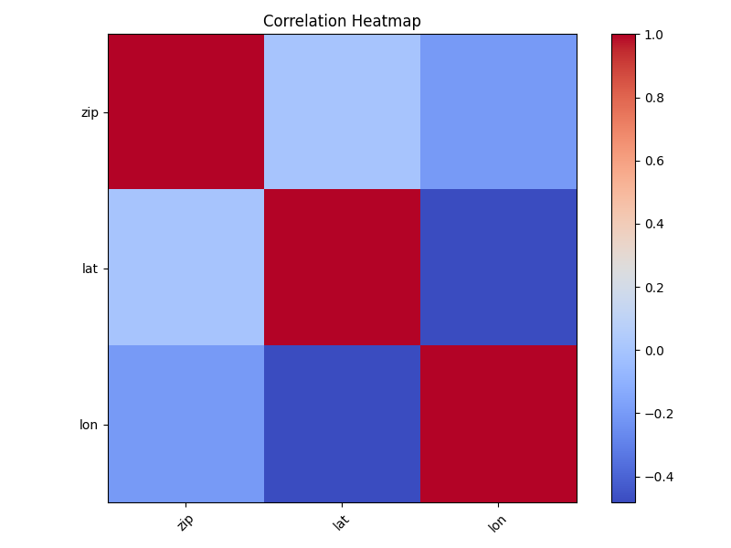
2734a530-db6b-4b5a-9aa7-9b067c16ab17_heatmap.png

Slide 9
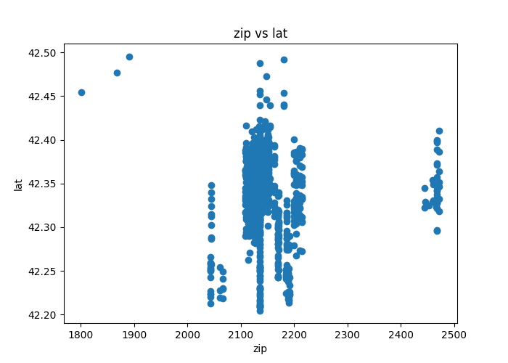
2734a530-db6b-4b5a-9aa7-9b067c16ab17_scatter.png

Slide 10
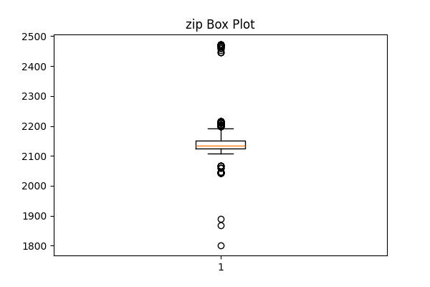
2734a530-db6b-4b5a-9aa7-9b067c16ab17_zip_boxplot.png

Slide 11
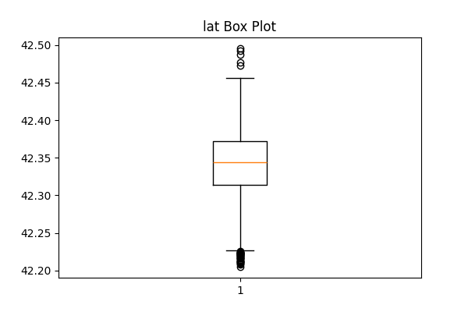
2734a530-db6b-4b5a-9aa7-9b067c16ab17_lat_boxplot.png

Slide 12
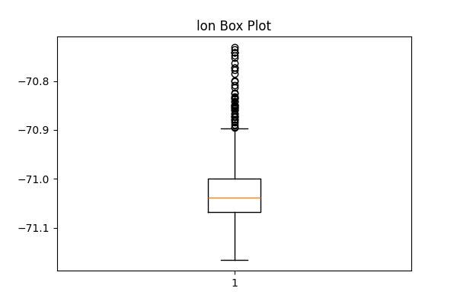
2734a530-db6b-4b5a-9aa7-9b067c16ab17_lon_boxplot.png

Slide 13
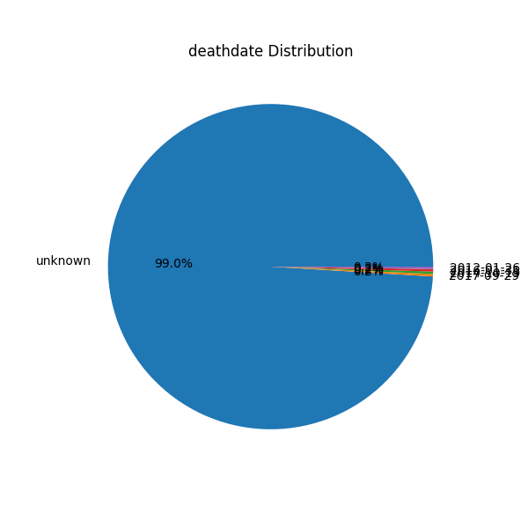
2734a530-db6b-4b5a-9aa7-9b067c16ab17_deathdate_pie.png

Slide 14
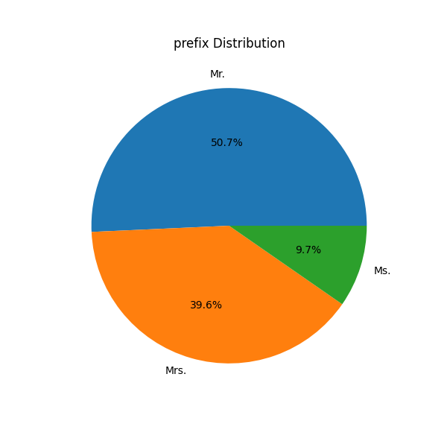
2734a530-db6b-4b5a-9aa7-9b067c16ab17_prefix_pie.png

Slide 15
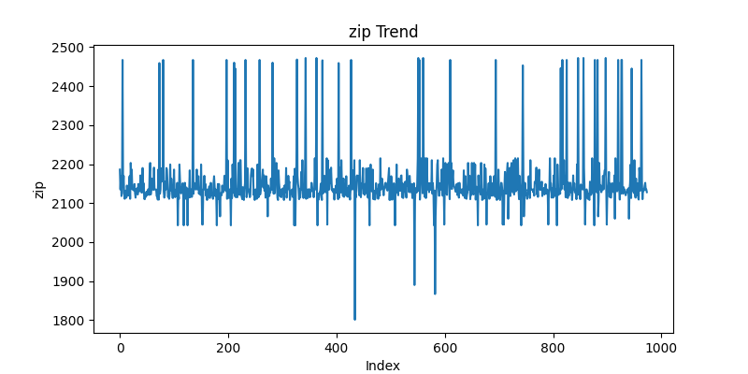
2734a530-db6b-4b5a-9aa7-9b067c16ab17_zip_line.png

Slide 16
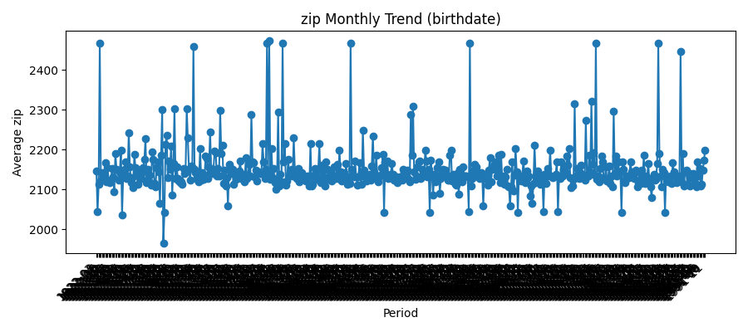
2734a530-db6b-4b5a-9aa7-9b067c16ab17_zip_time_trend.png

