Slide 1
Keylogger and security
CAPSTONE PROJECT
Presented By:
1. Mizba Kausar- Priyadarshini Engineering College

Slide 2
OUTLINE
Problem Statement
Proposed System/Solution
System Development Approach
Algorithm & Deployment
Result
Conclusion
Future Scope
References

Slide 3
Problem Statement
In today's digital age, where cybersecurity threats loom large, one of the significant concerns is the proliferation of keyloggers, stealthy software tools designed to monitor and record keystrokes on a user's computer without their knowledge. Keyloggers pose a severe threat to individuals and organizations as they can capture sensitive information such as passwords, credit card details, and other personal data, leading to identity theft, financial loss, and privacy breaches.

Slide 4
Proposed Solution
Keyloggers are software or hardware devices designed to record keystrokes made on a computer, often without the user's knowledge or consent. While there may be legitimate use cases for keyloggers, such as parental monitoring or employee supervision in certain contexts, they are frequently associated with malicious activities such as identity theft, espionage, and unauthorized access to sensitive information.
Using keylogger application users can retrieve data when working file is damaged due to several reasons like loss of power etc. This is a surveillance application used to track the users which logs keystrokes; uses log files to retrieve information. Using this application we can recall forgotten email or URL. In this keylogger project, whenever the user types something through the keyboard, the keystrokes are captured and mailed to the mail id of admin without the knowledge of the user within the time set.

Slide 5
System Approach
Developing a keylogger system requires a systematic approach that considers various aspects of software development, security, and ethical considerations. Below is a step-by-step guide to developing a keyloggers system:
1. Define Purpose and Scope:
Clearly define the purpose of the keylogger system, whether it's for legitimate use (e.g., parental monitoring, employee supervision) or for testing/security research.
Define the scope of the system, including the features it will include and the platforms it will support (e.g., Windows, macOS, Linux).
2. Research and Requirements Gathering:
Conduct research on existing keylogger software and techniques to understand common functionalities and security considerations.
Gather requirements from stakeholders, considering factors such as data logging capabilities, stealthiness, compatibility, and security measures.
3. Design Architecture:
Design the architecture of the keylogger system, considering factors such as modularity, scalability, and maintainability.

Slide 6
4. Develop Core Functionality:
Implement the core functionality of the keylogger system, including capturing keystrokes, logging data, and optionally capturing other user activities such as mouse movements and screenshots.
Ensure that the keylogger operates reliably and efficiently without impacting system performance.
5. Implement Stealth Mechanisms (if applicable):
If the keylogger is intended for covert monitoring, implement stealth mechanisms to hide its presence from users and security software.
Stealth techniques may include hiding files and processes, using rootkit-like behavior, and evading detection by antivirus software.
6. Incorporate Security Measures:
Implement security measures to protect the data collected by the keylogger, such as encryption of logged data, secure storage, and access controls.

Slide 7
Implement mechanisms to prevent unauthorized access to the keylogger system itself, such as password protection and authentication.
7. Testing and Quality Assurance:
Conduct thorough testing of the keylogger system to ensure functionality, reliability, and security.
Perform both unit tests and integration tests to validate the behavior of individual components and the system as a whole.
Consider security testing techniques such as penetration testing to identify and address vulnerabilities.
8. Documentation and User Support:
Prepare comprehensive documentation for users and administrators, including installation instructions, usage guidelines, and troubleshooting tips.
Provide ongoing support for users of the keylogger system, addressing any issues or questions they may have.

Slide 8
Algorithm
Keylogger applications designed by implementing the Exact String Matching algorithm can record all user activities related to the keyboard, and the results are stored automatically in a dedicated database that can only be accessed by the keylogger owner, the next development of the keylogger application can record.
a. The program will wait for all the system processes to initialize.
b. The keylogger daemon is initialized and the process will be gauged in scale of time.
c. A log file is created for the current session to log all the keystrokes and maintain a record.
d. If no event occurs, keylogger continues listening to the strokes.

Slide 9
Deployment
In most cases, keyloggers are malware deployed by cybercriminals on an infected computer. Once running on a computer, a keylogger can collect the sensitive information that the user types into the computer, such as passwords, credit card numbers, and similar data.

Slide 10

output

Slide 11
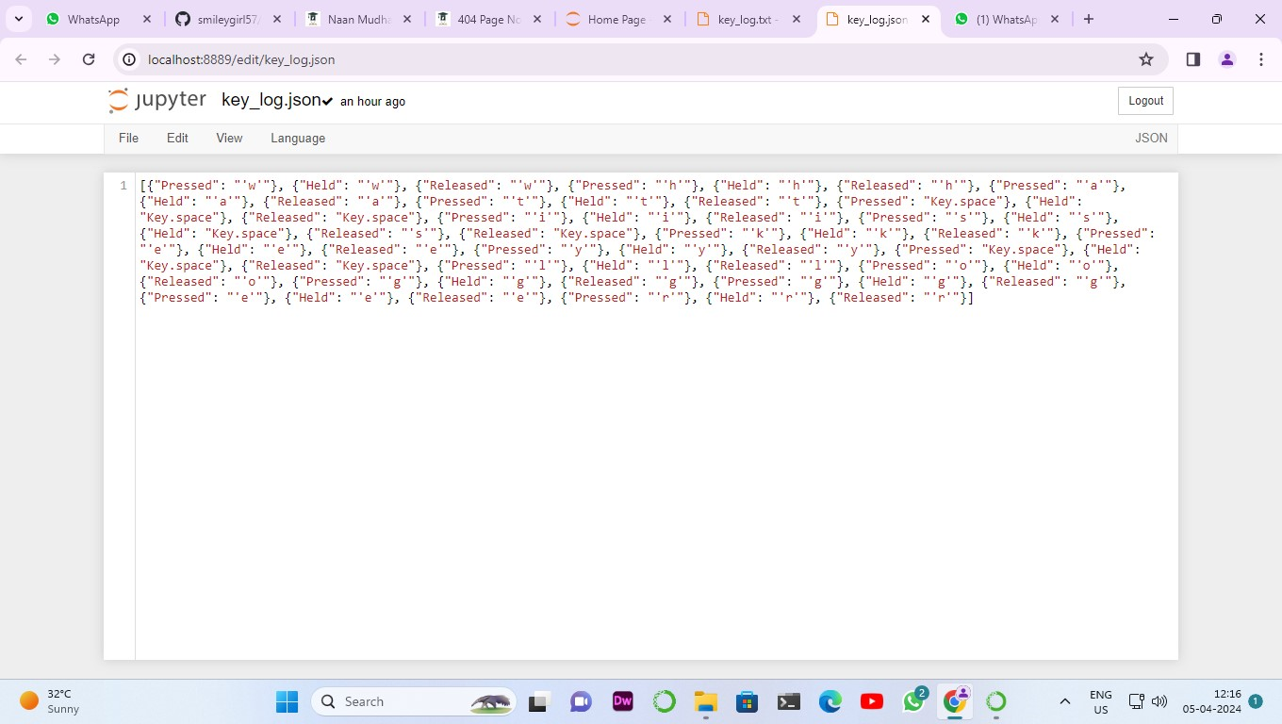
Result

Slide 12
Conclusion
In conclusion, keyloggers pose a significant threat to both personal and organizational cybersecurity. To mitigate this threat, individuals and organizations must remain vigilant, employing robust security measures such as antivirus software, firewalls, and regular system updates. Additionally, user education and awareness about the dangers of keyloggers and best practices for avoiding them are essential in safeguarding against potential breaches of sensitive information. Ultimately, combating the proliferation of keyloggers requires a multi-faceted approach involving technological solutions, proactive security measures, and user awareness to effectively protect against these insidious threats.

Slide 13
Future scope
A Keylogger is a form of software which is used to track or log the all the keys that a user strikes on their keyboard, usually in secret so that the user of the system doesn’t know that their actions are being monitored. It is otherwise known as keyboard capturer. These are perfectly legal and useful. They can be installed by employers to oversee the use of their computers, meaning that the employees have to complete their tasks instead of procrastinating on social media. Some of the possible amendments and improvements in this project are;
• Recording of system screen
• Secure web account for data storing
• Password Protection
• Parental Control

Slide 14
References
1. https://medium.com/
2. https://www.slideshare.net/
3. https://en.m.wikipedia.org/wiki/
4. https://security.stackexchange.com/
5. https://www.ionos.com/digitalguide/

Slide 15
THANK YOU

