Slide 1
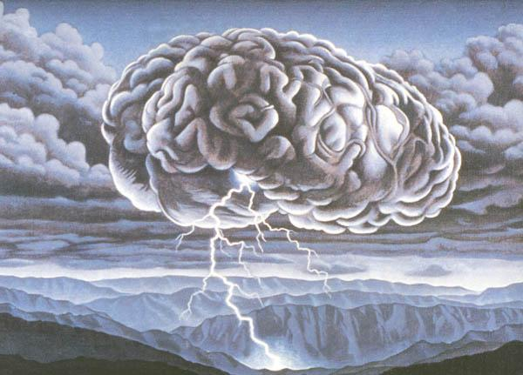
Brain-Storming

Slide 2

For what?
creativity

Slide 3
Process
Summary
Positive statement
Definite problem
Gather the participants

Slide 4
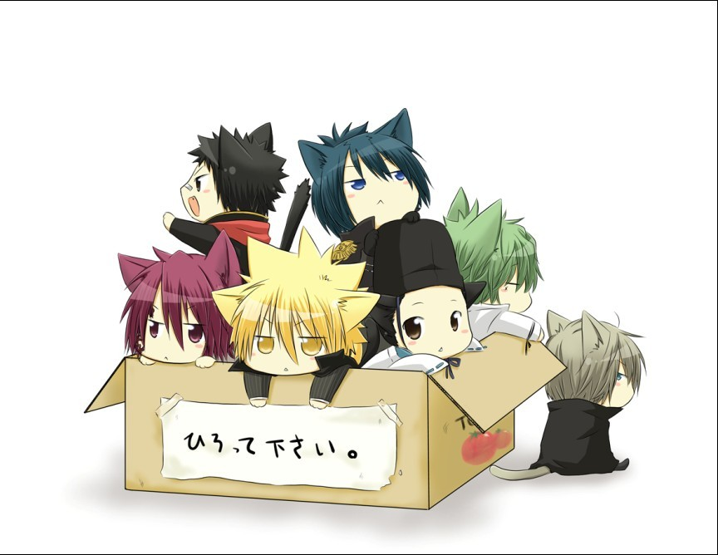


How to do better
Positive statement
Make good preparations
Listens respectfully earnestly
Attention time

Slide 5
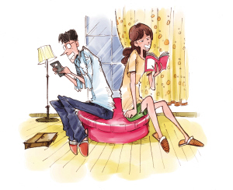
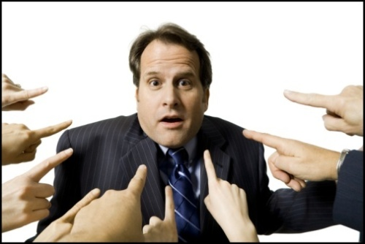
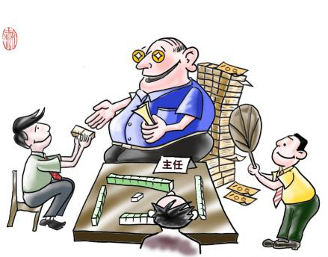
Wrong behavior
Silence
Criticize
Compliment

