Slide 1
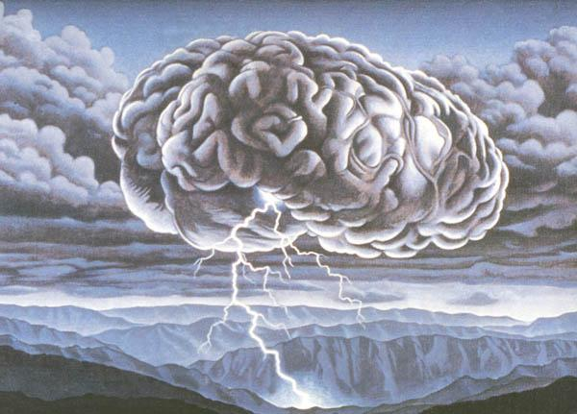
Brain-Storming

Slide 2
For what?
creativity

Slide 3
Process
Summary
Positive statement
Definite problem
Gather the participants

Slide 4
How to do better
Positive statement
Make good preparations
Listens respectfully earnestly
Attention time

Slide 5
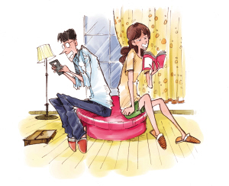
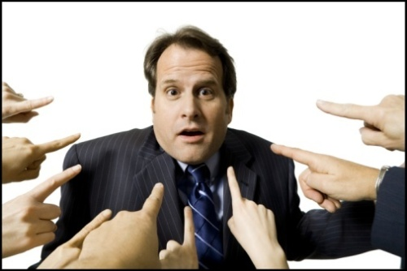
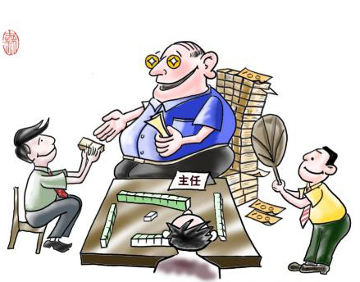
Wrong behavior
Silence
Criticize
Compliment

