Slide 1
Vish Interview Exercise

Slide 2
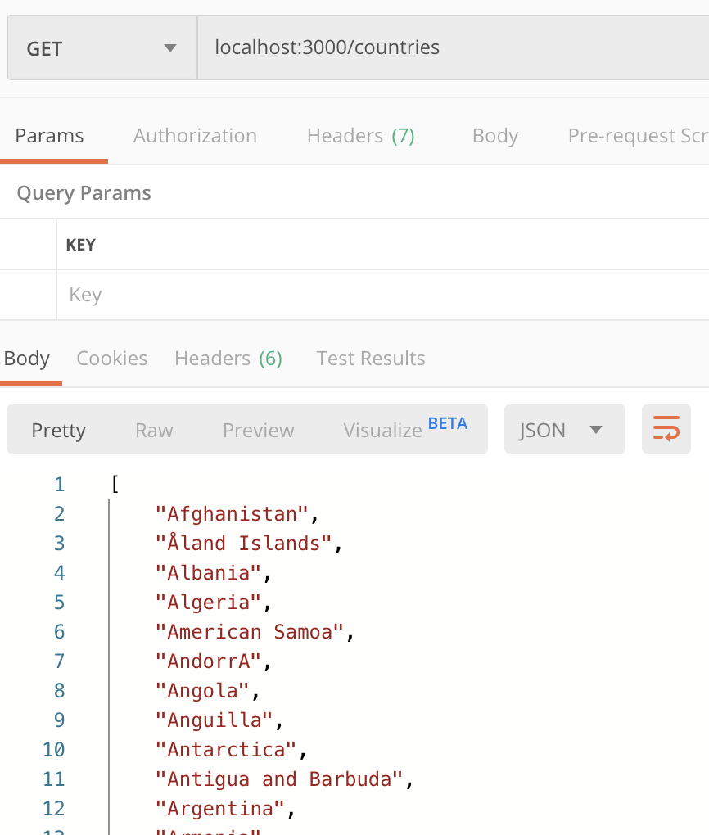
1
Created endpoint for a simple get
localhost:3000/countries
Returns list of all countries
Caveats:
- Used countries.json instead of country.ts
Postman output preview

Slide 3
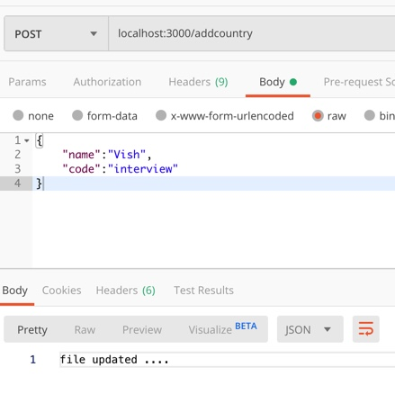
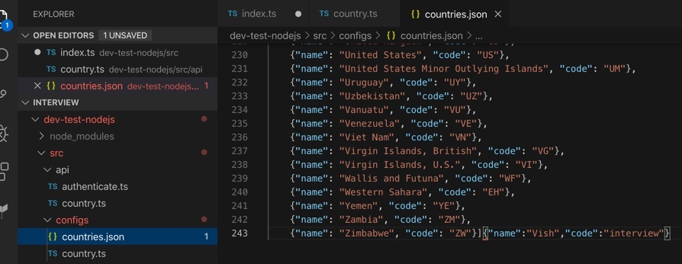
2
Created endpoint for a simple post
localhost:3000/addcountry
Add countries to the file
Caveats:
Used countries.json instead of country.ts
Json append not completely formatted
Postman output preview
file output preview

Slide 4
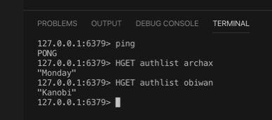
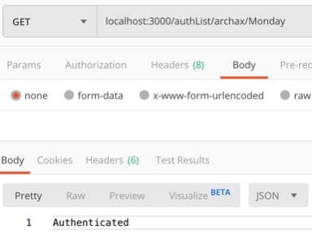
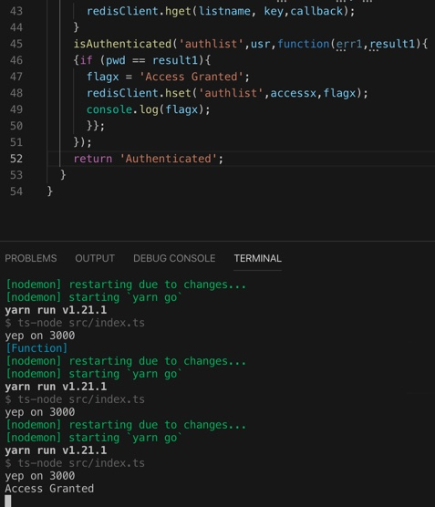
3
Use redis for authentication
Inserted key value on to redis
Endpoint with userid/password (not a real world scenario, apologies - exercise to try redis crud)
Caveats:
(1) Authentication does not implement real work authentication patterns
(1) Values set in redis
(2) Postman preview
(3) Do stuff – access granted

Slide 5
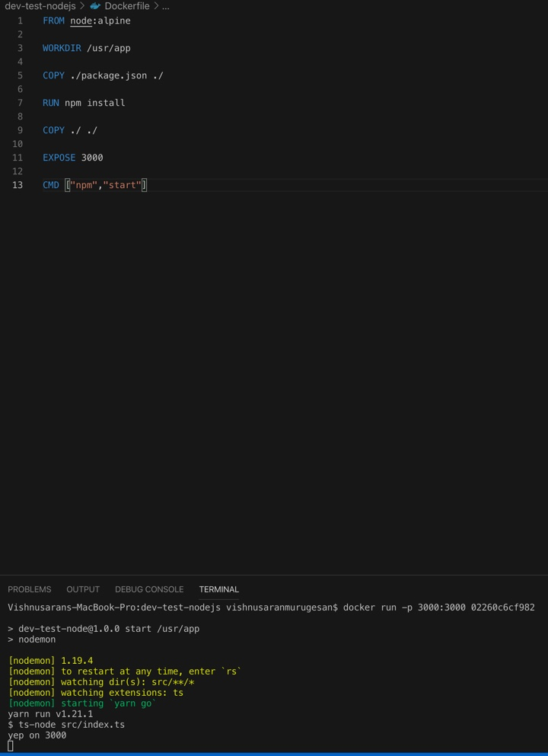
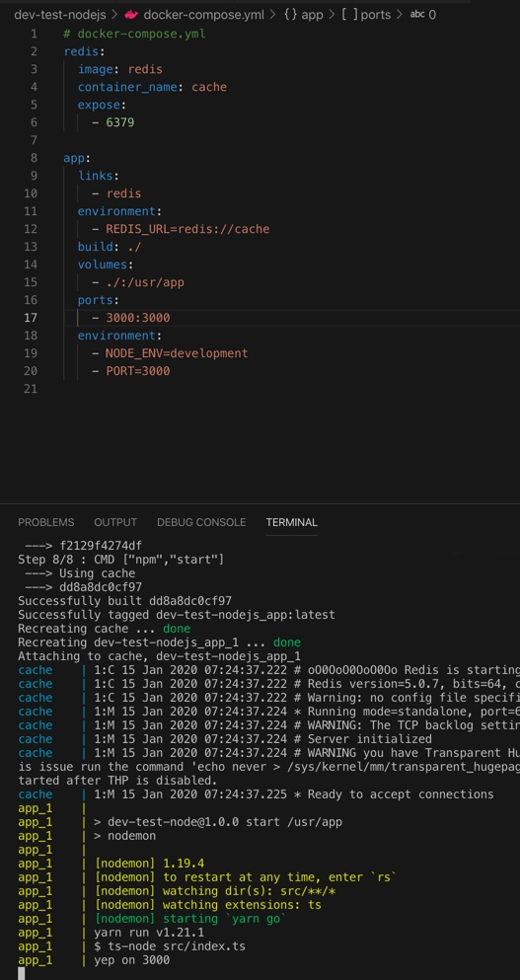
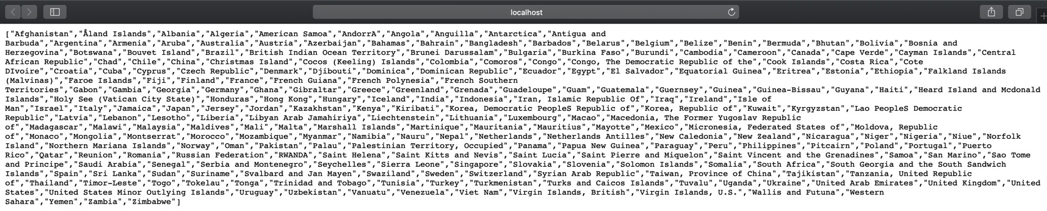
4
Dockerfile localhost –p 3000
docker-compose localhost

