Slide 1
PrognoScan
A new database for meta-analysis of the prognostic value of genes
Hideaki Mizuno, Kunio Kitada, Kenta Nakai, Akinori Sarai BMC Med Genomics. 2009, 2:18.

Slide 2
Backgrounds
Experiments and evidences are required to establish tumor markers and oncogenes such as,
Relation to cell proliferation
Tumorigenecity
Overexpression/Suppression in clinical samples
Relevance to prognosis
Gene X
Tumor marker, Oncogene
evidence
evidence
evidence
evidence
evidence
Experiment
Experiment
Experiment
Experiment
Experiment

Slide 3
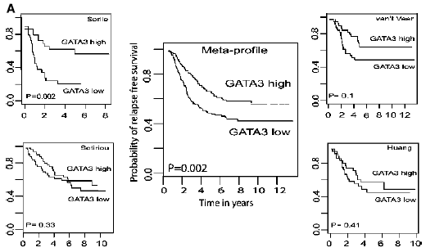
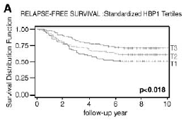
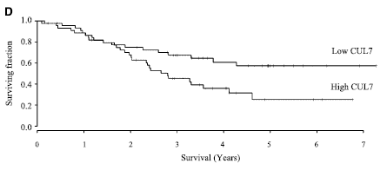
Backgrounds
Number of microarray datasets have been being published.
Cancer microarray datasets with clinical annotation provide an opportunity to link gene expression to patients’ prognosis.
GATA3 for breast cancer
HBP1 for breast cancer
CUL7 for NSCLC
Mehra et al. (2005)
Paulson et al. (2007)
Kim et al. (2007)

Slide 4
PrognoScan for utilizing public microarray datasets
To utilize public microarray datasets for survival analysis, PrognoScan database has been developed.
PrognoScan has two features of
  1) Data collection of publicly available cancer microarray datasets with clinical annotation
  2) Systematic assessment tool for prognostic value of the gene based on its expression using minimum p-value approach

Slide 5



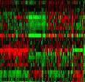

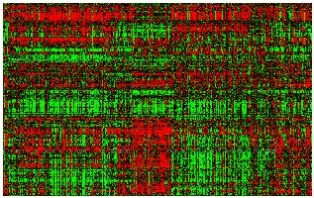
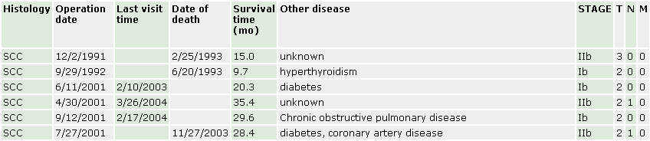
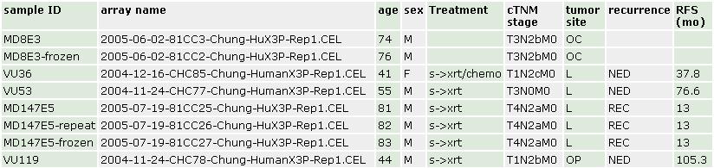
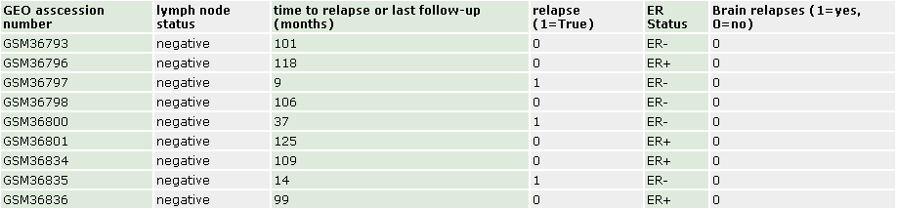
Data collection
Cancer microarray datasets with clinical annotation were collected from the public domains.
GEO
ArrayExpress
Lab web sites
Cancer dataset
Clinical annotation

Slide 6
Data collection
Annotations were manually curated.
  Study design: cohort, endpoint, therapy history, pathological parameters
  Experimental procedure: sample preparation, storage, array type, signal processing method

Slide 7
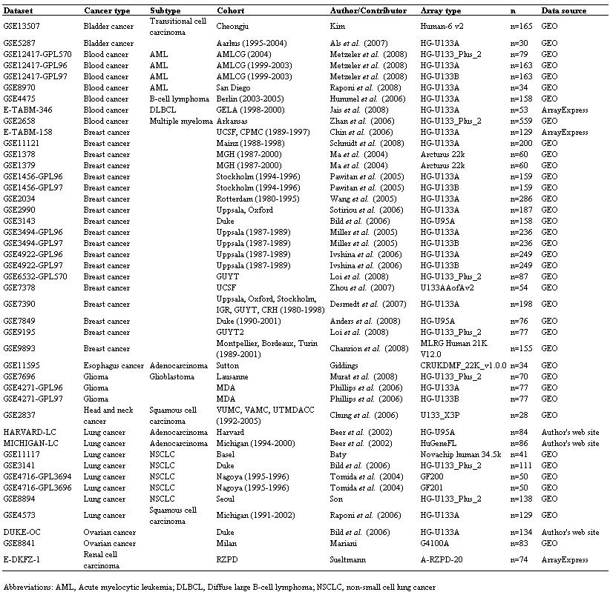
Data collection of PrognoScan
As of December 2008
44 datasets spanning bladder, blood, breast, brain, esophagus, head and neck, kidney, lung, and ovarian cancers were included.

Slide 8
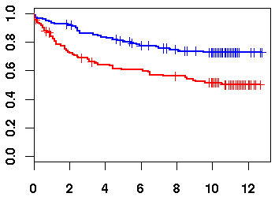
Steps for standard survival analysis
Step1) Grouping patients
    e.g. Metastasis+/-, Drug+/-
Step2) Comparison of risk difference of the groups
    Kaplan-Meier curve and Log-rank test
Kaplan-Meier curve
Group A
Group B
Group B
Patient
Difference gives
P-value
Survival Probability
Group A
Time

Slide 9
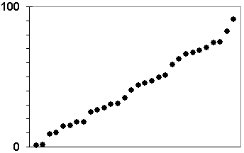
Issue 1) Grouping patients based on continuous measurements
Biological model (e.g. 20-30% BCs overexpress ERBB2)
    is applicable only to well studied factors
Arbitrary cutpoint (e.g. median)
    may not reflect biology
Exploration of the optimal cutpoint
?
?
?
Expression signal
Patients

Slide 10



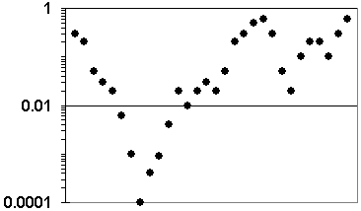
Minimum p-value approach explores the optimal cutpoint
Expression signal
Patients
P-value
Optimal cutpoint

Slide 11
Issue 2) Inflation of type I error
Multiple correlated testing for finding the optimal cutpoint causes inflation of type I error.
Expression signal
Patients
P-value

Slide 12
P-value correction
Miller and Siegmund formula
P-value correction formula for multiple correlated testing has been proposed as;
P_{cor} = 4φ(z) / z + φ(z){z – (1 / z)}log{(1 – ε)² / ε²}
P_{min}:
z:
φ():
[ε, 1 – ε]:
Observed minimum P-value
(1 – P_{min} / 2)
Normal density function
Range of the quantile considered to be cutpoints
Miller and Siegmund (1982)

Slide 13
Availability of the PrognoScan
PrognoScan having feature of 1) large data collection, and 2) systematic assessment tool, is available at:
http://www.prognoscan.org

Slide 14
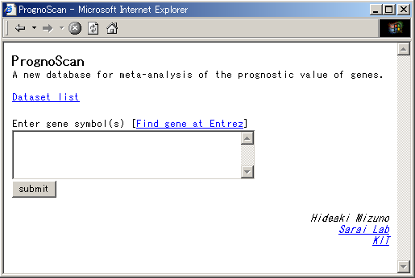
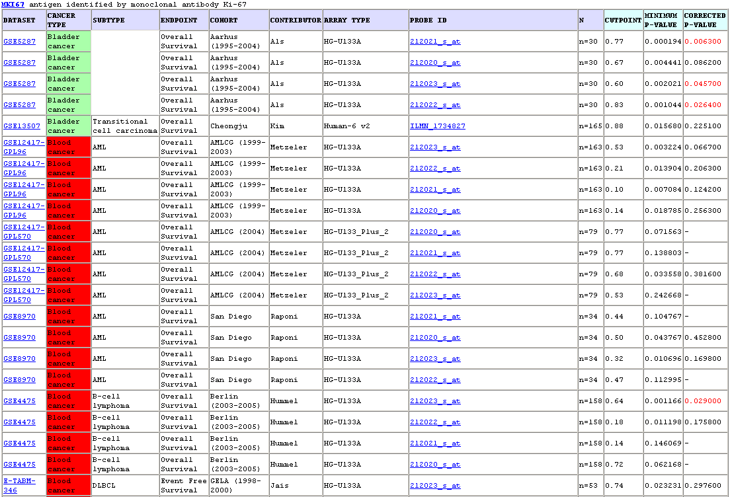
Utility of the PrognoScan
An example of tumor marker Ki-67 (MKI67)
Top page
Summary table
MKI67
Detailed page (next slide)

Slide 15
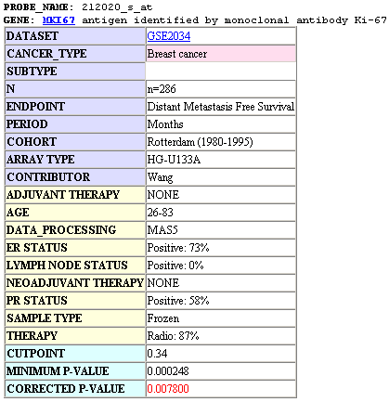
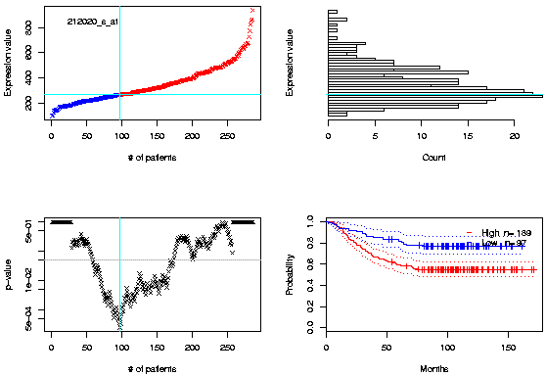
Utility of the PrognoScan
An example of tumor marker Ki-67 (MKI67)
Annotation table
Expression plot
Expression histogram
P-value plot
Kaplan-Meier plot

Slide 16
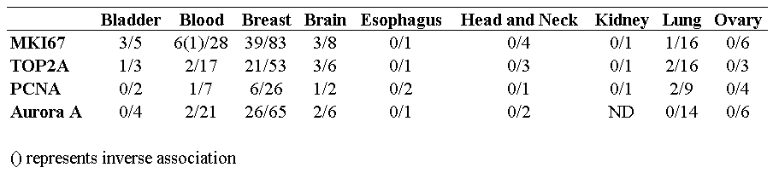
Utility of the PrognoScan
Examples for known tumor markers
# of significant associations / # of tests

Slide 17
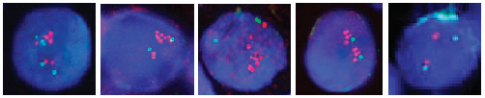
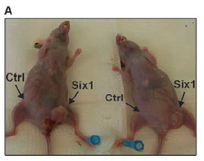
Utility of the PrognoScan
Testing the candidate oncogene SIX1
SIX1 is the candidate oncogene for breast cancers.
SIX1 overexpression increases cell proliferation
SIX1 is amplified in breast cancers.
SIX1 stimulates tumorigenesis.
No association to BC prognosis has been reported.
Coletta et al. (2004)
IDC
IDC
IDC
IDC
Normal
FISH
(SIX1/Con)
Reichenberger et al. (2008)
Coletta et al. (2004)

Slide 18
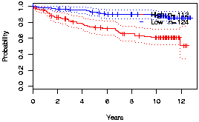
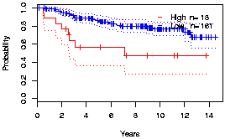
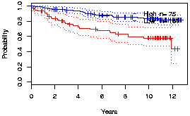
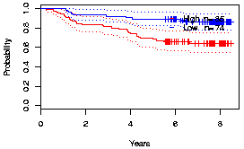
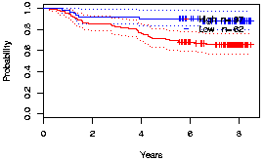
Prognostic value of SIX1 for Breast cancers
Breast cancer; Uppsala DFS (205817_at)
Breast cancer; Uppsala+Oxford DMFS (205817_at)
P_{cor} = 0.0002
P_{cor} = 0.0346
Breast cancer; Uppsala DFS (228347_at)
Breast cancer; Stockholm RFS (205817_at)
P_{cor} = 0.0006
P_{cor} = 0.0354
Breast cancer; Uppsala RFS (230911_at)
P_{cor} = 0.0449

Slide 19
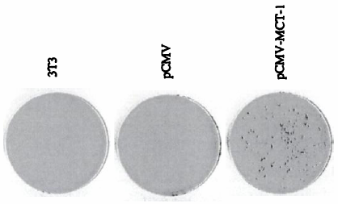
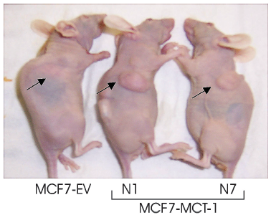
Utility of the PrognoScan
Testing the candidate oncogene MCTS1
MCTS1 is the candidate oncogene.
MCTS1 has transforming ability in vitro.
MCTS1 stimulates tumorigenesis.
No report for the association to cancer prognosis
Levenson et al. (1998)
Prosniak et al. (2005)

Slide 20
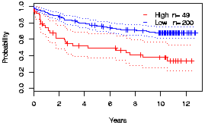
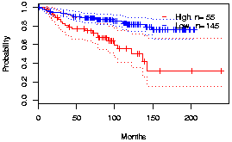
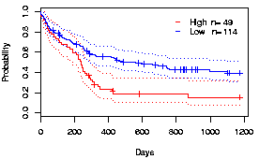
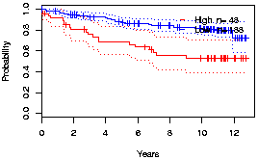
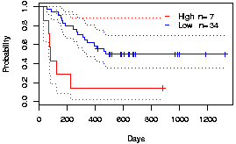
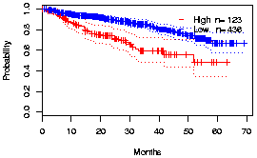
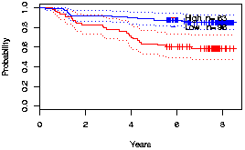
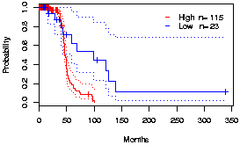
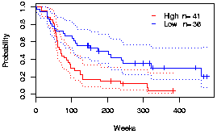
Prognostic value of MCTS1 for Blood, Breast, Brain and Lung cancers
Breast cancer; Uppsala DFS (218163_at)
Breast cancer; Mainz DMFS (218163_at)
Multiple Myeloma; Arkansas CSS (218163_at)
P_{cor} = 0.0002
P_{cor} = 0.0017
P_{cor} = 0.0244
Breast cancer; Uppsala DSS (218163_at)
NSCLC; Basel OS (H200011193)
AML; Munich OS (218163_at)
P_{cor} = 0.003
P_{cor} = 0.015
P_{cor} = 0.0002
Breast cancer; Stckholm RFS (218163_at)
NSCLC; Seoul DFS (218163_at)
Glioma; MDA OS (218163_at)
P_{cor} = 0.0053
P_{cor} = 0.014
P_{cor} = 0.0378

Slide 21
Summary
PrognoScan has features of 1) large data collection and 2) systematic assessment tool for prognostic value of the gene
Using PrognoScan, two candidate oncogenes could be likned to cancer prognosis.
PrognoScan provides powerful platform for evaluating potential tumor markers and oncogenes.

Slide 22
Limitations for PrognoScan
Public microarray datasets are from different studies.
  Cohort
    Patients with different background may follow a different clinical course
  Quality of care
    Hospital effects have been often reported.
  Experimental factors
    e.g. Chip design, Signal processing method
Random error
Users need to regard the result from PrognoScan in the context of conditions.

