Slide 1
MMDRAW extra feature
By: some ANONs

Slide 2
Something really cool that we can’t show you unless face-to-face so here’s a demo!
Shared drawing application feature using node.js, sockets.io and express.
I removed this feature from the canvas itself before submitting but have provided a copy of working folder; here’s how it works...

Slide 3
Shared drawing application feature
There will be a button on the drawing application that will take you to a separate server, on which you can draw with other people, real-time.
It is currently still in progress, I have set up the server on learn.gold but code still needs tweaking since it refuses to work on a custom port. Along with this, the overall “real time drawing application” feature needs improving aesthetically (it is not very visually appealing).

Slide 4
You can try it yourself using the following steps:
Download node.js
Run cmd/terminal
Open the sharedcode file provided through cmd/terminal
Enter “node server.js”
A message will appear when running
Open the shared application file through localhost:3000
Draw alone on different tabs (For now! Soon, we shall be able to draw with other people)

Slide 5
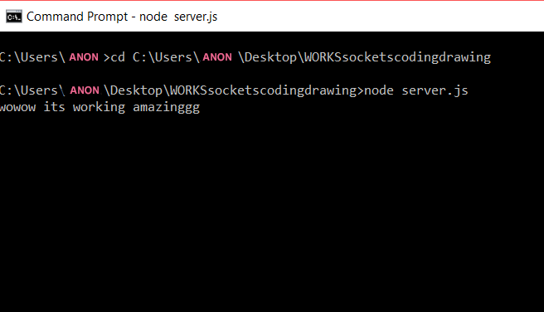

Once running you can check it out on localhost:3000

Slide 6
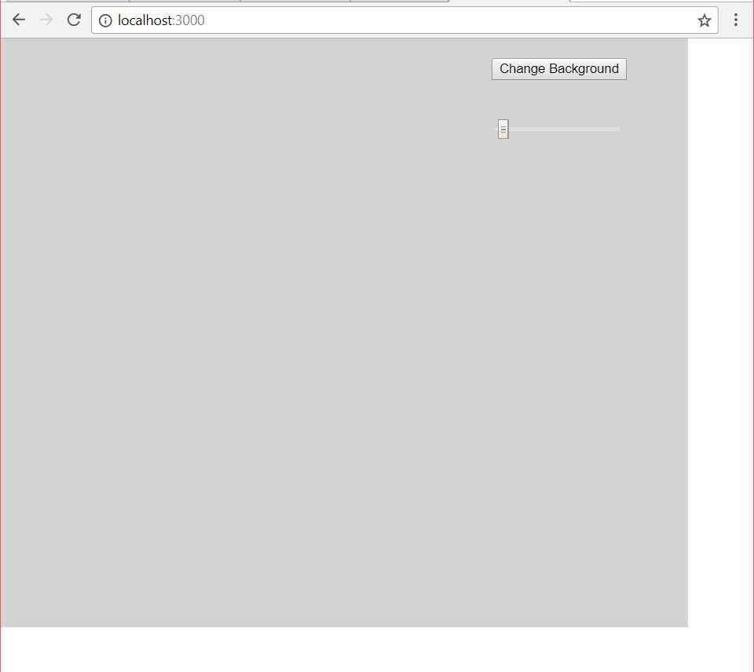
The shared application feature is quite plain at the moment

Slide 7
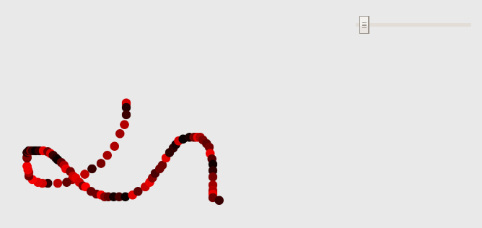
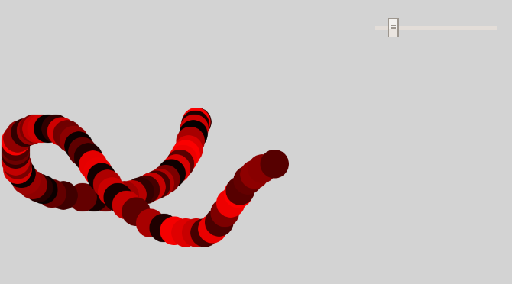
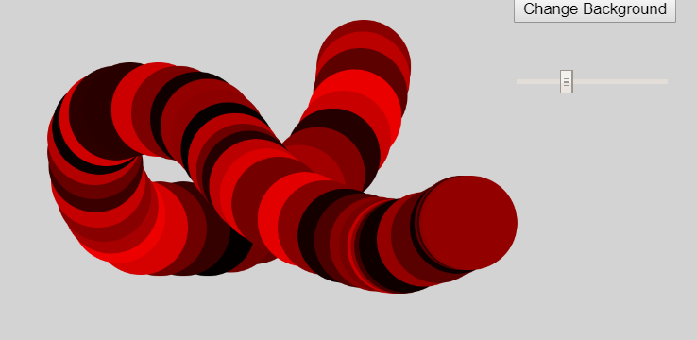
You can change the size of the pen tool
More colours to come soon..

Slide 8
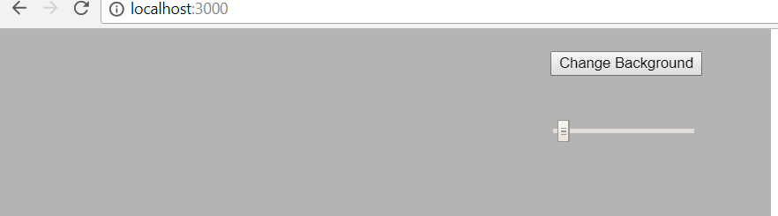
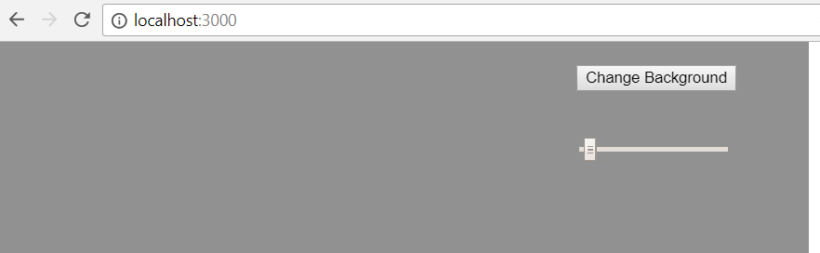
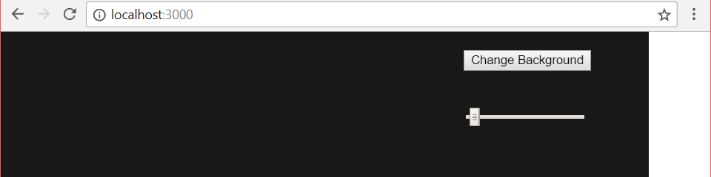
You can change the background to different shades of grey
AND BEST OF ALL...

Slide 9
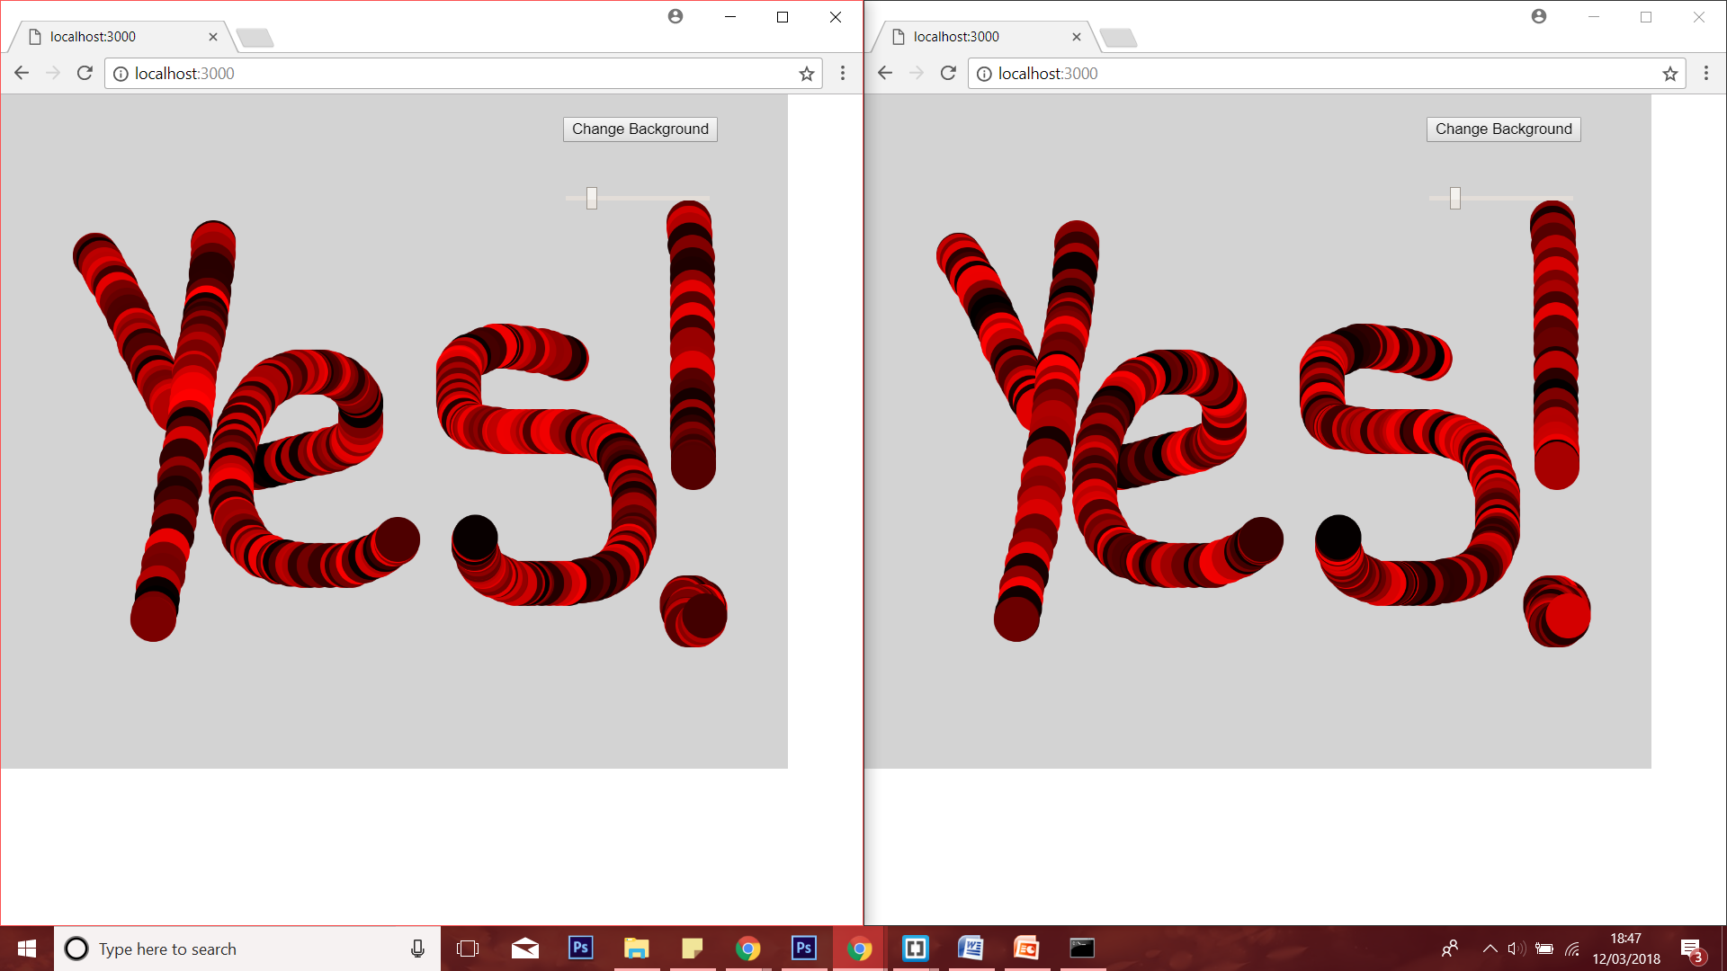
You can draw simultaneously on different tabs

Slide 10
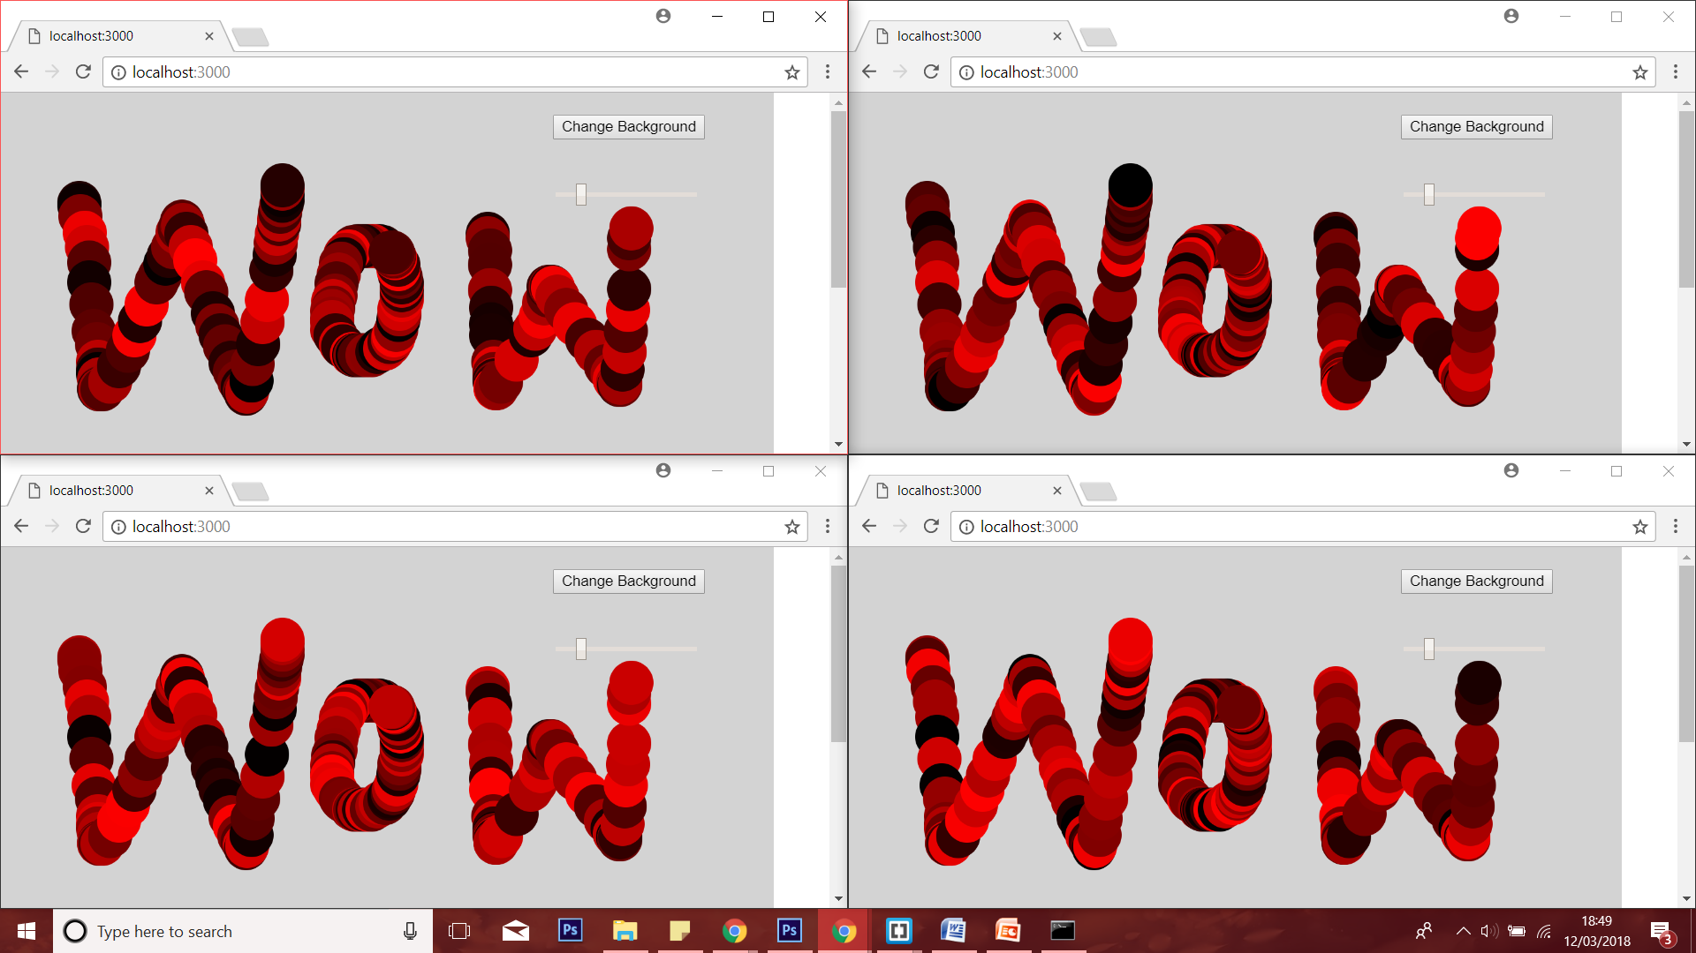
Yes, it works on many tabs

