Slide 1
APPLICATION OF TOPIC MODELING ON POLITICAL COMMENTARY
MASTER’S PROJECT DEFENSE
Aditya Parashar
University of Missouri

Slide 2
Outline
INTRODUCTION
PROJECT MOTIVATION
ALGORITHMS
INFRASTRUCTURE
EXPERIMENTS
RESULTS

Slide 3
INTRODUCTION
How and what we make of the world we live in.
NLP – Helps understand the world around us.
Classifying and categorizing the information
Important to understand classification categories – context, whole story, backstory and the follow-up
Making sense of the information that is present out there
Notes:
We can even program in NLP using Wolfram| Alpha now.
Constructs and functional programs use structure and asserts outside of the rules defined in Object oriented programming, though none of that can ever take over Natural Languages.
Use Insurance and mortgages to understand how we can make sense of it. Or something easier to understand is movies – rotten tomatoes – certified fresh or rotten And the movie ladybird where every user has certified it to be fresh. For a major movie – this is unheard of. So is the data skewed or is the movie actually that good ?
The only reason to classify is because of our need to – Cite resources here - http://www.brooklyn.cuny.edu/bc/ahp/CLAS/CLAS.Intro.html
The innate need to find order and impose order on nature and find hidden relationships.

Slide 4
STORY SO FAR ….
What are we using to find out information ? (what are the algorithms)
Relying heavily on Machine Learning. (structured or unstructured data sets)
Used across multiple domains – social networks, discussion groups, information retrieval, fake news,…
Notes:
Algorithms – decision trees(flowchart like structure), statistical models, probabilistic models, ML Models (word2Vec, LDA, LSI)

Slide 5
Project Motivation
Classification and categorization of political commentary
Hannity vs Maddow and Fox vs MSNBC – baselines/ground truth today
How close or similar are the other programs
Similarity scores against ground truth from the topics
If not similar, how dissimilar are they

Slide 6
TOPIC SIMILARITY
When a target topic from the training data is identified, similarly weighted topics from test data is used to find the importance of the topics and ascertain the similarity scores.
If the target topic that is identified is BASKETBALL, similar topics that result from the model and the overlap and the importance of topics are NBA, OLYMPICS, JORDAN, BLOCK, and MAGIC JOHNSON
Similar topic
NBA
Sport
Similar topic
MAGIC JOHNSON
Legends
Similar topic
JORDAN
Legends
Target topic
BASKETBALL
Gym class
Similar topic
DEFENSIVE BLOCK
Sport
Similar topic
OLYMPICS
Sport

Slide 7
Generative algorithms vs statistical algorithms
A generative algorithm models how the data was generated in order to categorize a signal. It asks the question: based on my generation assumptions, which category is most likely to generate this signal?
A statistical algorithm does not care about how the data was generated, it simply categorizes a given signal.

Slide 8
Term frequency – Inverse Document frequency algorithm (Tf-Idf)
A statistical algorithm that is intended to reflect how important a word is to a document in a collection or corpus.
Term Frequency : This is how many times a term appears in a particular document in the corpus
Document Frequency : This is how many of the documents the term appears in, in the corpus (and inverse document frequency is the inverse of this number)
Product of both the functions. Together, they are used as a measure of how important a term is to a particular document.
Notes:
Tfidf is often used as a weighting factor in searches of information retrieval, text mining, and user modeling. The tf-idf value increases proportionally to the number of times a word appears in the document, but is often offset by the frequency of the word in the corpus, which helps to adjust for the fact that some words appear more frequently in general. Nowadays, tf-idf is one of the most popular term-weighting schemes; 83% of text-based recommender systems in the domain of digital libraries use tf-idf.

Slide 9
Example of Tf-Idf
Document 1 : The game of life is a game of everlasting learning
Document 2: The unexamined life is not worth living
Document 3: Never stop learning
 | Document 1 | Document 2 | Document 3
life | 0.140550715 | 0.200786736 | 0.0
learning | 0.140550715 | 0.0 | 0.468502384

Slide 10
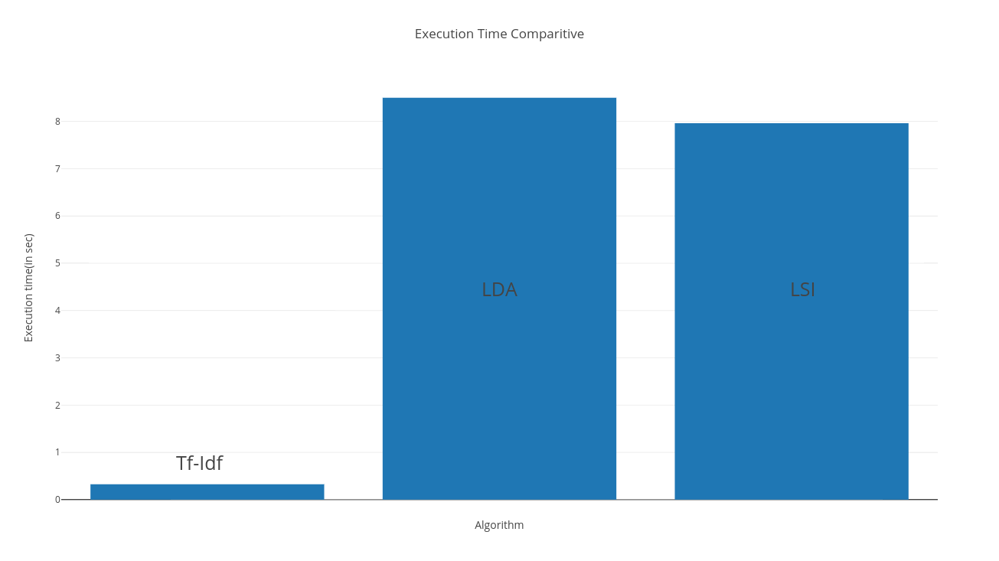
Comparison of Tf-Idf with LDA, LSI
# of Corpora :8
# of Words : ~1600
Total # of words : 12800
Notes:
83% of text-based recommender systems in the domain of digital libraries use tf-idf
Why tf-idf is used for classification

Slide 11
Infrastructure
Atmosphere - Cyverse Resources
cloud-hosted environment specifically designed for use by research and doctoral students
Heterogeneous environments with multiple general and specialized machines.
Initially started out on a Windows machine and moved to a Unix box.
Config / Parameter | Non-hosted Environments | Cyverse
Memory Management | Fixed and built into hardware. x86-64, x86 | Managed by Atmosphere, uses a memory controller.
Virtual Memory | CPU specific. | Segmented by physical memory. %age wise is greater than fixed memory.
Processors | I5, i7 Octa Core processors. | Intel i7 900 series
Memory Page Interrupts | Might need reboots to map pages to processes | Managed by the host – atmosphere.
Notes:
Atmosphere is a cloud-hosted environment specifically designed for use by research and doctoral students.
The python library was ported to an x64-based processor and the hosted environment provided pre-defined images which could be started and suspended as needed.

Slide 12
Setup on Cyverse - Gensim
Package Name | Version
gfortran | 7.2.0
libopenblas-dev | 0.2.19-3
liblapack-dev | 3.2
scipy | 1.0.0
numpy | 1.13.3
Gensim was used as the package since it is the most widely used topic modeling API. As a library, it has multiple deep learning models which can be used and implemented. Gensim and tensor flow as libraries are the most advanced and extensively used libraries. The wide adoption of the modeling API also provides support and maintenance of the implementation.

Slide 13
Data collected
Feature | Statistic
Number of documents | 58
Data Characteristics | text
Avg. Number of words per document | 1600
Total Number of words | 92726
Hannity – 16 documents
Maddow – 16 documents
Lawrence O'Donnell – 12 documents
Brett Briar – 14 documents
July 2017 through until October 2017
*one episode = one document
Notes:
1 episode = 1 document
July 2 oct for randomness

Slide 14
Data collected – snippets..
SEAN HANNITY, HOST: This is a "Fox News Alert." Welcome to "Hannity." Tonight, a major update in the "Hannity" investigation into the left's massive double standard on election interference. We have Newt Gingrich, Jay Sekulow, Monica Crowley will all be here with reaction.
But first, finally, the political left, the destroy Trump media are waking up to what we have been telling you now for months. Now, we are forcing them to cover stories that they have been ignoring. Now, that is tonight's very important "Opening Monologue."
Transcript:
Show: THE RACHEL MADDOW SHOW
Date: July 25, 2017
Guest: Chris Murphy, Elizabeth Warren, Eric Swalwell
CHARLIE SYKES, TALK RADIO PERSONALITY: – this goes on, it makes it harder
to pass, as you get more information about this legislation. And if you get to the skinny bill that they`re talking about , I think that you`re going to be looking at, and people are going to go

Slide 15
Data collected – snippets..
(BEGIN VIDEO CLIPS)
PRESIDENT DONALD TRUMP: I feel badly for General Flynn. I feel very badly. He's led a very strong life, and I feel very badly. Hillary Clinton on the Fourth of July weekend went to the FBI, not under oath. It was the most incredible thing anyone has ever seen. She lied many times. Nothing happened to her. Flynn lied in it's like they ruined his life. It's very unfair.
Transcript:
Show: THE LAST WORD WITH LAWRENCE O`DONNELL
Date: July 31, 2017
Guest: Al Hunt; Betsy Woodruff; Mieke Eoyang; Vince Warren; David Jolly
LAWRENCE O`DONNELL, HOST, THE LAST WORD: The county police on Long Island
– going to bring it up. He ain`t going to bring it up, Joy.
JOY REID, MSNBC: He`s not going to bring it up

Slide 16
Steps to get results
Training the Tf-Idf model
Evaluating similarity
Combining and collect results
Classify and categorize
Notes:
Add more here……..

Slide 17
Experiments : Evaluating similarity
Files are loaded in memory into a corpus attribute
Corpus → dictionary object → doc2bow → feature vectors
Feature vectors are compared to find the similarity
Similarity class – Sims is split into several sub-indexes called Shards
Shards are what uses the virtual memory and the output is paired similarity.

Slide 18
Workflow
Transcripts scraped and downloaded as corpora
Remove special characters
Corpora saved as strings
Train model
Classification using Tf-Idf
TOPIC EXPLORER WORKFLOW
init
prep
train
classify
Corpus.npz
Corpus-rev.npz
Corpus-model.npz
Notebooks
Notes:
Saving the commentary as “.txt” files to ensure they could be read into UTF-8 encoded files
Removing carriage returns and newlines
Removing special characters – asterisk(*), single quotes (‘), double quotes (“) and ticks (`)

Slide 19
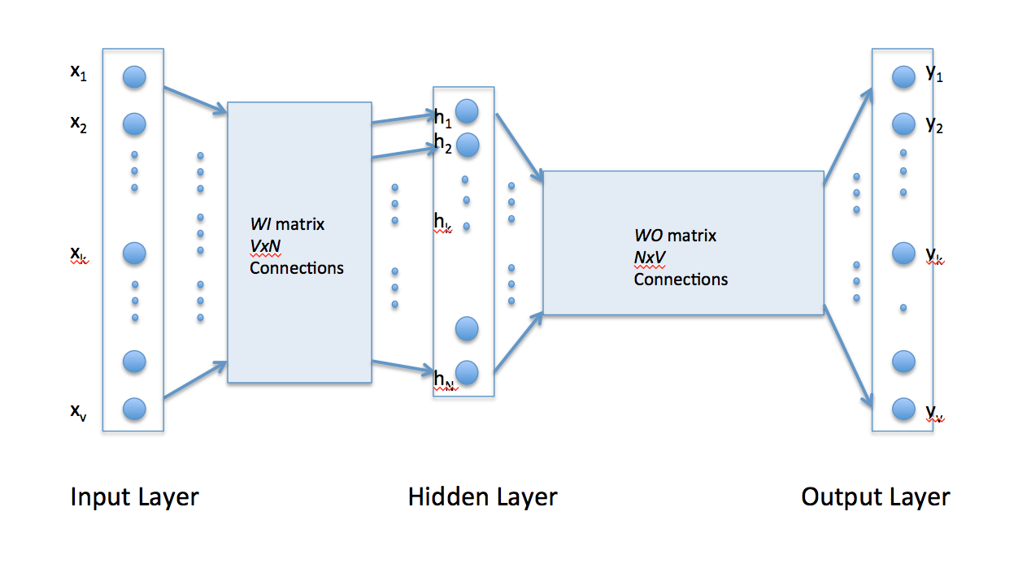
Classifier steps
Obtain text
Preprocess text
Initialize the model
Use the model
Output the results

Slide 20
RESULTS
“sims” index showing similarity scores when Hannity, Maddow were compared with FOX News Corpora.
The “sims” attribute returns results as a comparative score.
Notes:
Change the legends

Slide 21
RESULTS : DUPLETS
Corpus Size | MSNBC
5 | (37.482%, 7.881% )
10 | (42.025%, 8.367% )
15 | (47.993%, 10.008% )
20 | (50.0134%, 13.176% )
25 | (52.739%, 17.556% )
Corpus Size | FOX
5 | (42.875%, 13.53% )
10 | (47.167%, 14.992% )
15 | (55.003%, 15.274% )
20 | (73.0824%, 16.871% )
25 | (79.359%, 17.897% )

Slide 22
RESULTS: Confidence Estimate
High values of are concentrated on the end of the graph, so basing query retrieval on the top words here will likely return relevant documents.
Tf-Idf model trained based on vector size. From the graph, the greater the vector size, the similarity score and the extraction is greater.
Notes:
The results from MSNBC corpora when compared with Maddow and Hannity did not seem to show similar amounts of similarity. The percentage increase when the corpus size increased too, did not seem to show increased likeness.

Slide 23
SUMMARY
As the model gets more data and more text the similarity goes up
Discriminatory power of TF-IDF allows retrieval find relevant documents
TF-IDF is data agnostic.
No background information that was fed to the model itself.
Fox news classification increased as size of corpus increased, not the case with MSNBC.

Slide 24
FURTHER WORK
Adaptive TF-IDF – Usage
Beat TF-IDF schemes – better weighting.
Different languages
IR which looks at common features present across document pairs.
Tailoring Tf-Idf for commentaries – semantic usage, quality of text, WM Models

Slide 25
ACKNOWLEDGMENT
Dr. Jeff Uhlmann, Sean Goggins
Committee for the process
CS Department for the education
Friends and family
…
…
Fox and MSNBC for public transcripts..

Slide 26
QUESTIONS
??

