Slide 1
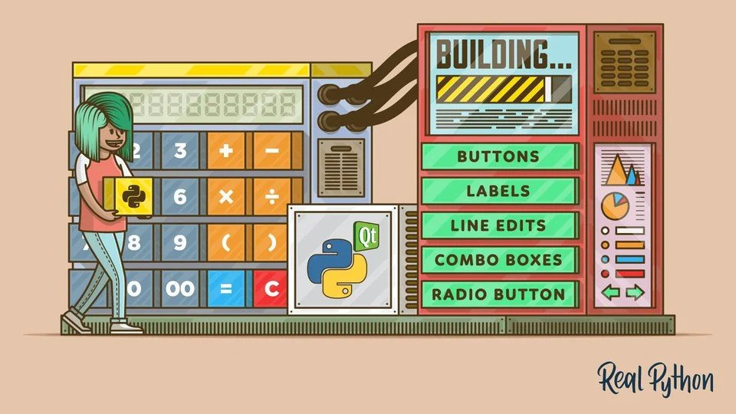
Flow For a Basic GUI
Widgaets
Import tkinter module
Import tkinter module
Rename the GUI Window
Geomatry Management using pack
Mainloop Method

