Slide 1
Funding in Startups -Trends Analysis
Mayank Jha
Analyst

Slide 2
Agenda
Overview of Dataset
Funds (Amount, Sources and Funding Rounds)
Distribution of Startups (outside USA region)
Distribution of Startups (USA regions)
Target Markets and Categories
Recommendation

Slide 3
Overview
Dataset contains information on
Funds (Amount and Sources)
Origin of Startup (Year and Location)
Focus of Startup (Categories and Market)
Current Status (operating/closed/acquired)

Slide 4
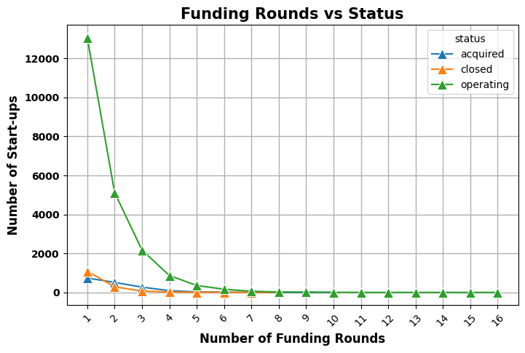
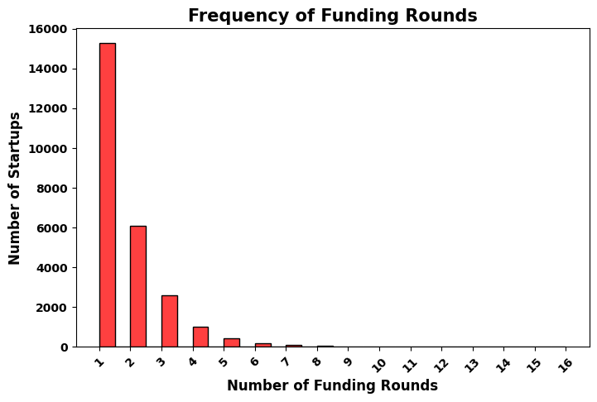
Funding Rounds
Most start-ups don’t seek funding beyond Round F (6 rounds).
Closed Start-ups usually reach Round C funding.
Start-ups are acquired before Round E funding

Slide 5
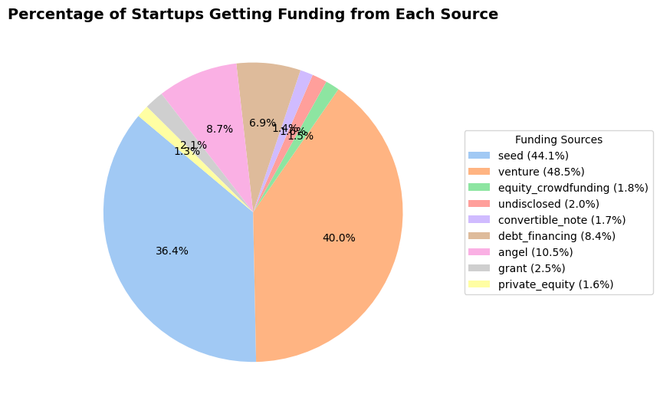
Sources of Funding
More than three-quarters of funding is sourced from either Seed Funding or Venture Capital Investments.
Angel Investors and Debt Financing are third and fourth biggest source of funds for startups.

Slide 6
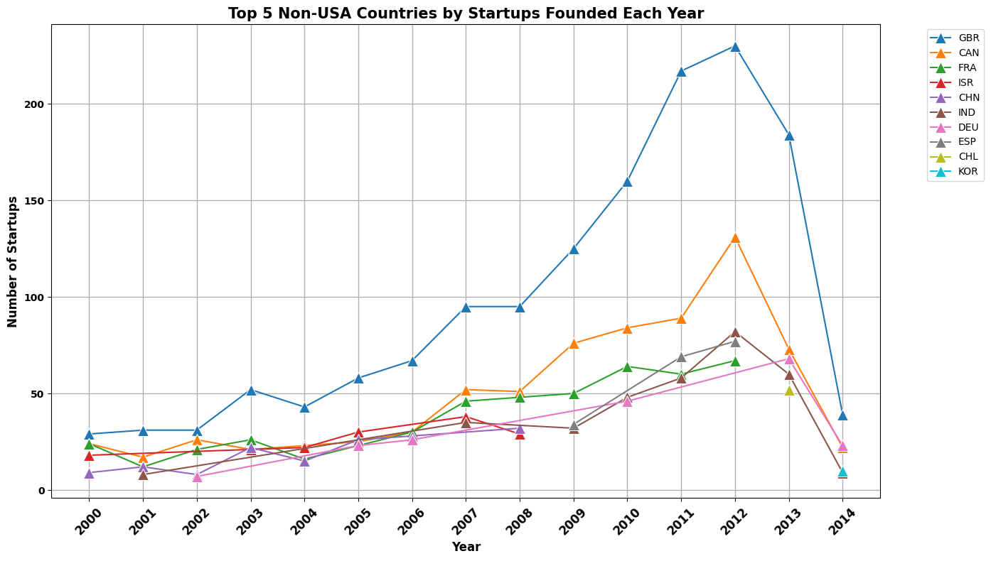
Distribution of Startups (outside USA region)
Globally, number of start-ups peaked in 2012.
Outside USA, Great Britain consistently produces most start-ups.
After 2007, Canada is the second-largest Start-up producers with France, Israel, India are ranked interchangeably over the years

Slide 7
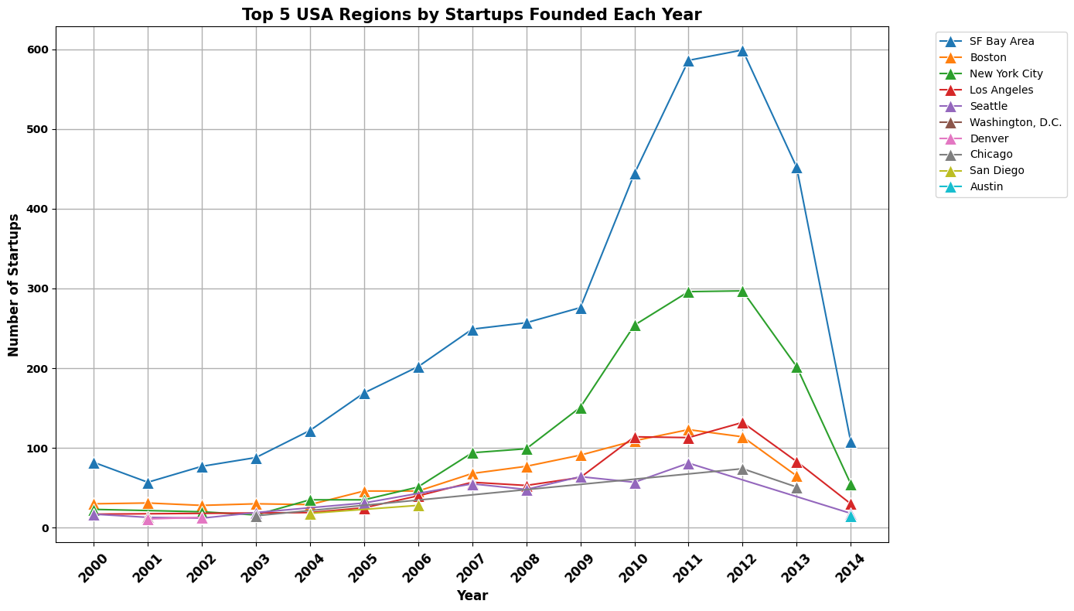
Distribution of Startups (USA regions)
Most USA star-ups are based out of San Francisco Bay Area and Los Angeles.
On Eastern coast, only Washington DC and Boston are major Star-up centers while most start-ups choose to be based out of Western Coast.
Following global trends, number of Start-ups have reduced after 2012.

Slide 8
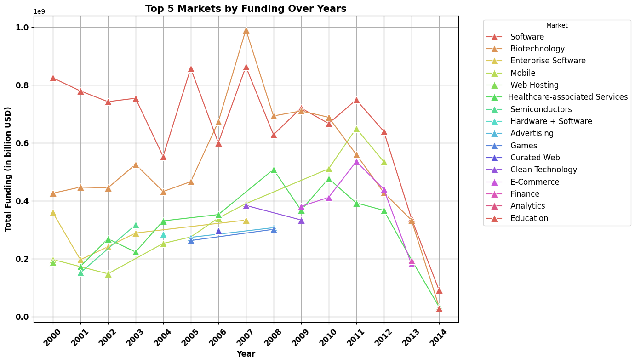
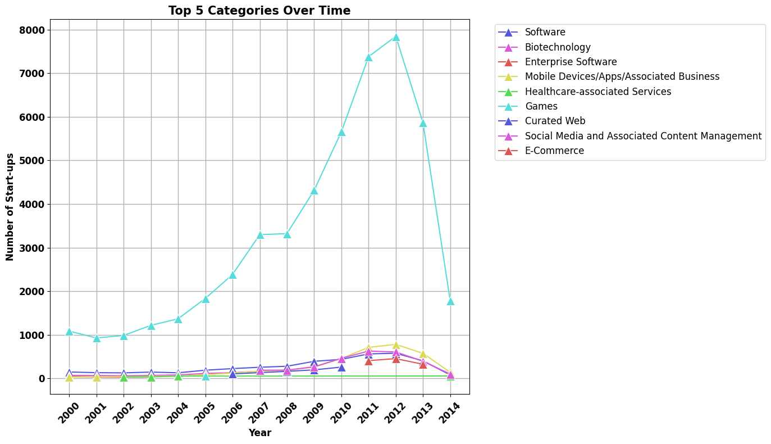
Target Markets & Focus Categories
Biotech and Software market areas most funded sectors over years
Gaming Start-ups outnumber other categories by a huge margin but other sectors like Health care, software, biotech, mobile outperform in terms of funding.
Many sectors like Enterprise software, advertising, clean Technology have seen a significant reduction in funding from investors, while E-commerce has entered Top 5 in both funding and number of start-ups.

Slide 9
RECOMMENDATIONS
USA east coast and Great Britain has high density of start-ups, but Israel, China and Israel are also attractive hub for Start-ups.
Rise in number of gaming startup and lack of proportionate investment can be a big opportunity for investors.
Angel Investors can focus on start-ups seeking seed-funding to increase their portfolio.
E-commerce start-up founders face stiff competition due to rise in numbers in that category

Slide 10
THANK YOU

