Slide 1
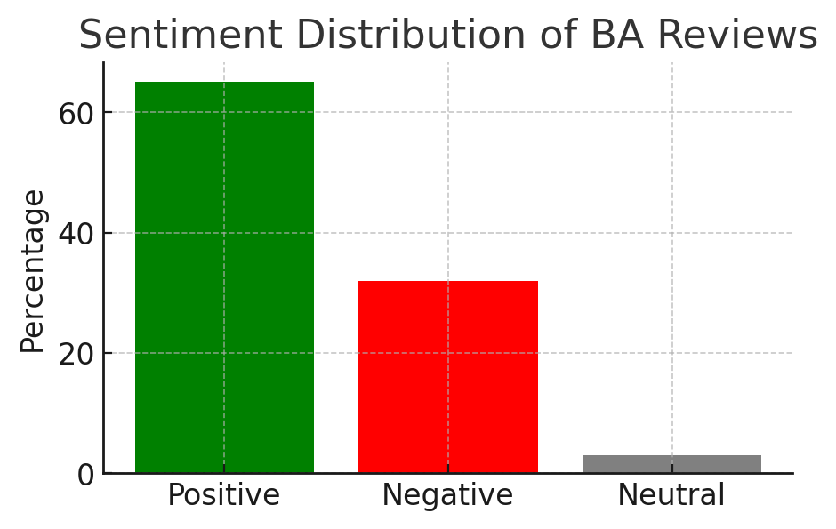

British Airways Review Analysis - Key Insights
1. Sentiment Analysis:
- Positive: 65%
- Negative: 32%
- Neutral: 3%
- Majority of reviews are positive, but a significant portion (32%) express dissatisfaction.
2. Common Topics in Negative Reviews:
- Delays, lost luggage, poor customer service, and refund issues.
- Long waiting times at airports.
3. Word Cloud Analysis:
- Most frequent words: 'flight', 'service', 'delays', 'experience', 'customer', 'luggage'.
- Highlights key areas of customer concern and satisfaction.
4. Actionable Insights:
- Improve baggage handling and reduce lost luggage complaints.
- Address customer service concerns and streamline refunds.
- Enhance communication about delays to improve customer experience.

